Slide 1
RENNAISANCE PERSPECTIVE
Basic ideas on Western
Spatial
Representation

Slide 2
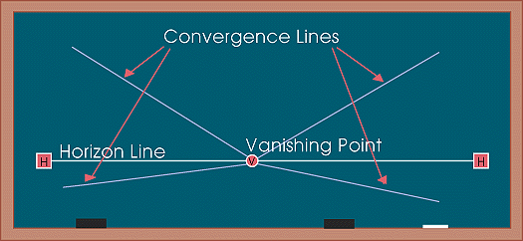
The perspective system Reproducing space
One point perspective
One point perspective or Linear perspective.
The horizon line in perspective drawing is a horizontal line across the picture. It is always at eye level - its placement determines where we seem to be looking from - a high place, or from close to the ground. The actual horizon might not be visible, but you need to draw a 'virtual' horizon to construct a picture in perspective.
Notes:
One point perspective or Linear perspective
The horizon line in perspective drawing is a horizontal line across the picture. It is always at eye level - its placement determines where we seem to be looking from - a high place, or from close to the ground. The actual horizon might not be visible, but you need to draw a 'virtual' horizon to construct a picture in perspective.
Convergence lines, vanishing lines, orthogonals
In Linear Perspective drawing, the diagonal lines that can be drawn along receding parallel lines (or rows of objects) to the vanishing point. drawing, the diagonal lines that can be drawn along receding parallel lines (or rows of objects) to the vanishing point.

Slide 3
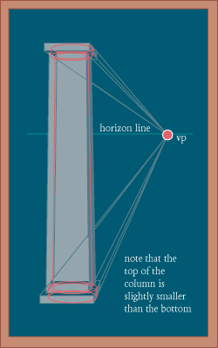
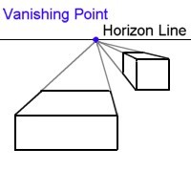
Perspective Vanishing point
VP vanishing point
On the horizon line
Where all the vanishing lines converge.
In Linear Perspective drawing,
the diagonal lines that can be drawn along
receding parallel lines (or rows of objects)
to the vanishing point.
Notes:
Vanishing lines

Slide 4
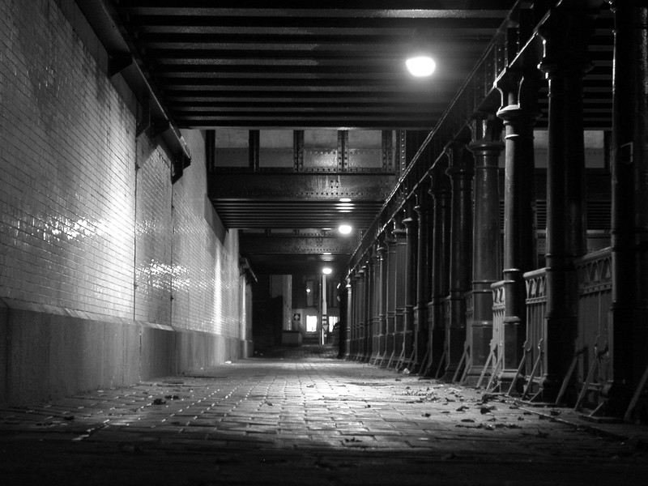
Perspective Vanishing point
VP vanishing point
On the horizon line
Where all the vanishing lines converge.
Notes:
Vanishing lines
Frame form jean Cocteau. Lequai

Slide 5
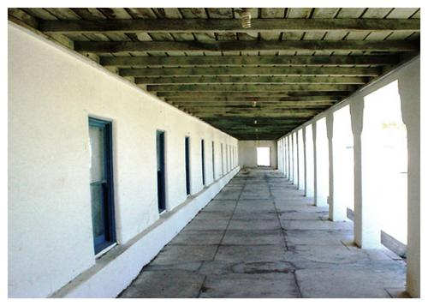
Perspective Vanishing point
Notes:
Vanishing lines
Frame form jean Cocteau. Lequai

Slide 6
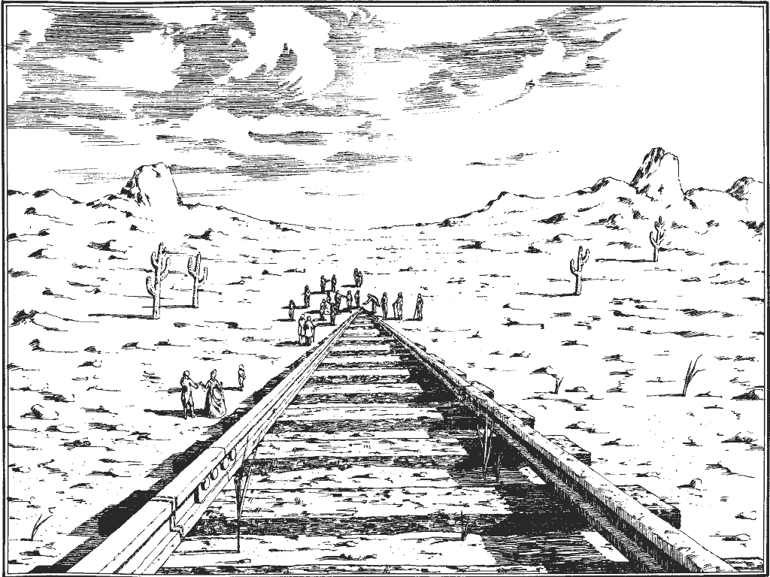
Perspective Vanishing point
Notes:
Vanishing lines
Frame form jean Cocteau. Lequai

Slide 7
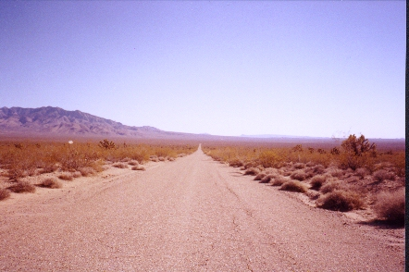
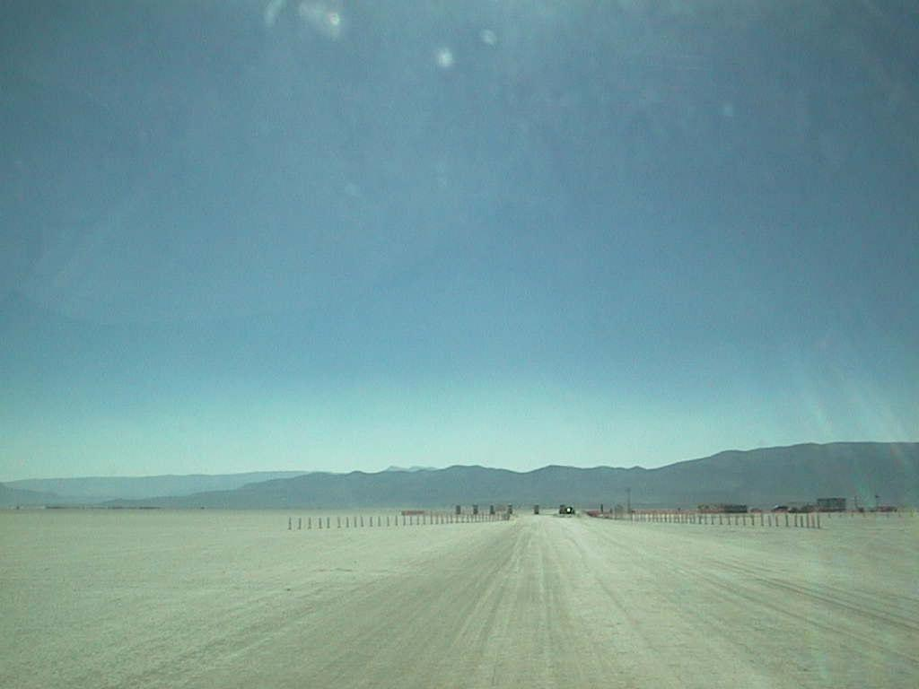
Perspective Vanishing point
The horizon line defines our position as a viewer,
It is placed at eye level
Notes:
Eye lens or through camera lens

Slide 8
Perspective Linear Perspective
Foreshortening
The distortion that perspective causes over objects
seen from a particular viewpoint
Notes:
Definition: Foreshortening

Slide 9
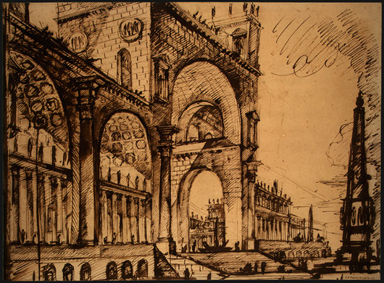
Perspective Vanishing point
Non
Congruent
Perspective
rendering

Slide 10
Perspective Vanishing point
Non
Congruent
Perspective
rendering

Slide 11
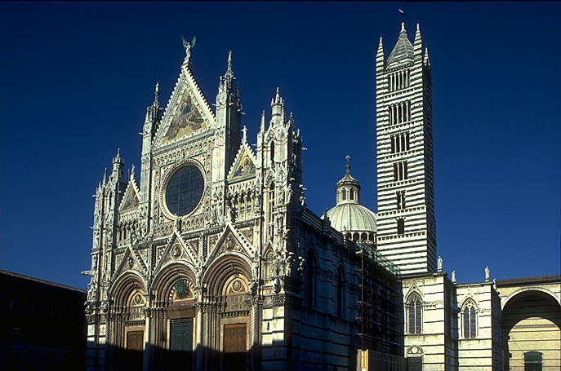
Perspective is founded on Optics, the curved lens in our eyes, or the lens in the camera
Interprets objects in a distorted but organized way.

Slide 12
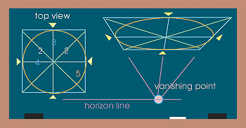
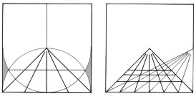
Perspective Drawing circles according to Perspective

Slide 13
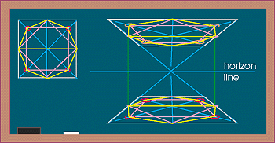
Perspective Drawing geometrical shapes according to Perspective

Slide 14
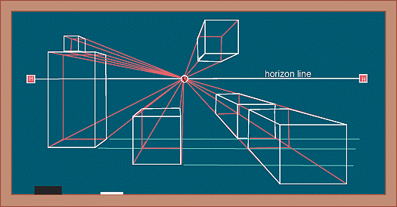
Perspective Parallel objects in a space seen with a one point perspective. (typical urban landscape)

Slide 15
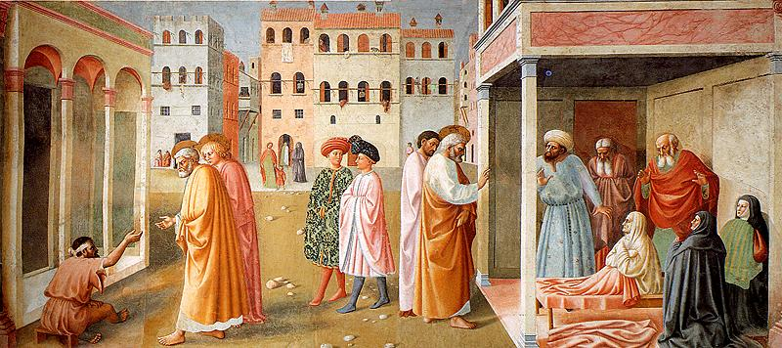
Perspective Parallel objects in a space seen with a one point perspective. (typical urban landscape)
Masaccio, and Masolino . Brancacci Chapel of Santa Maria della Carmine in Florence, 1426-28
Notes:
Masaccio, Brancacci Chapel of Santa Maria della Carmine in Florence,
1426-28

Slide 16
Perspective Parallel objects in a space seen with a one point perspective. (typical urban landscape)
Masaccio, and Masolino . Brancacci Chapel of Santa Maria della Carmine in Florence, 1426-28
Notes:
Masaccio, Brancacci Chapel of Santa Maria della Carmine in Florence,
1426-28

Slide 17
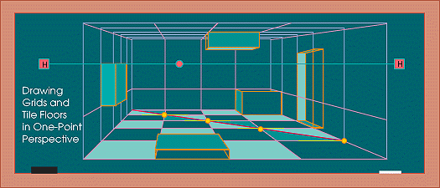
Perspective Parallel objects seen from a central point of view inside a cube. (typical interior situation)

Slide 18
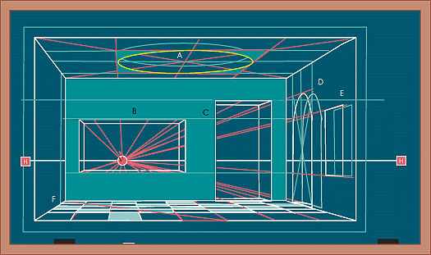
Perspective Parallel objects seen from a central point of view inside a cube. (frontal view)

Slide 19
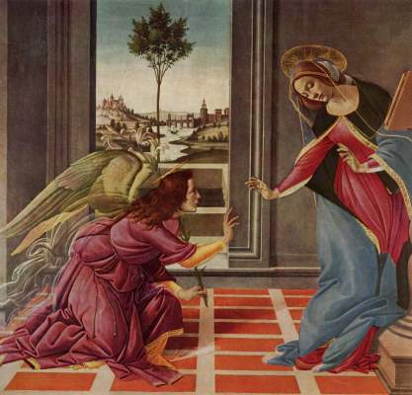
Perspective Parallel objects seen from a central point of view inside a cube. (typical interior situation,)
Early Rennaisance
Sandro Boticelli
(1445-1510)
“The Cestello Annunciation”
56 x 150 cm
(61,3 x 59,0 inches

Slide 20
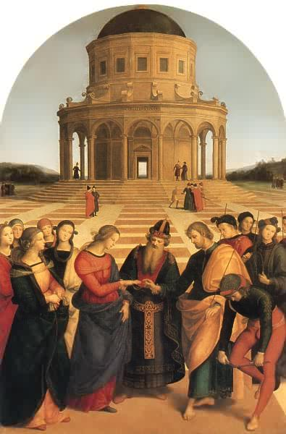
The marriage of the virgin,
1504.
“Lo sposalizio della vergine”
Pinacoteca Brera, Milano.
Raffaello

Slide 21
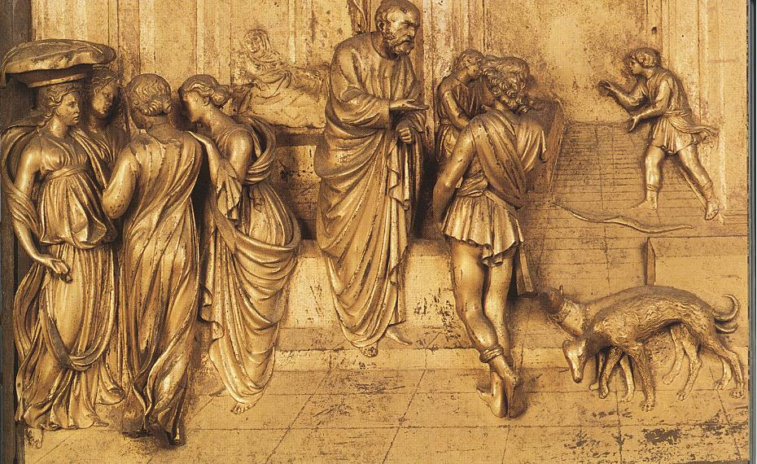
Perspective Central point of view inside a cube.
Lorenzo Ghilberti, Architect
1378-1455
Porta Baptisterio Fiorenze. Bass Relief
Notes:
Lorenzo Ghilberti, Architect
1378-1455
Porta Baptisterio Fiorenze

Slide 22
Perspective Central point of view inside a cube.
Notes:
Lorenzo Ghilberti, Architect
1378-1455
Porta Baptisterio Fiorenze

Slide 23
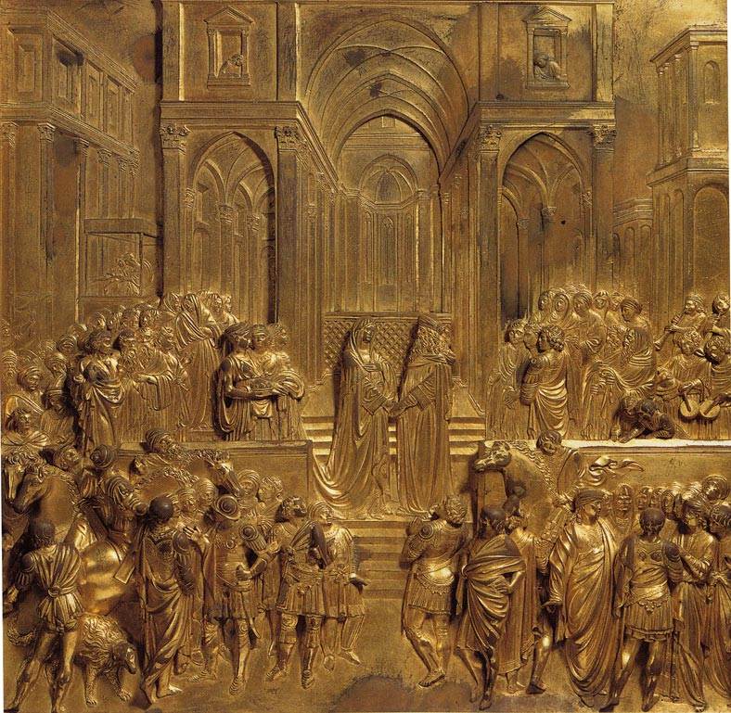
Lorenzo Ghilberti, Architect
1378-1455
Porta Baptisterio Fiorenze. Bass Relief
Notes:
Lorenzo Ghilberti, Architect
1378-1455
Porta Baptisterio Fiorenze

Slide 24
Horizon line
Lorenzo Ghilberti, Architect
1378-1455
Porta Baptisterio Fiorenze. Bass Relief
Notes:
Lorenzo Ghilberti, Architect
1378-1455
Porta Baptisterio Fiorenze

Slide 25
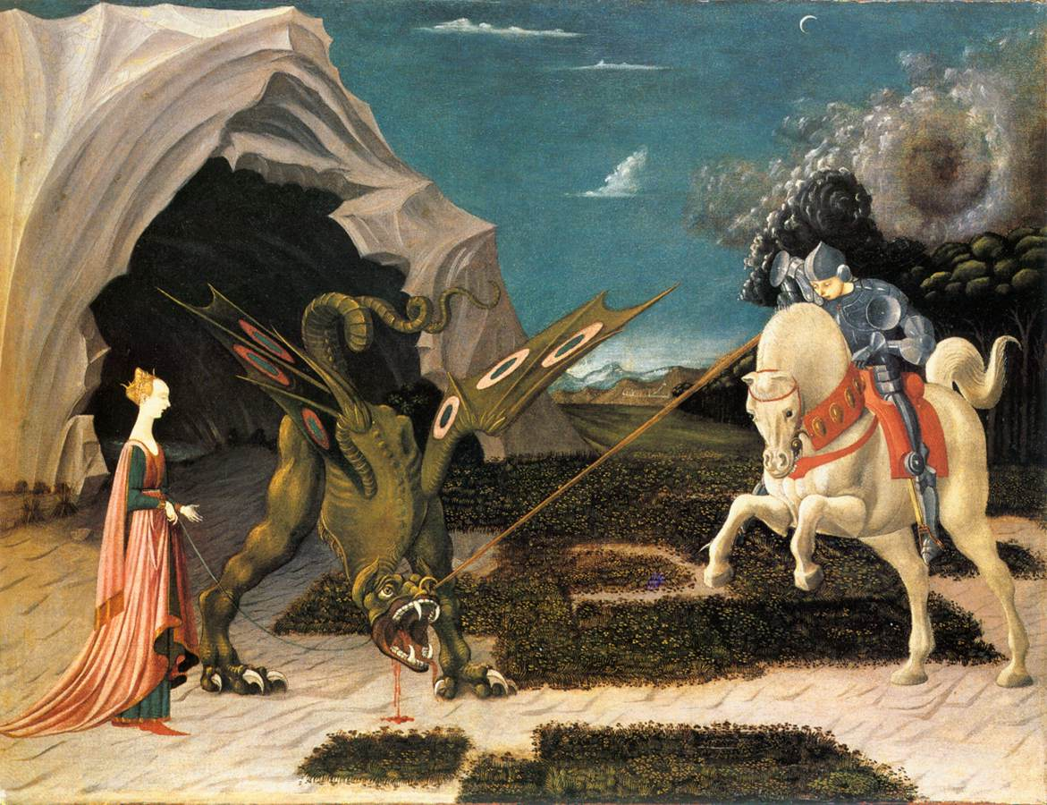
Perspective Parallel objects seen from a central point of view inside a cube.example
Paolo Ucello. St. George and the Dragon, 1456. National Gallery, London

Slide 26
Perspective Parallel objects seen from a central point of view inside a cube.example
Paolo Ucello. St. George and the Dragon, 1456. National Gallery, London

Slide 27
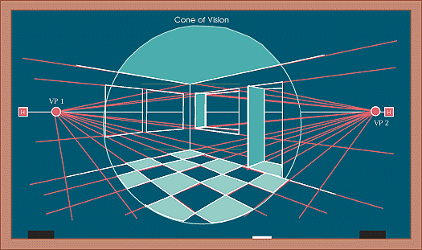
Perspective Parallel objects seen with a 2 point view inside a cube.
Horizon line

Slide 28
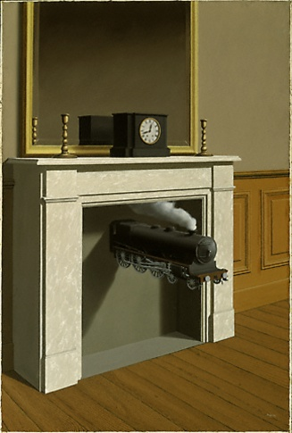
Perspective 2 point perspective (typical interior situation Side view)
Rene Magritte
French Surrealist artist.
1898-1967

Slide 29
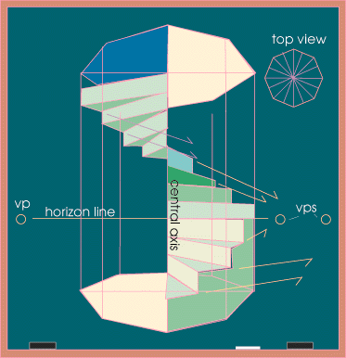
Perspective Spiral staircase

Slide 30
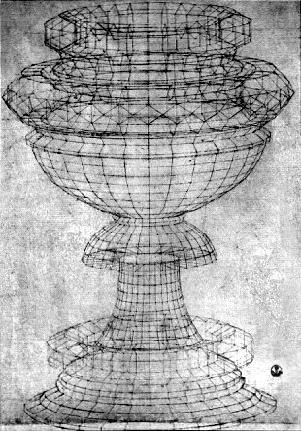
Perspective Revolving structure
Rennaisance passion for Perspective and Geometry.
Paolo Ucello,
“Drawing of a chalice”, 1430
Pen and ink
Galleria degli Uffizi, Florence
Vasari called perspective: “A tours de force of illusion “

Slide 31
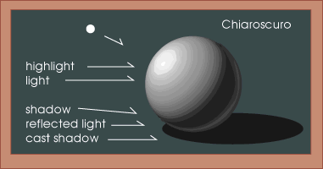
Shading an object Lit from a single source (point) of light

Slide 32
Shading a round object Lit from a single point (source)

Slide 33
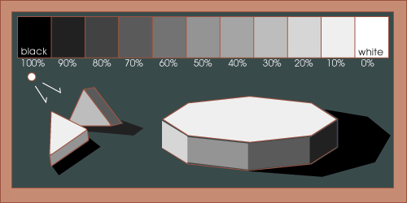
Shading an object with multiple planes Lit from a single point (source)

Slide 34
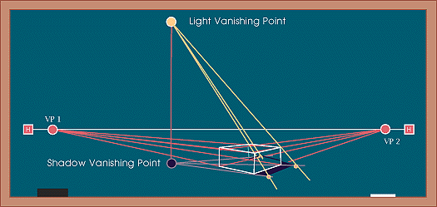
Shading an object Calculating the projected shadows of an object According to a light source.

Slide 35
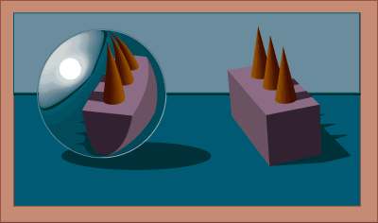
Reflective objects Calculating the reflection projected on a cylindrical surface.

