Slide 1
Mythology as content/structure of a narrative
Carl Jung. Swiss Psychiatrist founder of Analytical Psychology and influential thinker.
Theory of “the Collective Unconscious”
Primordial Images, symbols or Archetypes that act as “organizing principles” of our psyche and are shared by most cultures and individuals with very similar content.
Notes:
Collective unconscious is a term of analytical psychology, coined by Carl Jung. It is proposed to be a part of the unconscious mind, expressed in humanity and all life forms with nervous systems, and describes how the structure of the psyche autonomously organizes experience.
Jung distinguished the collective unconscious from the personal unconscious, in that the personal unconscious is a personal reservoir of experience unique to each individual, while the collective unconscious collects and organizes those personal experiences in a similar way with each member of a particular species.
Jung also made reference to contents of this category of the unconscious psyche as being similar to Levy-Bruhl's use of collective representations or "représentations collectives," Mythological "motifs," Hubert and Mauss's "categories of the imagination," and Adolf Bastian's "primordial thoughts."

Slide 2
Mythology as content of a narrative
Joseph Campbell. American scholar on World Comparative Mythology
From the video lecture “Shukhavati”
MYTHS are PUBLIC dreams
DREAMS are PRIVATE myths
Meaning that both Myths and Dreams share the same metaphoric language and preoccupation for human core.

Slide 3
The Collective Unconscious
The common patterns of representation or symbologies can be understood with studies in the areas of anthropology, cultural practices and religions of the world.
They are also heavily present in mythologies.
Oral cultures tend to contain plenty of ideas, practices and cultural constructions
that have not been reduced or suppressed by religion and science through
centuries of written civilization.
Numerology: is any study of the purported divine, mystical or other special relationship between a number and some coinciding observed (or perceived) events.
Notes:
Modern numerology often contains aspects of a variety of ancient cultures and teachers, including Babylonia, Pythagoras and his followers (Greece, 6th century B.C.), astrological philosophy from Hellenistic Alexandria, early Christian mysticism, early Gnostics, the Hebrew system of the Kabbalah, The Hindu Vedas, the Chinese "Circle of the Dead", Egyptian "Book of the Masters of the Secret House" (Ritual of the Dead)
In 325 A.D., following the First Council of Nicaea, departures from the beliefs of the state Church were classified as civil violations within the Roman Empire.
Numerology had not found favor with the Christian authority of the day and was assigned to the field of unapproved beliefs along with astrology and other forms of divination and "magic".

Slide 4
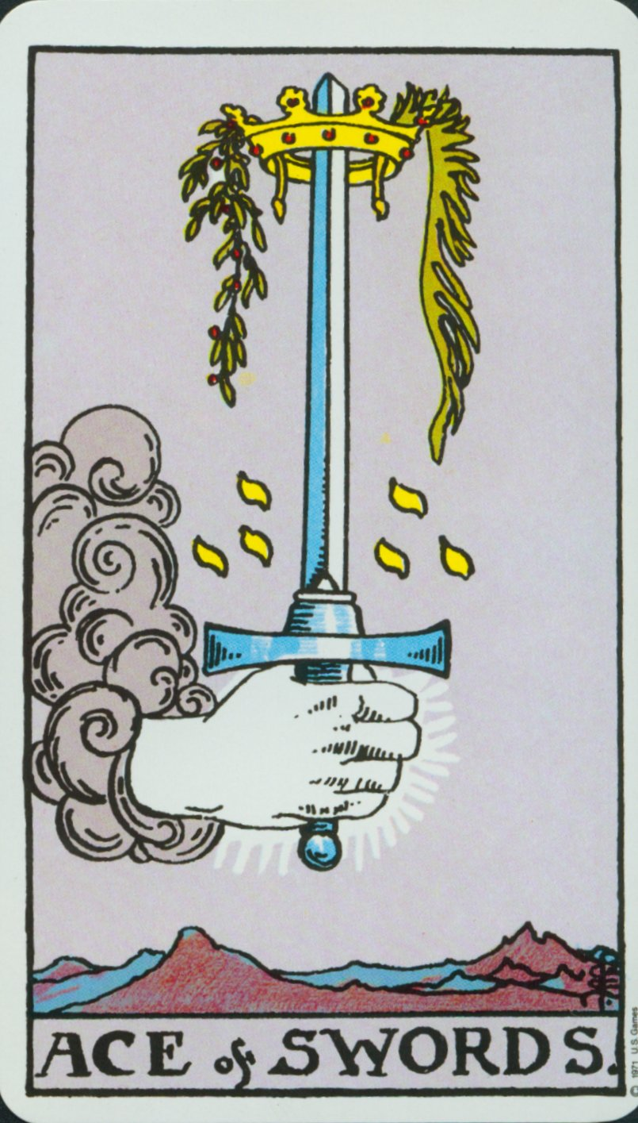
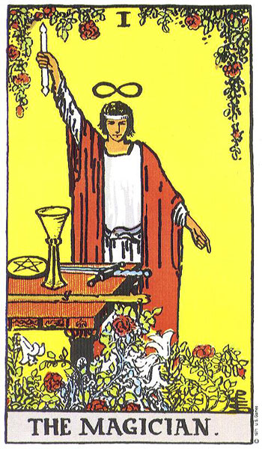
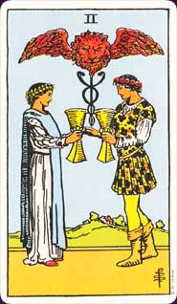
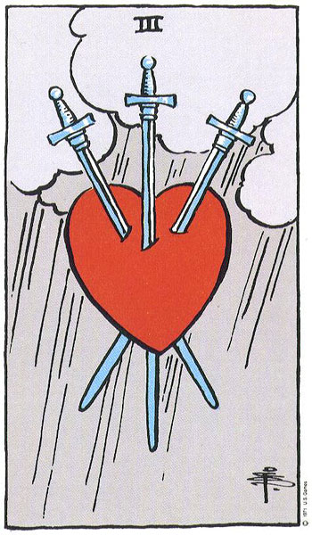
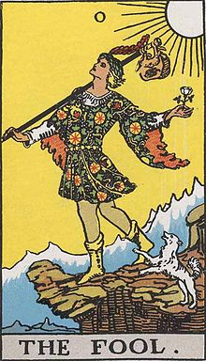
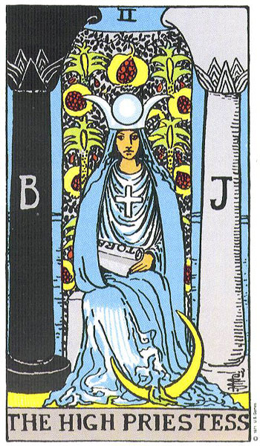
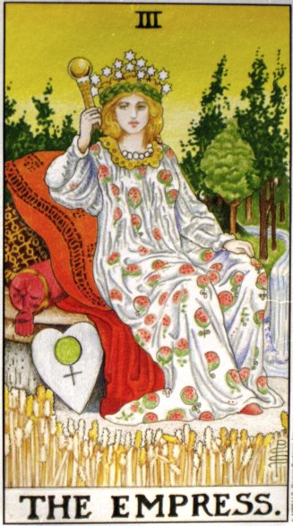
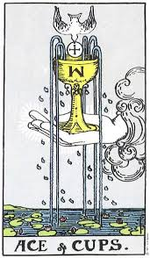
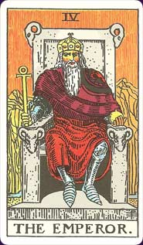
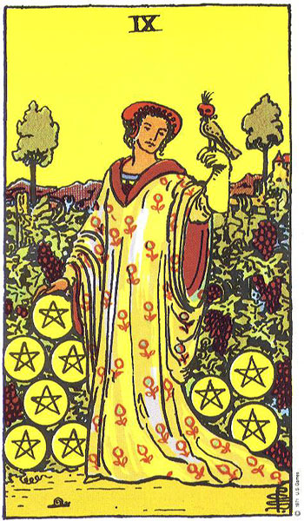
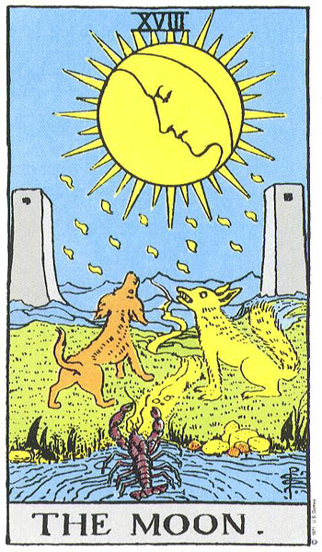
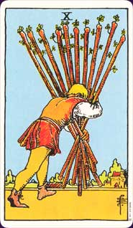
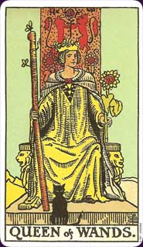
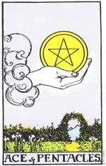
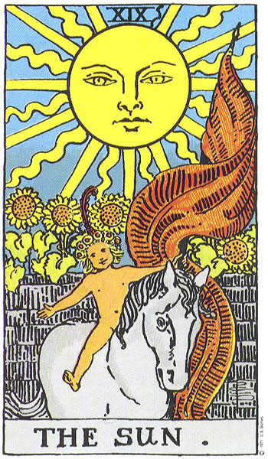
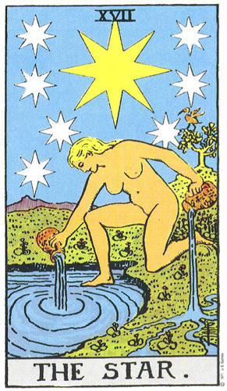
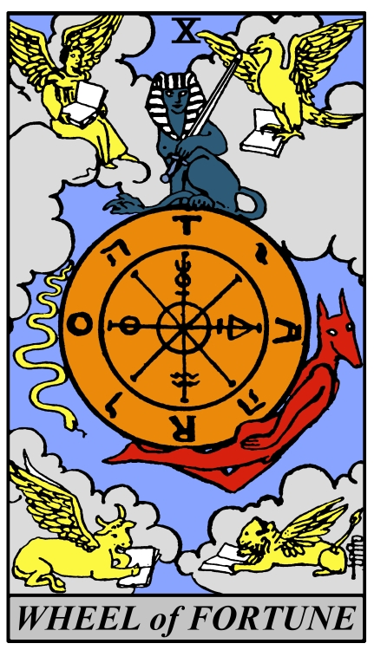
TAROT deck
78 cards total
22 Triumphs
Major Arcana
56 cards
divided into 4 Suits
First known as trionfi and later as tarocchi, tarock, and others, It is a pack of playing cards (numbering 78), used from the mid-15th century in various parts of Europe to play a group of card games
Notes:
The Visconti-Sforza tarot deck is a 15th century Tarot deck and one of the oldest known to exist.^{[1]} It had a significant impact on the visual composition, card numbering and interpretation of modern decks.
a pack of playing cards (numbering 78), 22 TRIUMPHS/ 56 cards divided in 4 SUITS (Wands, Cups, Swords, Coins):
RIDER WAITE PACk: Pamela Colman Smith (Illustration), Arthur Edward Waite. Designed in 1909
Yeats introduced Smith to the Hermetic Order of the Golden Dawn, which she joined in 1901 and in the process met Waite. When the Golden Dawn splintered due to personality conflicts, Smith moved with Waite to the Independent and Rectified Rite of the Golden Dawn (or Holy Order of the Golden Dawn). In 1909, Waite commissioned Smith to produce a tarot deck with appeal to the world of art, and the result was the unique Waite-Smith tarot deck.
First known as trionfi and later as tarocchi, tarock, and others, IT is a pack of playing cards (most commonly numbering 78), used from the mid-15th century in various parts of Europe to play a group of card games such as Italian tarocchini and French tarot. From the late 18th century until the present time the tarot has also found use by mystics and occultists in efforts at divination or as a map of mental and spiritual pathways.
22 TRIUMPHS (22 letters of Jewish alphabet) catalog of medieval social types, human archetypes
0 Fool / I Magician / II High Priestess / III Empress / IV Emperor / V hierophant-Pope / VI Lovers / VIII Chariot

Slide 5
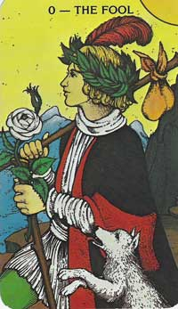
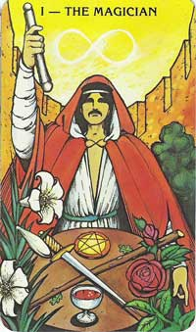
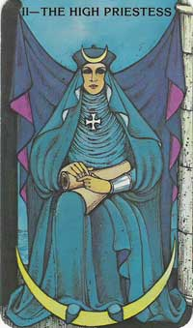
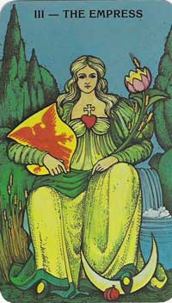
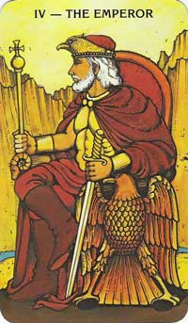
Archetypes in the Tarot
Innocence
Beginning
Simplicity
Blind faith
Action
Awareness
Resourcefulness
Secret
Knowledge
Source
Moral duty
Oracle
Premonition
Creativity
Abundance
Fertility
Promise
Exuberance
Femininity
Creativity
Strategy
Rulership
Authority
Rigidity
Masculinity
Notes:
The Fool Tarot card meaning deals with that youthful exhuberance we feel when starting out on a new adventure or taking a journey of faith. We feel anticipation, butterflies flutter in our stomach, and our skin prickles with excitement...our journey is underway - we're unstoppable!
However, along with this passion comes impetuousness. The Fool makes no plans, or gives no thought to possible complications along the way. Happy to be doing something different, the Fool blindly sets out where all else may fear to tread.
When contemplating the Fool Tarot card meaning, I think of Joseph Campbell's landslide statement: "Follow your bliss." We can see this attitude in this card, which is wonderful. But, we must also note the lack of care about consequences - blind faith is the Fool's only guide.

Slide 6
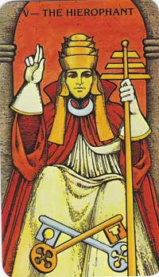
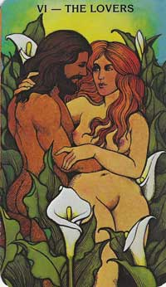
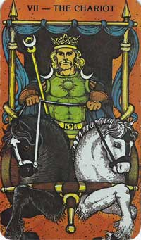
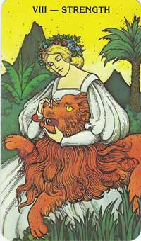
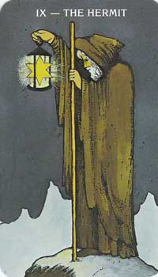
Archetypes in the Tarot
Law
Respect
Ceremony
Tradition
Conformity
Union
Trust
Temptation
Attachment
Vulnerability
Flow of Energy
Skill
Control
Action
Balance
Will
Focus
Physicality
Balance
Courage
Compassion
Understanding
Humility
Solitude
Retreat
Observation
Detachment
Search of Essence

Slide 7
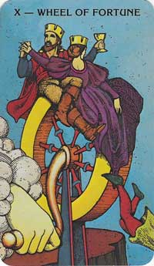
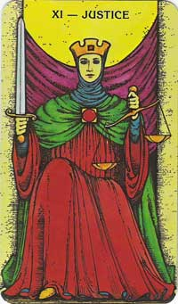
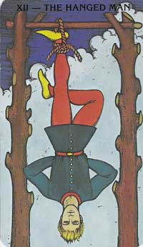
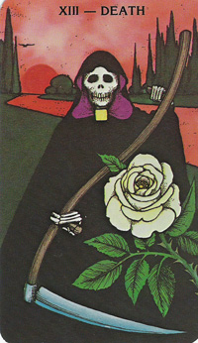
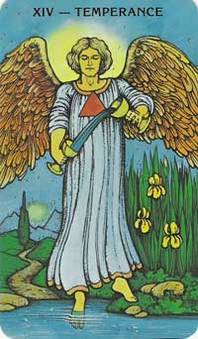
Archetypes in the Tarot
Change
Chance
Destiny
Revolution
Consequence
Truth
Balance
Equality
Congruence
Examination
Accountability
Assuming responsibility
Search of Truth
Taking time
Acceptance
Submission
Surrender
Sacrifice
Overturning
Balance
Healing
Blending
Connection
Chemistry
Fluidity
Moderation
Change
End of a stage
Transition
Termination

Slide 8
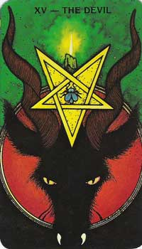
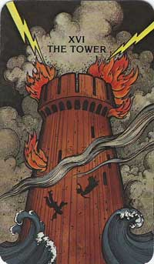
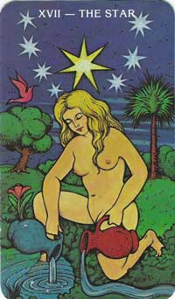
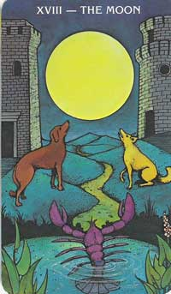
Archetypes in the Tarot
Cycle
Emotion
Intensity
Ascending of the Unconscious
Imagination
Influence
Confusion
Energy
Growth
Understanding
Illumination
New beginnings
Breaking through
Vitality
Egotistic
Addiction
Enslavement
Loss
Violent change
Upheaval
Exposure
Sudden shift
Blind sided
Loss of control
Overdue situation
Hope
Healing
Guidance
Assurance
Rejuvenation
Serenity
Notes:
the inverted (up-side-down) five-pointed star is the opposite of its original meaning.
The five-pointed star, or pentagram is a symbol of harmony amongst all the elements. Therefore inverted, this symbol means disharmony, error, and maligned thought. The Devil is nothing more than a metaphor for living a base/banal and substandard existence
Pitchers are symbolic of vessels containing the nectar of life, the healing waters of peace. They pour out an endless supply of crystal clear, cleansing waters. In this renditio

Slide 9
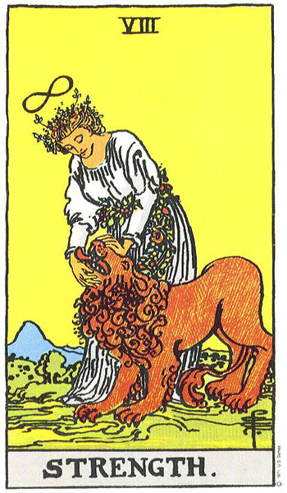
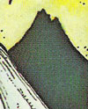
Archetypes in the Tarot
The Maiden
The key is to Know yourself and to Temper your primal urges with your more divine, spiritual nature
Mountains symbolize aspiration, achievement, courage and accomplishment.
A wreath or crown around the maiden's head is a symbol of Victory.
The lion is a symbol of Fire which burns within us - representing our wants and desires with a intense blaze.
Card n8 in the major Arcana of the Tarot deck
Notes:
the rose is a queen of garden of the soul. She champions our senses with her voluptuous beauty and heady fragrance. It's no wonder the Rose is used in the Tarot - this flower fully engages our attention as well as all our senses.
Temperance: experiencing harmony. Fostering cooperation. Centered and secure.
Maiden. Wreath: Wreaths symbolize completion and infinity (circle)
A wreath or crown around the maiden's head is a symbol of victory.
n this case, the wreath indicates victory can be claimed in the battle against banal or primal urges
LION: the lion is a symbol for the primal urges - the physical needs and cravings we all, as humans want met. The lion is also a symbol of fire which burns within us - representing our wants and desires with a intense blaze.
The key is to know thyself and temper our primal (ego) urges with our more divine, spiritual nature.

Slide 10
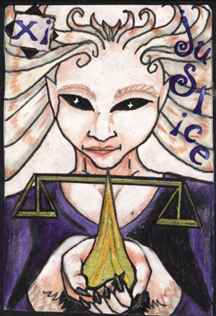
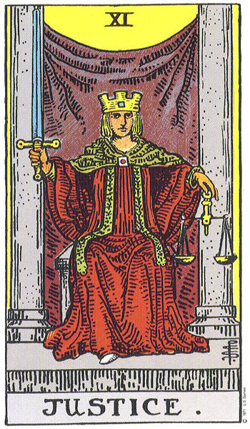
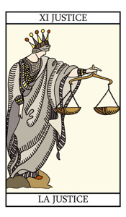
Justice
Meaning:
Truth
Balance
Equality
Congruence
Examination
Accountability
Card n11 in the major Arcana of the Tarot deck

Slide 11
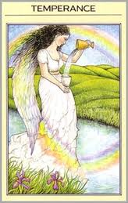
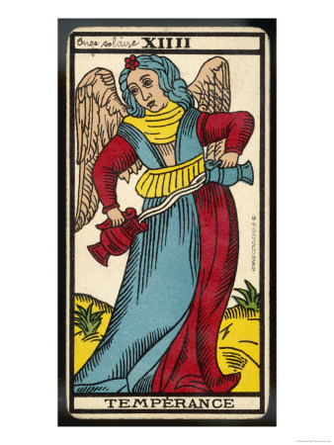
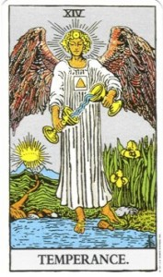
Temperance
Meaning:
Balance
Healing
Blending
Connection
Chemistry
Fluidity
Moderation
Card n14 in the major Arcana of the Tarot deck

Slide 12
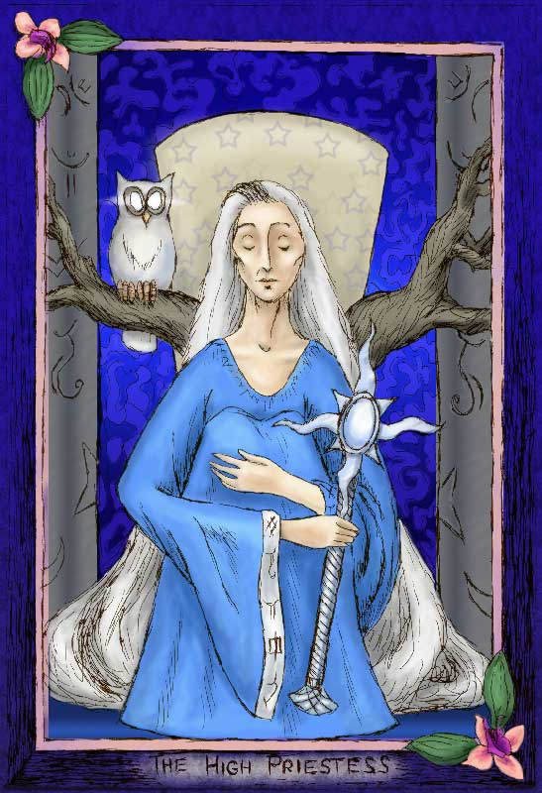
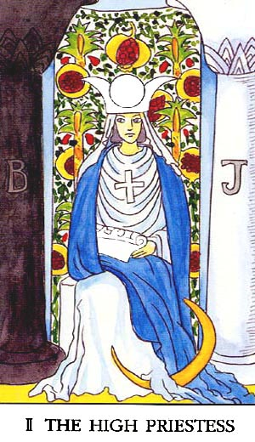
The Priestess
Meaning:
Secret
Knowledge
Influential
Moral duty
Oracle
Premonition
Card n2 in the major Arcana of the Tarot deck

Slide 13
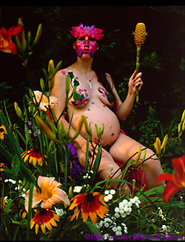
The Empress
Meaning:
Creativity
Sensuality
Abundance
Fertility
Promise
Nurturing
Exuberance
Feelings
Card n3 in the major Arcana of the Tarot deck
Notes:
… The Empress shows a deep connection with our femininity. Femininity translates in many ways – beauty, sensuality, fertility, creative expression, nurturing – and is necessary in creating balance in both men and women. The Empress calls on you to connect with your feminine energy. Create beauty in your life.
… On a metaphorical level, the Empress may represent the birth of a new idea, a product, or a new way of being.
… The Empress indicates that the Universal energy is about to intervene in your life. It may be just enough to give you a glimpse of a miracle or it may be even more. You may or may not know whom or what brings such good fortune but the care and nurturing that will result come as no accident. What appears to be coincidental good luck may actually be the result of a series of good choices you have made. It is your turn to have things work out in your favour, to be blessed and to feel nurtured. Know that you are worthy of receiving this loving embrace.
From Rachel Pollack’s ’78 Degrees of Wisdom’: …In readings the Empress represents a time of passion, a period when we approach life through feelings and pleasure rather than thought.

Slide 14
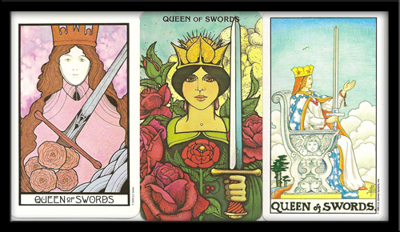
Archetypes in the Tarot
x

Slide 15
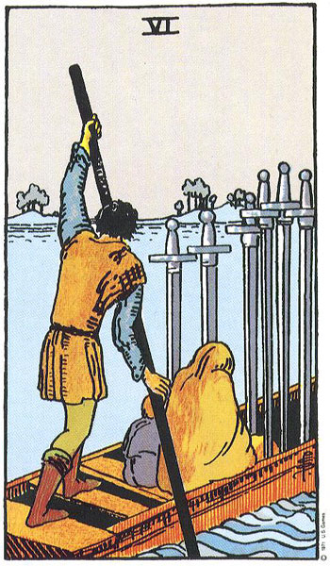
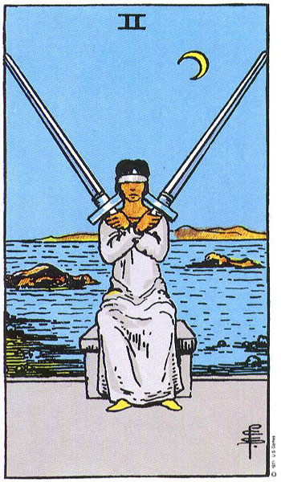
Archetypes in the Tarot
Swords
Represents the principle of AIR,
Feelings, emotions and evolution, change
Notes:
III of Swords: Feeling the heart break. Feeling isolated from those you love. Experiencing betrayal
VI of Swords: Felling sorrow, Keeping the head just above the water, working to get through the day. Picking up the pieces.

Slide 16
0 The beginning
The Arabic number 0 is shaped like an egg,
representing its infinite potential
Innocence
Beginning
Simplicity
Blind faith
Numerology is a very interesting case of cultural construction because in the Western civilization we tend to understand numbers only as a materialistic scientific language and not as cultural symbols
Notes:
The Visconti-Sforza tarot deck is a 15th century Tarot deck and one of the oldest known to exist.^{[1]} It had a significant impact on the visual composition, card numbering and interpretation of modern decks.
a pack of playing cards (numbering 78), 22 TRIUMPHS/ 56 cards divided in 4 SUITS (Wands,Cups, Swords, Coins:
RIDER PACk: PamelaColman Smith (Illustration), Arthur Edward Waite. Designed in 1910
First known as trionfi and later as tarocchi, tarock, and others, IT is a pack of playing cards (most commonly numbering 78), used from the mid-15th century in various parts of Europe to play a group of card games such as Italian tarocchini and French tarot. From the late 18th century until the present time the tarot has also found use by mystics and occultists in efforts at divination or as a map of mental and spiritual pathways.
22 TRIUMPHS (22 letters of Jewish alphabet) catalog of medieval social types, human archetypes
0 Fool / I Magician / II High Priestess / III Empress / IV Emperor / V hierophant-Pope / VI Lovers / VIII Chariot

Slide 17
2 Duality
Notice the symbols:
•The wand: command •The infinite: potential, growth
•The 4 suits: sword, wand, pentagram &cup
•the white lilies: fruit of a higher spirit
• the red roses: passion, emotional energy
Female principle for the same Stage of development
Male principle for a first stage of the game
Absolute passiveness
Unconscious Awareness
Premonition
Potential
Mystery
Notice the symbols:
•The columns of Light and darkness •The moon: female, hidden knowledge
•The Water behind: the unconscious
•The pattern of pomegranates: knowledge
Action
Awareness
Resourcefulness
Focus
Tarot: first known as trionfi and later as tarocchi, tarock, and others) is a pack of playing cards (most commonly numbering 78), used from the mid-15th century in various parts of Europe to play a group of card games .From the late 18th century until the present time the tarot has also found use by mystics and occultists in efforts at divination or as a map of spiritual pathways.
Notes:
concentrating having singleness of purpose ___________2 Duality of opposites
being totally committed applying the force of your will feeling centered __cloak _the veil of the temple
The High Priestess is the mysterious unknown that women often represent, especially in cultures that focus on the tangible and known.
B and J: Boaz and Jakin: the names of the pilars of the temple of Jerusalem
sensing the mystery looking beyond the obvious _TORA/ TARO higher knowledge_inner self. Jewish TORAH: jewish law. 5 books of Moses
Veil: protection from knowledge: knowledge before ripeness means destruction
Moon_ all moon-goddess religions feature mythos of the goddess ferocious side (darkness_destruction) KALI
High priestess represents a DARK and mysterious aspect of the female force.
The Power of passivity approaching a closed off area opening to the unknown
seeking what is concealed acknowledging the Shadow
Kabbalists took a term form the talmud: ShekinaH (Gods anima: female aspect, God’s glory manifesttation in the physical world)

Slide 18
2 A different vision of Duality
St.
Mathew
St.
John
1
First card
2
Second card
The beginning of duality
The 4 cardinal points
(also 4 evangelists)
2 wands, one on each hand
Triumphant naked figure (free of attachments) an hermaphrodite in some decks)
Surrounded by a great garland in the shape of a 0
St.
Luke
St.
Mark
21
The last card
The end of duality: the complete triumph
Notes:
integrating experiencing wholeness/ bringing parts together
achieving your heart's desire seeing dreams come true flourishing finding a beautiful solution
Lion: Saint Mark // Man: Mathew// Ox or winged bull: Luke// The eagle: John
In iconography the evangelists often appear in Evangelist portraits derived from classical tradition, and are also frequently represented by the following symbols, which originate from the four "living creatures" that draw the throne-chariot of God, the Merkabah, in the vision in the Book of Ezekiel (Chapter 1) reflected in the Book of Revelation
Matthew the Evangelist, the author of the first gospel account is symbolized by a winged man,
Luke the Evangelist, the author of the third gospel account (and the Acts of the Apostles) is symbolized by a winged ox or bull – a figure of sacrifice, service and strength.
John the Evangelist, the author of the fourth gospel account is symbolized by an eagle – a figure of the sky, and believed to be able to look straight into the sun
Apocalypsis: book of Revelation
En el Apocalipsis los números son usados como símbolos. El siete, por ejemplo, denota la perfección (porque la cabeza perfecta tiene siete orificios). Pero el seis significa la imperfección, pues le falta uno de siete, como la ceguera, por ejemplo, que es falta de vista, es una imperfección. Y la máxima imperfección es el seis triplicado (666) que es el número del Mal, el número de la Bestia (Ap. 13, 18).
Book of Revelation the last book of the New Testament, the revelation which John receives is that of the ultimate victory of good over evil and the end of the present age, and that is the primary meaning of the term, one that dates to 1175.^{[1]} Today, it is commonly used in reference to any prophetic revelation or so-called End Time scenario, or to the end of the world in general
Most modern scholars believe it was written around AD 95, with some believing it dates from around AD 60.
similarities between the Gospel of John and Revelation. For example, both works are soteriological and possess a high Christology, stressing the divine nature of Jesus as opposed to the human nature stressed by the Synoptic Gospels.

Slide 19
2 Different vision of Duality.
Cosmogony
Venus of Lespunge, 2600BC
Hindu goddess Lakshmi of wealth, Prosperity and Beauty.
Hindu goddess Kali of destruction over the dead body of her husband . Notice the Royal Cobra of awareness.
Jung contemplated the archetypes of the Good mother and the Terrible mother incarnating the Creation and Destruction of the Natural in different cultures.
Notes:
Brahma, Vishnu, and Shiva (Trimurti) in Puranic Hinduism // Shakti, Lakshmi, and Saraswati (Tridevi) in Puranic Hinduism
Kālī (Sanskrit: काली, IPA: [kɑːliː]), also known as Kālikā (Sanskrit: कालिका), is the Hindu goddess associated with empowerment, shakti. The name Kali comes from kāla, which means black, time, death, lord of death,
Maja Shivarati
Lakshmi (Sanskrit: लक्ष्मी lakṣmī, Hindi pronunciation: [ˈləkʃmi]) is the Hindu goddess of wealth, prosperity (both material and spiritual), fortune, and the embodiment of beauty. She is the consort of the god Vishnu. Also called Mahalakshmi, she is said to bring good luck and is believed to protect her devotees from all kinds of misery and money-related sorrows.^{[1]} Representations of Lakshmi are also found in Jain monuments.
Lakshmi is called Shri or Thirumagal because she is endowed with six auspicious and divine qualities, or Gunas, and also because she is the source of strength even to Vishnu. When Vishnu incarnated on earth as avatars Rama and Krishna, Lakshmi incarnated as his consort. Sita (Rama's wife), Radha (Krishna's lover)^{[2][3][4]} and Rukmini and the other wives of Krishna are considered forms of Lakshmi.^{[5]}
Lakshmi is worshipped daily in Hindu homes and commercial establishments as the goddess of wealth. She also enjoys worship as the consort of Vishnu in many temples. The festivals of Diwali and Kojagiri Purnima are celebrated in her honour.

Slide 20
2 Different vision of Duality.
Cosmogony
Catholic Representation of the Pietá
Catholic Virgin Mary representing
the nourishing mother
“Inmaculada” of Bartolome Esteban Murillo.
Representing purity
Jung contemplated the archetypes of the Good mother and the Terrible mother incarnating the Creation and Destruction of the Natural in different cultures.
Notes:
Pietà
1499 Marble, height 174 cm, width at the base 195 cm Basilica di San Pietro, Vatican

Slide 21
2 Different vision of Duality.
Cosmogony
Ishtar-Inana-Isis-Astarte
Hindu goddess Lakshmi of wealth, Prosperity and Beauty.
Egyptian depiction of the Tree of Life.
Tutumosis the III breastfed by Goddess Isis
Goddess Ashtarte, with snakes on her hands stepping on skulls.
Hindu goddess Kali of destruction.
Jung contemplated the archetypes of the Good mother and the Terrible mother incarnating the Creation and Destruction of the Natural in different cultures.
Notes:
Kālī (Sanskrit: काली, IPA: [kɑːliː]), also known as Kālikā (Sanskrit: कालिका), is the Hindu goddess associated with empowerment, shakti. The name Kali comes from kāla, which means black, time, death, lord of death,
Figuras ambiguas, ambas, ya que la Tierra, en el verano dadora de todos los dones –Pan-Dora, en la tradición griega‑, fructificada por el sol resucitado en abundantes cosechas, en vida resurgente, en fertilidad; en el invierno ‑como el veneno que también portaba la serpiente‑, era dadora de muerte, de sequía, de semilla enterrada, de mengua de su ‘paredro' el sol.
De allí que en varias representaciones de Ishtar-Inana-Isis-Astarté se la presenta no solo con serpientes en las manos sino pisando cráneos humanos, símbolo universal de la muerte.

Slide 22
2 Different vision of Duality.
Cosmogony
Hindu Bangalore Lord Shiva meditating in the mountains
Hindu Shiva Natajara., the Cosmic Dancer.
Hindu view of destruction as a way of maintaining Balance in the Universe. Shiva the destroyer.
Notes:
Shiva is usually worshipped in the aniconic form of lingam. He is described as an omniscient yogi, who lives an ascetic life on Mount Kailash,^{[5]} as well as a householder with a wife Parvati, and two sons, Ganesha and Kartikeya. Shiva has many benevolent as well as fearsome forms. He is often depicted as immersed in deep meditation, with his wife and children or as the Cosmic Dancer. In fierce aspects, he is often depicted slaying demons.
Koothan is derived from the Tamil word Koothu, which means dance or performance. A male dancer is termed Koothan. Nāṭaraja is derived from the Sanskrit words narta rājan "lord of dance". The change of the dental /rt/ to a retroflex /ṭ/ with concomitant vowel lengthening is a normal sound change for the Prakrit languages descended from Sanskrit.
A cobra uncoils from his lower right forearm, and the crescent moon and a skull are on his crest. He dances within an arch of flames. This dance is called the Dance of Bliss, aananda taandavam. The upper right hand holds a small drum shaped like an hourglass that is called a ḍamaru in Sanskrit.^{[4][5][6]} A specific hand gesture (mudra) called ḍamaru-hasta (Sanskrit for "ḍamaru-hand") is used to hold the drum.^{[7]} It symbolizes sound originating creation or the beat of the drum is the passage of time. The upper left hand contains Agni or fire, which signifies destruction. The opposing concepts in the upper hands show the counterpoise of creation and destruction or the fire of life. The second right hand shows the Abhaya mudra (meaning fearlessness in Sanskrit), bestowing protection from both evil and ignorance to those who follow the righteousness of dharma. The second left hand points towards the raised foot which signifies upliftment and liberation. It also points to the left foot with the sign of the elephant which leads the way through the jungle of ignorance. The dwarf on which Nataraja dances is the demon Apasmara (Muyalaka, as known in Tamil), which symbolises Shiva's victory over ignorance. It also represents the passage of spirit from the divine into material.

Slide 23
3 Trinity
Graph of the Roman Catholic construction of God
The three graces
Sandro Botticelli
The Holy Trinity. Hungarian unknown master, 1450
The three graces
III century.
Pompey
Hildegard Von Bingen
A vision of a female Trinity. XIII century
Notes:
http://www.anamchara.com/2012/08/23/hildegards-mystical-trinity/
http://en.wikipedia.org/wiki/Hildegard_of_Bingen
Hildegard of Bingen. German, Elected a magistra by her fellow nuns in 1136
he Rhine valley where Hildegard lived
She is brilliant for her profoundly positive spirituality of nature, the cosmos, and the body (she was one of the first medical writers of medieval Europe), along with a clear appreciation of the authority of personal experience — which paved the way for many other great visionaries who followed in her footsteps.
833 years after her death, was finally officially inscribed in the Catholic Church's record of saints this past

Slide 24
3 Classical Ages
• Childhood
• Maturity
• Old Age
Klimt, Gustav
The Three Ages of Woman, 1905
Oil on canvas 178 x 198 cm
Galleria Nazionale d'Arte Moderna, Rome

Slide 25
3 Ages of the female
The Maiden
•The temptress
•The Old woman
(the wise/the witch)
Edvard Munch:
"Woman in Three Stages", 1899. Lithograph, 46.2 x 59.2 cm

Slide 26
The temptress. Edward Munch
”Lady from the Sea”, 1896
•The temptress
Edvard Munch:
"Woman in Three Stages", 1899. Lithograph, 46.2 x 59.2 cm
Notes:
Triple Goddess (Neopaganism), a concept in Wicca and other Neopagan belief systems: sometimes a universal, global, "Great Goddess" who is threefold; sometimes a single goddess as maiden, matron and crone; and sometimes three sisters.
In religious iconography or mythological art,^{[2]} three separate beings may represent either a triad who always appear as a group (Greek Moirai, Charites, Erinnyes and the Norse Norns) or a single deity known from literary sources as having three aspects (Greek Hecate, Diana Nemorensis.^{[3]})
Brahma, Vishnu, and Shiva (Trimurti) in Puranic Hinduism // Shakti, Lakshmi, and Saraswati (Tridevi) in Puranic Hinduism

Slide 27
The Great Goddess
•Mother Goddess, associated with life,
Creation and its rhythms during the
culmination of the Bronze Age,
7,000 Bc.
Venus of Laussel
Notes:
Triple Goddess (Neopaganism) a universal, global, "Great Goddess" who is threefold; sometimes a single goddess as maiden, matron and crone; and sometimes three sisters.
According to Joseph Campbell. Mythology of the Culmination of the Bronze Age. Europe 7,000 BC Tripple mother goddess is dominant.
Associated with the Moon, with the Boar, with the serpent.
Painted caves. The womb
In religious iconography or mythological art,^{[2]} three separate beings may represent either a triad who always appear as a group (Greek Moirai, Charites, Erinnyes and the Norse Norns) or a single deity known from literary sources as having three aspects (Greek Hecate, Diana Nemorensis.^{[3]})
Brahma, Vishnu

Slide 28
Triads of Gods
•
•Brahma
bSaraswati
•Vishnu
bLakshmi
•Shiva
bParavati
The three greatest Hindu deities are shown here together with their consorts. They are sometimes regarded as a trinity, who together represent aspects of the supreme godhead.
The four-headed Brahma, holding copies of the oldest Indian sacred scriptures, the Vedas, together with his consort Saraswati, symbolises the power of creation. Next to him the blue Vishnu, with his consort Lakshmi, represents the energy that upholds and preserves creation. To their right Shiva, with his wife Parvati, embodies the power of destruction. All three divine couples sit on lotus flowers, which are one of the most ancient Indian symbols of purity and spiritual power. This painting may have been made for the enjoyment of a local nobleman or ruler and was probably the work of local artists in north-west India around 1770"
Notes:
Triple Goddess (Neopaganism), a concept in Wicca and other Neopagan belief systems: sometimes a universal, global, "Great Goddess" who is threefold; sometimes a single goddess as maiden, matron and crone; and sometimes three sisters.
In religious iconography or mythological art,^{[2]} three separate beings may represent either a triad who always appear as a group (Greek Moirai, Charites, Erinnyes and the Norse Norns) or a single deity known from literary sources as having three aspects (Greek Hecate, Diana Nemorensis.^{[3]})
Brahma, Vishnu, and Shiva (Trimurti) in Puranic Hinduism /
Shakti, Lakshmi, and Saraswati (Tridevi) in Puranic Hinduism
All three divine couples sit on LOTUS flowers, which are one of the most ancient Indian symbols of purity and spiritual power.

Slide 29
4 Cardinal points
Septentriones, referring to the seven stars that make up the constellation of The Bear, or Plough, that is a pointer for the Pole Star in the North
in Latin, Occidens, from the Latin occido, to fall or set, reminding us where the sun sets.
North
West
East
In Latin, Oriens, from the verb orior, to rise, reminding us where the sun rises._ The Orient_ The Levant_
South
in Latin, Meridiens, referring to where the sun is in the middle of the day [in the northern hemisphere north of the tropics]
Notes:
http://www.geog.port.ac.uk/webmap/hantsmap/hantsmap/cmprose.htm
The four main directions are the Cardinal points of the compass; north, east, south, west. These 4 directions are at right angles, 90 degrees to each other, a 1/4 of the circle. The cardinal points are also called 'principal points'.

Slide 30
4 Seasons
Natural Darkness, and light festivities (Christmas).
Contemplation, passivity.
Death and the perseverance for survival.
Harvest, Gathering,
Wisdom, Maturity, Melancholy.
Winter
Autum
Spring
A new beginning, coming back to life.
Beauty: flowers, bees, youth.
Summer
Celebration. Long days
Notes:
Hildegard von Bingen : Spring was a longed-for season in the middle ages. After the dark and cold of winter, the lengthening days, the increasing warmth of the sun, the first showing of fresh green growth and flowers, were all savoured. Spring was the time when Easter took place, one of the most important religious festivals in medieval times and also a celebration of new life and feasting after the long fasting of Lent. Spring was when many plants were gathered to make dyes for clothes, to transform gowns and robes. New leaves, lichens, flowers and mosses were all gathered.
aequus (equi) which means "equal" and nox or noct which means "night". Therefore the word Equinox means "equal night". It is the time of the year when there is a perfect balance between day and night; between the Sun and the Moon;

Slide 31
4 Cardinal Virtues
Cardinal virtues: Prudence/Justice/Fortitude/Temperance
Notes:
Cardinal virtues: Prudence/Justice/Fortitude/Temperance
Plato first discussed the cardinal virtues in the Republic, foundation of “natural morality
Prudence_the ability to govern and discipline oneself by the use of reason. skill and good judgment in the use of resources. Aristotles defined as :ecta ratio agibilium, "right reason applied to practice."
justice is concerned with what we owe someone else precisely because he is not us.
Aristote:
Wisdom and prudence are the two virtues of the intellect.

Slide 32
The Seven Classical Virtues
Patience ____ Wrath
Diligence ____ Sloth
Temperance ____ Gluttony
Generosity ____ Greed
Chastity ____ Lust
Humility ____ Pride
Notes:
Cardinal virtues: Prudence/Justice/Fortitude/Temperance
Plato first discussed the cardinal virtues in the Republic, foundation of “natural morality
Prudence_the ability to govern and discipline oneself by the use of reason. skill and good judgment in the use of resources. Aristotles defined as :ecta ratio agibilium, "right reason applied to practice."

Slide 33
The Seven Classical Virtues
xx
Patience ____ Wrath
Diligence ____ Sloth
Chastity/Abstinence ____ Lust
Chastity ____ Lust
Generosity ____ Greed
Humility ____ Pride
Temperance ____ Gluttony
Notes:
Chastity/Abstinence
Zeal/Diligence

Slide 34
Number seven
SUN _Gold-Sunday
7 days of the week
Saturday_Lead_ SATURN
MOON _Silver_Moonday
7 visible planets
7 Metals
Friday_Copper_ VENUS
MARS _Iron_Tuesday
Thursday_Tin_ JUPITER
MERCURY _Mercury_Wednesday
Notes:
From antiquity up until the mid-eighteenth century, the number of metals known and recognised as such was seven. They were: lead, tin, iron, gold, copper, mercury and silver. Brass, made from copper, was used, but people didn’t realize it was an alloy that included zinc, until the latter half of the eighteenth century. The metal which finally broke the sevenfold spell of millennia (in 1752) and was called the ‘eighth metal’ was platinum, emerging from the gold mines of Columbia.
Belief in a linkage of these seven metals with the 'seven planets' reaches back into prehistory: there was no age in which silver was not associated with the Moon, nor gold with the Sun. These links defined the identities of the metals. Iron, used always for instruments of war, was associated with Mars, the soft, pliable metal copper was linked with Venus, and the chameleon metal mercury had the same name as its planet. Then, around the beginning of the 18th century these old, cosmic imaginations were swept away by the emerging science of chemistry. The characters of the metals were no longer explained in terms of their cosmic origins but instead in terms of an underlying atomic structure. New metals started to be discovered which made the old view appear limited.
http://www.alchemywebsite.com/kollerstrom_sevenfold.html

Slide 35
Princess Celestia
Pegasus Unicorn
Ruler of Equestria
Princess Luna
Pegasus Unicorn
Elements of Harmony
Pinkie pie
Earth pony
LAUGHTER
Rarity
Unicorn
GENEROSITY
3
4
2
FRIENDSHIP
5
Fluttershy
Pegasus
KINDNESS
Rainbow dash
Pegasus
LOYALTY
1
6
Apple jack
Earth pony
HONESTY
Twilight sparkle
Unicorn
MAGIC
Notes:
Moon/Selene/Luna
Celestial< Celeste< Caelum=Sky, heavens
moves from Canterlot to Ponyville in order to continue the study of friendship under Princess Celestia's tutelage, and regularly maintains correspondence with the Princess

