Slide 1
RENNAISANCE
PERSPECTIVE
Basic ideas on Western
Spatial
Representation

Slide 2
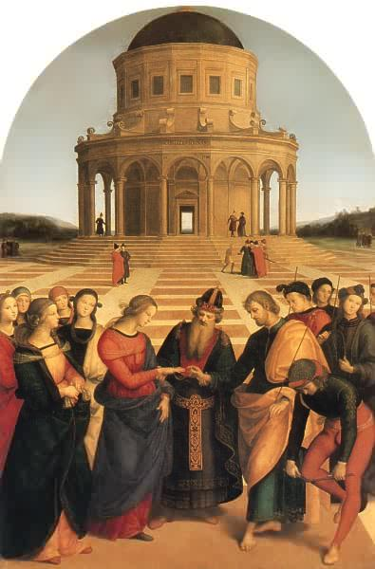
The perspective system
Representing “real space” in a 2D surface
One point perspective,
Central Perspective
or
Linear perspective
Notes:
One point perspective or Linear perspective
The horizon line in perspective drawing is a horizontal line across the picture. It is always at eye level - its placement determines where we seem to be looking from - a high place, or from close to the ground. The actual horizon might not be visible, but you need to draw a 'virtual' horizon to construct a picture in perspective.
Convergence lines, vanishing lines, orthogonals
In Linear Perspective drawing, the diagonal lines that can be drawn along receding parallel lines (or rows of objects) to the vanishing point. drawing, the diagonal lines that can be drawn along receding parallel lines (or rows of objects) to the vanishing point.

Slide 3
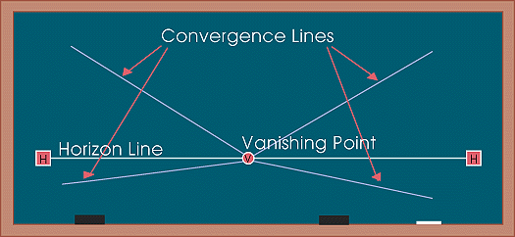
The perspective system
Representing real space in a 2D surface
One point perspective, Central or Linear perspective.
The horizon line in perspective drawing is a horizontal line across the picture.
It is always at eye level - its placement determines where we seem to be looking from (a high place, or from close to the ground).
The actual horizon might not be visible, but you need to draw a 'virtual' horizon to construct a picture in perspective.
Objects are perceived smaller as they get close to that line. That line represents the “visible infinite”: the visible end of earth or water.
Notes:
One point perspective or Linear perspective
The horizon line in perspective drawing is a horizontal line across the picture. It is always at eye level - its placement determines where we seem to be looking from - a high place, or from close to the ground. The actual horizon might not be visible, but you need to draw a 'virtual' horizon to construct a picture in perspective.
Convergence lines, vanishing lines, orthogonals
In Linear Perspective drawing, the diagonal lines that can be drawn along receding parallel lines (or rows of objects) to the vanishing point. drawing, the diagonal lines that can be drawn along receding parallel lines (or rows of objects) to the vanishing point.

Slide 4
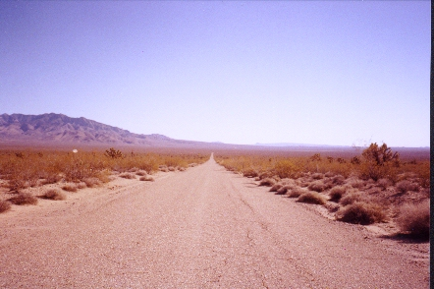
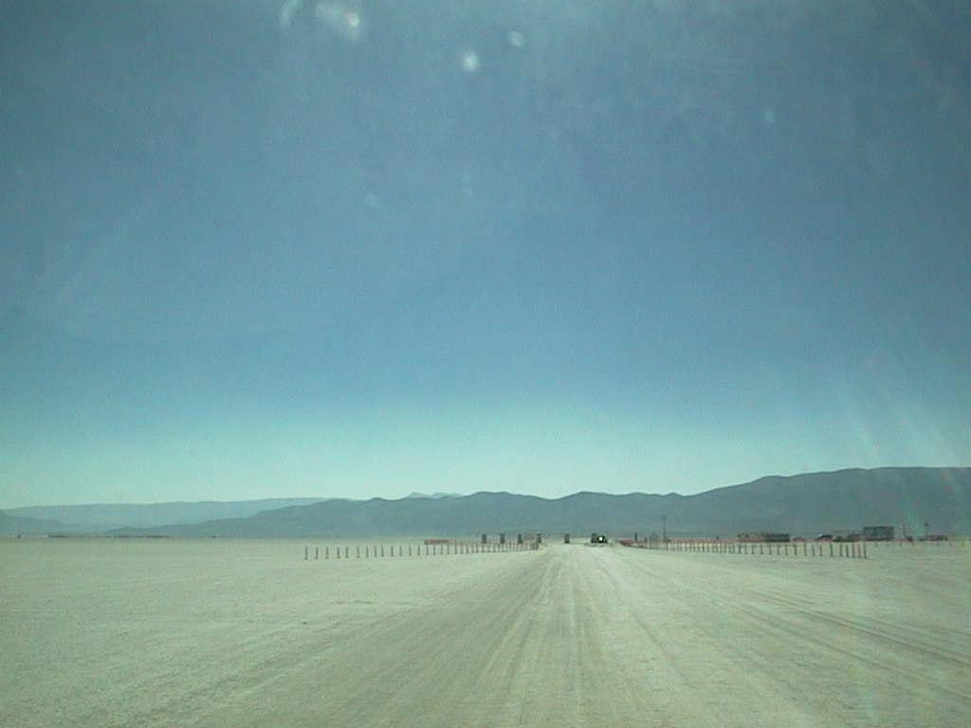
Perspective
Vanishing point on the horizon line
*
*
The horizon line defines our position as a viewer: it is always placed at eye level.
When we look at a photograph we assume the position of the photographer
Notes:
Eye lens or through camera lens

Slide 5
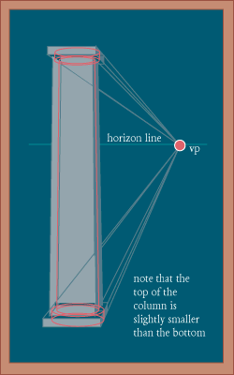
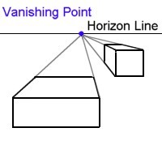
Perspective
The Vanishing point
VP vanishing point
It is placed on the horizon line.
All the vanishing lines converge to that point.
Eyes of the viewer
at this level
In Linear Perspective drawing,
The lines that go from the viewer to the infinite
(the ones that would represent 3D space)
are drawn along receding along
towards the vanishing point.
Feet of the viewer at this level
Notes:
Vanishing lines

Slide 6
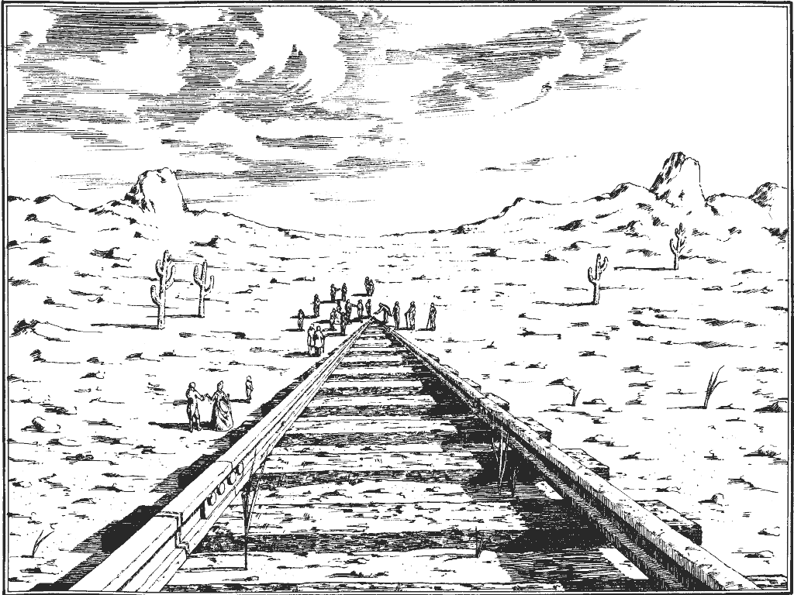
Perspective
Vanishing point
Basic attempt to perspective with incorrect sizing in the figures

Slide 7

Perspective
Vanishing point

Slide 8
Perspective
Vanishing point

Slide 9
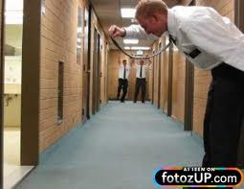


Playing with Perspective
Those are photos that are defying the representation of Space
by using strong perceptual patterns, like Proximity that produce
a simple and appealing explanation of what is seen.

Slide 10
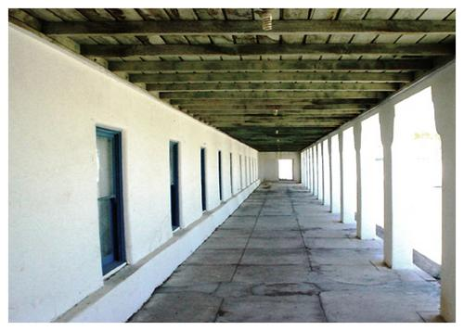
Perspective
The Vanishing point in 1 point perspective
Because the perspective system is based on optics and lenses (how we humans see), Photographic images
match Perspective, since they capture reality from the point of view of a lens.

Slide 11
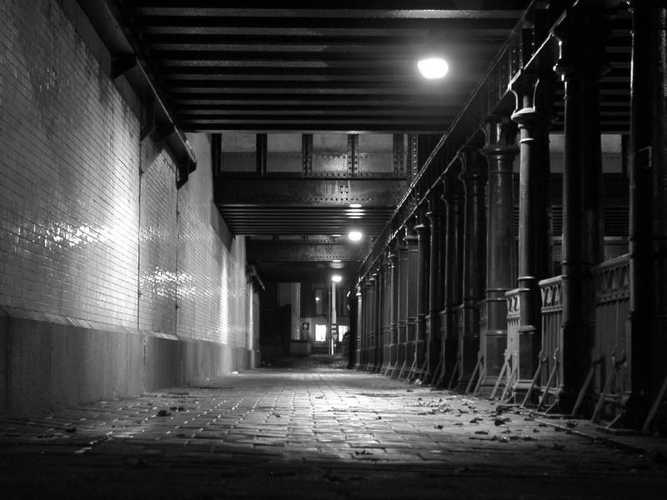
Perspective
Vanishing point
VP vanishing point
On the horizon line
Where all the vanishing lines converge.
Horizon line
Vanishing lines.
Frame of film “Lequai” from director Jean Cocteau.
Notes:
Vanishing lines
Frame of film “Lequai” from director Jean Cocteau.

Slide 12
Perspective
Vanishing point
VP vanishing point
On the horizon line
Where all the vanishing lines converge.
Vanishing lines.
Frame of film “Lequai” from director Jean Cocteau.
Notes:
Vanishing lines
Frame of film “Lequai” from director Jean Cocteau.

Slide 13
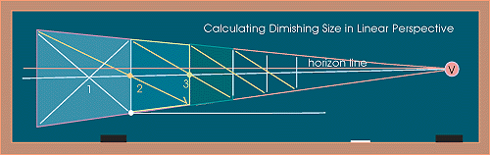
Perspective
1 point or Linear Perspective
Foreshortening
The distortion that perspective causes over objects
seen from a particular viewpoint.
It is more obvious as we get closer to the horizon.
Notes:
Definition: Foreshortening

Slide 14
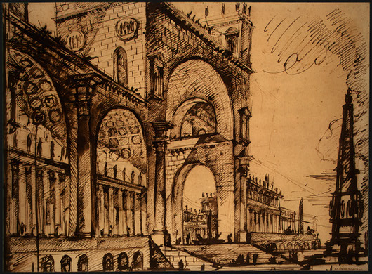
Perspective
Vanishing point
Non
Congruent
Perspective
rendering

Slide 15
Perspective
Vanishing point
Non
Congruent
Perspective
rendering

Slide 16
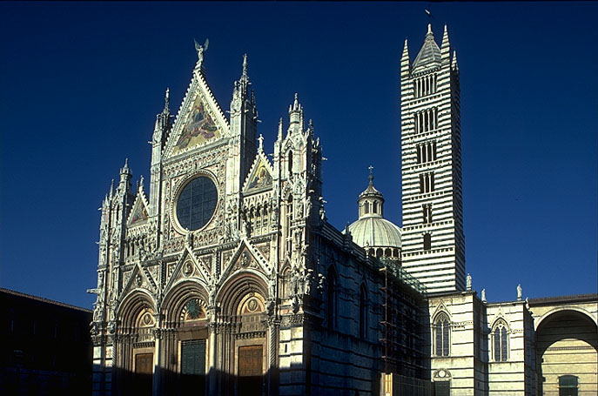
Perspective is founded on Optics. The curved lens in our eyes, or the lens in the camera
Interprets objects in a distorted but organized way.
Very low point of view, camera pointed high

Slide 17
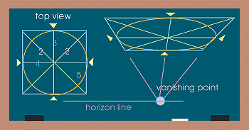
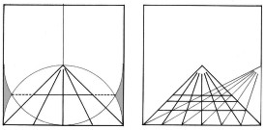
Perspective
Drawing circles according to Central Perspective

Slide 18
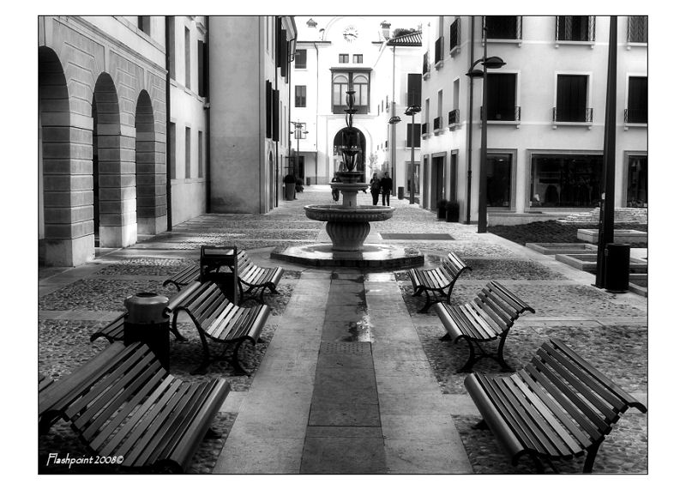
Perspective
Vanishing point
Highly
deformed
arches
Highly deformed
Geometrical figure
Highly deformed circles
Notes:
Vanishing lines
Frame of film “Lequai” from director Jean Cocteau.

Slide 19
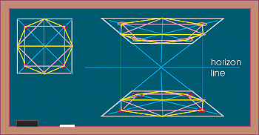
Perspective
Drawing geometrical shapes according to Central Perspective

Slide 20
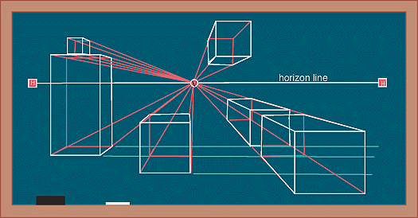
Perspective
Parallel objects in a space seen with a one point perspective.
(typical urban landscape seen through Central Perspective)

Slide 21
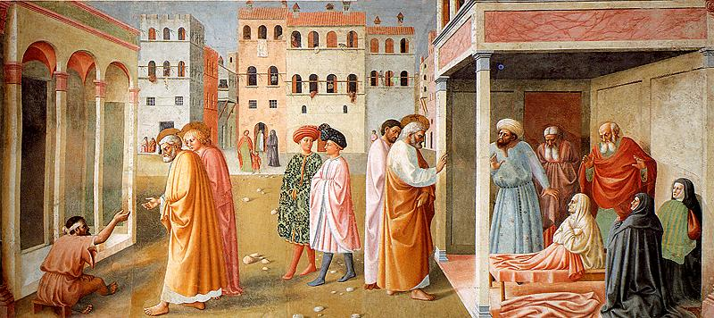
Perspective
Parallel objects in a space seen with a one point perspective.
(typical urban landscape)
Masaccio, and Masolino .
Brancacci Chapel of Santa Maria della Carmine in Florence, 1426-28
Notes:
Masaccio, Brancacci Chapel of Santa Maria della Carmine in Florence,
1426-28

Slide 22
Perspective
Parallel objects in a space seen with a one point perspective.
(typical urban landscape)
Masaccio, and Masolino .
Brancacci Chapel of Santa Maria della Carmine in Florence, 1426-28
Notes:
Masaccio, Brancacci Chapel of Santa Maria della Carmine in Florence,
1426-28

Slide 23
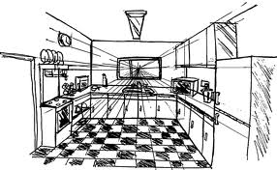
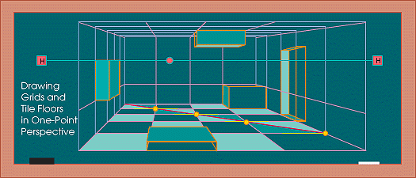
Perspective
Parallel objects seen from a central point of view inside a cube.
(typical interior situation)

Slide 24
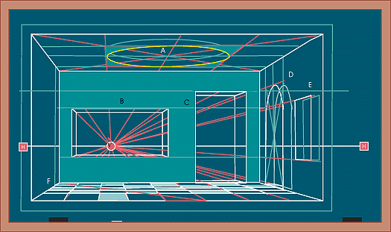
Perspective
Parallel objects seen from a central point of view inside a cube.
(frontal view)

Slide 25
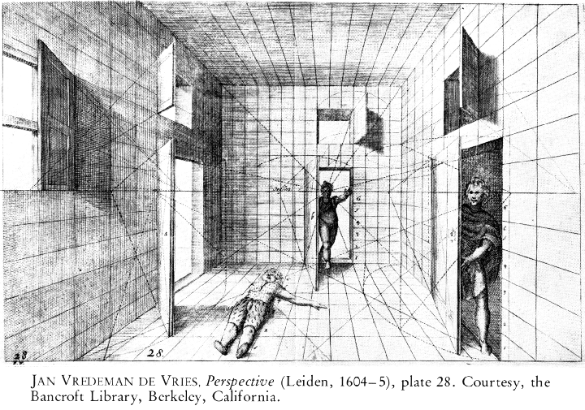
Perspective
Parallel objects seen from a central point of view inside a cube.
(frontal view)

Slide 26
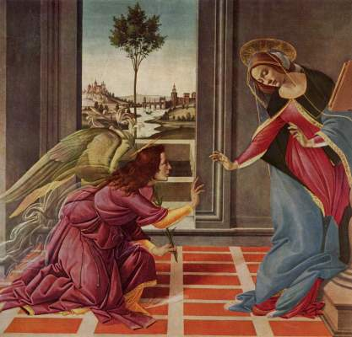
Perspective
Parallel objects seen from a central point of view inside a cube.
(typical interior situation,)
Early Rennaisance
Sandro Boticelli
(1445-1510)
“The Cestello Annunciation”
56 x 150 cm
(61,3 x 59,0 inches

Slide 27
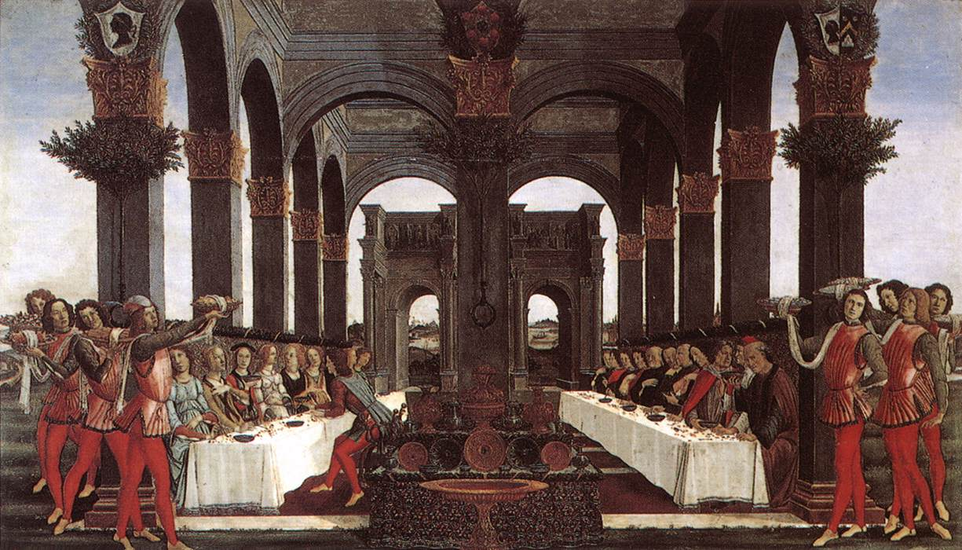
Perspective
Parallel objects seen from a central point of view
Early Rennaisance, Sandro Boticelli (1445-1510)
“Nastagio-degli-onesti”1483
Notes:
Paintings by Technique: tempera
Paintings by Material: panel
Dimensions: 142 x 83 cm
taken from Boccaccio's Decameron, the fifth tale of the ninth day.
«El infierno de los amantes crueles». Se trata de la historia de un joven de Rávena, Nastagio degli Onesti, rechazado por su amada. Ve en el bosque a una mujer perseguida por un jinete, quien la ataca y mata; inmediatamente, ella se levanta y vuelve a repetirse el castigo sin fin, debido a que se trata de fantasmas, una maldición, debido a que la joven perseguida no atendió a los requerimientos de su pretendiente y éste se suicidó. Nastagio cree que tal aparición puede serle útil: hace que su desdeñosa amada la vea, con lo que consigue finalmente vencer su resistencia y llegar a un matrimonio feliz.

Slide 28
The marriage of the virgin,
1504.
“Lo sposalizio della vergine”
Pinacoteca Brera, Milano.
Raffaello

Slide 29
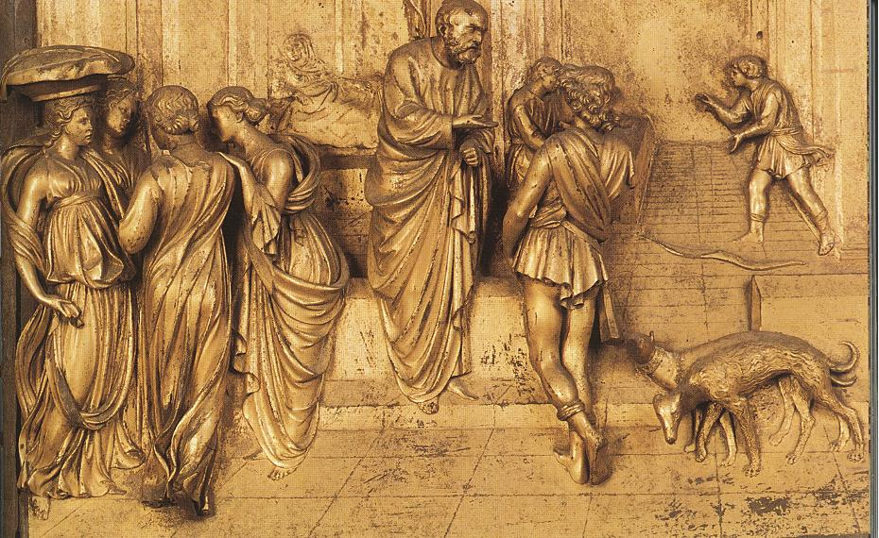
Perspective
Central point of view inside a cube.
Lorenzo Ghilberti, Architect
1378-1455
Porta Baptisterio Fiorenze. Bass Relief
Notes:
Lorenzo Ghilberti, Architect
1378-1455
Porta Baptisterio Fiorenze

Slide 30
Perspective
Central point of view inside a cube.
Notes:
Lorenzo Ghilberti, Architect
1378-1455
Porta Baptisterio Fiorenze

Slide 31
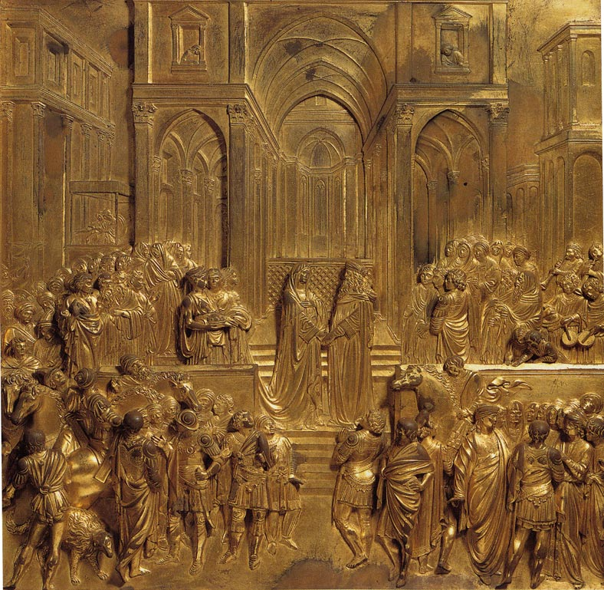
Lorenzo Ghilberti,
Architect
1378-1455
Porta Baptisterio Fiorenze.
Bass Relief
Notes:
Lorenzo Ghilberti, Architect
1378-1455
Porta Baptisterio Fiorenze

Slide 32
Horizon line
Lorenzo Ghilberti,
Architect
1378-1455
Porta Baptisterio Fiorenze.
Bass Relief
Notes:
Lorenzo Ghilberti, Architect
1378-1455
Porta Baptisterio Fiorenze

Slide 33
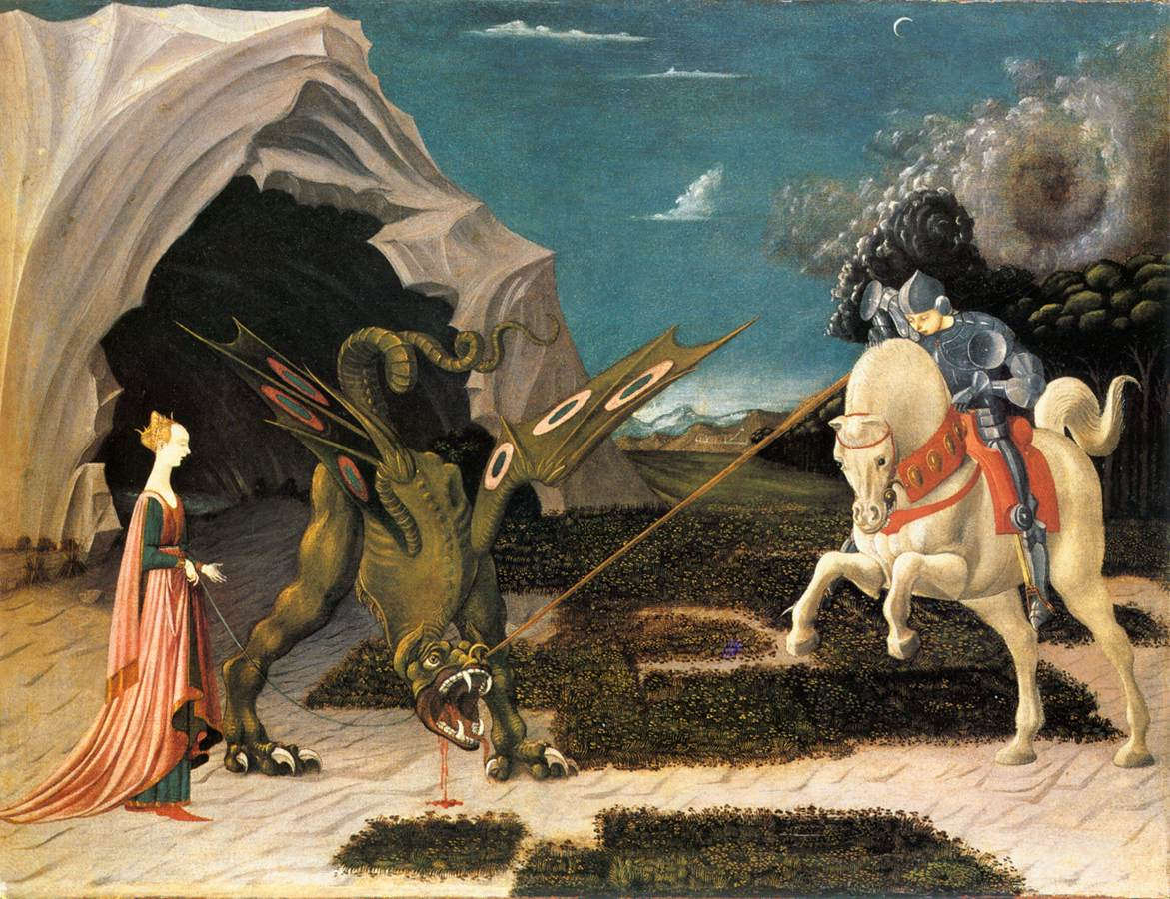
Perspective
Parallel objects seen from a central point of view inside a cube.example
Paolo Ucello. St. George and the Dragon, 1456.
National Gallery, London.

Slide 34
Perspective
Parallel objects seen from a central point of view inside a cube.example
Paolo Ucello. St. George and the Dragon, 1456.
National Gallery, London
Attempt to apply perspective to nature in the XV century.

Slide 35
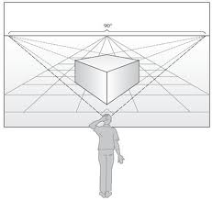
The perspective system
Representing “real space” in a 2D surface
Vanishing point 1
Vanishing point 2
Object is in oblique position to the viewer
Parallel lines merge on the same side point
Two point perspective,
or
Oblique perspective
Notes:
One point perspective or Linear perspective
The horizon line in perspective drawing is a horizontal line across the picture. It is always at eye level - its placement determines where we seem to be looking from - a high place, or from close to the ground. The actual horizon might not be visible, but you need to draw a 'virtual' horizon to construct a picture in perspective.
Convergence lines, vanishing lines, orthogonals
In Linear Perspective drawing, the diagonal lines that can be drawn along receding parallel lines (or rows of objects) to the vanishing point. drawing, the diagonal lines that can be drawn along receding parallel lines (or rows of objects) to the vanishing point.

Slide 36
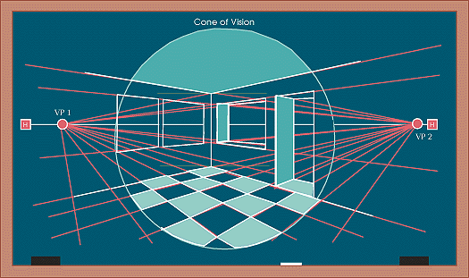
Perspective
Parallel objects seen with a 2 point view inside a cube.
First
vanishing
point
The lines going towards the vanishing points are perpendicular to each other. As you move away from
the central area objects appear somehow deformed (perspective aberration).
Second
vanishing
point
Horizon line

Slide 37
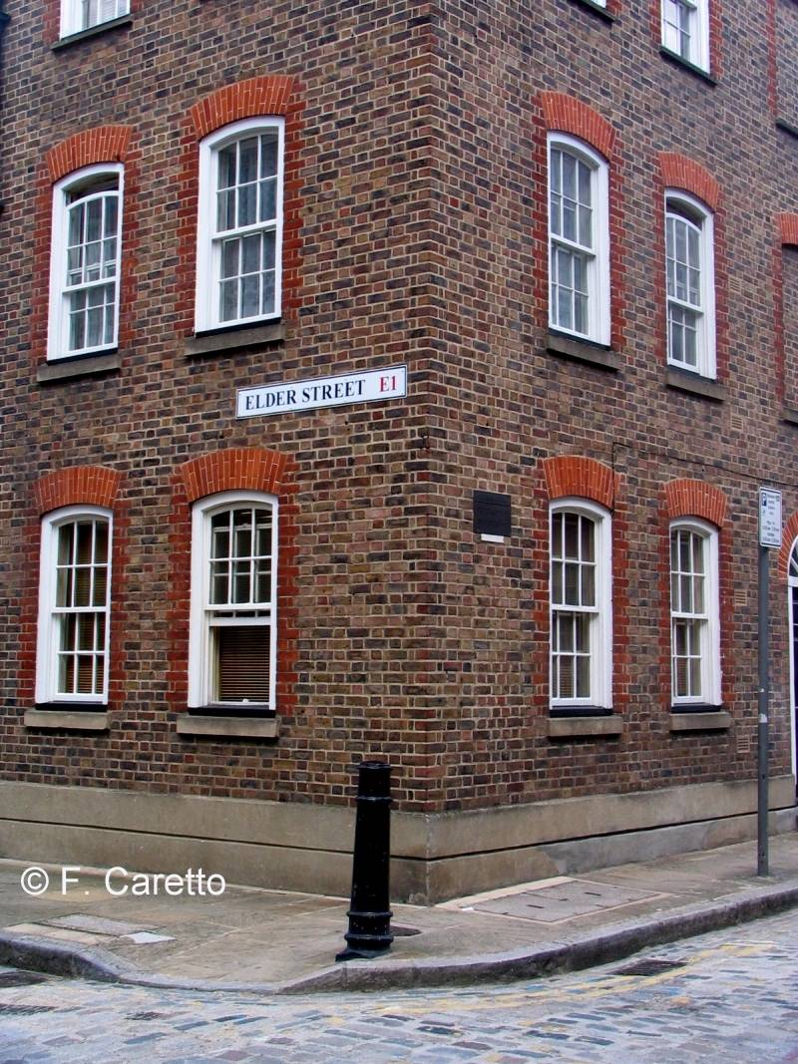
Perspective
2 point view
Horizon line

Slide 38
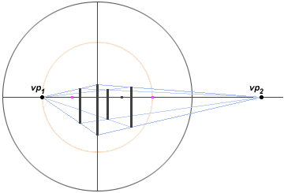
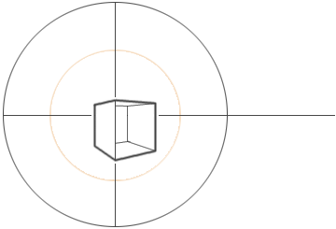
Perspective
A cube seen with a 2 point view
Outside a central sphere, marked by the viewers point, objects get very deformed if placed to the bottom
of the page or towards the bottom and the sides.

Slide 39
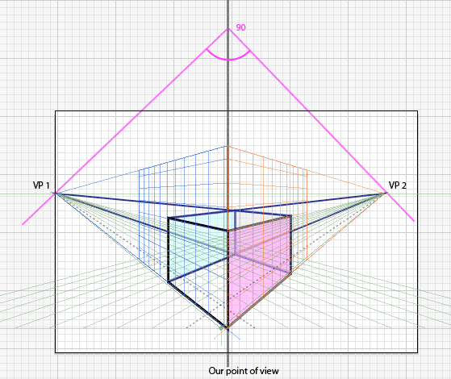
Perspective
A cube seen with a 2 point view
Outside a central sphere, marked by the viewers point, objects get very deformed if placed to the bottom
of the page or towards the bottom and the sides.
Notice that to truly represent a cube,
both vanishing points need to form
a 90 degree angle with center on
the vertical representing the viewers
stand point.
That vertical is defined by the closest
angle of the cube.
Because this cube is placed very close
to the bottom of the page it shows
a lot of deformation,
specially in the lower part.

Slide 40
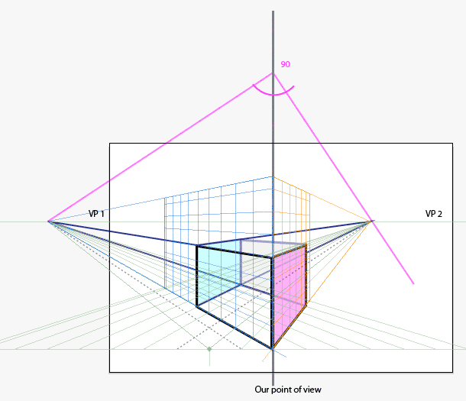
Perspective
A cube seen with a 2 point view
Outside a central sphere, marked by the viewers point, objects get very deformed if placed to the bottom
of the page or towards the bottom and the sides.
Both vanishing points are still forming
a 90 degree angle with center on
the vertical representing the viewers
stand point.
That 90 degree can be placed upper
or lower on that vertical.
It is usually calculated by making sure that the distance from the horizon to the center of the angle (up of the page) is the same than
the distance from the bottom of the drawing to the horizon.
The higher the center of that imaginary
angle, the further apart the vanishing points will be and the less deformation we will get.
As a general rule the vanishing points
(at least one of them or both) should be outside the border of you paper.

Slide 41
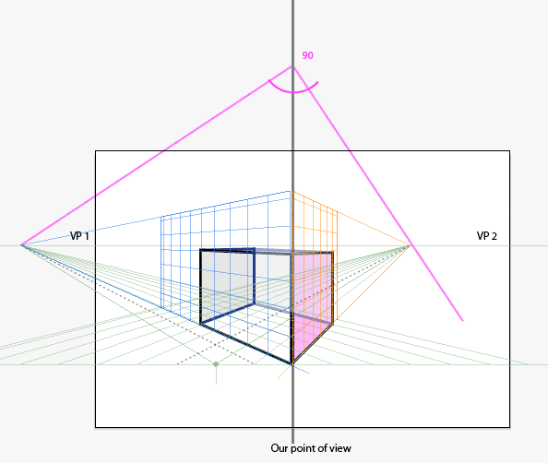
Perspective
A cube seen with a 2 point view
The cube to the right has less deformation because of being placed towards the center of that imaginary sphere

Slide 42
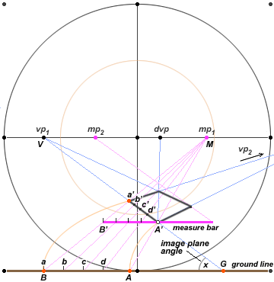
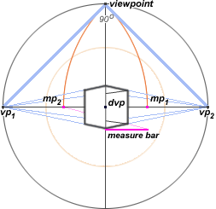
Perspective
A cube seen with a 2 point view
With more measurements we could calculate how a real object (with defined measurements) would look
in our defined space.
VP 2

Slide 43
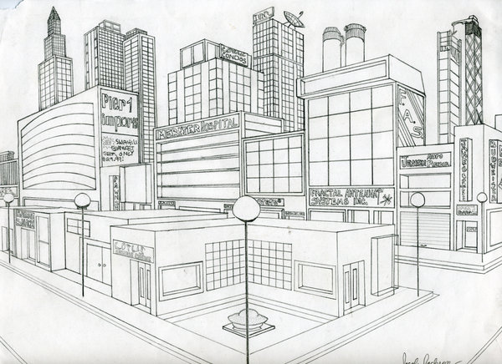
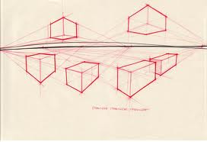
Perspective
A cube seen with a 2 point view
Objects placed in a different angle to the viewer will have different vanishing points.
Because a city is built in an orthogonal plan,
The whole view can be built with only 2
vanishing points.

Slide 44
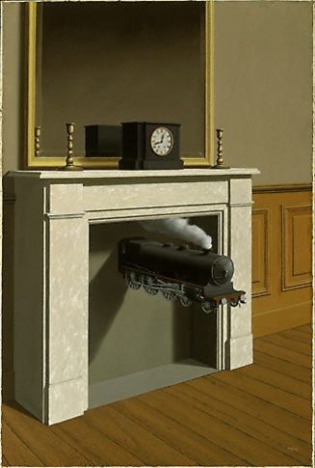
Perspective
2 point perspective
(typical interior situation
Side view)
Rene Magritte
French Surrealist artist.
1898-1967

Slide 45
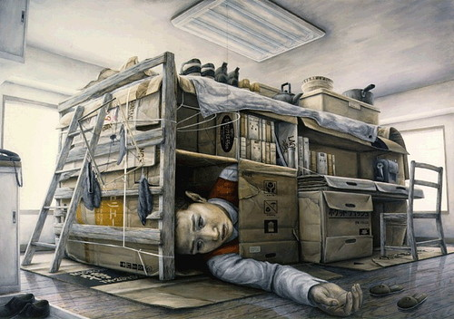
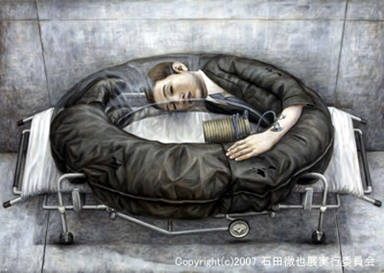
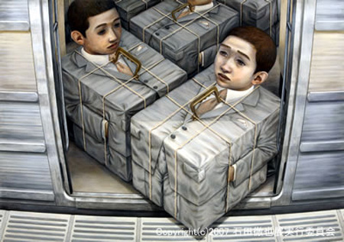
Perspective
2 point perspective
Tetsuya Ishida
Japanese contemporary artist, 1973-2005
Notes:
The artist died in 2005 after being hit by a train leaving behind around 180 works created during his 10 year art career.
http://www.toxel.com/inspiration/2008/11/07/incredible-paintings-by-tetsuya-ishida/
Yaizu, Shizuoka, Japan

Slide 46
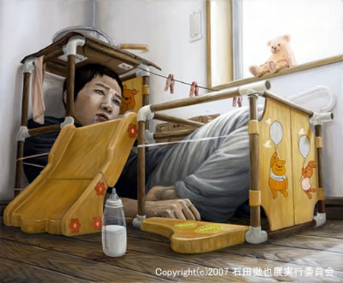
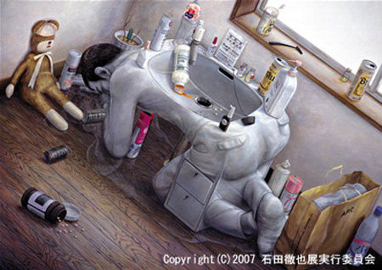
Perspective
2 point perspective
Tetsuya Ishida
Japanese contemporary artist, 1973-2005
Notes:
The artist died in 2005 after being hit by a train leaving behind around 180 works created during his 10 year art career.
http://www.toxel.com/inspiration/2008/11/07/incredible-paintings-by-tetsuya-ishida/
Yaizu, Shizuoka, Japan

Slide 47
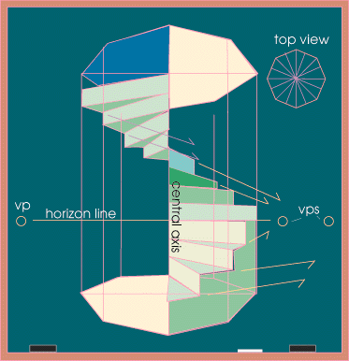
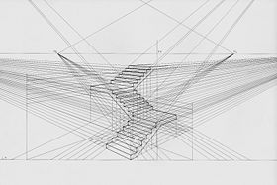
Perspective
Spiral staircase

Slide 48
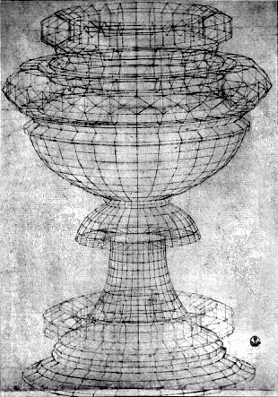
Perspective
Revolving structure
Rennaisance passion for Perspective and Geometry.
Paolo Ucello,
“Drawing of a chalice”, 1430
Pen and ink
Galleria degli Uffizi, Florence
Vasari called perspective: “A tours de force of illusion “

Slide 49
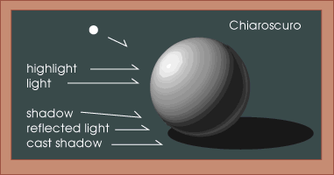
Shading an object
Lit from a single source of light
(point of light)

Slide 50

Shading an object with multiple planes
Lit from a single point (source)

Slide 51

Shading an object
Calculating the projected shadows of an object
According to a light source.

Slide 52

Reflective objects
Calculating the reflection projected on a cylindrical surface.

Slide 53


Reflective objects
3 Point perspective.

Slide 54

Reflective objects
3 Point perspective.

Slide 55




Reflective objects
3 and 4 Point perspective.
3
Point
perspective
4
Point
perspective
Ascending and Descending,
Lithograph, 1960
M.C. Escher
Hand with reflecting sphere,
Lithograph, 1935
M.C. Escher
Notes:
Ascending and Descending is a lithograph print by the Dutch artist M. C. Escher which was first printed in March 1960. The original print measures 14" × 11¼”. The lithograph depicts a large building roofed by a never-ending staircase. Wikipedia
Artist: M. C. Escher

