Slide 1
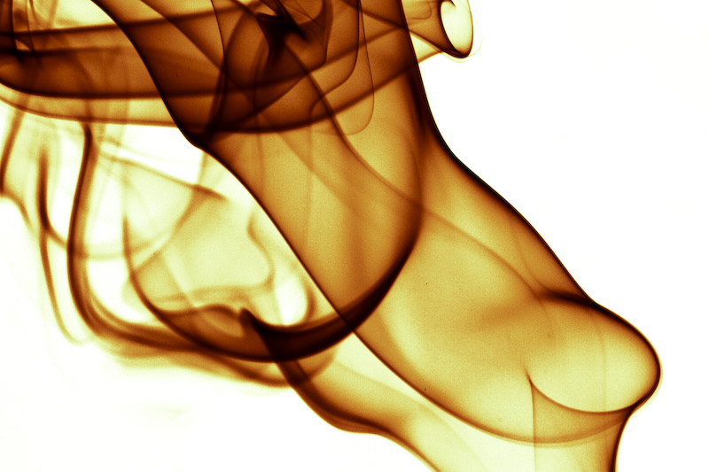
McLuhan Theory
Hot Media
vs
Cold Media
Victor Bernedo

Slide 2
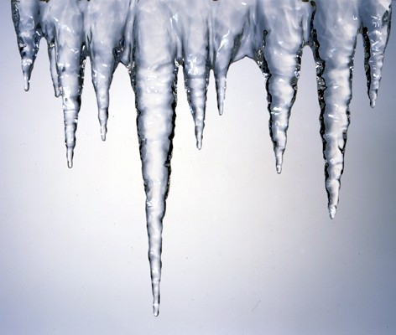
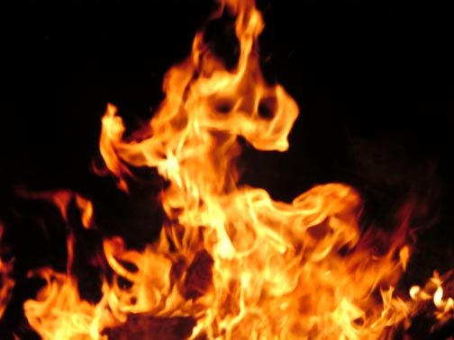
HOT
intoxicating
loud
bright
clear fixed
overpowers
Wispy
Soft shadowy
blurred seductive
changeable
COLD

Slide 3
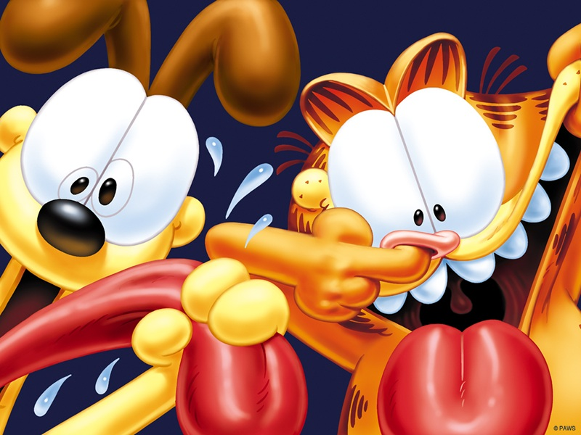
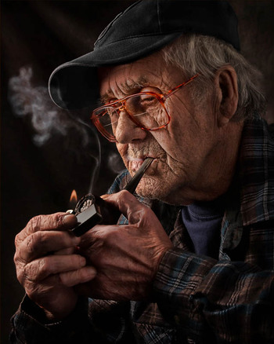
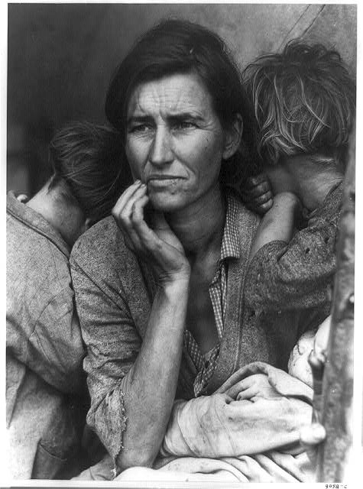
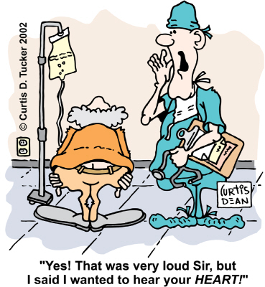
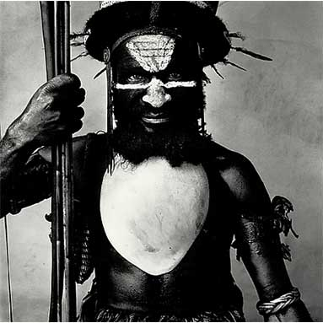
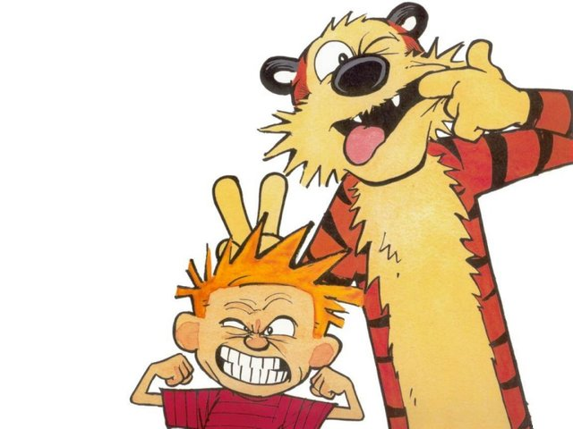
HOT
photography vs cartoons…
COLD

Slide 4
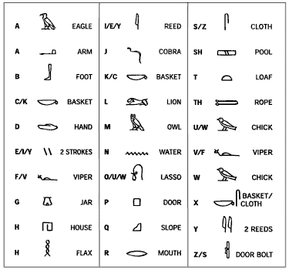
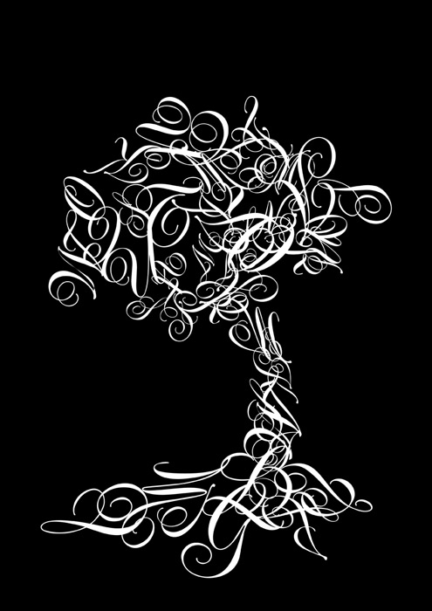
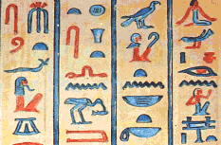
A B
C D E
F G
H I
J K
L M N
O P Q
R S T
U V
W X
Y Z
HOT
alphabets & typography
vs hieroglyphics…
COLD

Slide 5
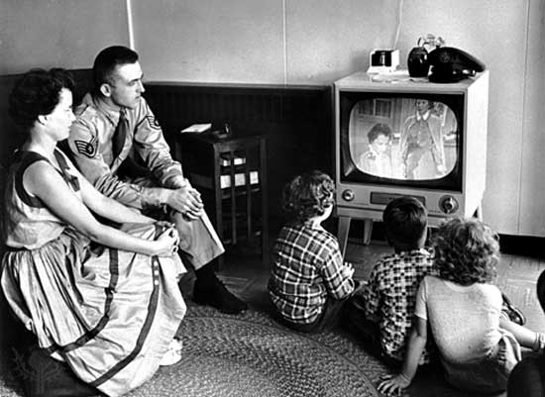
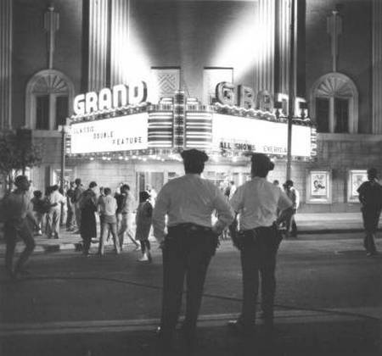
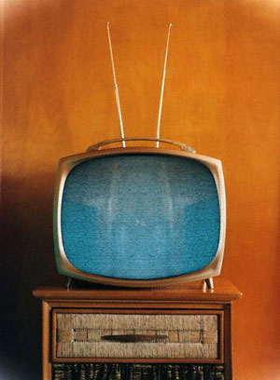
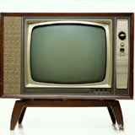
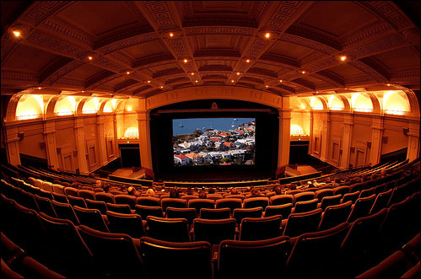
HOT
HOT:
Entrance fees, prepared comfort, huge screens, dark, dramatic spaces
COLD
COLD:
More intimate, less flashy, always available

Slide 6
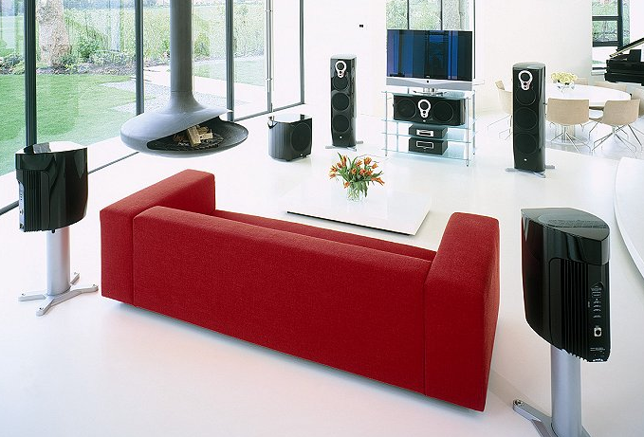
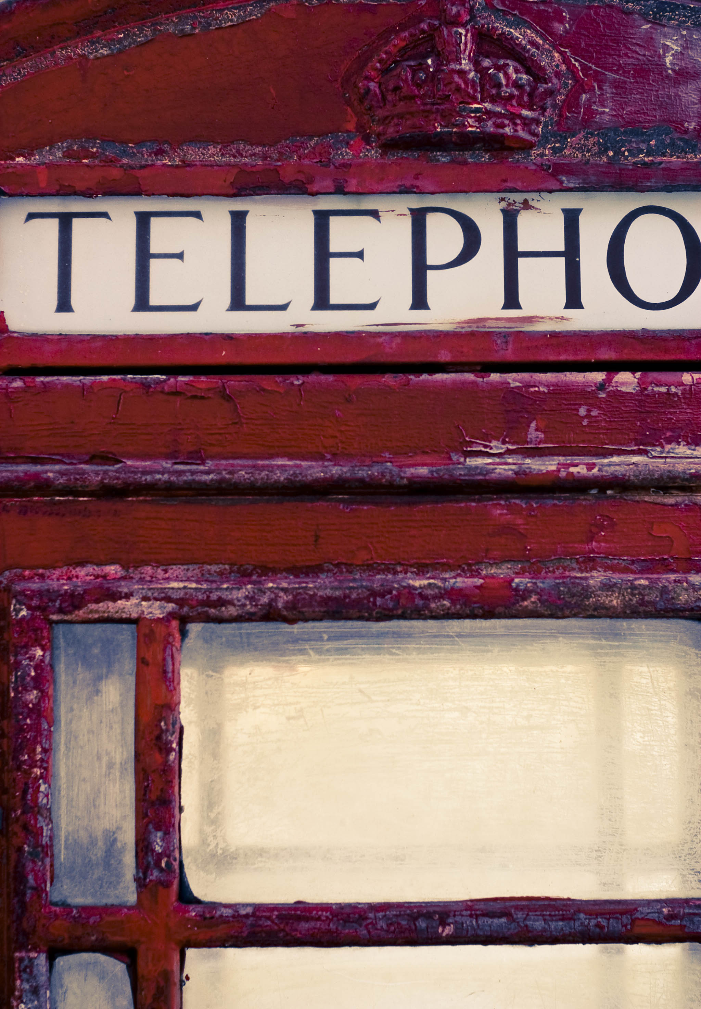
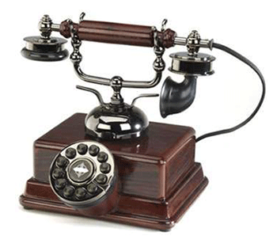
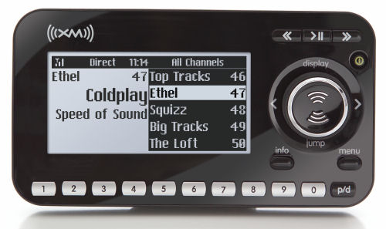
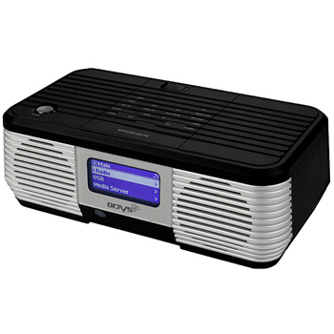
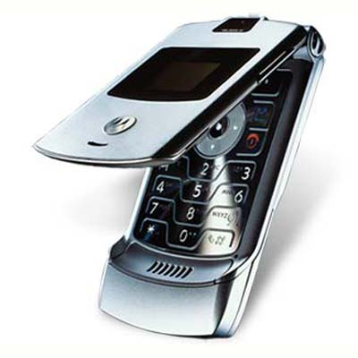
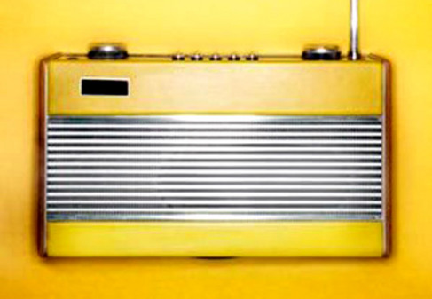
COLD: Smaller, more compact, live & personal interactions, lower quality of sound, only 1 person talks at a time
HOT: Surround sound, high quality sound, more than one person can enjoy at a time
HOT
COLD

Slide 7
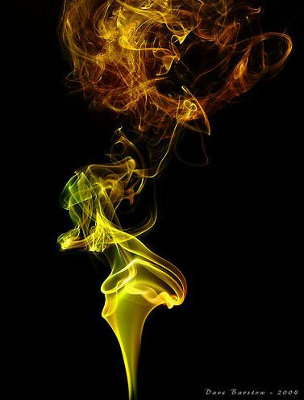
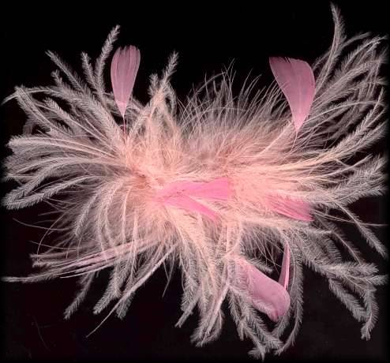
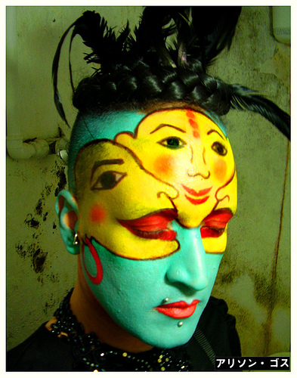
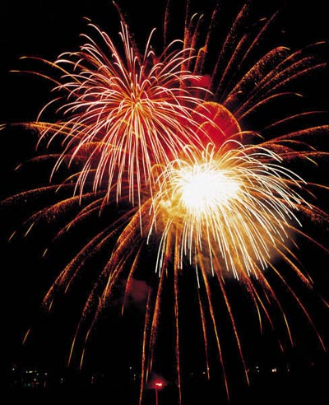
COLD
HOT
HOT: Bright, loud, vivid, fixed, overpowering,
COLD: Soft, whispy, shadowy, blurred, changeable, quiet

Slide 8
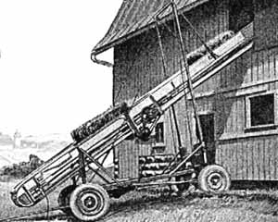
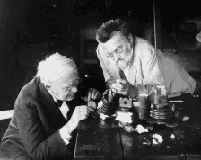
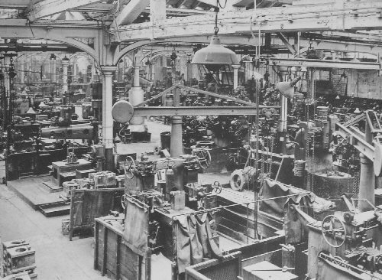
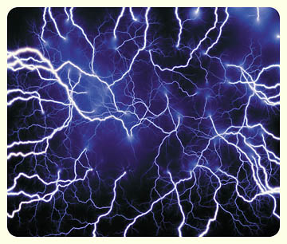
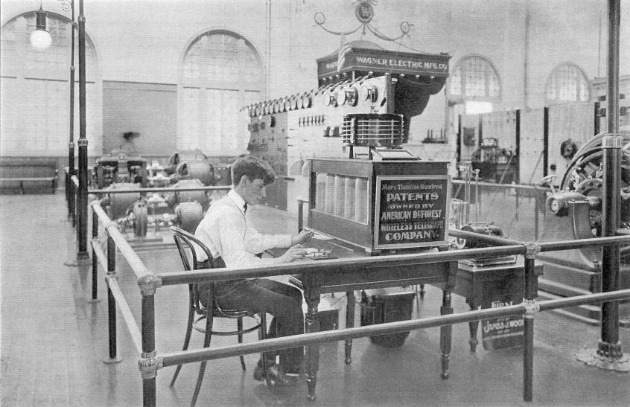
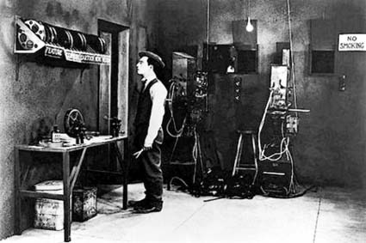
HOT
COLD
Mechanical Age
Electrical Age

Slide 9
HOT vs COLD
Loud, bright, vivid, fixed, intoxicating
Film
Photography
Radio / Hi-fidelity
Printed work / Alphabet
Phonetic alphabet / Typography
Mechanical Age
Whispy sketches of sound
Soft, shadowy, blurred, changeable
Television
Cartoon
Phone / Cell Phone
Speech / Oral communication
Hieroglyphics
Electrical Age

Slide 10
All media exist to invest our lives with artificial perceptions and arbitrary values. McLuhan Art is anything you can get away with McLuhan I wouldn’t have seen it if I didn’t believe it McLuhan
…THE END…

