Slide 1
The medium is the message
Marshall Mcluhan

Slide 2
Medium

Slide 3
Message
Content
Images
TEXT

Slide 4
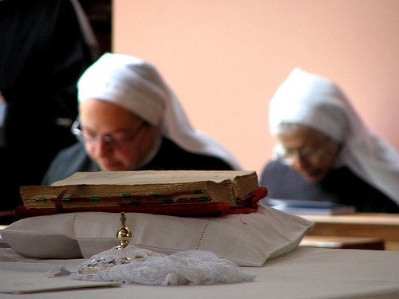
Different Medias Have Different Levels of Belief

Slide 5
Certain medias are easier to absorb than others

Slide 6
Content is irrelevant
Less Physical, more visual

Slide 7
Media changes our perception.

Slide 9
Media is the extension of people

Slide 10
The medium is the message

