Slide 1
The Soft Edge
Michael Bartz

Slide 2
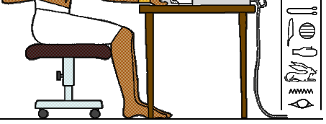
The Information Revolution

Slide 3
The Beginning of the Alphabet
Preserving the spoken word

Slide 4
Phoenician Alphabet
The alphabet that revolutionized ancient communication

Slide 5
Greek Alphabet
Greece adopted the alphabet for its own purposes

Slide 6
Ancient Roman Alphabet
Rome continued using the alphabet insuring a monopoly of knowledge

Slide 7
Anglo-Saxon Futhorc
The written word started to evolve

Slide 8
Old English alphabet
The alphabet continues its evolution

Slide 9
Modern Latin Alphabet
The alphabet as we currently know it
Uppercase
A B C D E F G H I J K L M N O P Q R S T U V W X Y Z
Lowercase
a b c d e f g h i j k l m n o p q r s t u v w x y z

Slide 10
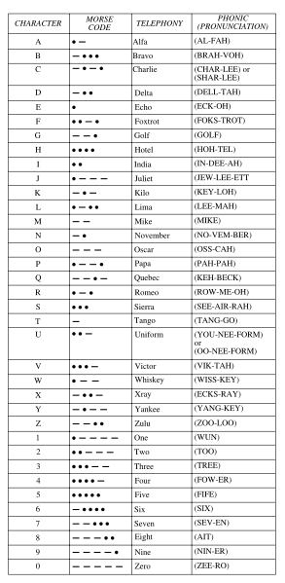
Phonetic Alphabet
The spoken word continues to change the alphabet

