Slide 1
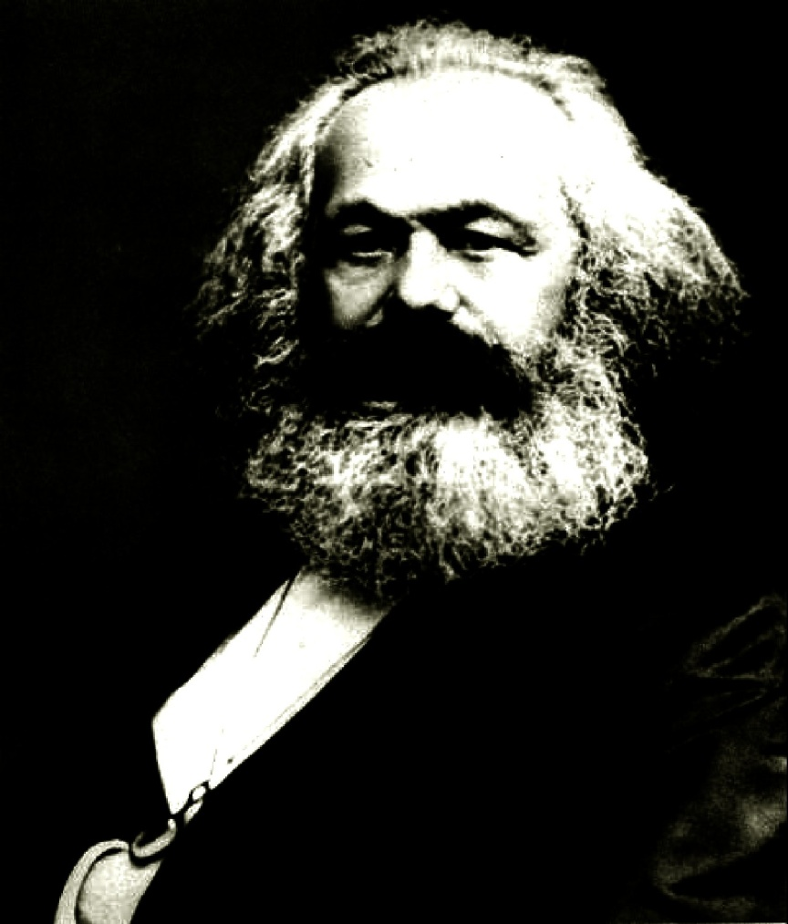
THE ARTS
IN MARXISM

Slide 2
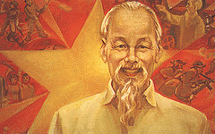
SOCIALIST REALISM
What started as censorship soon became a breakthrough for educational artistic styles.
In the first, depicted socialist society always as the positive connotation, leaders such as Stalin took advantage of such art forms to keep the populace in the dark of any negative aspects in Socialism.
1980’s brought on the more Marxian goal for Socialist Realism, the importance of portraying how social activity shapes human development. The goal as reaffirmed by Maxim Gorky, a primary figure in the Socialist Realism style, was to keep optimistic about life.

Slide 3
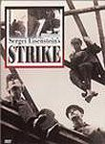
MARXIST FILM
The use of film became the best form of displaying Marxist ideas, film director Sergei Einstein became the pioneer for abandoning Hollywood type narrative film making and gearing each emotional frame toward clashing conflict in imagery and emotion.
Film makers influenced by the Marxist cause began to revolutionarily challenge how film could both teach and express. Movies such as “In girum imus nocte et consumimur igni” (Wandering around in the night we are consumed by fire) went so far as to attack the nonchalant movie goers for attempting to escape their mediocre lifestyle.
Situationist film making was conjured up through the efforts of Marx’ directing followers, transitioning stereotypical movies such as a classic kung-fu into messages on capitalism & proletarians.

Slide 4
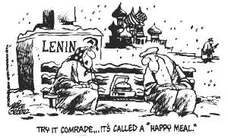
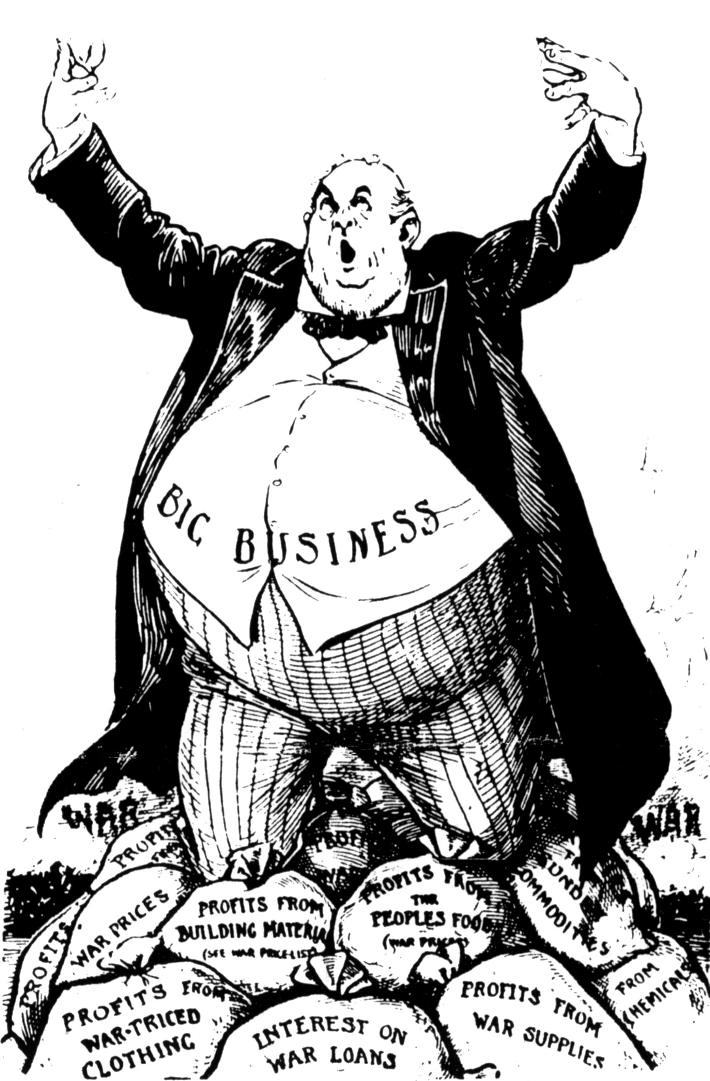
SATIRE
Using jokes and satire to sway opinion, leave officials and ideas in the negative humorous light was definitely a piece of the Marxist artistic influence, though perhaps more an adaptation of his ideas rather than his personal use.
Spanning from children’s education to women’s suffrage, satire could attack serious matters indirectly, though during the soviet reign this became a dangerous dance for artists.

Slide 5
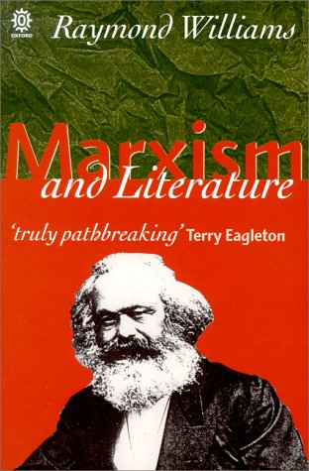
LITERARY CRITICISM
Literature, at this point in history, was for Marxists the most influential form of art producible. They could create whole atmospheres with which to captivate their reading audience simply through powerful verbiage.
Social conditions, for both Marx and Engel, were directly linked with political and economic situation. Just as Marx examines contradictions within society, so too Marxist critics make correlations between literary pieces, finding and exploiting the weak positions to make an encompassing point.
Though this uses another method of analyzing, the end product of literary criticism remains to expose some truth on the inner change and development of society.

Slide 6
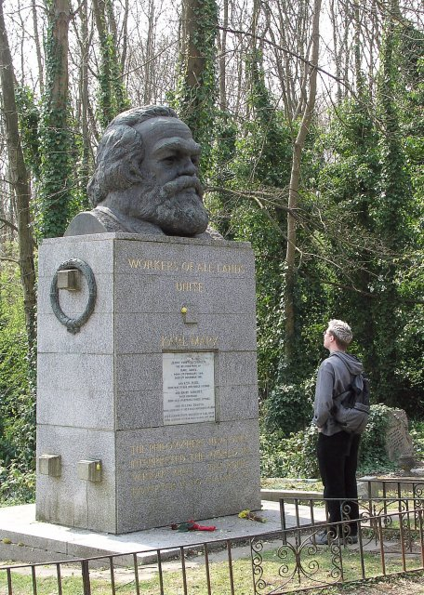
Don’t think Marx the man, nor the bad taste you most likely have already been taught.
Think Marxism, if only to recreate the sort of revolutionary thought he started to define.

