Slide 1
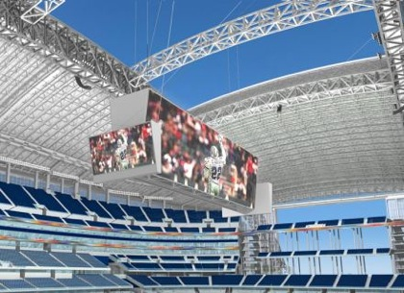
Hamlet on the Holodeck
Janet Murray's writing on “The Future of
Narrative in Cyberspace” and its relation to current and future media trends.
By: Kenneth Markwardt
Fall 2009

Slide 2
Overview
Janet Murray presents an array of examples and explanations regarding media and its implications on the world
She presents both the positive and negatives of this technologically diverse theatre that we are living in
Her ideas are neither cynical nor exuberant, rather taking an objective look at what we have learned from the past and what we might expect from the future

Slide 3

Star Trek Examples
Murray presents an example from Star Trek where Captain Janeway and other shipmates are able to explore a virtual alternate universe. This universe is very detailed and expansive, allowing her to explore an alternate life in another time period.
This form of entertainment is initially unquestioned and seen as a form of release for its users.
However, complications arise and it is realized that perhaps this form of entertainment might not be all that innocent...

Slide 4
Star Trek cont.
Janeway begins to notice the negative effects of this form of entertainment.
  She becomes so entranced with the virtual world, she seems to be falling in love with the protagonist in her story, though she has a relationship back home
    This raises issues of morality and whether it is considered cheating when using forms of media to sustain “relationships”
    Her involvement in the story becomes such that she and the rest of the crew get distracted from reality
    She must confront this reality when an enemy is able to control their stories and holograms and essentially take over the lives of the crew

Slide 5
Star Trek cont.
The virtual world in Star Trek becomes as “dangerous and debilitating as a hallucinogenic drug”.
  The crew allows itself to get taken over by its media
  They are so infatuated with their stories and their reality, that they can no longer decide what is real and what is not.
  The crew gets hooked on their media and must make conscious decisions to stop using it or be destroyed.

Slide 6

Brave New World Examples
Murray presents the story of Aldous Huxley's “Brave New World”
The world has become a place where happiness and experiences are essentially controlled by science.
  The chemicals and stimulations required for reactions to receptors in the brain have been figured out and synthesized, making for the same joy to be felt by taking a drug as actually living life.

Slide 7
Brave New World Continued
The protagonist, who is newly introduced to the future world, and is therefore not accustomed to such synthetic joy, is dismayed when he would rather go home and read a book than get a drug induced pleasure.

Slide 8
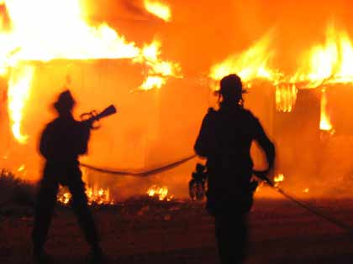
Fahrenheit 451
In Ray Bradbury's novel “Fahrenheit 451”, a similar story is heard.
People are no longer allowed to read books, and instead, get their entertainment by ever-evolving visual media that is controlled by the government.
The citizens are essentially hypnotized by their exquisite television experiences and do not want to deal with reality.

Slide 9
Fahrenheit 451 cont.
The results of the hypnotism of the public is that no one wants to discuss the oncoming war and the results of that war.
  There is a sentiment of “someone else's husband always dies”
The public would rather live with their virtual families and lives than discuss their real ones.

Slide 10

The Good...
However, despite all of the bad that Murray discusse initially, she does on to point out that we do still have the ultimate control.
  We can always turn off our media, it just requires some will power, and in all of the examples mentioned, there is a hero who realizes the hypnotizing effect that media can have on its audience.
  The media in question always has some good, its just when it goes too far that we get in trouble.

Slide 11
The Good cont...
Star Trek
  The holodeck did provide for excellent stress relief. To operate as a successful officer, one must be able to exercise the mind outside of work.
  The holodeck allowed for Janeway to have a serious mental discussion regarding her morality and thoughts of home.
  It was only until the crew lost their willpower to say “No” to the media that they got in trouble.

Slide 12
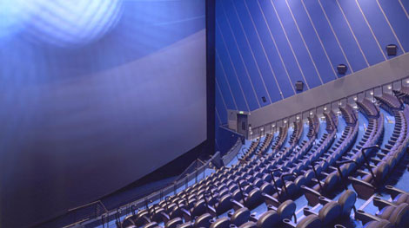
Media's Positive Impact
Murray presents more positive ideas on media in her second chapter, “Harbingers on the Holodeck”.
She mentions that “we rely on works of fiction, in any medium, to help us understand the world and what it means to be human.”
  Technologies will continue to develop, but traditional storytelling has really not changed too drastically.
  People will fear change and new technologies forever.
  It is likely that the same arguments that are being raised by these authors about technology would have been raised in the past about books.

Slide 13
Media's Positive Impact Cont.
Computers have become faster, cheaper and more powerful
  All of the stories and fables of morality from the past can now be condensed into one computer.
The advent of technology and media only allows for more advanced stories and complicated story lines.
  These stories allow us to even further comprehend and discuss what it means to be human.

Slide 14
Elevated Consciousness
Through such movies as Rashomon and A Christmas Story, we are allowed to further contemplate situations that we might not have been able to explain through a book or tale.
  It is now possible to realize and tell stories about what things might be like in alternate worlds.
    That doesn't mean we have to become infatuated with them and lose a grip on reality.

Slide 15
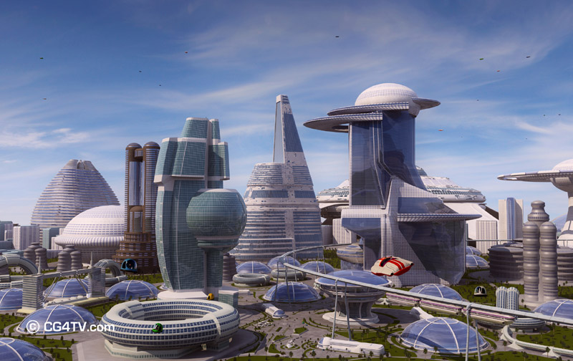
Conclusions and Opinion
Yes, as Murray points out, media can be as “dangerous and debilitating as a hallucinogenic drug”.
But, frankly, so can almost everything else.
People develop unhealthy relationships with things every single day.
  So as with anything else, we should realize its potential, both good and bad.
We should prepare for the bad, but also be excited for the good, not scared.

