Slide 1
Walter Benjamin 1892-1940
“The Work of Art in the Age of Mechanical Reproduction”

Slide 2
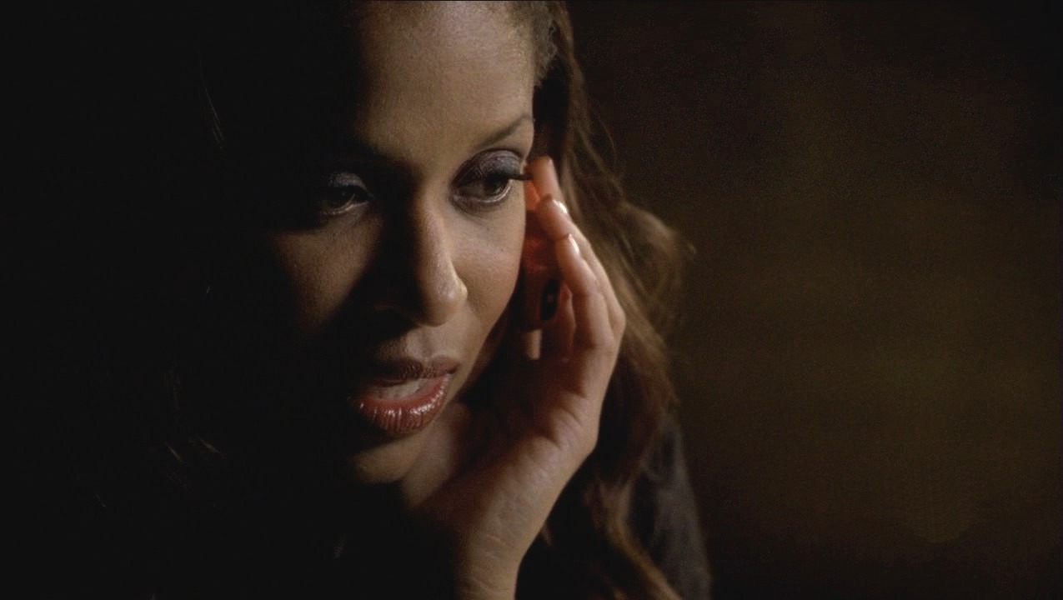
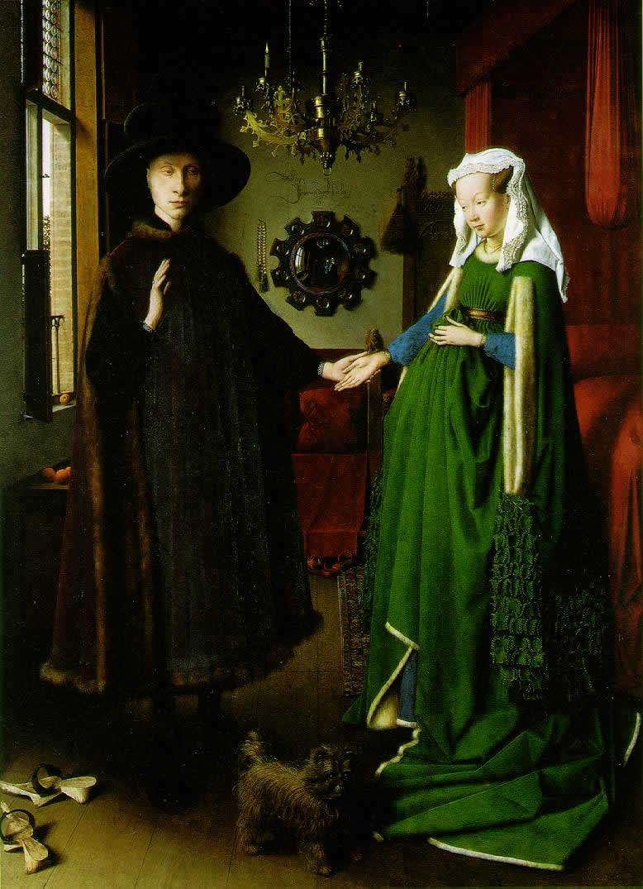
SPOKE OF THE AURA OF MEDIA
That
feeling of
awe and
reverence felt
in presence
of great
artwork.

Slide 3
THIS “AURA” HAS BEEN SHATTERED WITH MASS CONSUMPTION OF COPIES OF ORIGINAL ART.

Slide 4
Its
restricted
exhibition.
Its
publicized
authenticity.
Its cultural
value.
Who made the
Artwork.
This aura inheres not in the artwork itself, but in its external attributes.

Slide 6
Art’s mechanical
reproducibility.
Brought forms of
art, such as film,
that
had no original.
Audience could
choose
when and how
to view
artwork.
Aura
Art
freed
from
place and
ritual.

Slide 7
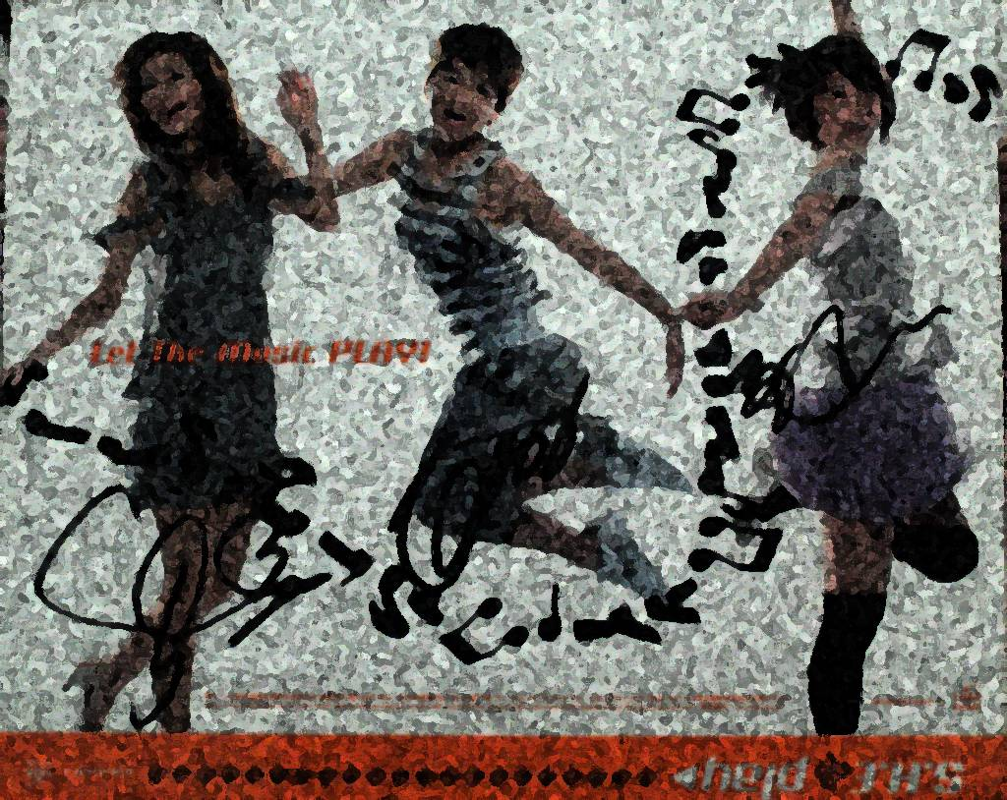
Camera Could hold aspects of original vision, not recordable by the naked eye, but recordable to the lens.
How much can you remember from seeing something for just a moment?
Moment captured

Slide 8
“Mechanical Reproduction of art changed the reaction of the masses towards art.”
Walter Benjamin.
Picasso Painting
vs.
Chaplin Movie
Conventional is uncritically enjoyed.
Truly new is criticized with aversion.

Slide 9
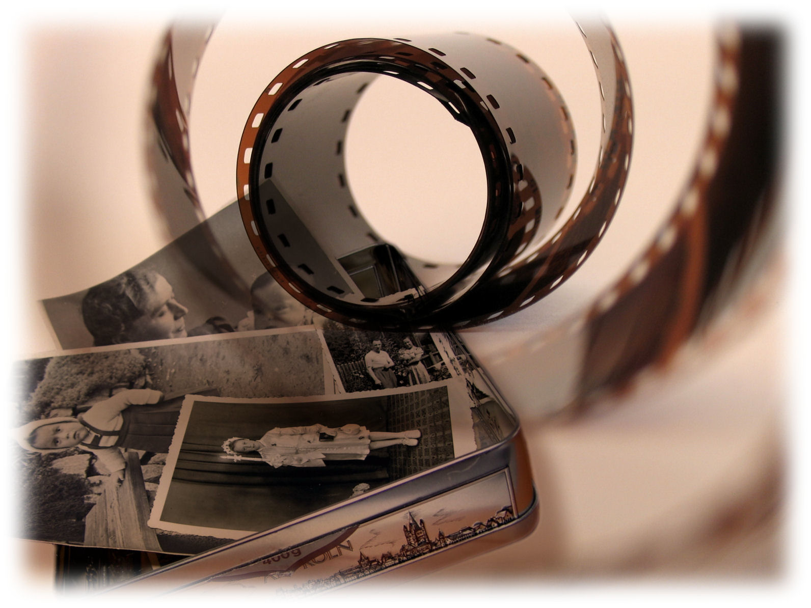
An “authentic” work of art has its basis in ritual.
A photographic negative produces infinite # of print.
“Authentic” print makes no sense anymore.

Slide 10
When criterion of “authenticity” ceases to exist with artistic reproduction… Function of art is undone.

