Slide 1
“The Medium is The Message”
Presented By:
Jason Donaldson

Slide 2
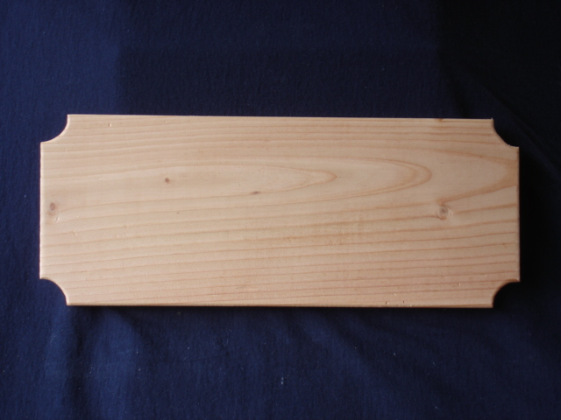
Medium
The Medium is the material through which information is transferred.

Slide 3
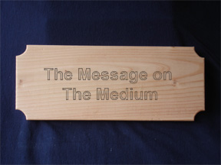
Message
The Message is the information conveyed through the medium.

Slide 4
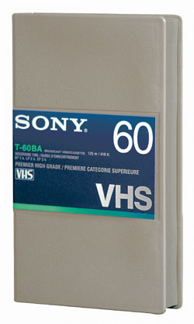
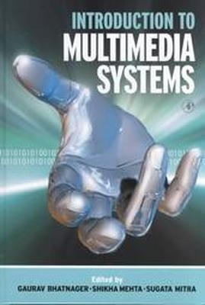
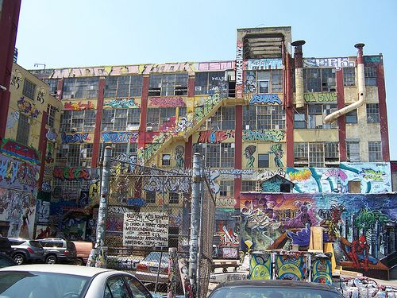
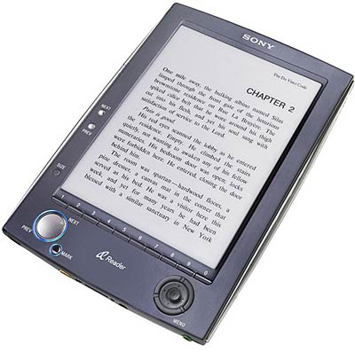
Media & Messages
The Medium that a Message is on affects how it’s interpreted.
Do you prefer to watch an educational video or read a textbook that contains the exact same material?
Which medium of communication yields a greater understanding of the information to you?
If the material for this course was painted on the side of a building rather than typed out in a reader, would you do better or worse on the quizzes? Would you even bother to do the reading?

Slide 5
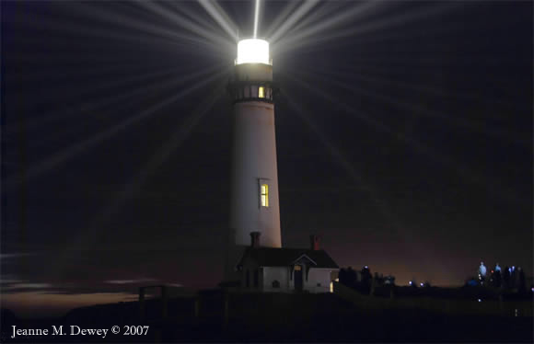
The Electric Light
The Electric Light is considered to be “pure information.” It’s a medium, but alone it has no message. The light on the right demonstrates that the message of a medium is another medium.
If, however, this single light is the light on the top of a lighthouse, then it has a message: “shallow water, all ships stay away.”

Slide 6
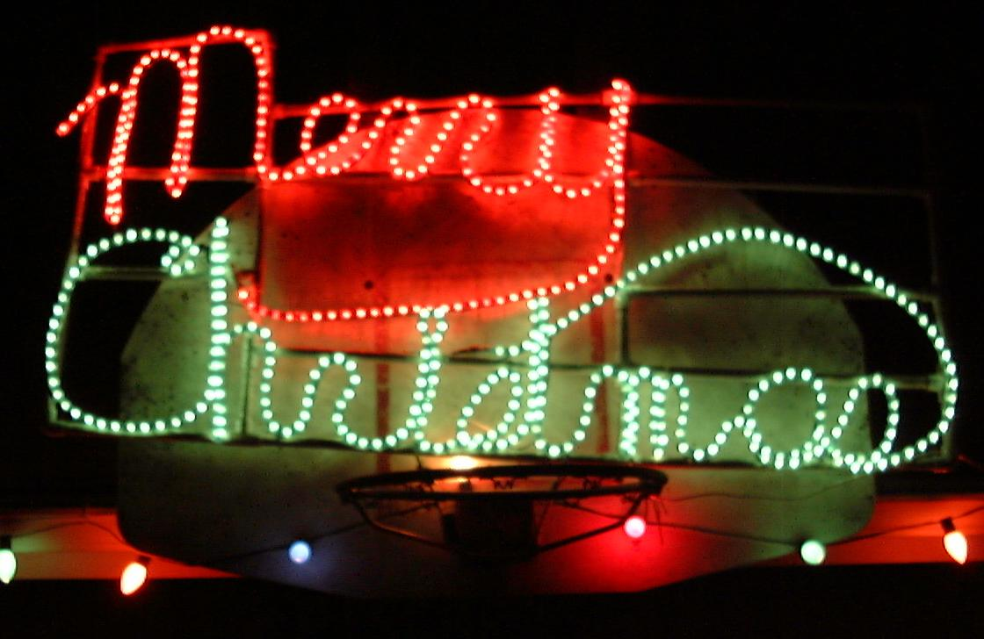
The Electric Light as a Message
Many lights together, or lights of different colors, can create messages. Sometimes it’s a company’s name, a picture of some sort, or a culturally accepted symbol.

Slide 7
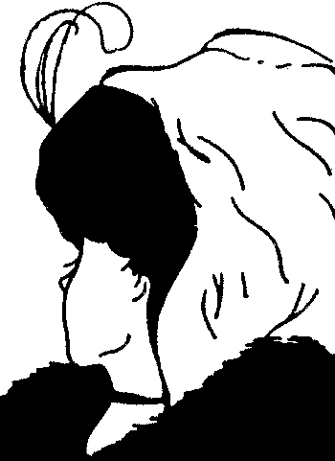
How We See Things
How we see things affects how we perceive them and what we interpret their message(s) to be.
Is the Left picture of a cliff or horse?
Is the Right picture of a young women or an old women? Or maybe both?

Slide 8
What We See
If we find a dead body with writing on the person’s chest that reads: “Call Joe Johnson 682-121-3954.” Joe Johnson will be called, whether by us or the police. However, if we instead find a piece of tattered paper on the ground that reads the same, Joe Johnson will most likely not be called.
So as you can see, the Medium is the Message.

Slide 9
Where We See Things
If you found this piece of paper in an airport you would likely fear that it may be related to a hijacking and immediately give it to the nearest airport security officer. However, if you found it next to a trashcan in town, you’d probably think nothing of it.
Additionally, if you knew how to read Arabic you’d know that this is nothing more than a religious abstract. It supposedly reads: “In the beginning God created heaven and earth. The earth was formless and empty, and darkness covered the deep water. The spirit of God was hovering over the water. Then God said, "Let there be light!" So there was light. God saw the light was good. So God separated the light from the darkness. God named the light "day", and the darkness he named "night". There was evening, then morning, the first day. Then God said, "Let there be a horizon in the middle of the water in order to separate the water". So God made the horizon and separated the water above and below the horizon. And so it was. God named what was above the horizon "sky". There was evening, then morning, a second day.”

Slide 10
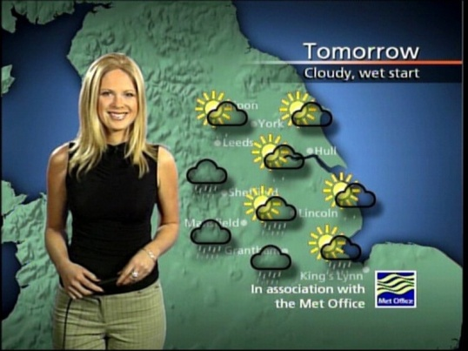
The Low Down
The Medium affects how we interpret its Message, and so the Message intern becomes the Medium.
An opinion labeled as a “fact” on a fancy piece of paper will be believed by more people than the same fact on coffee-stained paper would be.
If a news reporter on a credible TV network says it’s going to snow in Goleta, she’ll most likely be believed. However, if a news reporter on a Public Access Channel says it’s going to snow in Goleta, she’ll likely be laughed at.

