Slide 1
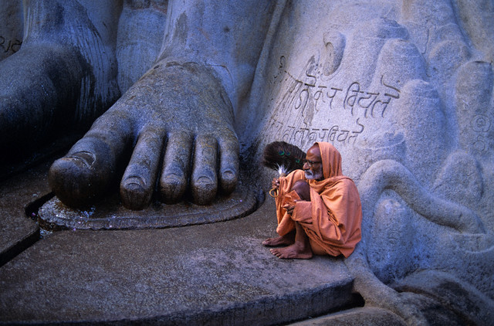
The Loss of Acoustic Space…
A quick look at the effects the alphabet has on the way we gather information. Conveyed through the ideas of Paul Levingson & Marshal McLuhan

Slide 2
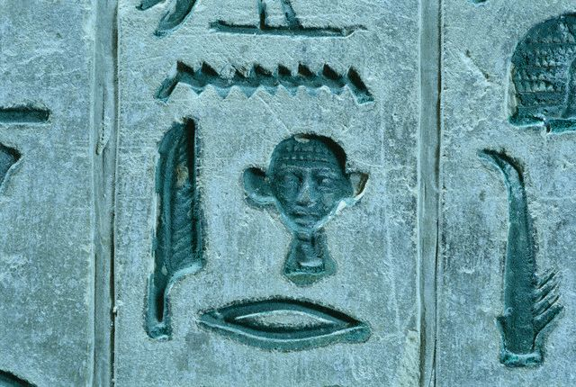
Before the Alphabet
Hieroglyphs were the only medium for preserving the spoken word.
They depicted the meaning of a word in images rather than sound.

Slide 3
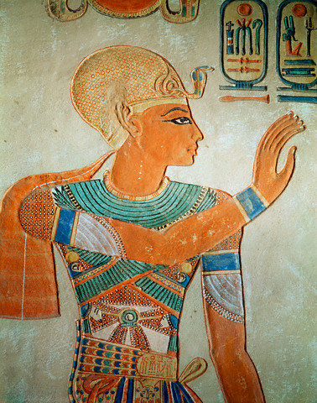
A Revelation
Amenhotep IV created essentially the first monothesic diety (one God) worshiping the sun...
The pharaoh chose to use hieroglyphs to convey his message…

Slide 4
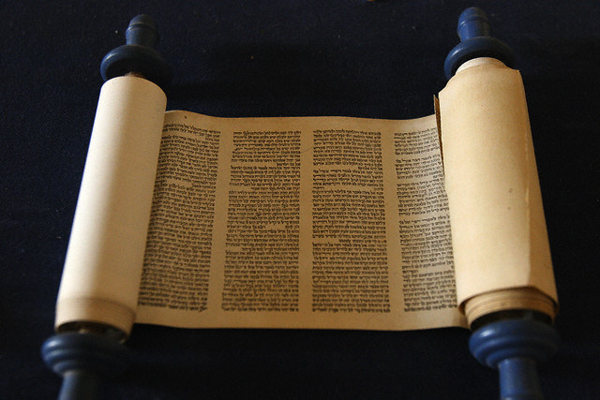
The End of the Beginning
Needless to say, Amenhoteps attempt at a monotheistic deity died with him.
But his fundamental ideas were adopted by the Hebrews, and conveyed in a completely different way…

Slide 5
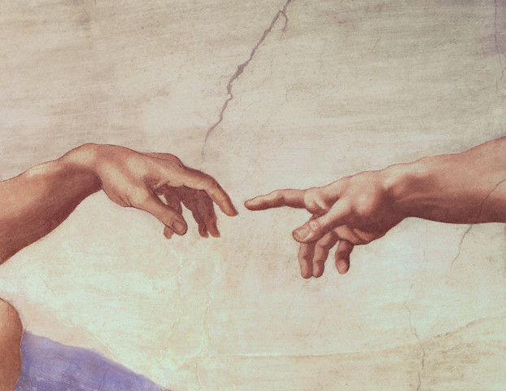
The Age of Linear Thought
The Hebrews created an alphabet that used sounds to apply meaning to objects and ideas.
This was a better form for expressing the idea of God because it’s hard to give meaning to something that isn’t tangible…

Slide 6
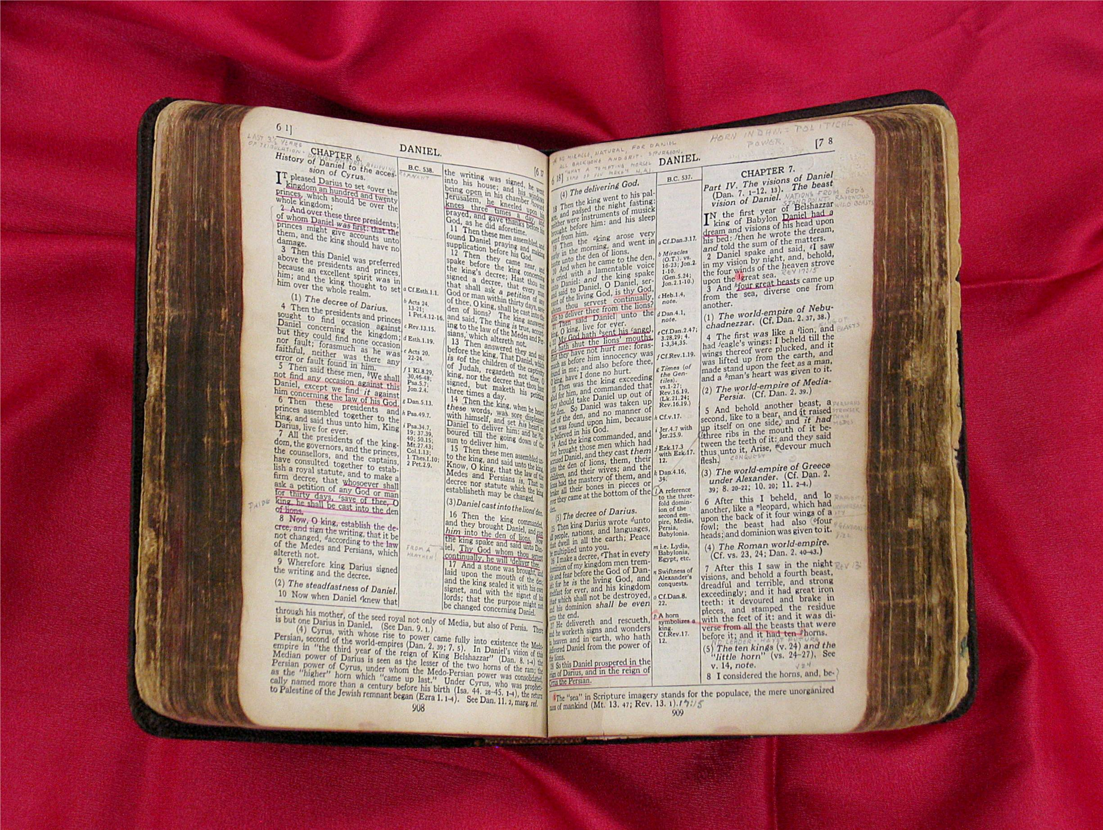
We get lost in the picas and points of text, and look only to it for answers…

Slide 7
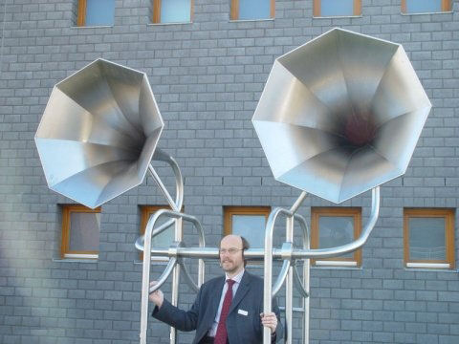
But we loose something else in the process….

Slide 8
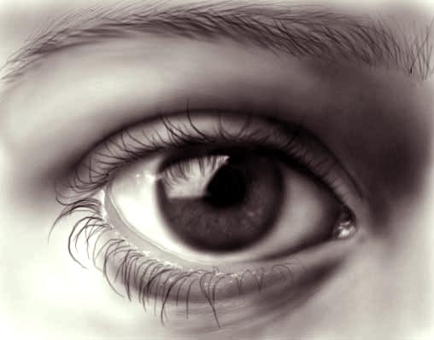
We Loose Acoustic Space
According to Marshal McLuhan, we loose Acoustic Space by learning through a linear medium such as the alphabet, which relies heavily on sight…

Slide 9
We rely on Vision to learn since most media uses the written word to convey a message. Smell and touch aren’t a major part of the learning process anymore.

Slide 10
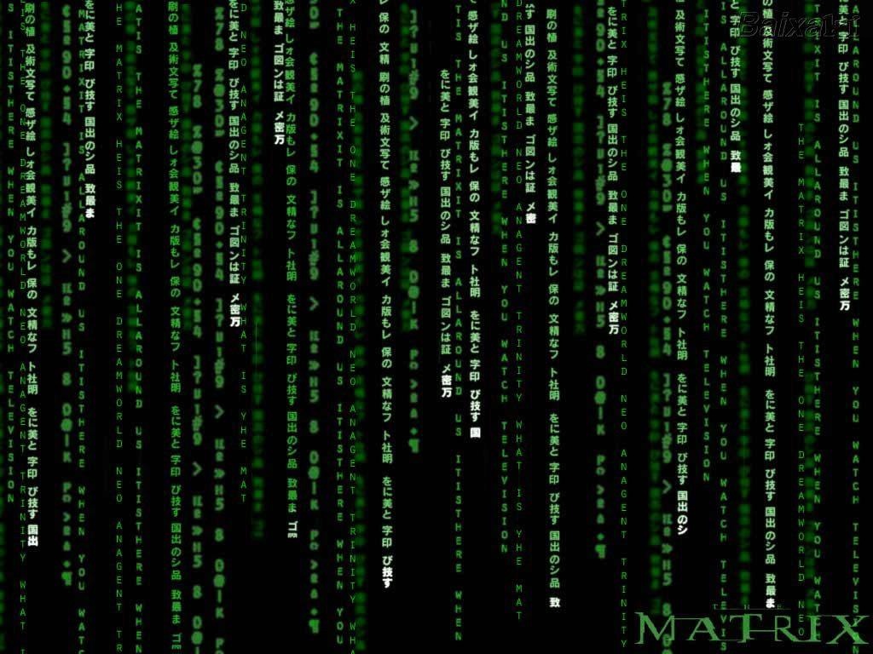
This is about to change….
The Internet is a new level of acoustic space and perhaps a gateway to a more efficient, right brain way of thinking…

Slide 14
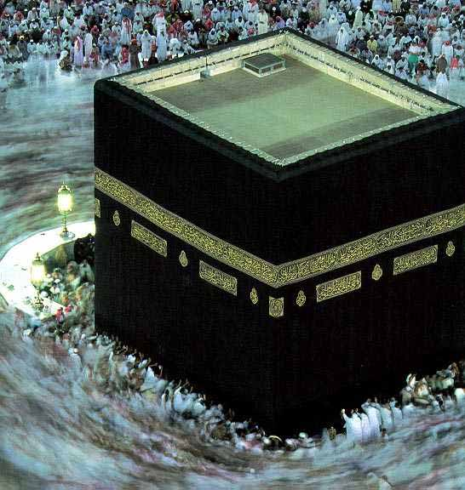
Religion takes over the world after the written word is introduced…

