Slide 1
Final Project: Gaming/Janet Murray
Ryan deRegt
Intro to Multimedia

Slide 2
Janet Murray
Digital Media Professor at MIT, Massachusetts Institute of Technology.
Wrote the book, the Holodeck: The Future of Narrative in Cyberspace.

Slide 3
Janet Murray
The main point in the Holodeck: The Future of Narrative in Cyberspace, is that video games and computers are a new way to tell a story
Like books, comics and movies, Video games have a story line.
In a video game the player is active, can make decisions and control the development of the story.

Slide 4
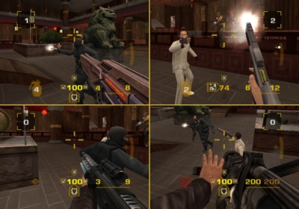
VideoGames: First Person Shooter
There’s usually a one player mode with missions and a storyline.
A multiplayer has up to 4 players on a PlayStation
or an Xbox. You can also play against other users if you play an online game.
First Person
Shooter:
You have to shoot the other players before you get shot.
Halo
Goldeneye

Slide 5
Role Playing Games
In Role playing games, like “World of Warcraft”, the object is to have your character solve Puzzles, find things and learn new skills.
There is some fighting but its not an important part of the game.

Slide 6
Stories in video games
Most games have stories in them like movies or books and even music.
There’s usually a hero and a villain.
The player is usually a hero but some games they can also choose to be the villain.
The player has to collect things.
Most games first shooter and Role Playing have power ups or extra. Example: If Mario gets a mushroom he gets taller.

Slide 7
Consoles
Video Game consoles:
Playstation 3, Xbox Wii
Handheld devices:
Gameboy
PSP

Slide 8
Consoles GAMES
Some consoles have exclusive rights to certain games: Only Nintendo can make Mario games.

Slide 9
Online games
There are many websites such as addicting games.com that have free computer games online.
Most of the games on these websites were created with Adobe Flash, so they show a world in 2D dimensions (2D games).

Slide 10
Online Games
Most of the new video game consoles like PS3 and Xbox 360 you can play games online if you want to play a game against someone else.

Slide 11
THE WII REMOTE
The Nintendo Wii has remote controls with motion
sensors which makes the interactivity feel more realistic.
“if you’re playing a baseball you actually swing at the ball”.
The user has to have more participation in this type of games.

Slide 12
My thoughts on games
Most games have stories in them, except sports or puzzle games.
I think that stories in the game draw people to continue playing because you would not leave a movie before the end…
Game stories might have stronger influence when they can have audio and 3D graphics.
Some games even have voiceovers from famous actors.

