Slide 1
Marshal McLuhan
The Global Village
By: Fredrik Klingberg
“The global village is the idea that the world and its people form
an interconnected social whole, a village of common interests
and concerns, linked by global communication, media, and
rapid international transportation.”

Slide 2
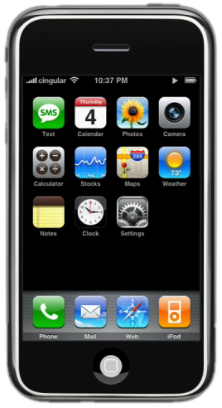
Global Village
McLuhan describes how the globe has been transformed into a village by electric technology.
Information/opinions/thoughts/culture/politics from almost every corner on the earth in your hands, for you to read and learn about.

Slide 3
The borders
The country borders becomes smaller, almost disappears
since we are more and easily connected to each other.

Slide 4
E-commerce
Internet working as an extension of our bodies
When e-commerce became global
it erased even bigger borders.

Slide 5
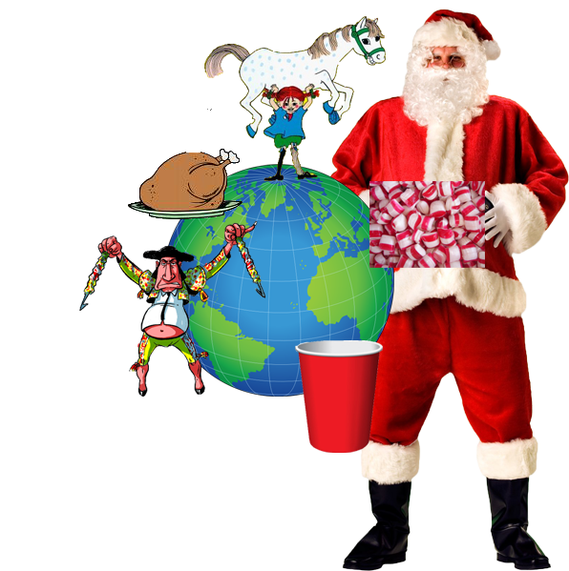
Changed culture
Just like country borders, culture borders
fell as well. Media spread knowledge of
other cultures even further, automatically
people picked up on them and
“converted” them to their own.

Slide 6
Online culture
“Online culture” is a common “culture” in which
people browsing the internet are exposed too
and learning the same things.

Slide 7
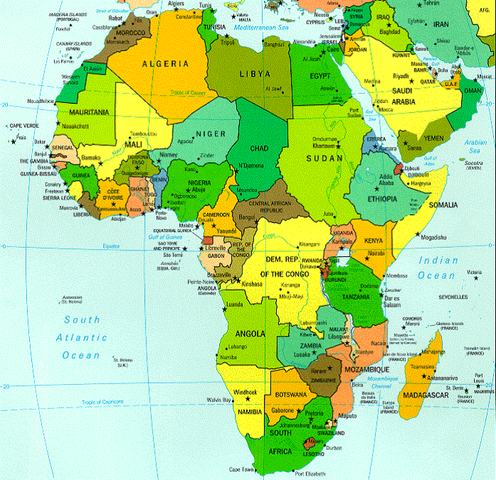
Nationalism
Several nations in Africa were created to oppose the colonization of their land by British and German imperialists. Since these people shared a common culture and did not want to lose it they grew hate against globalization of global culture and the overwhelming global culture
+ borders =

Slide 8
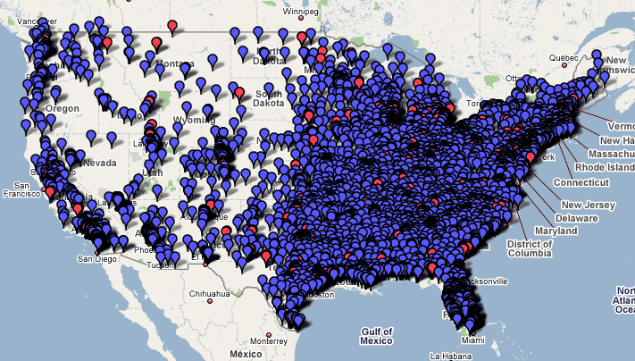
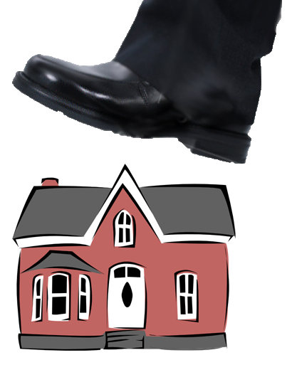
Nationalism
They were not alone being afraid of the global culture.
Smaller/Local companies could not keep up with the insane spread of marketing, and was pushed down.

Slide 9
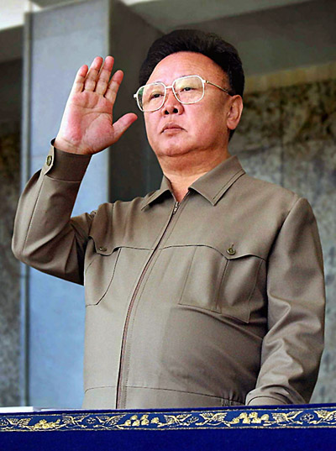
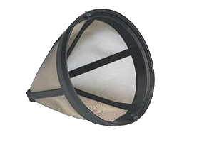
Criticism
But there are some things that interrupt the true information that is send.
For example the Chinese government tends to filter some of the information that is broadcasted in different mediums in the country.
FILTER
>
>

Slide 10
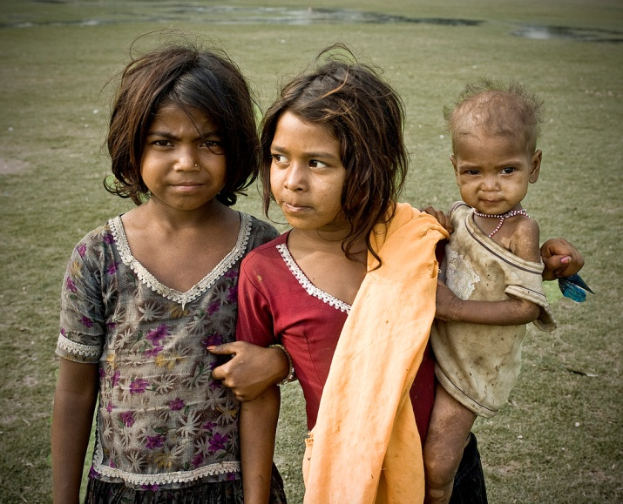
Another things is that not all are equally connected to the internet, most often because of economical disadvantages. These people are excluded from the global arena and are not participants in the global village

Slide 11
The End

