Slide 1
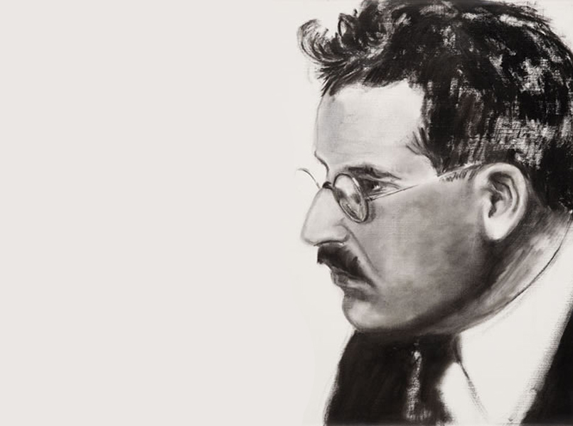
Walter Benjamin
By Forrest Rucker

Slide 2
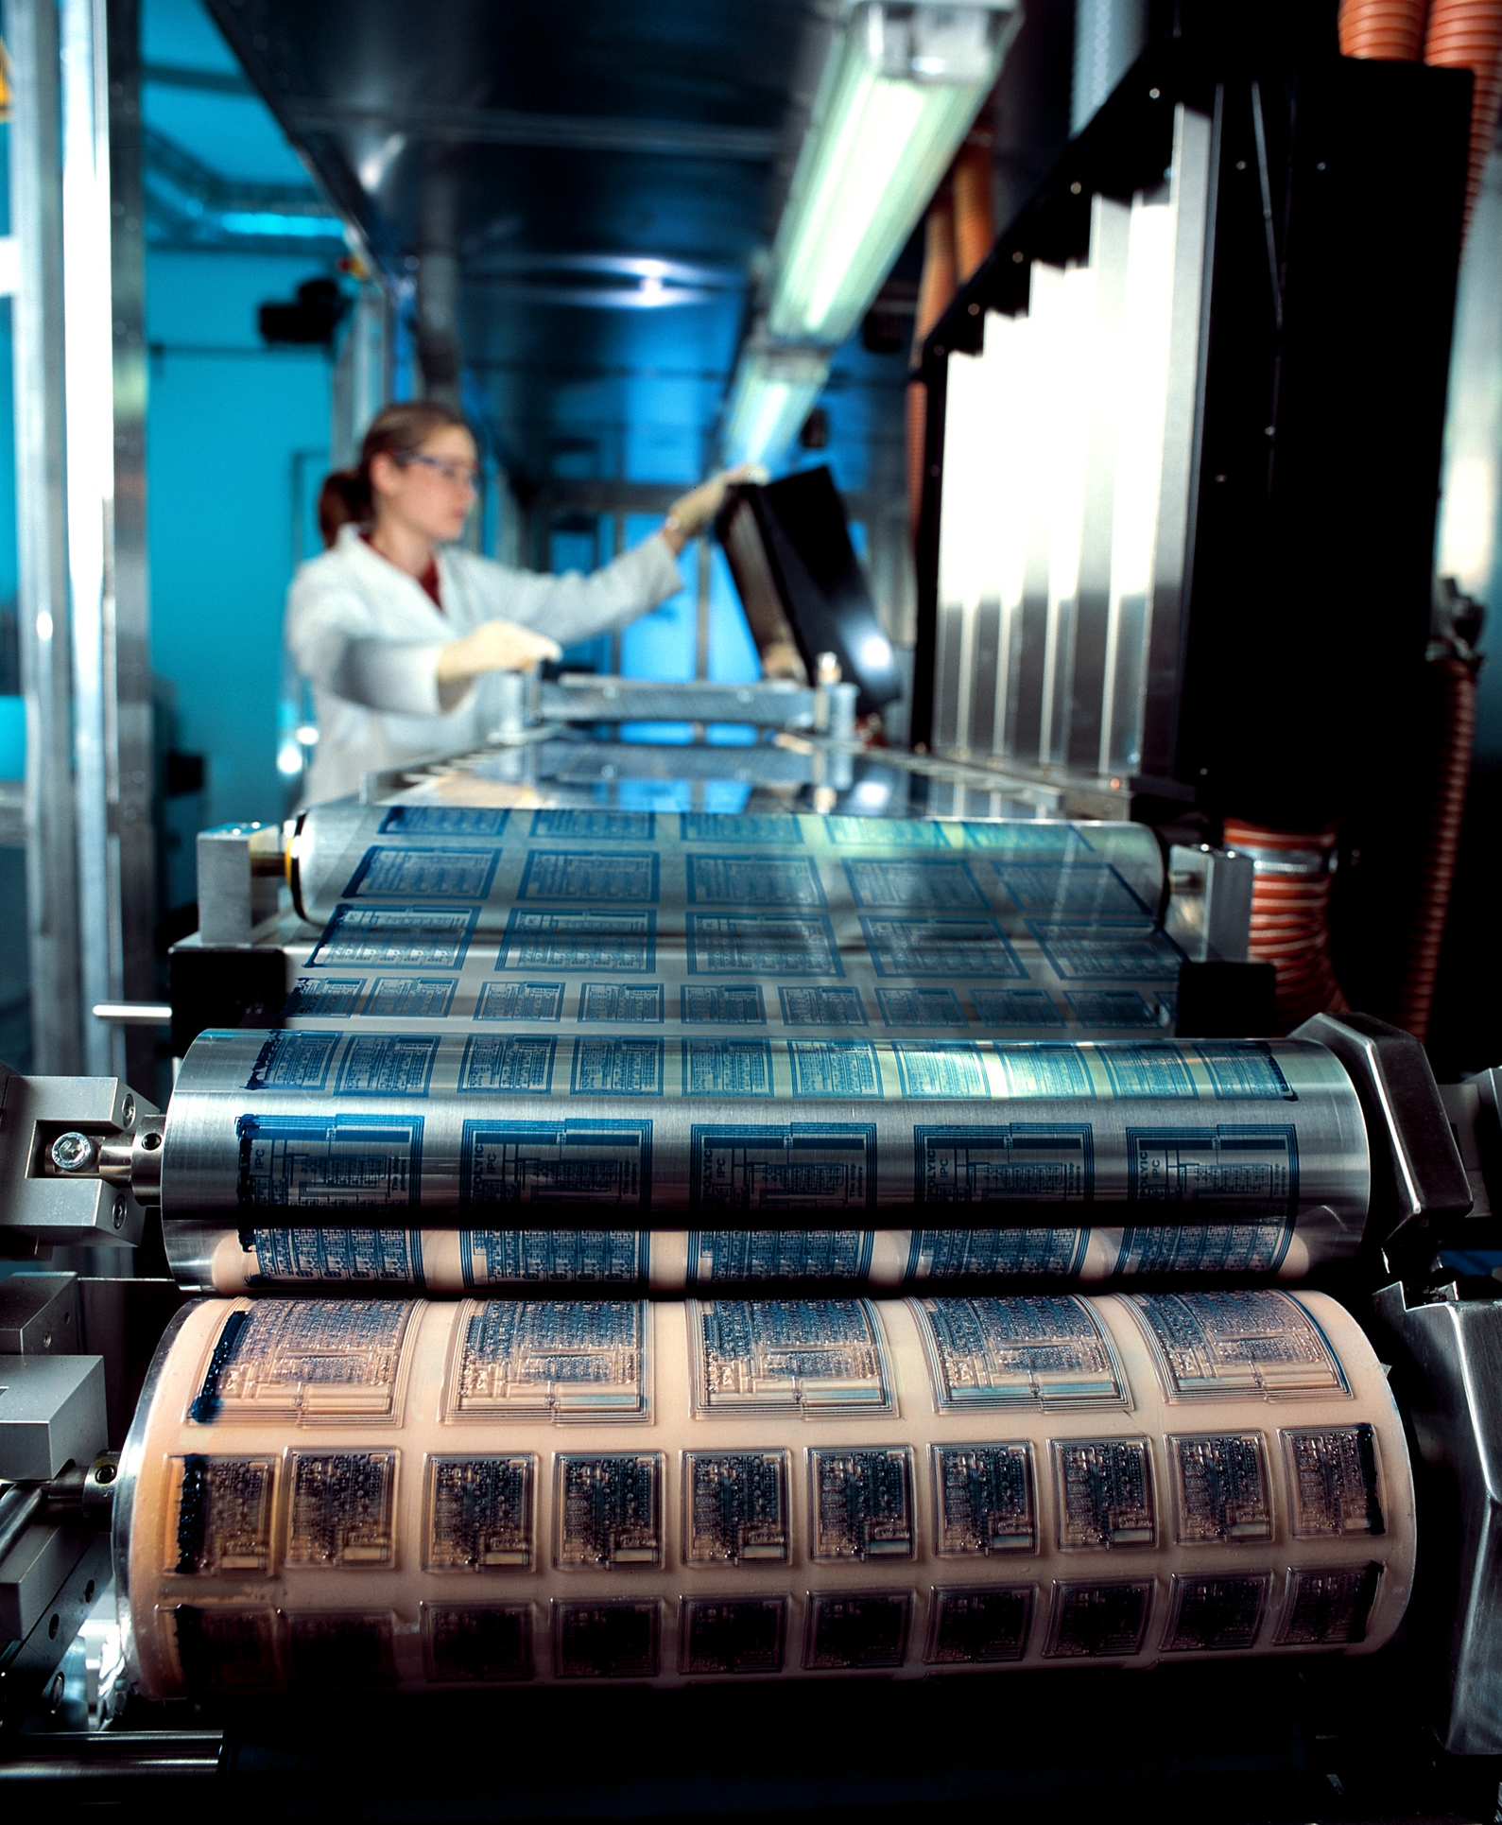
Traditional Art
Mechanical Reproduction
Time and space Ritual
Authenticity Individual experience
Idealistic Reactionary attitude
Meets beholder halfway Exhibition
Editions Simultaneous
Materialistic Progressive attitude

Slide 3
Traditional art is defined by Benjamin as having “aura”; “its presence in time and space, its unique existence at the place where it happens to be.”
Notes:
Traditional art resembles the qualities of being idealistic. The piece itself has a presence when it is a one-of-a-kind. Though the art may be reproducible by imitation, the original can only be considered perfect because of the quality of aura.

Slide 4
When something becomes reproducible, it loses its aura in exchange for accessibility.
Notes:
Mechanical reproduction breaks the tradition of art by allowing content to be seen in anyone’s own particular situation. This new mode of perceiving content is different enough to have a different effect on the viewer. Reproducibility therefore has potential to have profound effects on society.

Slide 5
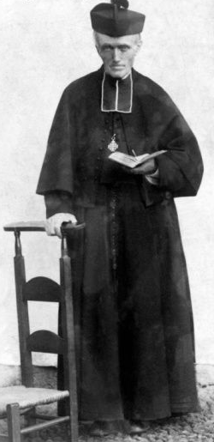
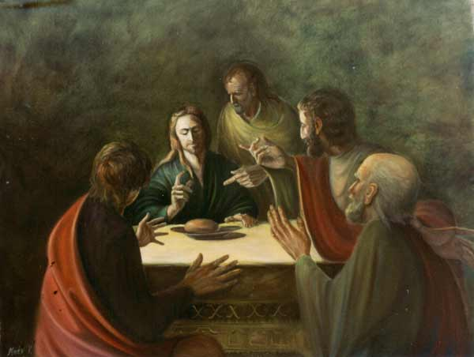
Early use of script is ritualistic.
Notes:
Walter Benjamin’s theses apply to what we’ve learned before in our readings. When books had less capacity for mass reproduction, the priority for reproduction was the bible. These less common books may be considered more sacred at this time because they were only directly accessible to priests.

Slide 6
Printed word had a time and a place.
Notes:
To learn about the text of the bible, people must attend readings at a church. The bibles have aura to a small extent due to the lack of mechanical reproduction to allow for asynchronous readings.

Slide 7
The printing press allows secular
and non-secular reading to the masses.
Notes:
With the printing press, books of virtually any content can be distributed to the masses, allowing for readings outside of the previous synchronous rituals.

Slide 8
The camera behaves like an external set of eyes that captures a reproducible viewpoint in time and space that breaks the aura.
Notes:
A photograph is like a small window space into a previous time in a different place. It recreates what we would see and allows us to see the image away from the source.

Slide 9
Film makes the impossible possible
Notes:
Through editing, films show many sequences of visuals and sounds that no longer present a linear progression of what is really captured in front of a camera. The film camera offers an experience that is not possible to see in real life.

Slide 10
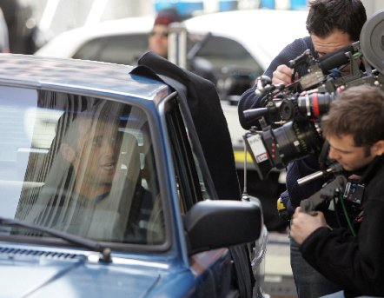
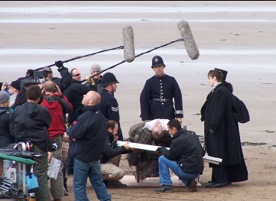
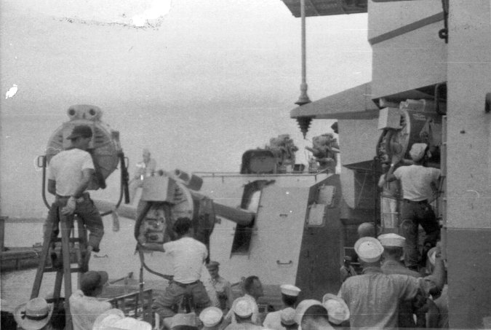
“The audience’s identification with the actor is really an identification with the camera.”
Notes:
The presence of a camera means the absence of an audience as the actor performs. The figure that an actor portrays diminishes in aura through both the camera and the lack of interacting with a public.

Slide 11
“The film responds to the shriveling of aura with an artificial build-up of the ‘personality’ outside the studio.”
Notes:
The perception of the actor is influenced more strongly outside of the studio due to the nature of film.

Slide 12
“It is inherent that in the technique of film… that everybody who witnesses its accomplishments is somewhat of an expert”
Notes:
Benjamin states that the distinction between author and reader is small since the reader can become the writer at any moment. It starts off with the daily press allowing a readers space for letters to the editor. In film too, the public may change from passer-by to movie extra.

Slide 13
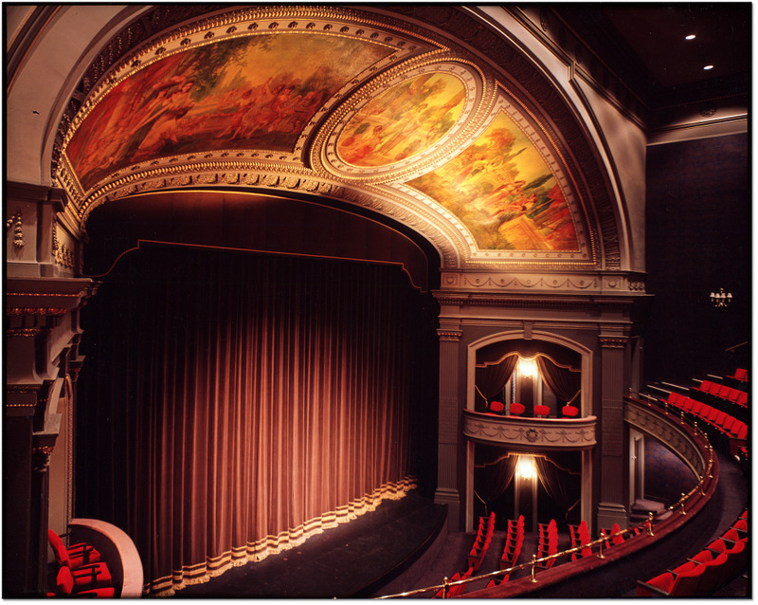
The End

