Slide 1
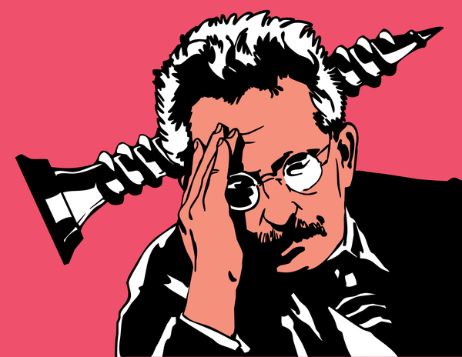
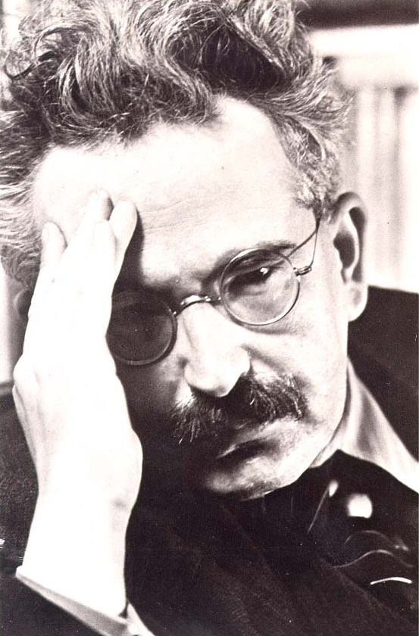
by EVELINAekstrand
WALTERbenjamin.

Slide 2
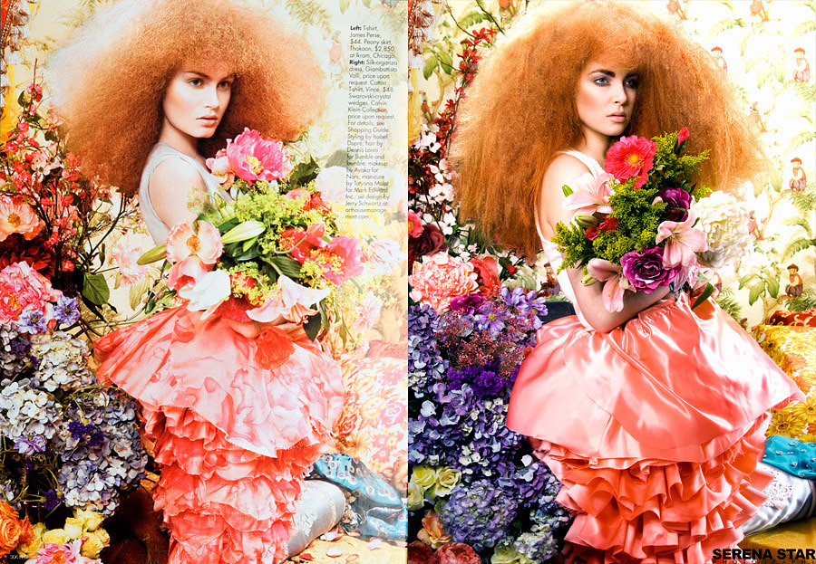
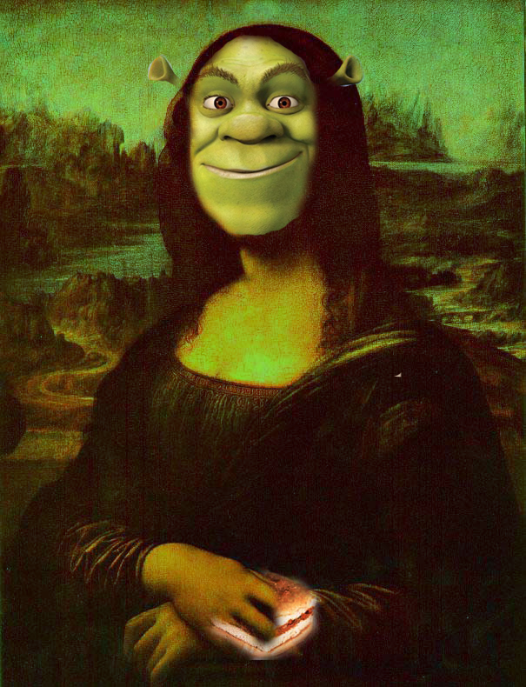
ARTisREPRODUCABLE.
MAN-MADE artifacts could always be imitated by men.

Slide 3
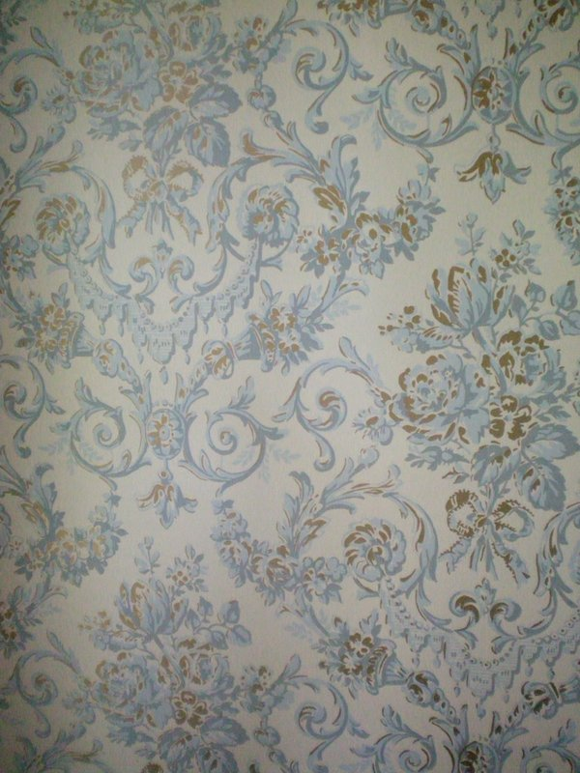
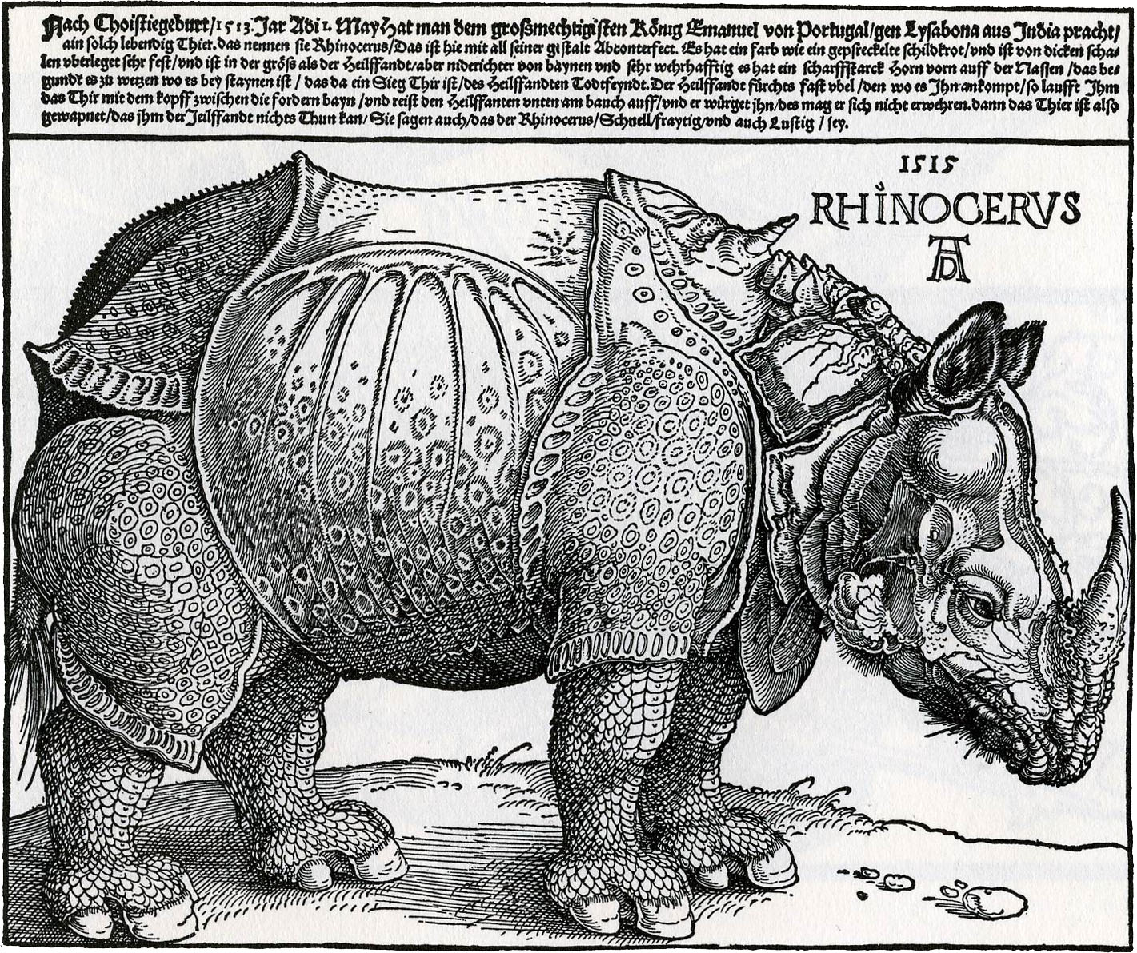
print is merely a special, though particularly important case. During the Middle Ages ENGRAVING and etching were added to the woodcut.

Slide 4
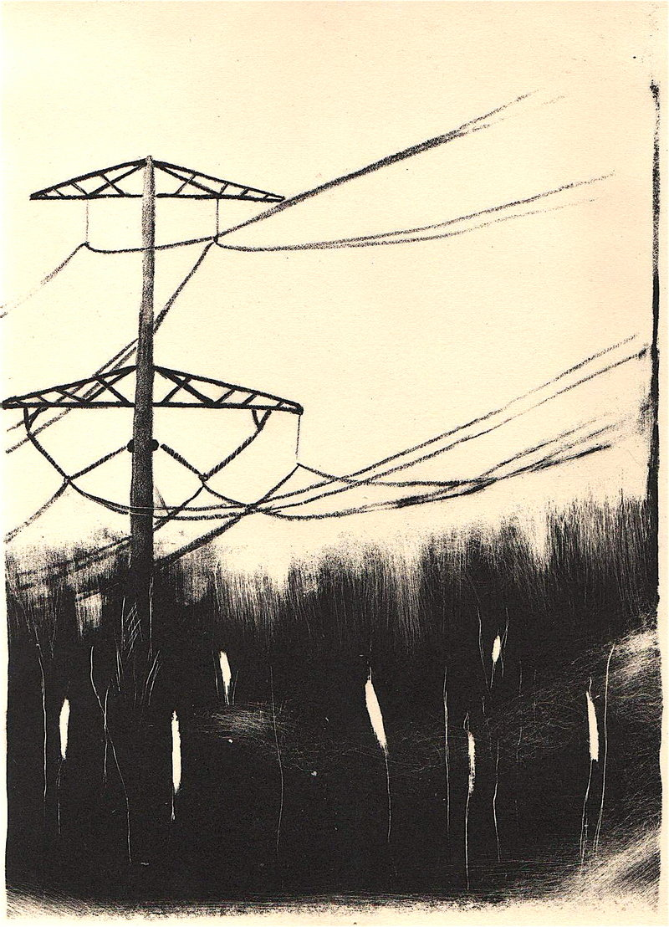
LITOGRAPHY enabled graphic to illustrate everyday life in newpapers before photography.

Slide 5
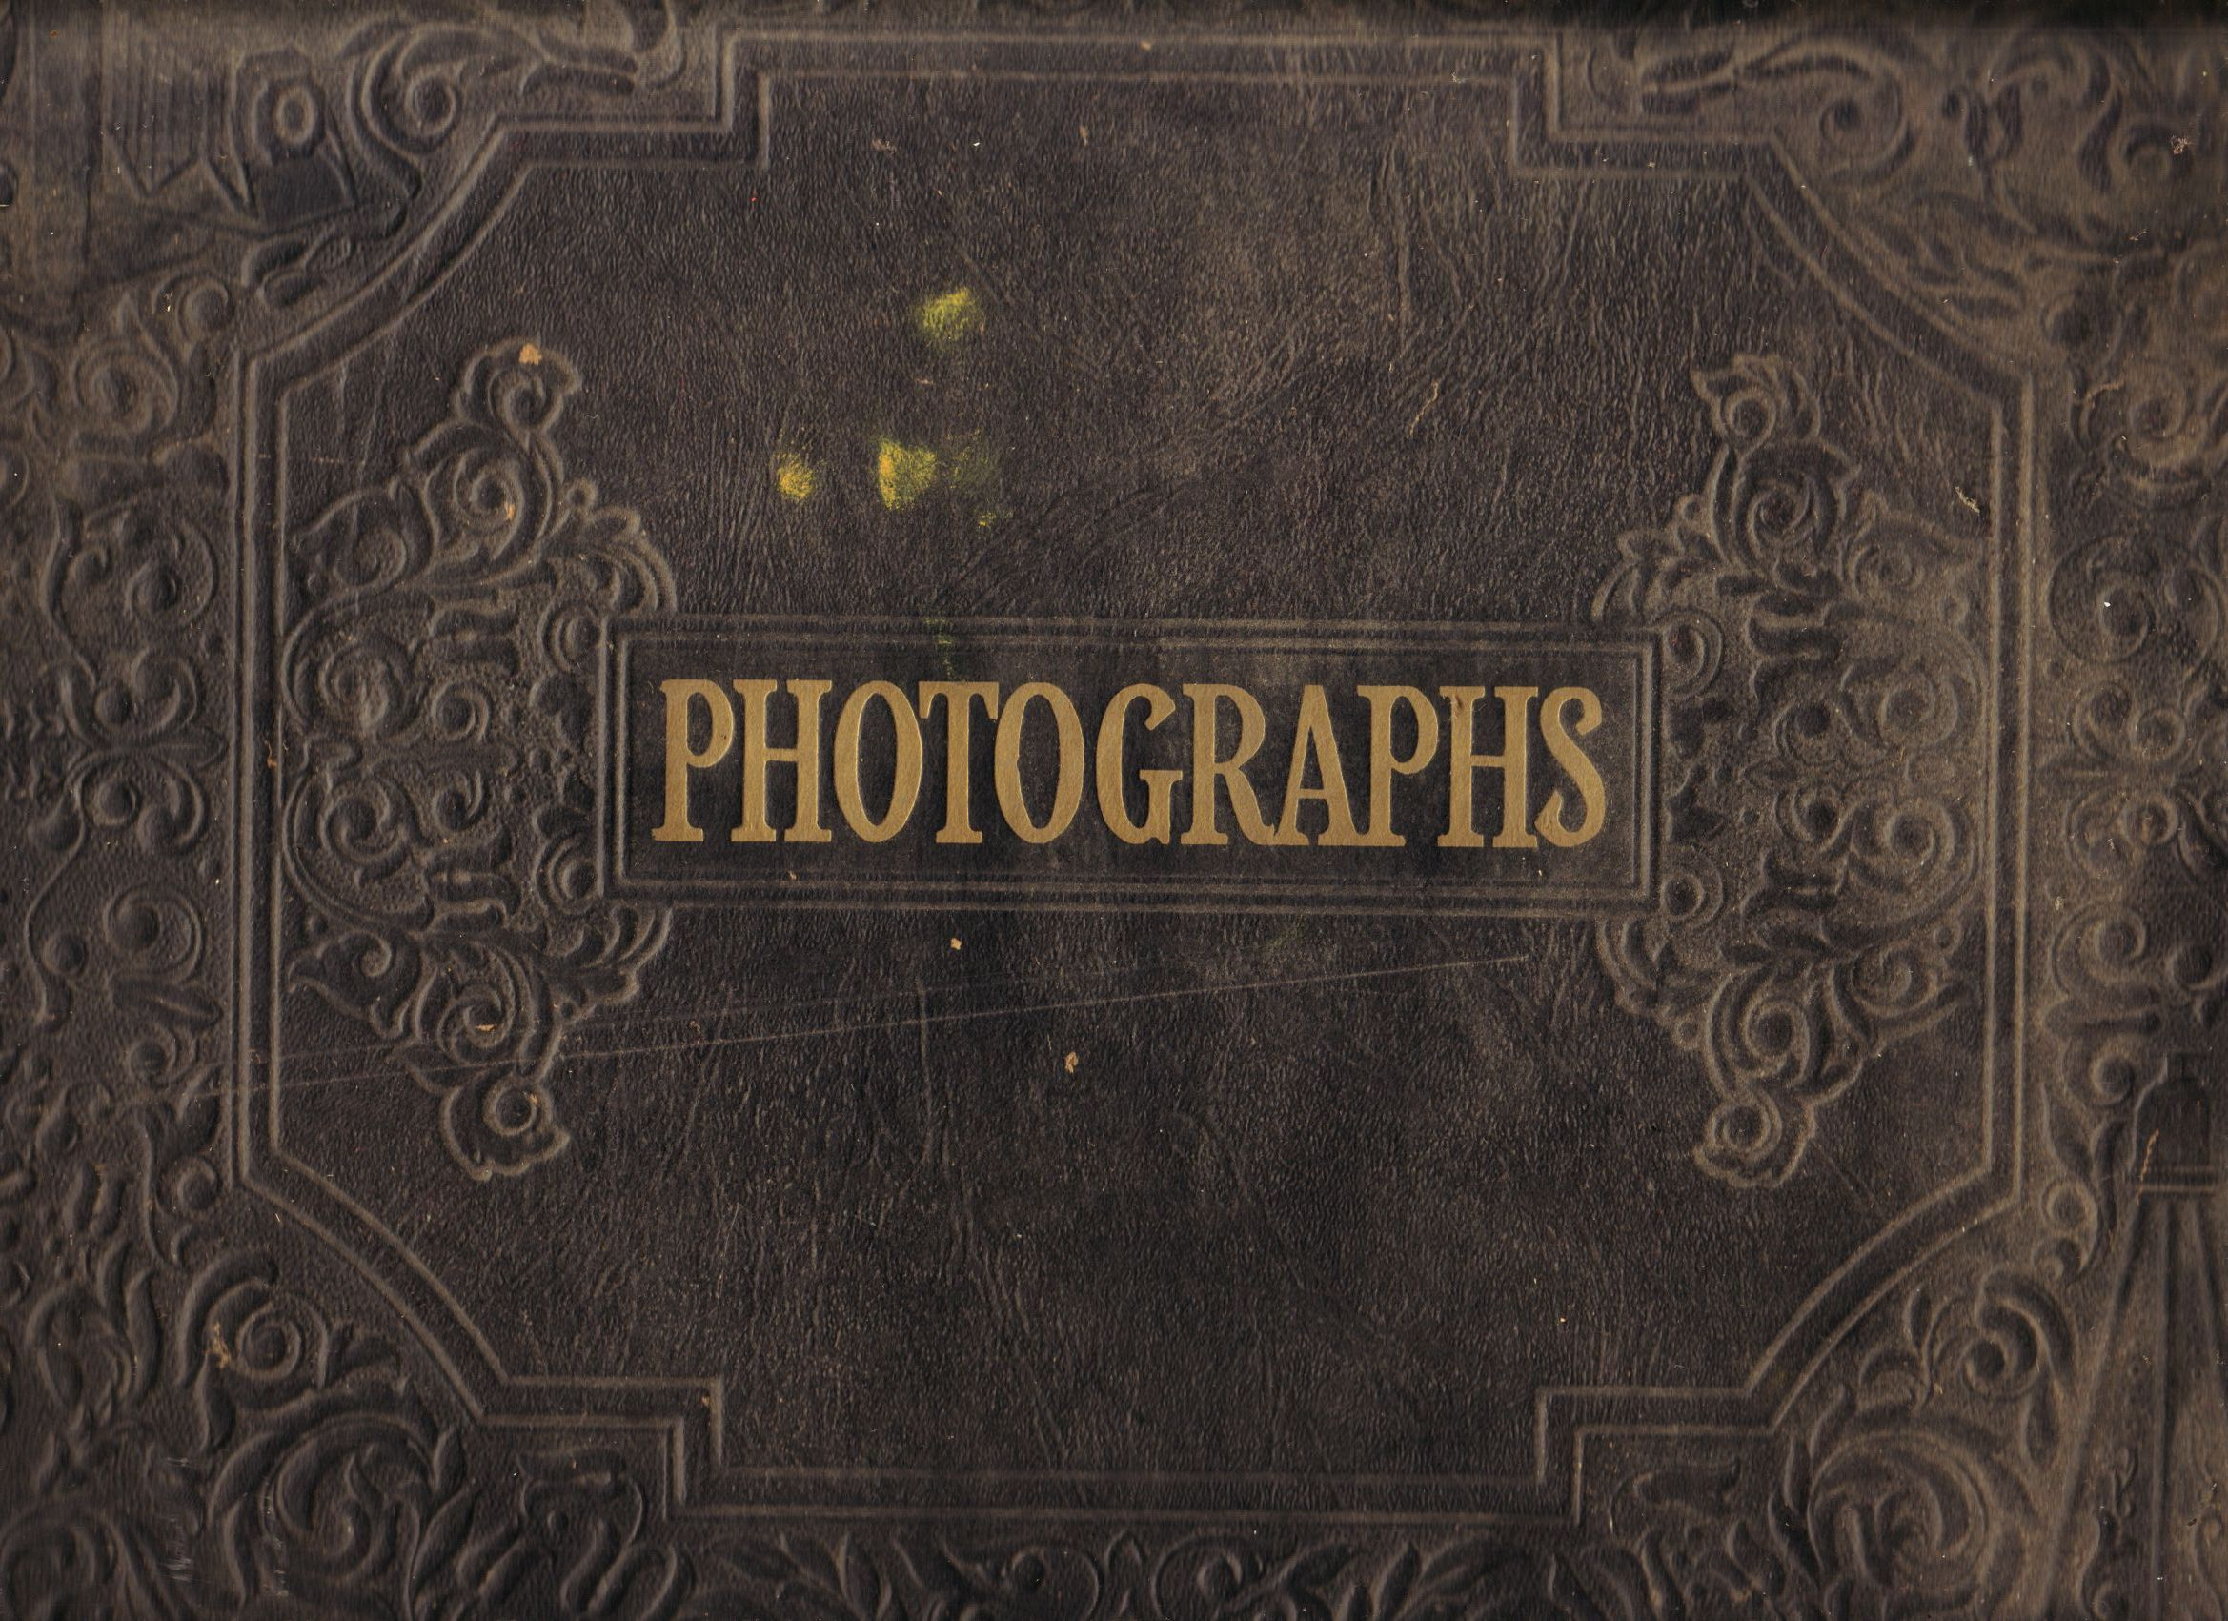
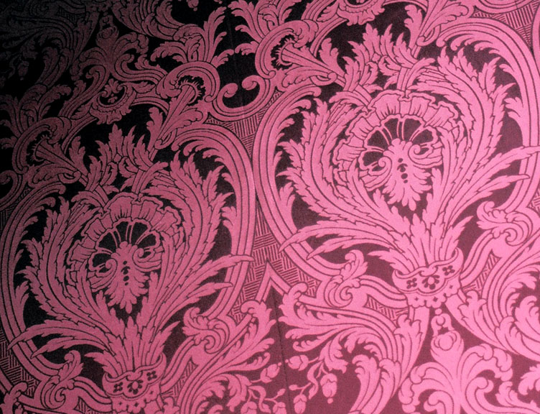
the eye perceives more swiftly than the hand can draw. PICTORIAL reproduction can keep pace with speech.

Slide 6
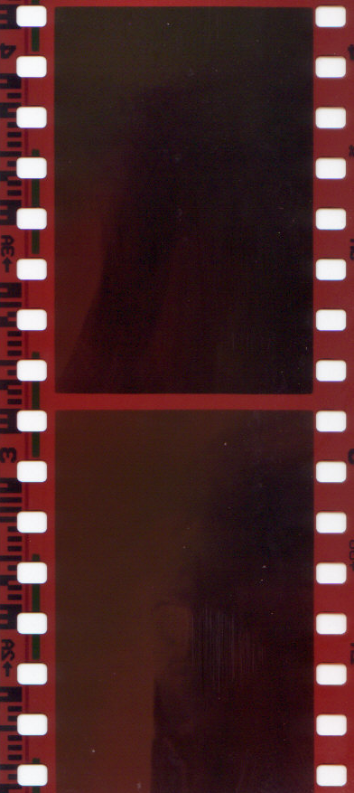
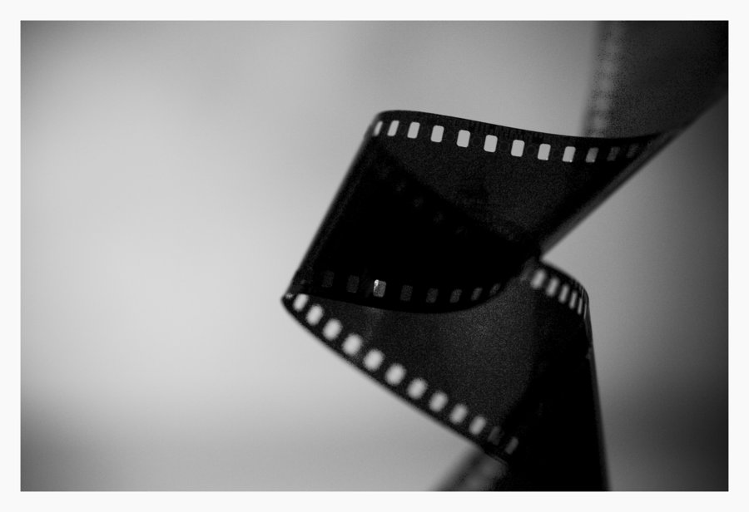
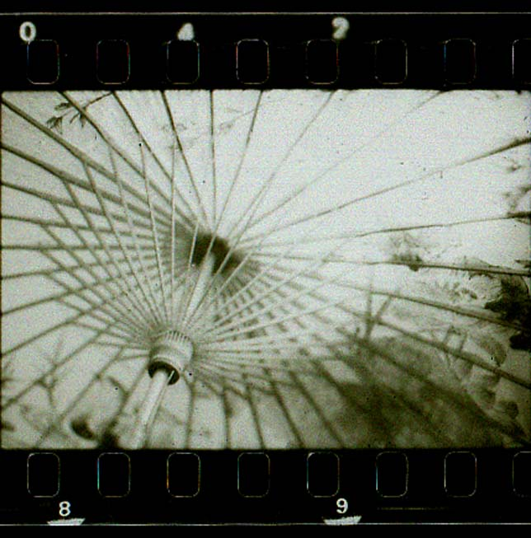
NEGATIVES
are the originals.
REproducable.

Slide 7
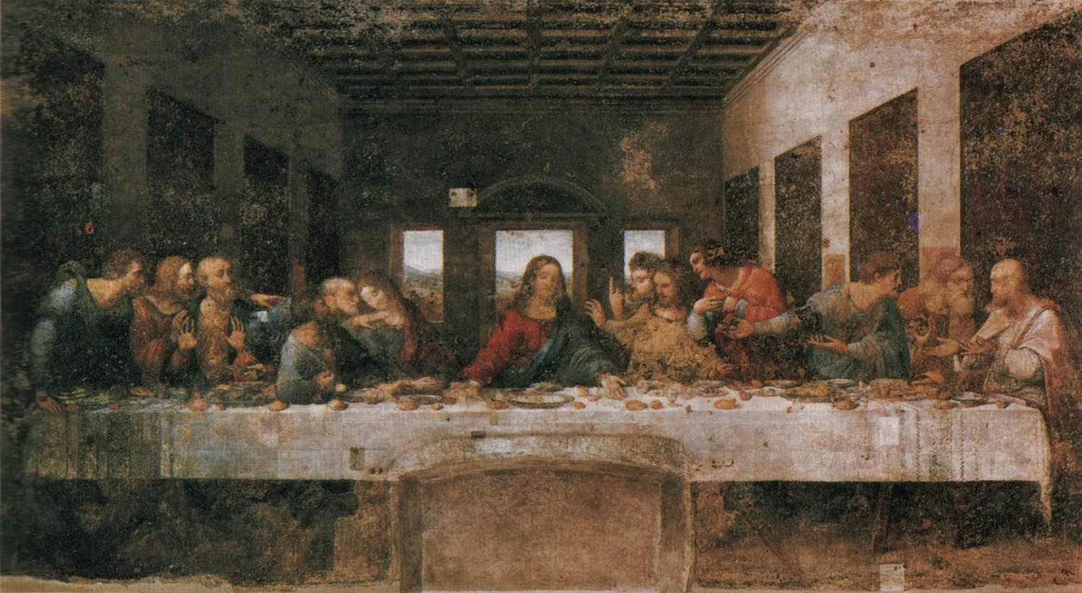
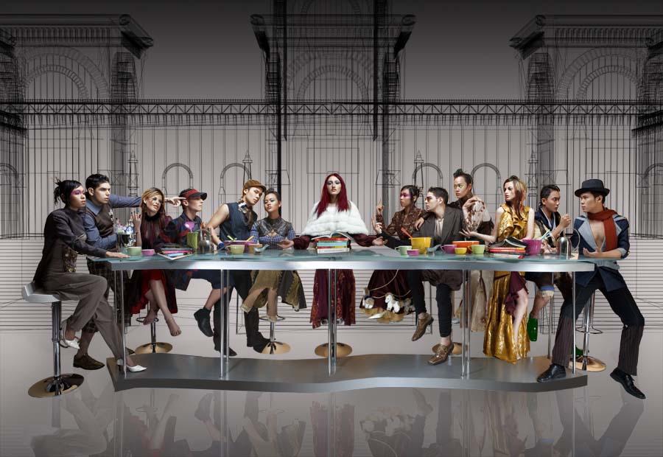
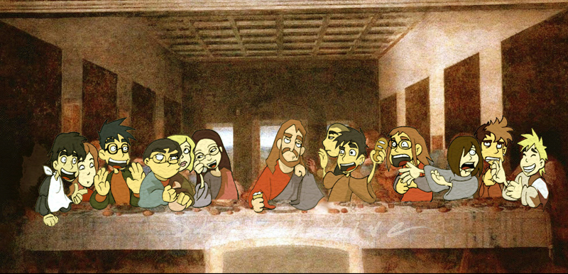
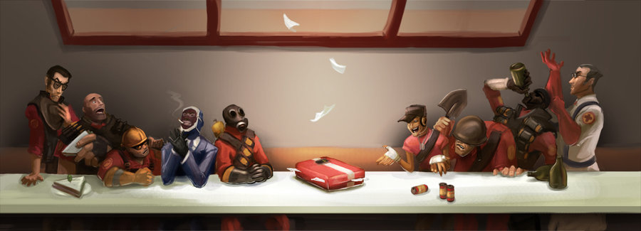
RITUALISTICvalue.

Slide 8
EXHIBITIONvalue.
historicalOCURRENCEScaptured.

Slide 9
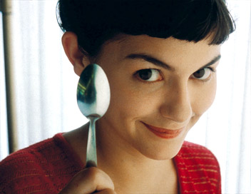
”the film has not yet realized its
true meaning, its real
possibilities…
these consist in its unique
faculty to express by
natural means and with
incomparable
persuasiveness all
that is fairylike,
marvelous,supernatural.”
FRANZwerfel
progressively?
reactionary?

Slide 10
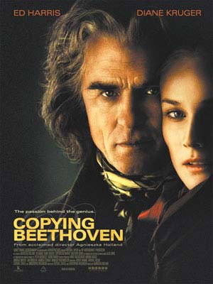
”shakespeare, rembrandt, beethoven will make films… all legends, all mythologies and all myths, all founders of religion, and the very religions… await their exposed resurrection, and the heroes crowd each other at the gate.”
ABELgance
POWERFULLart.

Slide 11
Even the most perfect reproduction of a work of art is lacking in one element: its in time and space, its existence at the place where it happens to be. This unique existence of the work of art determined the history to which it was subject throughout the time of its existence. This includes the which it may have suffered in physical condition over the years as well as the various changes in its .
PRESENCE
UNIQUE
CHANGES
OWNERSHIP

Slide 12
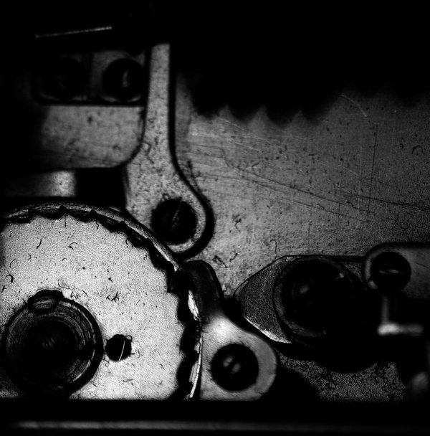
the whole sphere of authenticity is outside TECHNICAL – and, of course, not only technical – REPRODUCIBILITY.

Slide 13
”mechanical reproduction of art changed the reaction of the masses towards art.”
WALTERbenjamin

