Slide 1
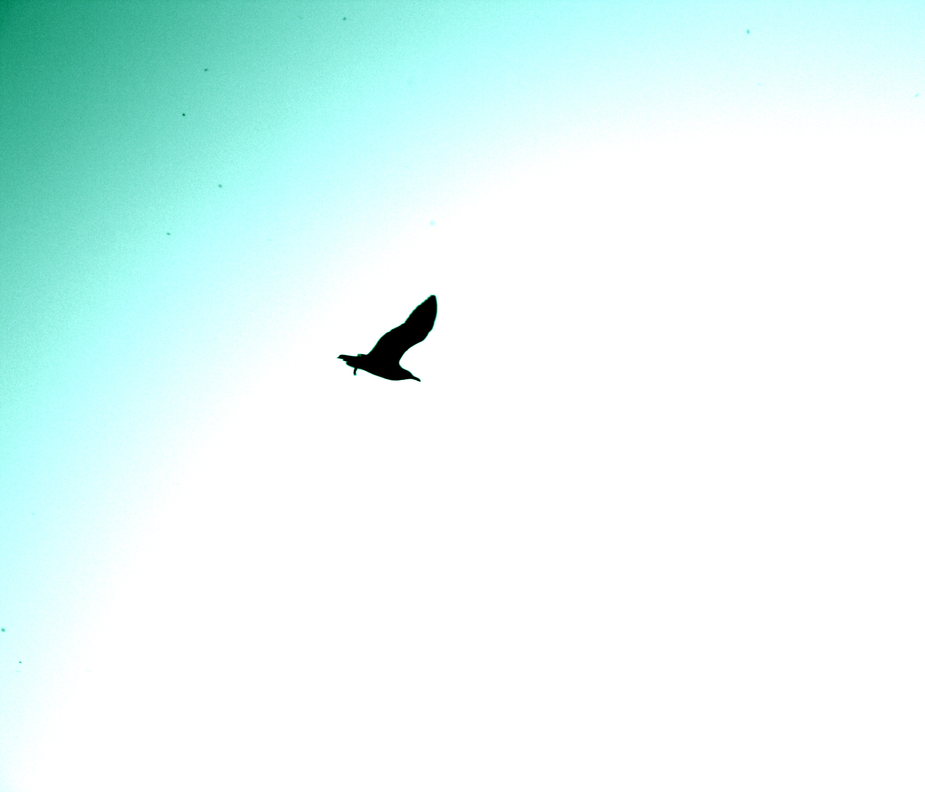
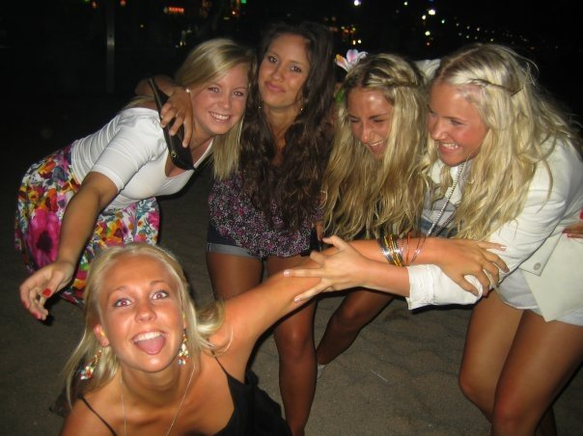
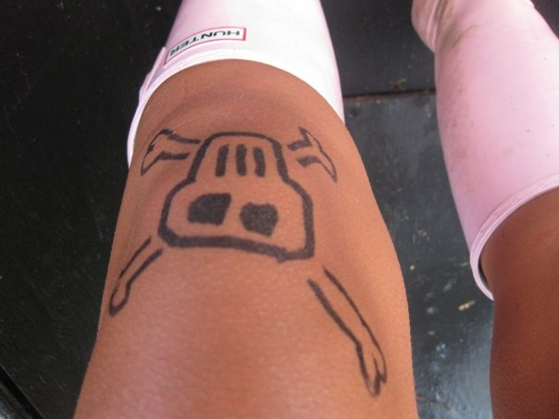
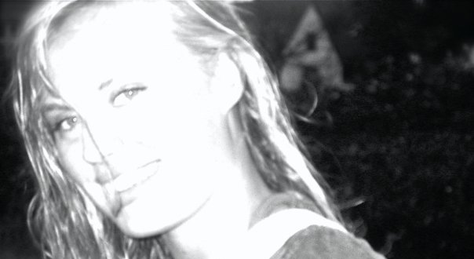
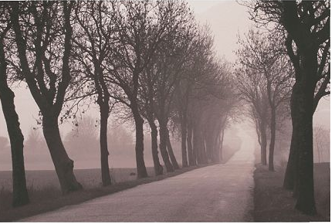
Photography as a social construction
Private documentation Fashion Art Hobby
HOME CONTACT TERMS OF USE

Slide 2
Photography as a social construction
Private documentation Fashion Art Hobby
PRIVATE DOCUMENTATION
HOME CONTACT TERMS OF USE

Slide 3
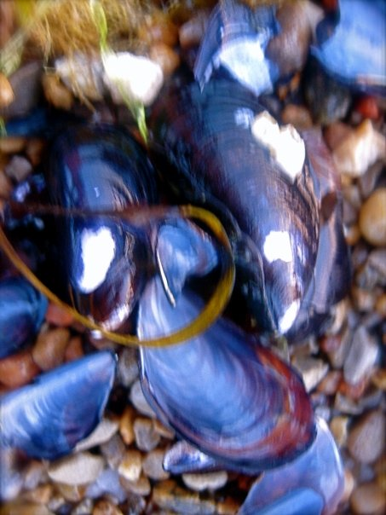
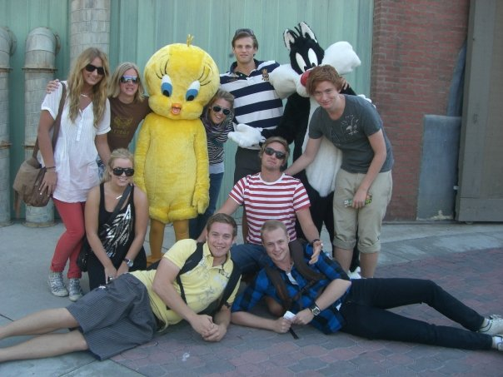
Photography as a social construction
Private documentation Fashion Art Hobby
Private documentation of you
& your friends
Digital cameras and cell phone cameras. Everyone has access to them. They are getting cheaper and better.
More opportunities to document everything and nothing. Important moments as well as those days that just pass by.
Facebook then makes everybody else, friends and friends friends (maybe even the friends-friends friends), see and comment. Both your important moments and the days that, as we know, just passed
by.
HOME CONTACT TERMS OF USE

Slide 4
Photography as a social construction
Private documentation Fashion Art Hobby
FASHION
HOME CONTACT TERMS OF USE

Slide 5
Photography as a social construction
Private documentation Fashion Art Hobby
Fashion industry
Photography as a job.
Advanced cameras and equipment.
Use of well thought of methods. Such as models, stylists, lightning and scene setting.
The industry of fashion is huge and everybody follows it, in what ever direction it goes. The photographer is the one who documents it and translates it to the people.
Reach out to the mass through fashion magazines, ELLE for an example, and label’s websites.
HOME CONTACT TERMS OF USE

Slide 6
Photography as a social construction
Private documentation Fashion Art Hobby
ART
HOME CONTACT TERMS OF USE

Slide 7
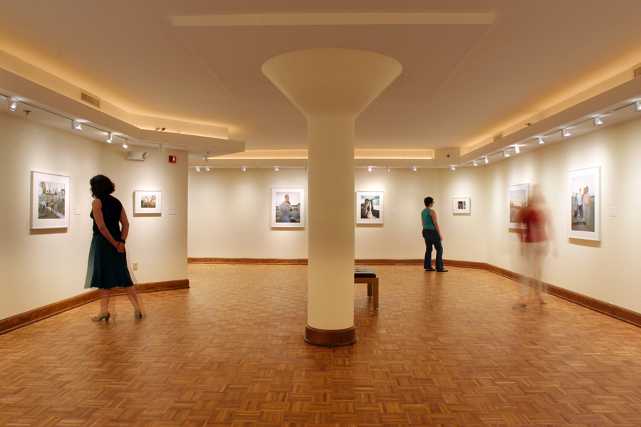
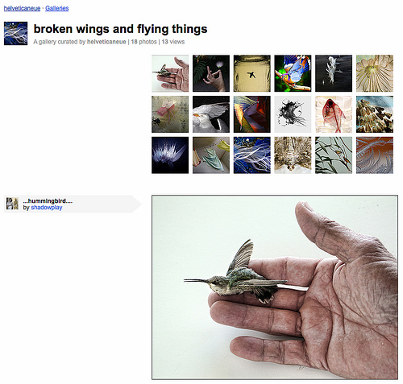
Photography as a social construction
Private documentation Fashion Art Hobby
Art photography
Art photography is something that is getting more and more popular. There are galleries with just photography instead of painted art.
Webpage’s with wide selections of art photography, such as devoiantart or flickr.
An art form that is available to a larger crowd than painted art. Big company’s like IKEA makes it affordable for everyone to have a piece of art photography on their walls.
Mass production as well as fine art galleries with unique examples.
HOME CONTACT TERMS OF USE

Slide 8
Photography as a social construction
Private documentation Fashion Art Hobby
HOBBY
HOME CONTACT TERMS OF USE

Slide 9
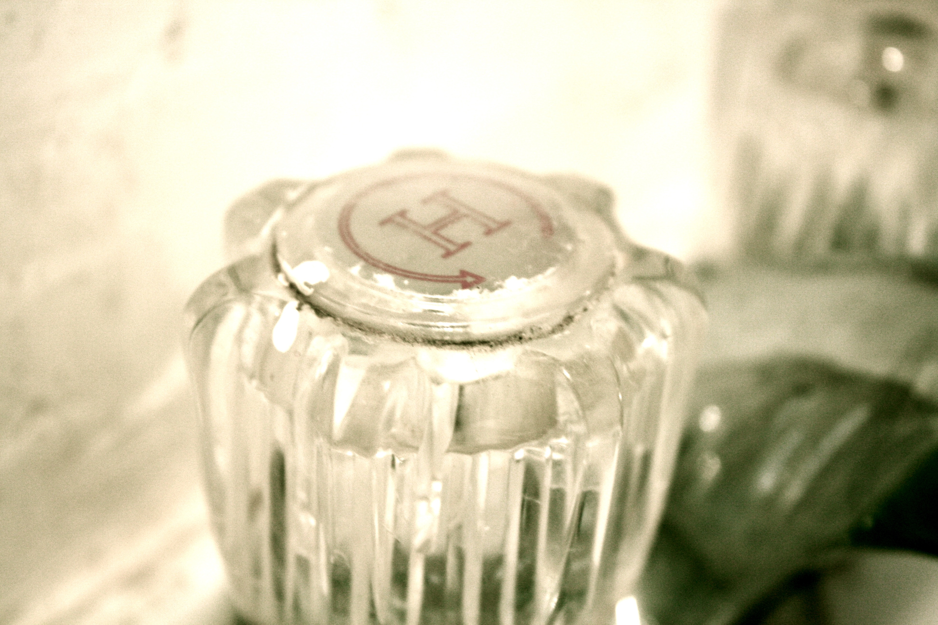
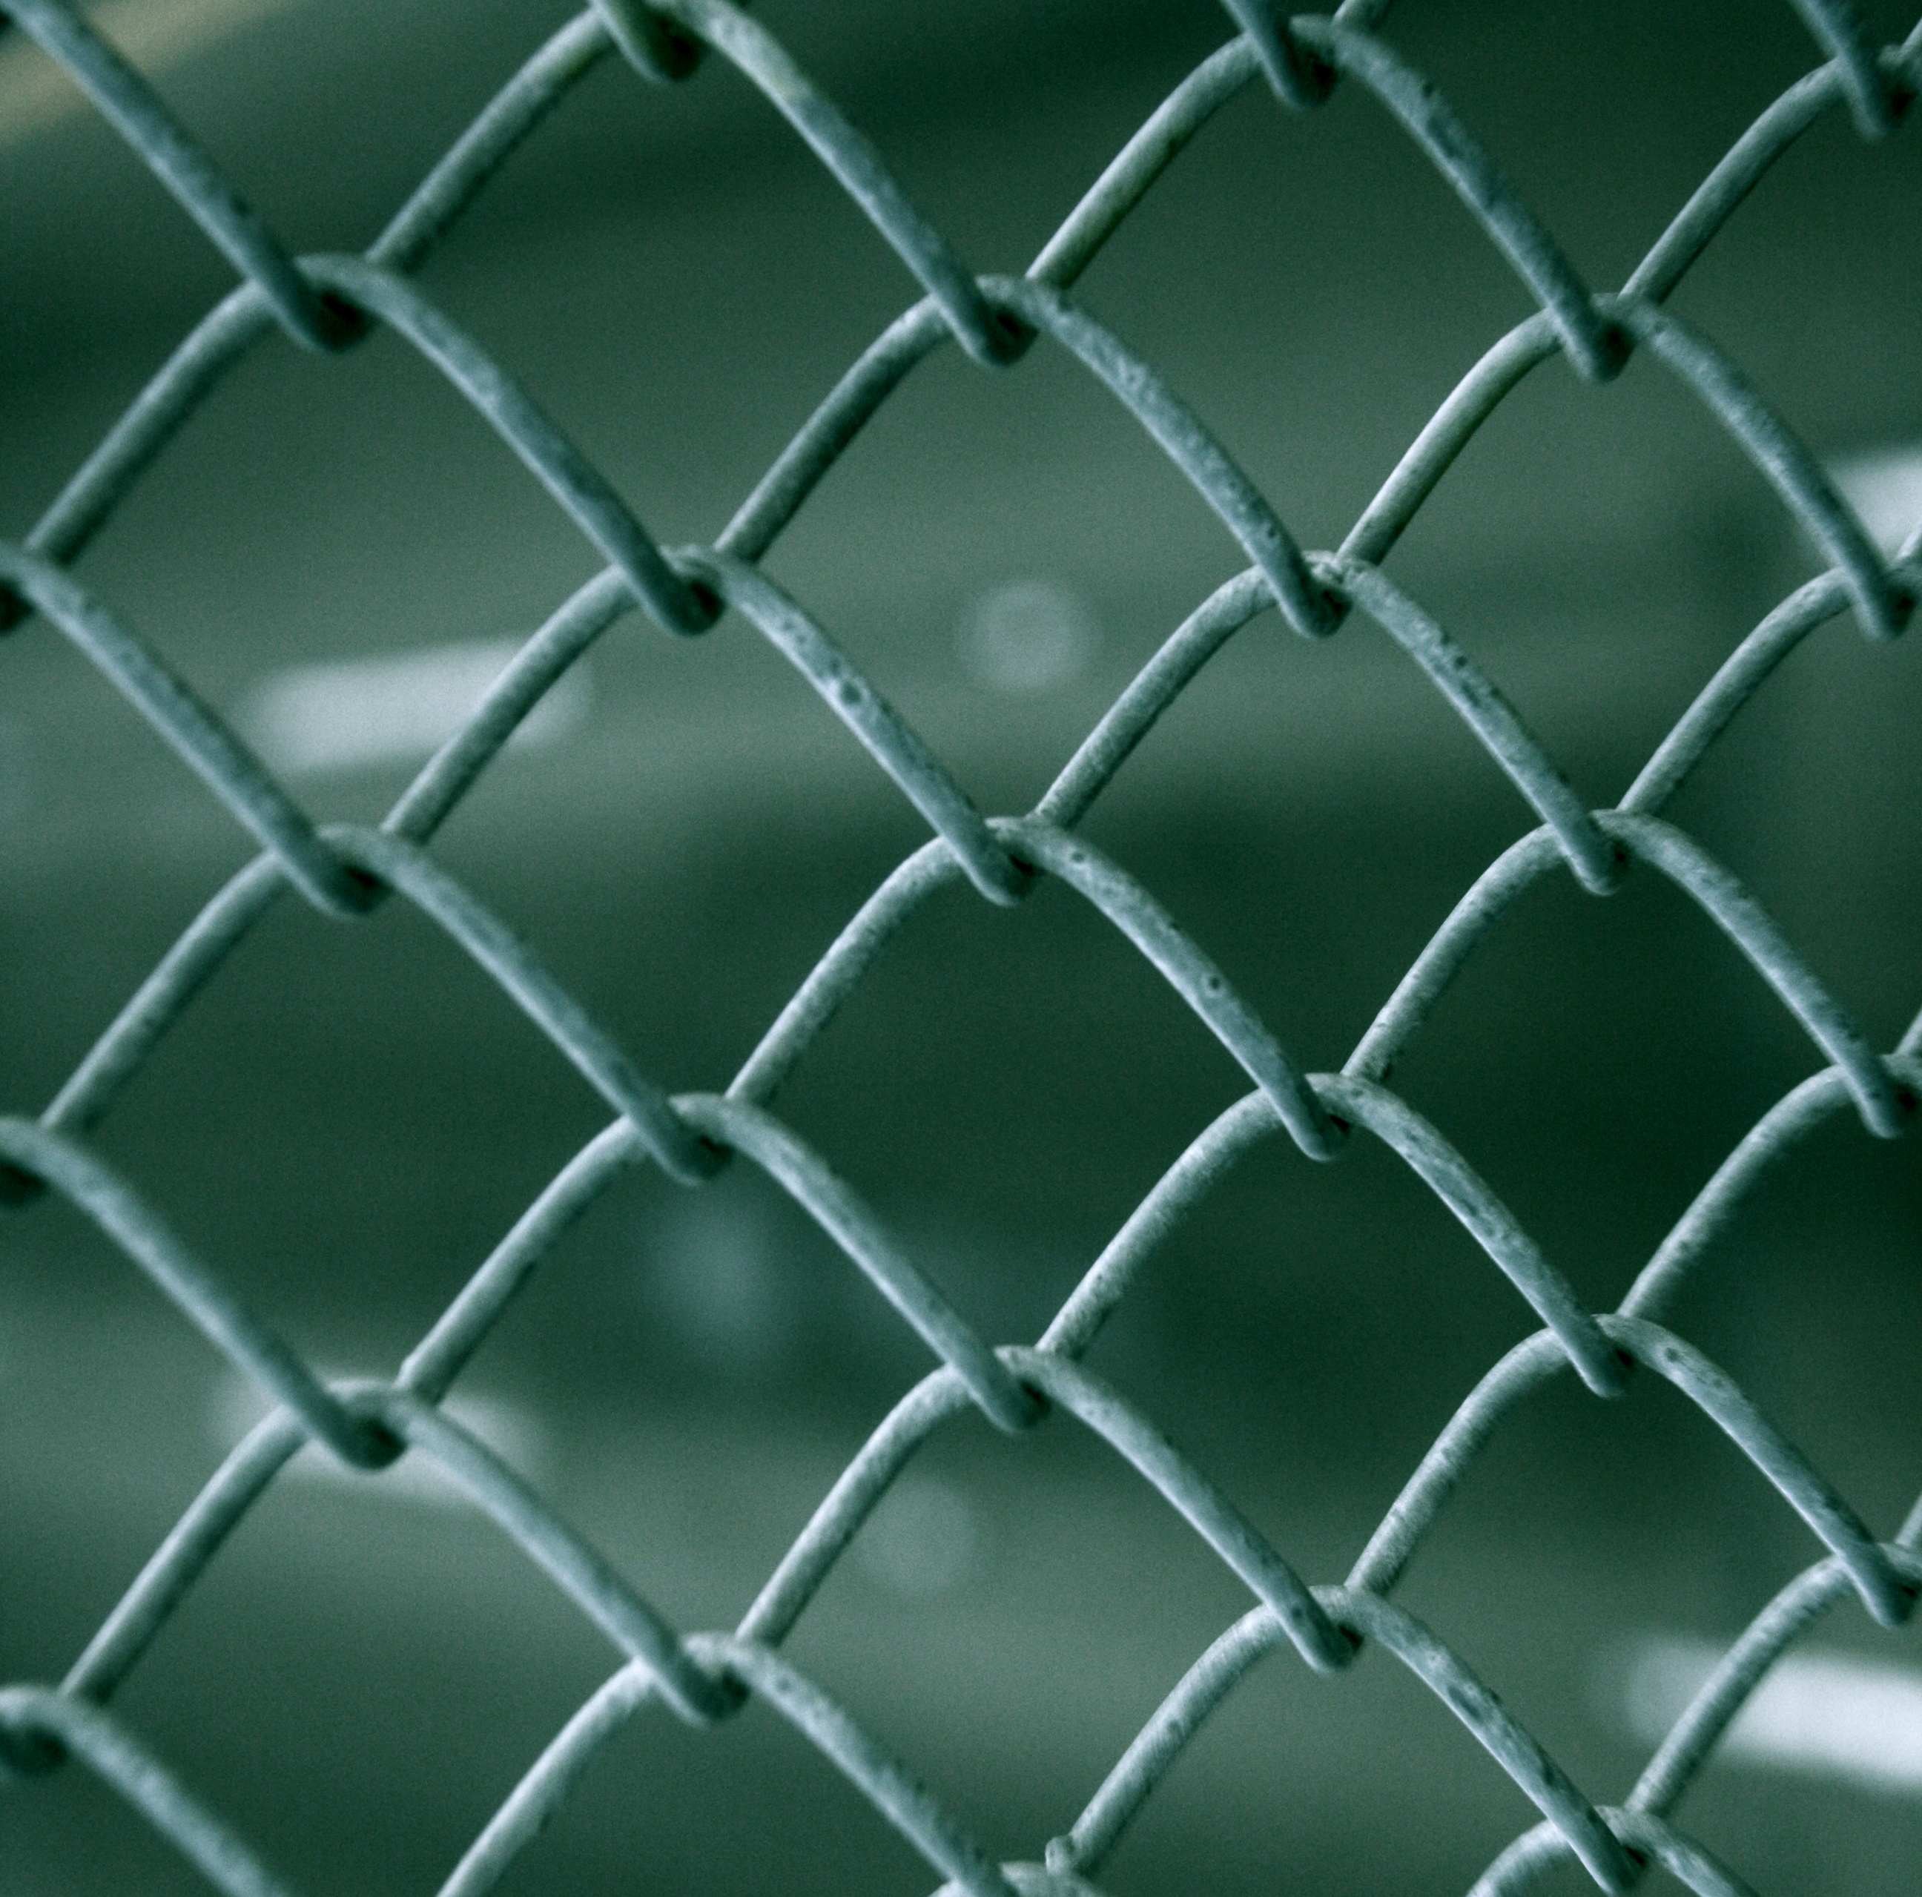
Photography as a social construction
Private documentation Fashion Art Hobby
Hobby
Since advanced cameras are available for reasonable prices everyone can call themselves amateur photographer.
You can take photography classes to learn more about how to use your equipment or use different techniques for example.
The motives are endless; there are no limits but your imagination.
Through creating your own blog you can show off your hobby or creating an account at a already existing photography webpage were you can upload your photos.
I have a blog at blogspot.com were I can show my photos for everyone.
HOME CONTACT TERMS OF USE

