Slide 1
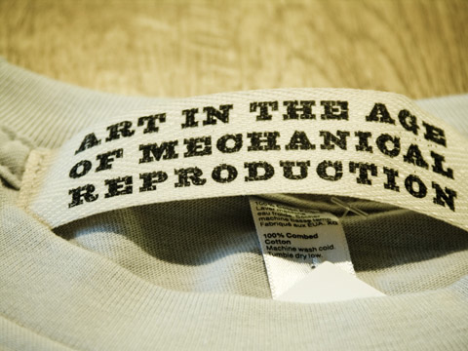
Walter Benjamin
By: Claudia Nelson

Slide 2
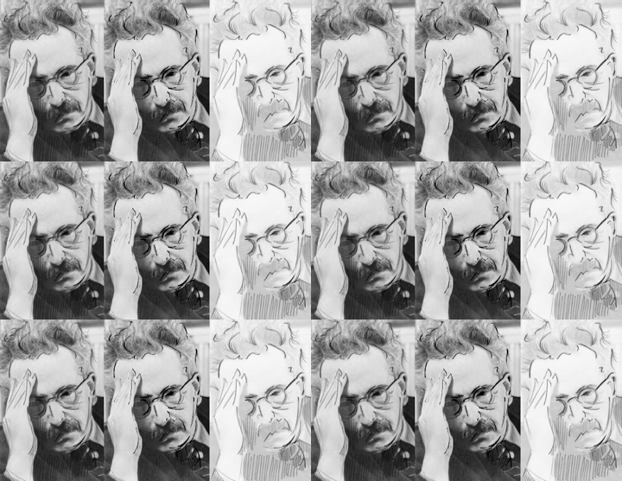
Who is Walter?
1892-1940 literary critic Philosopher Sociologist Translator radio broadcaster essayist

Slide 3
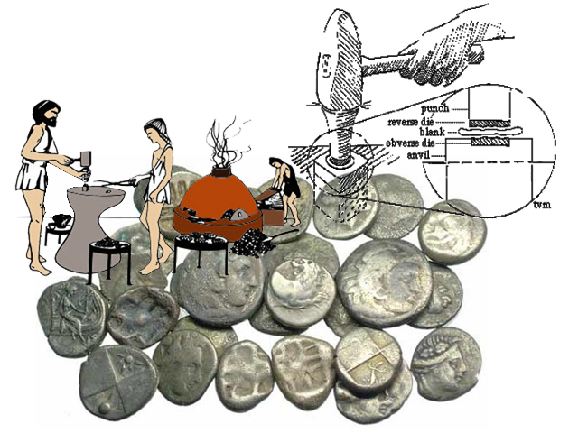
The beginning
The Greeks reproduce by founding and stamping

Slide 5
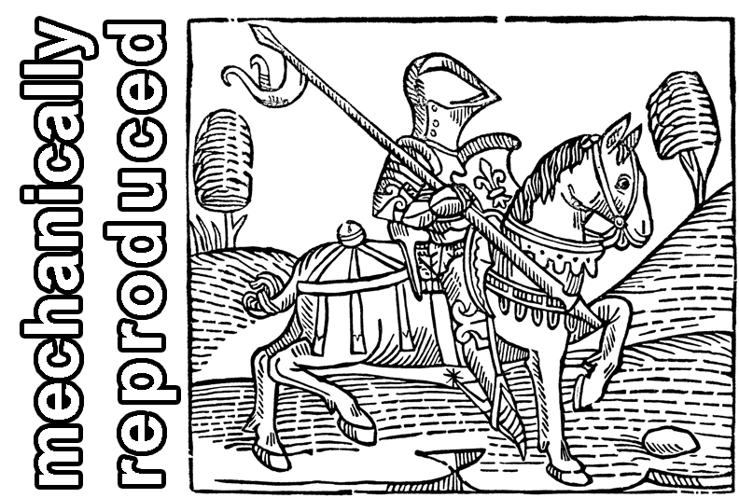
Graphic Art replicas now available!

Slide 6
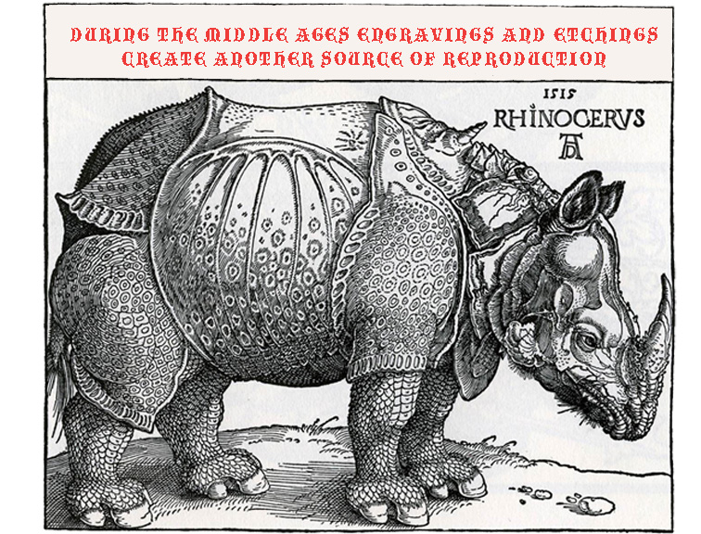

Slide 9
OR

Slide 13
Value decreases due to the reproduction

Slide 14
Film=No Aura due to the masses?

