Slide 1
Media
And
COLD
Presented by Bobbi Tacoma

Slide 2
COLD
High participation
McLuhan referred to Jazz when choosing the terms Hot and Cold medium
Low definition
Cool
High definition
HOT
Low participation

Slide 3
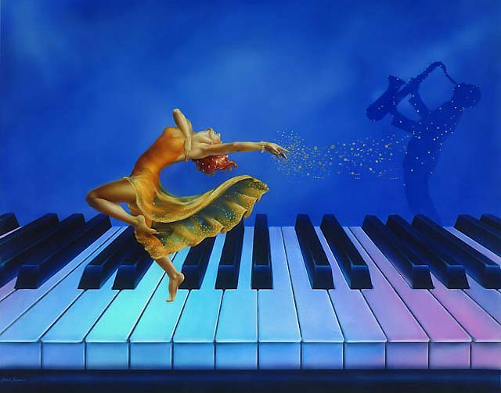
Hot Jazz Cool Jazz
loud
soft
Seducing
Overpowering
excluding
Changeable
1950
1920
Cool Man
Hot Baby
Listener involvement
Cool Jazz
Hot Jazz is highly structured
is
unstructured

Slide 4
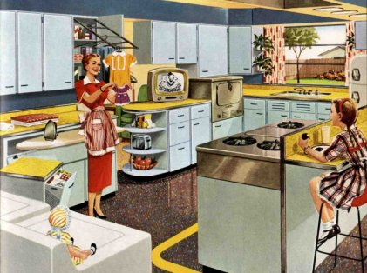
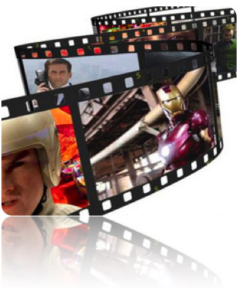
Hot Media
Telephone ____Cell phone
Oral communication Learn by watching and talking
Print books
Radio
Television watched in the home. You can do other activities
Lectures
Seminar
Film
Special training
Cartoon
Visual
Low data
Phonetic Alphabet
Photograph
Non specialized
Cold
Media
Specialized
Tribal
Linear
Multiple senses
Single sense
High data
Mechanical Age
Electrical Age

Slide 5
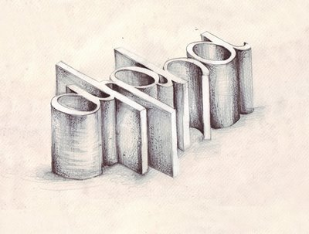
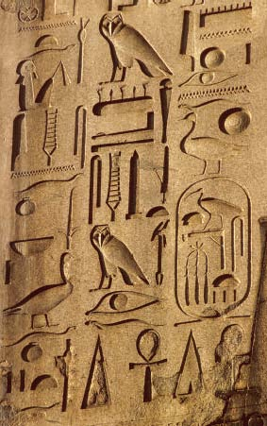
HOT
Hieroglyphics
Each symbol is whole
The spoken word
The Phonetic Alphabet is fragmented. Letters are put together to complete a whole.
The written word
COLD

Slide 6
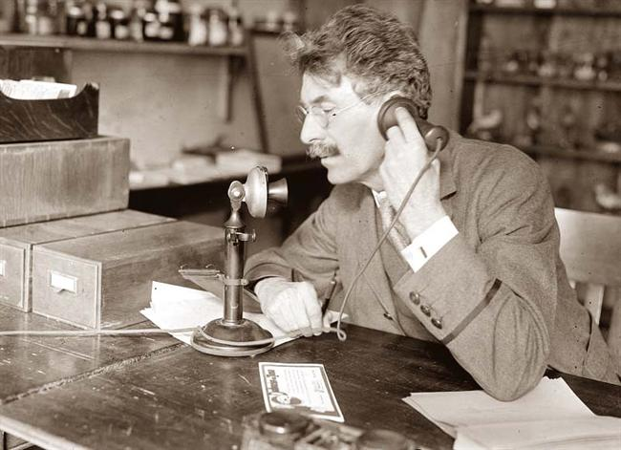
The Radio
The Telephone
Cold
Hot
Hot
Hot
Hearing and speech makes the
Hearing dominates and excludes the other senses
conversation emotional
The radio is entertainment
The pitch of voice gives true meaning to what is being said
Low participation
Immediate participation

Slide 7
The Telephone gets colder
Telephone lines are like umbilical cords
Restricting
Communication Satellites set people free to wander with their phones-more applications are added to the phone and it becomes a mini computer
Cords Limit movability

Slide 8
Photography
Lacks detail
COLD
HOT
Complete
Cartoon
Needs completion
the mind
Engages
What you see is what you get

Slide 9
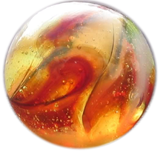
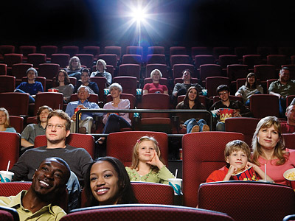
Film seen in the theater
HOT
Has limited availability
Dark space
Large screen
Loud
A place is created
Intense
To watch movies
No need to add data
Need to purchase tickets
Time is set aside to go to the theater

Slide 10
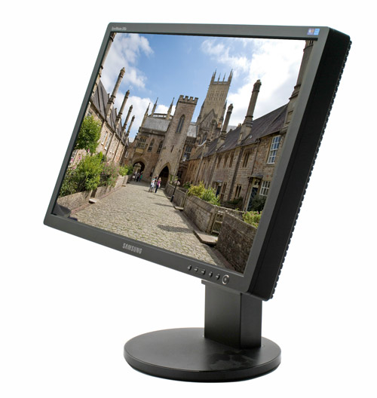
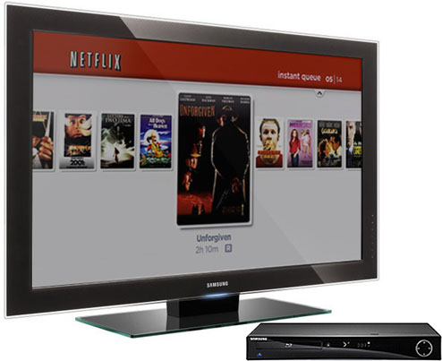
Film seen at home
Is available anytime
Rewind
On the internet
Replay
On television
Stop
Fast forward
You can rent,
buy, or
download
movies
Pause
COLD
The viewer has control

Slide 11
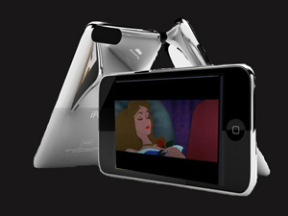
Film seen on the go
iPod touch
Can be watched wherever you are
COLDER

Slide 12
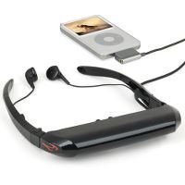
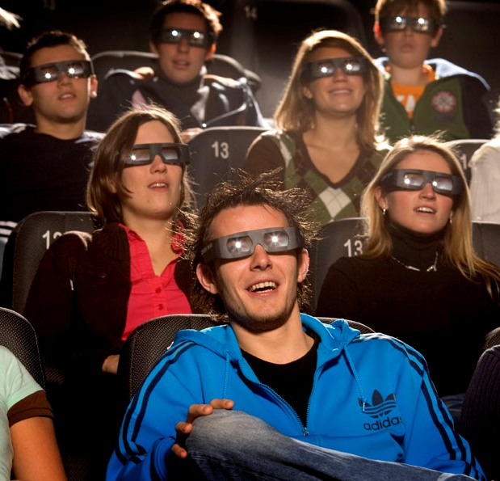
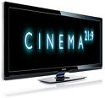
Tomorrows Technology Today
New Hot New Cold
3-D Movies now called The illusion of depth
Personal Movie Theaters Goggles The illusion of 52” television screen from 9” away
Cinema 21:9 Cinemascope LCD TV No distortion of films

Slide 13
One idea feeds another
“One of the effects of living with electric information is that we live habitually in a state of information overload. There's always more than you can cope with.” Marshall McLuhan

Slide 14
The world is changing
Get on board for the ride of your life

