Slide 1
Walter Benjamin July 15, 1892 to September 27, 1940
German-Jewish Marxist literary critic,
Essayist, translator and philosopher.
Associated with the Frankfurt School of critical theory.
Greatly inspired by the Marxism of Bertolt Brecht.
Notes:
Translated Marcel Proust, “in search of lost time”(Remembrance of Things Past). ﾋ la recherche du temps perdu
a monumental work of twentieth-century fiction published in seven parts from 1913 to 1927.
Translated Charles Baudelaire: “tableaux parisiens”.

Slide 2
Walter Benjamin July 15, 1892 to September 27, 1940
As a sociological and cultural critic, Benjamin combined ideas of historical materialism, German idealism and Jewish mysticism.
in a body of work which was an entirely novel contribution to western philosophy, Marxism, and aesthetic theory.
Notes:
As a sociological and cultural critic, Benjamin combined ideas of historical materialism, German idealism and Jewish mysticism in a body of work which was an entirely novel contribution western philosophy, Marxism, and aesthetic theory.

Slide 3
Walter Benjamin July 15, 1892 to September 27, 1940
The work of Art in the Age of Mechanical
Reproduction, 1936. "The Work of Art in the Age of Its Technological Reproducibility" (Das Kunstwerk im Zeitalter seiner technischen Reproduzierbarkeit).

Slide 4
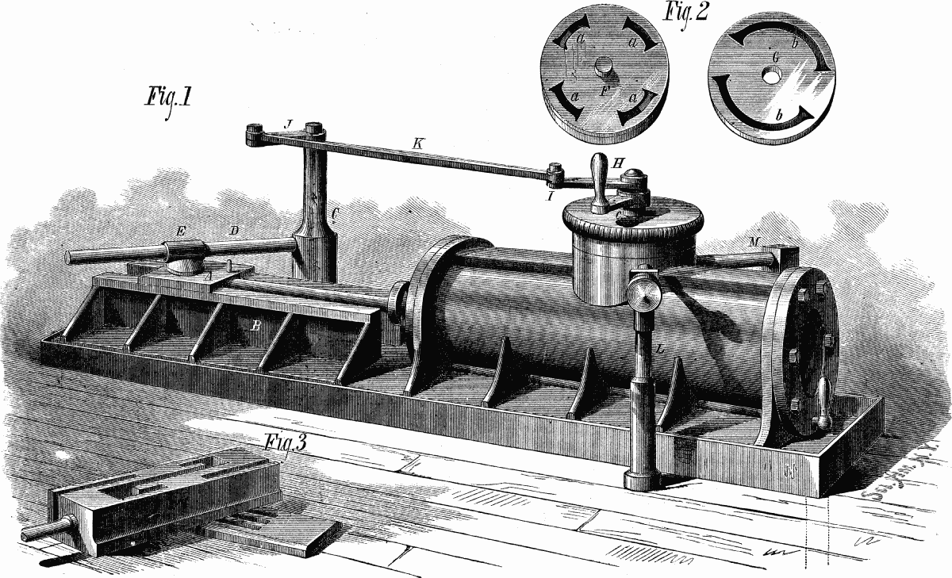
The Industrial revolution
The Industrial Revolution began in England in the eighteenth century and quickly spread across Europe and North America.
New technology and inventions transformed an agricultural and commercial way of life into a modern industrial society.
Changes brought about by the Industrial Revolution changed family structure and lifestyle as
the factory system drew workers away from the rural family economy to urban areas.
XVIII century. England.
Notes:
XVIII century. England.

Slide 5
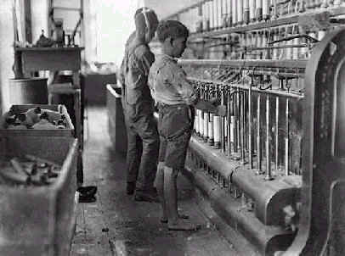
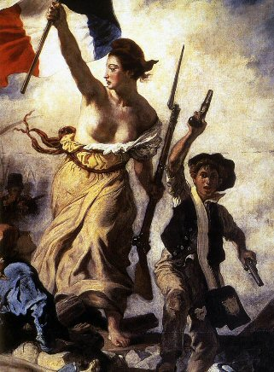
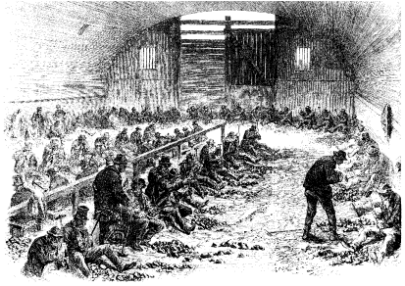
The French revolution
Economical changes
Social changes
Political changes
Notes:
XVIII century. England.
James Watt's steam engine (Be sure to check out the animation!)ﾊ ﾊﾊﾊ Eli Whitney's cotton ginﾊ ﾊﾊﾊ Henry Bessemer's steel making process

Slide 6
Marxist terms
Capitalist
(Aristocracy)
The person who buys the labor power, generally someone who does own the land and technology to produce, is a "capitalist" or “Bourgeois”
Means of production
•Materials
•Technology
•Working power
Surplus value
Proletariat
Working class
Those who must sell their “labour power” .The proletarians inevitably outnumber the capitalists.
In 1867 Marx publishes the first volume of his work “Capital”, a work which analyzed the capitalist process of production
Marx elaborated his version of the labor theory value,
The surplus value, and the exploitation of the proletarian class which would ultimately lead to a falling rate of profit in the collapse of industrial capitalism.
Notes:
Karl Heinrich Marx (May 5, 1818 – March 14, 1883)
without a doubt the most influential socialist thinker to emerge in the 19th century. Although he was largely ignored by scholars in his own lifetime, his social, economic and political ideas gained rapid acceptance in the socialist movement after his death in 1883.
It was not until 1867 that Marx was able to publish the first results of his work in volume 1 of Capital, a work which analyzed the capitalist process of production. In Capital, Marx elaborated his version of the labor theory value and his conception of surplus value and exploitation which would ultimately lead to a falling rate of profit in the collapse of industrial capitalism. Volumes II and III were finished during the 1860s but Marx worked on the manuscripts for the rest of his life and they were published posthumously by Engels.
However, his stress on the economic factor in society and his analysis of the class structure in class conflict have had an enormous influence on history, sociology, and study of human culture.
Marx's analysis of history focuses on the organization of labor and depends on his distinction between:
the means / forces of production, literally those things (like land, natural resources, and technology) necessary for the production of material goods; and
the relations of production, in other words, the social relationships people enter into as they acquire and use the means of production.
Marx believed that under capitalism, the means of production change more rapidly than the relations of production (for example, we develop a new technology, such as the Internet, and only later do we develop laws to regulate that technology). Marx regarded this mismatch between (economic) base and (social) superstructure as a major source of social disruption and conflict.
Marx had a special concern with how people relate to that most fundamental resource of all, their own labour power. He wrote extensively about this in terms of the problem of alienation. As with the dialectic, Marx began with a Hegelian notion of alienation but developed a more materialist conception. Capitalism mediates social relationships of production (such as among workers or between workers and capitalists) through commodities, including labor, that are bought and sold on the market. For Marx, the possibility that one may give up ownership of one's own labor — one's capacity to transform the world — is tantamount to being alienated from one's own nature; it is a spiritual loss.

Slide 7
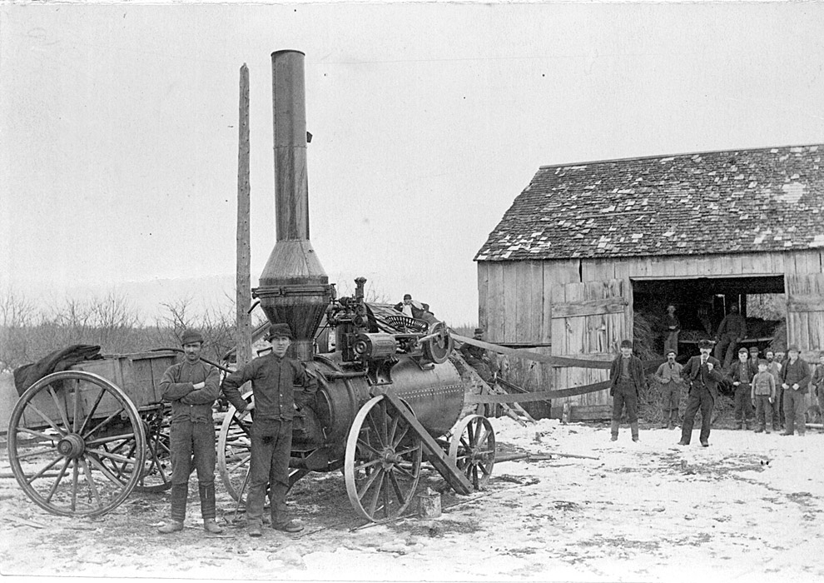
The Industrial revolution
Unites States. Ohio. Threshing machine with steam engine, [ca. 1914]}
Notes:
Threshing machine with steam engine, [ca. 1914}

Slide 8
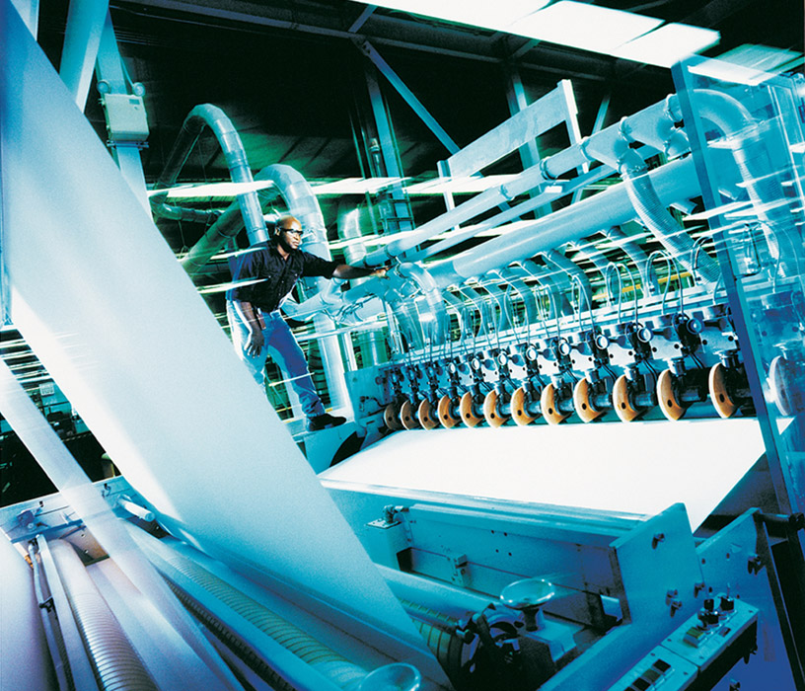
Technology
Post Industrial Revolution. Born as a consequence of it, with the development of science and the markets.

Slide 9
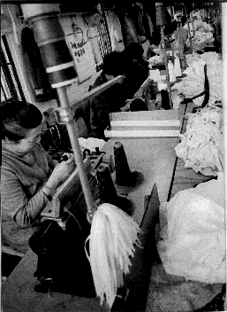
Alienation
Marx had a special concern with how people relate to that most fundamental resource of all, their own labour power.
Capitalism mediates social relationships of production (such as among workers or between workers and capitalists) through commodities, including labor, that are bought and sold on the market.
For Marx, the possibility that one may give up ownership of one's own labor — one's capacity to transform the world — is tantamount to being alienated from one's own nature; it is a spiritual loss.
Notes:
Marx had a special concern with how people relate to that most fundamental resource of all, their own labour power. He wrote extensively about this in terms of the problem of alienation. As with the dialectic, Marx began with a Hegelian notion of alienation but developed a more materialist conception.
Capitalism mediates social relationships of production (such as among workers or between workers and capitalists) through commodities, including labor, that are bought and sold on the market.
For Marx, the possibility that one may give up ownership of one's own labor — one's capacity to transform the world — is tantamount to being alienated from one's own nature; it is a spiritual loss.

Slide 10
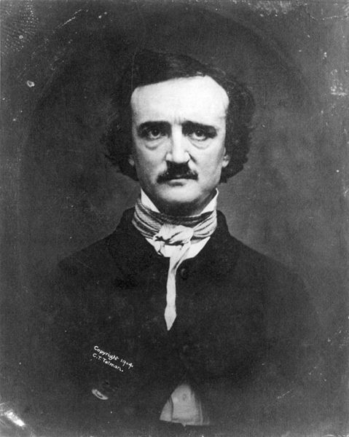
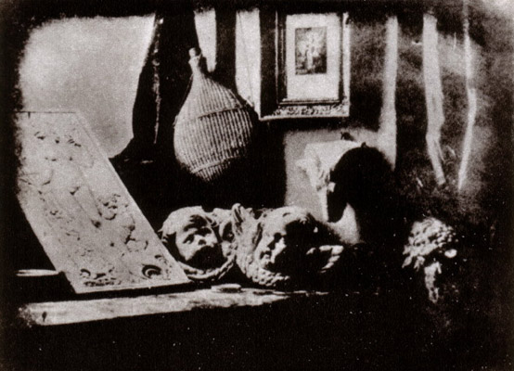
The “aura” on early Photography
Daguerre, Atelier.1837
A photograph of a daguerreotype of Edgar Allan Poe 1848, first published 1880. Taken by W.S. Hartshorn, Providence, Rhode Island, November, 1848.
Notes:
Daguerreotype.
The daguerreotype is an early type of photograph, developed by Louis Daguerre, in which the image is exposed directly onto a mirror-polished surface of silver bearing a coating of silver halide particles deposited by iodine vapor. In later developments bromine and chlorine vapors were also used, resulting in shorter exposure times. The daguerreotype is a negative image, but the mirrored surface of the metal plate reflects the image and makes it appear positive in the proper light. Thus, daguerreotype is a direct photographic process without the capacity for duplication.

Slide 11
The “aura” on early Photography
The daguerreotype is an early type of photograph photograph, developed by Louis Daguerre, in which the image is exposed directly onto a mirror-polished surface of silver bearing a coating of silver halide particles deposited by iodine vapor. In later developments bromine and chlorine vapors were also used, resulting in shorter exposure times The daguerreotype is a negative image, but the mirrored surface of the metal plate reflects the image and makes it appear positive in the proper light. Thus, daguerreotype is a direct photographic process without the capacity for duplication.
Notes:
Daguerreotype.
The daguerreotype is an early type of photograph, developed by Louis Daguerre, in which the image is exposed directly onto a mirror-polished surface of silver bearing a coating of silver halide particles deposited by iodine vapor. In later developments bromine and chlorine vapors were also used, resulting in shorter exposure times. The daguerreotype is a negative image, but the mirrored surface of the metal plate reflects the image and makes it appear positive in the proper light. Thus, daguerreotype is a direct photographic process without the capacity for duplication.

Slide 12
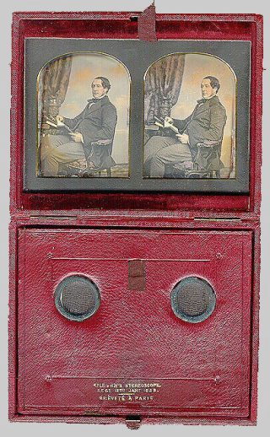
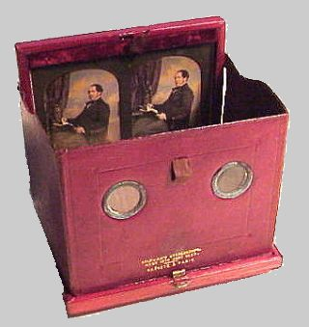
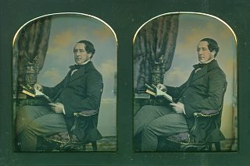
Stereo Daguerrotype, ca. 1853
Notes:
Daguerreotype.
The daguerreotype is an early type of photograph, developed by Louis Daguerre, in which the image is exposed directly onto a mirror-polished surface of silver bearing a coating of silver halide particles deposited by iodine vapor. In later developments bromine and chlorine vapors were also used, resulting in shorter exposure times. The daguerreotype is a negative image, but the mirrored surface of the metal plate reflects the image and makes it appear positive in the proper light. Thus, daguerreotype is a direct photographic process without the capacity for duplication.

Slide 13
The purpose of Photography
Evocation of Beauty
Documentation of Reality
The evocation of beauty
is a last resort of
Ritual function

Slide 14
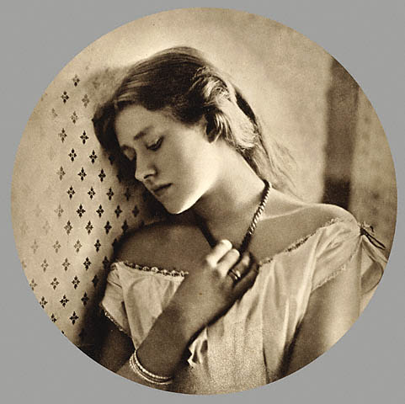
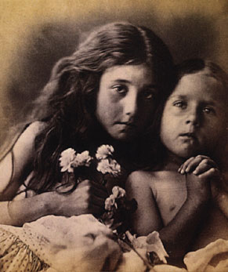
Early Photography, Julia Margaret Cameron
(1815-1879)
“Sadness”, 1864
Model: Helen Terry
Shakespearean actress
Young wife of George Frederic Watts
Notes:
Julia Margaret Cameron (June 11, 1815 ﾐ January 26, 1879) was a British photographer. She became known for her portraits of celebrities of the time, and for Arthurian and similar legendary themed pictures.Cameron's photographic career was short (about 12 years) and came late in her life. Her work had a huge impact on the development of modern photography, especially her closely cropped portraits which are still mimicked today. Her house, Dimbola Lodge, on the Isle of Wight can still be visited.
On 1863, when Cameron was 48 years old, her daughter gave her a camera as a present, thereby starting her career as a photographer. Within a year, Cameron became a member of the Photographic Societies of London and Scotland. In her photography, Cameron strove to capture beauty. She wrote, "I longed to arrest all the beauty that came before me and at length the longing has been satisfied."[1]

Slide 15
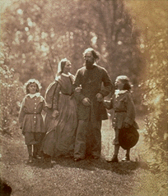
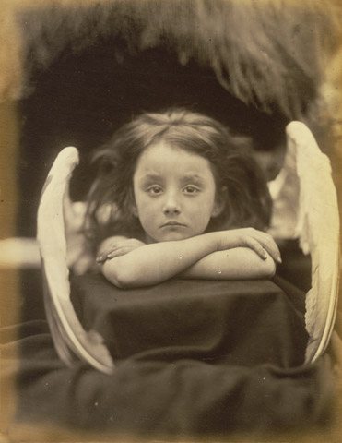
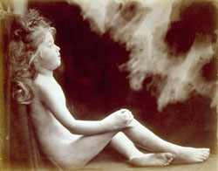
Early Photography, Julia Margaret Cameron
(1815-1879)
An angel unwinged (the young Endymion), 1872
albumen silver photograph.
“I Wait”. Sitter: Rachel Gurney, 1872.
Notes:
In this study Rachel Gurney partially undermined Cameron's desire to transform her image into a cherubic likeness with her confrontational gaze and blasé expression. Despite her sitter's lack of enthusiasm, Cameron created an engaging and technically accomplished picture.
In Greek mythology, Endymion was a mortal man who fell in love with Selene, the goddess of the Moon. To keep him eternally young, Selene cast a spell over Endymion putting him into a state of sleep forever.
This image is also titled An angel unwinged. Cameron's interpretation of this alternative title is not clear. She often portrayed children as angels but in this study has abandoned actual wings, suggesting their presence instead through an arc of diffused light in the background.

Slide 16
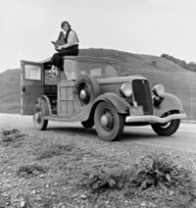
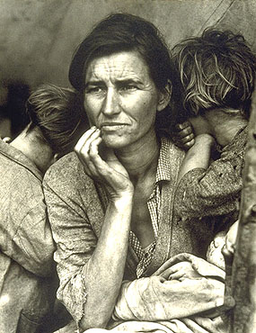
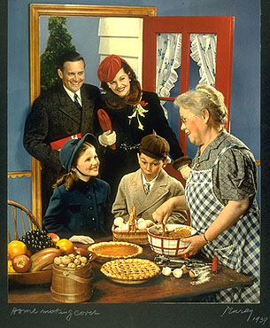
Early Photography, 30s.
Photography as documentary. Migrant Mother by Dorothea Lange.
Dorothea Lange's Migrant Mother depicts destitute pea pickers in California,
centering on Florence Owens Thompson, a mother of seven children, age 32,
in Nipomo, California, March 1936.
Media View. Thanks giving postcard of the period.
Notes:
Dorothea Lange's Migrant Mother depicts destitute pea pickers in California,
centering on Florence Owens Thompson,
a mother of seven children, age 32,
in Nipomo, California, March 1936.
(Photo property of the government)
From 1935 to 1939, Lange's work for the RA and FSA brought the plight of the poor and forgotten ﾑ particularly sharecroppers, displaced farm families, and migrant workers ﾑ to public attention. Distributed free to newspapers across the country, her poignant images became icons of the era.
With the onset of the Great Depression, Lange turned her camera lens from the studio to the street. Her studies of unemployed and homeless people captured the attention of local photographers and led to her employment with the federal Resettlement Administration (RA), later called the Farm Security Administration (FSA).

Slide 17
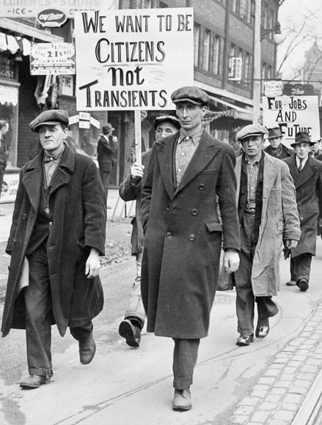
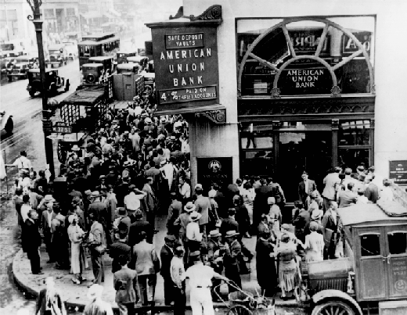
Photography as documentary, 30s.
Crowd at New York's American Union Bank during a bank run early in the Great Depression.
Unemployed men march in Toronto, Canada
Harshly impacted by both the global economic downturn and the Dust Bowl, Canadian industrial production had fallen to only at 58% of the 1929 level by 1932, the second lowest level in the world after the United States, and well behind nations such as Britain, which only saw it fall to 83% of the 1929 level. Total national income fell to 55% of the 1929 level, again worse than any nation other than the United States.
Notes:
Harshly impacted by both the global economic downturn and the Dust Bowl, Canadian industrial production had fallen to only at 58% of the 1929 level by 1932, the second lowest level in the world after the United States, and well behind nations such as Britain, which only saw it fall to 83% of the 1929 level. Total national income fell to 55% of the 1929 level, again worse than any nation other than the United States.

Slide 18
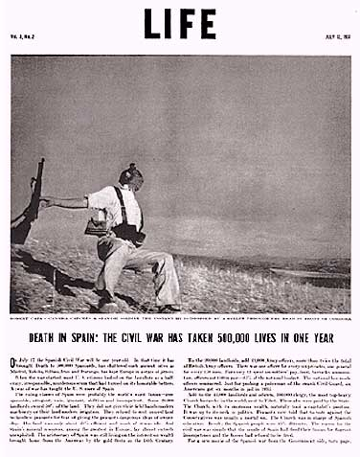
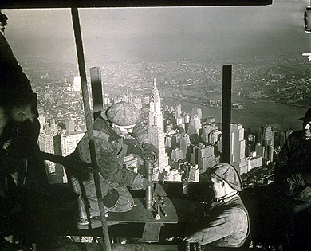
Photography, 30s.
a
Construction workers in NY.
Robert Capa captures on film the Spanish Civil War, notably Death of a Loyalist Soldier.
Notes:
Migrant Mother by Dorothea Lange. American combat photographer, Robert Capa captures on film the Spanish Civil War, notably Death of a Loyalist Soldier.
When The Falling Soldier was published in the July 12, 1937, issue of Life magazine, the caption stated, "Robert Capa's camera catches a Spanish soldier the instant he is dropped by a bullet through the head in front of C羊doba." Over the following years and decades, during and after Capa's death, the photograph was widely published without any questions ever being raised about its reliability as an unposed document.

Slide 19
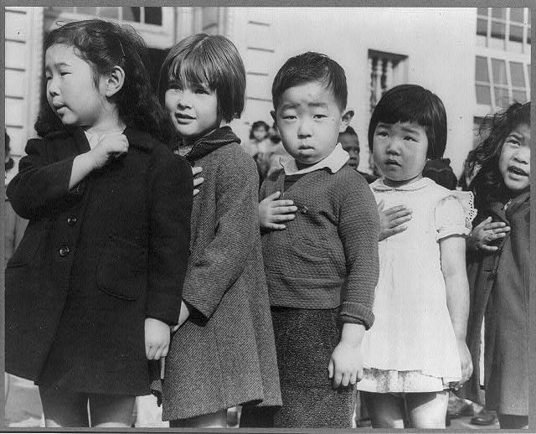
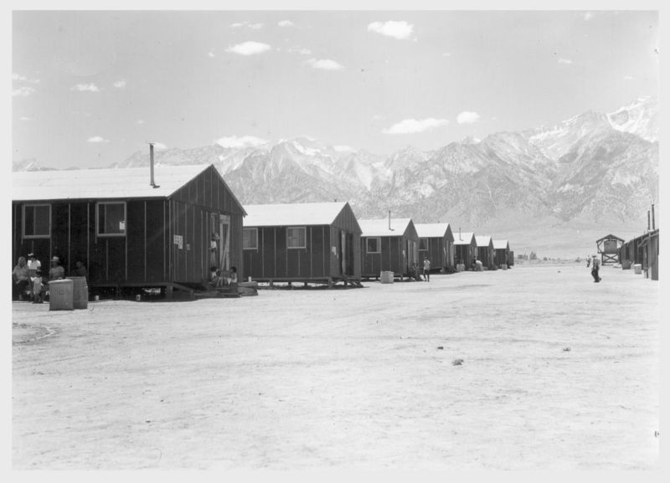
Photography, 40s.
Children at the Weill public school in San Francisco pledge allegiance to the American flag in April 1942, prior to the internment of Japanese Americans in concentration camps.
PHOTOGRAPHER: Dorothea Lange
TITLE: “San Francisco, Calif., Mar. 1942.“
A large sign reading "I am an American" placed in the window of a store, at 13th and Franklin streets, on December 8, the day after Pearl Harbor. The store was closed following orders to persons of Japanese descent to evacuate from certain West Coast areas. The owner, a University of California graduate, will be housed with hundreds of evacuees in War Relocation Authority centers for the duration of the war
Title: Manzanar, California-
Photographer: Lange, Dorothea
California. 7/2/42 Far end of barrack row looking west to the desert beyond with the mountains in the background.
Evacuees at this War Relocation Authority center are encountering the terrific desert heat.
Notes:
Forced evacuation of Japanese-Americans (Nisei) to relocation camps in the American West, on assignment for the War Relocation Authority (WRA).
Title: Manzanar, Calif.--Far end of barrack row looking west to the desert beyond with the mountains in the background. Evacuees at this War Relocation Authority center are encountering the terrific desert heat. -- Photographer: Lange, Dorothea -- Manzanar, California. 7/2/42

Slide 20
The Frankfurt School
• Theodor Adorno
• Walter Benjamin
Notes:
Frankfurt School
The Frankfurt School is a school of neo-Marxist critical theory, social research, and philosophy. The grouping emerged at the Institute for Social Research (Institut für Sozialforschung) of the University of Frankfurt am Main in Germany when Max Horkheimer became the Institute's director in 1930. The term "Frankfurt School" is an informal term used to designate the thinkers affiliated with the Institute for Social Research or influenced by them. It is not the title of any institution, and the main thinkers of the Frankfurt School did not use the term to describe themselves.
The Frankfurt School gathered together dissident Marxists, severe critics of capitalism who believed that some of Marx's followers had come to parrot a narrow selection of Marx's ideas, usually in defense of orthodox Communist or Social-Democratic parties

Slide 21
Theodor Adorno
…was worried about the "distracted" relation to art characteristic of mass consumption.
Notes:
Frankfurt School

Slide 22
Walter Benjamin
…argued that the development of “the aura” was a complicated historical development.
Having began as a consequence of ritual function, became linked to politics when, technology allowed the work of art to be infinitely reproduced, without to being able to differentiate “the Original” from the “copies”.
Notes:
Frankfurt School
] http://filer.case.edu/~ngb2/Authors/Benjamin.html

Slide 23
The work of Art in the Age of Mechanical Reproduction. Walter Benjamin
A work of art has always been REPRODUCTIBLE
Imitated by men.
The difference between the ORIGINAL and the COPIES
was clear
• Engraving
• Etching
• Lithography

Slide 24
The work of Art in the Age of Mechanical Reproduction. Walter Benjamin
Around 1900 technology had reached a standard that permitted it
to reproduce all transmitted works of art and thus to cause the most profound change
in their impact upon the public;
it also had captured a place of its own among the artistic processes.

Slide 25
The work of Art in the Age of Mechanical Reproduction. Walter Benjamin
Quality?
Confronted with its manual reproduction
the original preserved all its authority
a
u
r
a
The presence of the ORIGINAL
Is a prerequisite to the concept of authenticity
Notes:
Confronted with its manual reproduction, which was usually branded as a forgery, the original preserved all its authority;

Slide 26
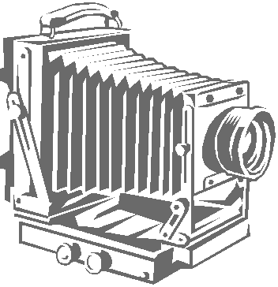
The work of Art in the Age of Mechanical Reproduction. Walter Benjamin
The process of reproduction can bring out those aspects of the original that are unattainable to the naked eye yet accessible to the lens,
Quality?
a
u
r
a
With the aid of certain processes, such as enlargement or slow motion, the camera can capture images which escape natural vision.
Technical reproduction can put the copy of the original into situations which would be out of reach for the original itself.
Notes:
in photography, process reproduction can bring out those aspects of the original that are unattainable to the naked eye yet accessible to the lens, which is adjustable and chooses its angle at will. And photographic reproduction, with the aid of certain processes, such as enlargement or slow motion, can capture images which escape natural vision. Secondly, technical reproduction can put the copy of the original into situations which would be out of reach for the original itself.
The authenticity of a thing is the essence of all that is transmissible from its beginning, ranging from its substantive duration to its testimony to the history which it has experienced.

Slide 27
The work of Art in the Age of Mechanical Reproduction. Walter Benjamin
a
u
r
a
The technique of reproduction detaches the reproduced object from the domain of Tradition.
By making many reproductions, it substitutes a plurality of copies for a unique existence, and in permitting the reproduction to meet the beholder or listener in his own particular situation, it reactivates the object reproduced.
Notes:
One might subsume the eliminated element in the term ﾒauraﾓ and go on to say: that which withers in the age of mechanical reproduction is the aura of the work of art. This is a symptomatic process whose significance points beyond the realm of art. One might generalize by saying: the technique of reproduction detaches the reproduced object from the domain of tradition. By making many reproductions it substitutes a plurality of copies for a unique existence. And in permitting the reproduction to meet the beholder or listener in his own particular situation, it reactivates the object reproduced. These two processes lead to a tremendous shattering of tradition which is the obverse of the contemporary crisis and renewal of mankind.

Slide 28
The work of Art in the Age of Mechanical Reproduction. Walter Benjamin
a
u
r
a
These two processes lead to a tremendous shattering of tradition which is the origin of the contemporary crisis and renewal of mankind.
Notes:
One might subsume the eliminated element in the term ﾒauraﾓ and go on to say: that which withers in the age of mechanical reproduction is the aura of the work of art. This is a symptomatic process whose significance points beyond the realm of art. One might generalize by saying: the technique of reproduction detaches the reproduced object from the domain of tradition. By making many reproductions it substitutes a plurality of copies for a unique existence. And in permitting the reproduction to meet the beholder or listener in his own particular situation, it reactivates the object reproduced. These two processes lead to a tremendous shattering of tradition which is the obverse of the contemporary crisis and renewal of mankind.

Slide 29
The work of Art in the Age of Mechanical Reproduction. Walter Benjamin
?
a
u
r
a
Both processes are intimately connected with the contemporary mass movements
Their most powerful agent being FILM.
Its social significance, is inconceivable without its destructive, cathartic aspect, that is, the liquidation of the traditional value of the cultural heritage
Notes:
Both processes are intimately connected with the contemporary mass movements. Their most powerful agent is the film. Its social significance, particularly in its most positive form, is inconceivable without its destructive, cathartic aspect, that is, the liquidation of the traditional value of the cultural heritage. This phenomenon is most palpable in the great historical films. It extends to ever new positions. In 1927 Abel Gance exclaimed enthusiastically:ﾒShakespeare, Rembrandt, Beethoven will make films... all legends, all mythologies and all myths, all founders of religion, and the very religions... await their exposed resurrection, and the heroes crowd each other at the gate.ﾓPresumably without intending it, he issued an invitation to a far-reaching liquidation.

Slide 30
The work of Art in the Age of Mechanical Reproduction. Walter Benjamin
a
u
r
a
In 1927 Abel Gance exclaimed enthusiastically about film:
“…Shakespeare, Rembrandt, Beethoven will make films... all legends, all mythologies and all myths, all founders of religion, and the very religions... await their exposed resurrection, and the heroes crowd each other at the gate”
Notes:
Both processes are intimately connected with the contemporary mass movements. Their most powerful agent is the film. Its social significance, particularly in its most positive form, is inconceivable without its destructive, cathartic aspect, that is, the liquidation of the traditional value of the cultural heritage. This phenomenon is most palpable in the great historical films. It extends to ever new positions. In 1927 Abel Gance exclaimed enthusiastically:ﾒShakespeare, Rembrandt, Beethoven will make films... all legends, all mythologies and all myths, all founders of religion, and the very religions... await their exposed resurrection, and the heroes crowd each other at the gate.ﾓPresumably without intending it, he issued an invitation to a far-reaching liquidation.

Slide 31
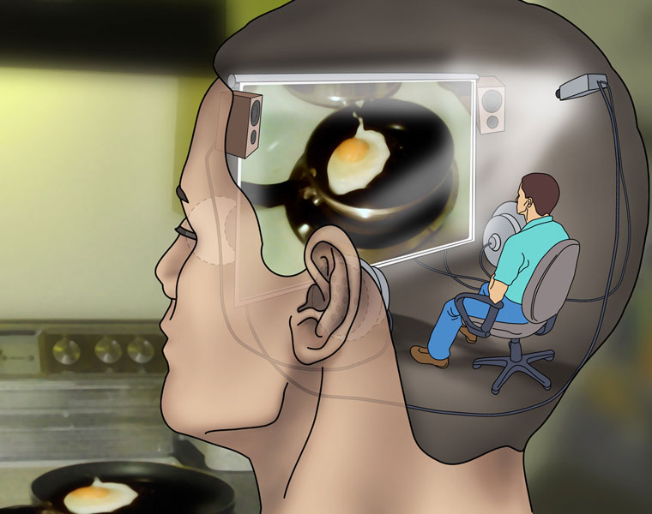
The work of Art in the Age of Mechanical Reproduction. Walter Benjamin
The mode of
human sense
of
perception
Humanity’s entire mode
Of existence
Changes
with

Slide 32
The work of Art in the Age of Mechanical Reproduction. Walter Benjamin
Of a natural entity:
Subtle. Perceivable in contemplation (quiet)
Isolating the importance of the experience
a
u
r
a
SOCIAL BASIS of contemporary decay of “the aura”
Related to the increasing significance of “the masses” in contemporary life.
Spatially humanly
The DESIRE of Contemporary masses to bring things CLOSER
As ardent as their bent towards OVERCOMING the UNIQUENESS of every reality, by accepting its reproduction.
Notes:
The concept of aura which was proposed above with reference to historical objects may usefully be illustrated with reference to the aura of natural ones. We define the aura of the latter as the unique phenomenon of a distance, however close it may be.

Slide 33
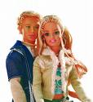
The work of Art in the Age of Mechanical Reproduction. Walter Benjamin
Do we have a desire as consumers to overcome uniqueness?
Don’t we sacrifice that as an exchange for price and consistency of the product?

Slide 34
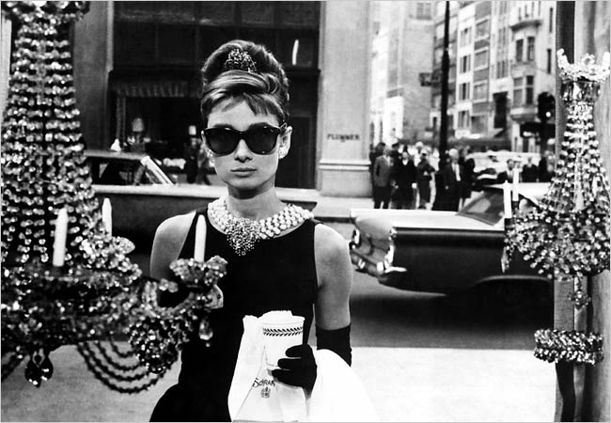
The work of Art in the Age of Mechanical Reproduction. Walter Benjamin
The uniqueness of a work of art is inseparable from its being imbedded in the fabric of tradition.
Notes:
the existence of the work of art with reference to its aura is never entirely separated from its ritual function.
In other words, the unique value of the ﾒauthenticﾓ work of art has its basis in ritual, the location of its original use value
This ritualistic basis, however remote, is still recognizable as secularized ritual even in the most profane forms of the cult of beauty. The secular cult of beauty, developed during the Renaissance and prevailing for three centuries, clearly showed that ritualistic basis in its decline and the first deep crisis which befell it.

Slide 35
The work of Art in the Age of Mechanical Reproduction. Walter Benjamin
The unique value of the “authentic” work of art has its basis in “ritual”
This ritualistic basis, however remote, is still recognizable as secularized ritual even in the most profane forms of the cult of beauty
Notes:
the existence of the work of art with reference to its aura is never entirely separated from its ritual function.
In other words, the unique value of the ﾒauthenticﾓ work of art has its basis in ritual, the location of its original use value
This ritualistic basis, however remote, is still recognizable as secularized ritual even in the most profane forms of the cult of beauty. The secular cult of beauty, developed during the Renaissance and prevailing for three centuries, clearly showed that ritualistic basis in its decline and the first deep crisis which befell it.

Slide 36
An Analysis of Art in the Age of Mechanical Reproduction
mechanical reproduction emancipates the work of art from its parasitical dependence on ritual.
From a photographic negative, one can make any number of prints; to ask for the “authentic” print makes no sense.
The instant the criterion of authenticity ceases to be applicable to artistic production,
the total function of art is reversed.
Instead of being based on ritual, it begins to be based on another practice: politics.
Notes:
With the advent of the first truly revolutionary means of reproduction, photography, simultaneously with the rise of socialism, art sensed the approaching crisis which has become evident a century later. At the time, art reacted with the doctrine of lﾕart pour lﾕart, that is, with a theology of art. This gave rise to what might be called a negative theology in the form of the idea of ﾒpureﾓ art, which not only denied any social function of art but also any categorizing by subject matter. (In poetry, Mallarme was the first to take this position.)
An analysis of art in the age of mechanical reproduction
mechanical reproduction emancipates the work of art from its parasitical dependence on ritual.
From a photographic negative, for example, one can make any number of prints; to ask for the ﾒauthenticﾓ print makes no sense.
the instant the criterion of authenticity ceases to be applicable to artistic production, the total function of art is reversed. Instead of being based on ritual, it begins to be based on another practice ﾐ politics.

Slide 37
An Analysis of Art in the Age of Mechanical Reproduction
The cult of beauty is still linked to the love/admiration to what is thought as unique
Mechanical reproduction destroys the historical mystique around beauty
Notes:
With the advent of the first truly revolutionary means of reproduction, photography, simultaneously with the rise of socialism, art sensed the approaching crisis which has become evident a century later. At the time, art reacted with the doctrine of lﾕart pour lﾕart, that is, with a theology of art. This gave rise to what might be called a negative theology in the form of the idea of ﾒpureﾓ art, which not only denied any social function of art but also any categorizing by subject matter. (In poetry, Mallarme was the first to take this position.)
An analysis of art in the age of mechanical reproduction
mechanical reproduction emancipates the work of art from its parasitical dependence on ritual.
From a photographic negative, for example, one can make any number of prints; to ask for the ﾒauthenticﾓ print makes no sense.
the instant the criterion of authenticity ceases to be applicable to artistic production, the total function of art is reversed. Instead of being based on ritual, it begins to be based on another practice ﾐ politics.

Slide 38
Walter Benjamin on Film

Slide 39
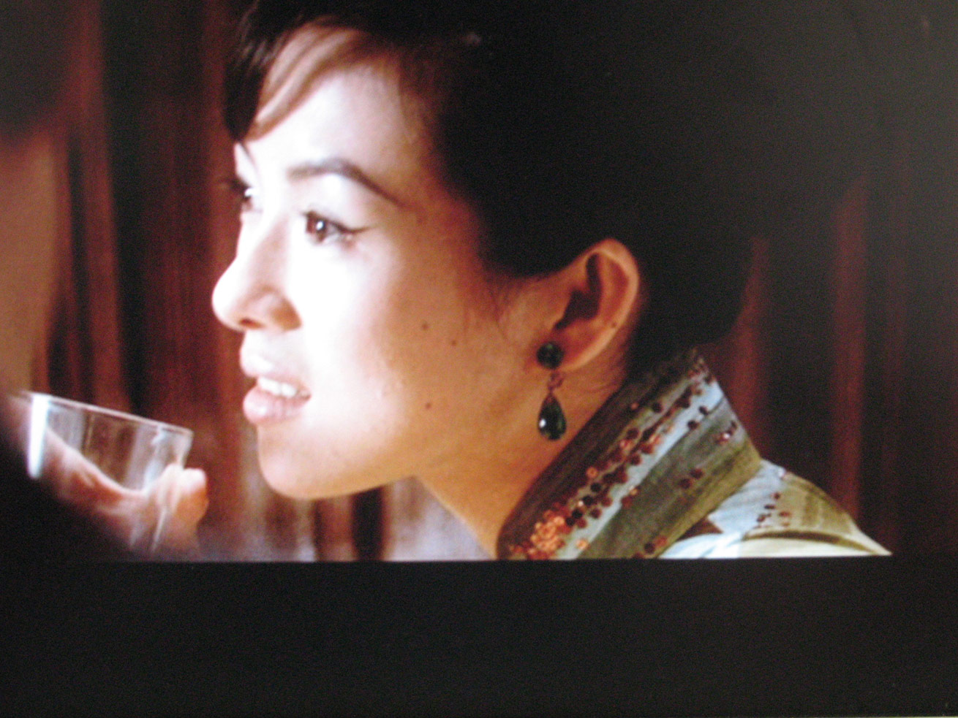
Film as a Revolutionary Medium
The actor
The part is acted for a mechanical contrivance
The man has to operate with his whole living person, yet forgoing his aura (linked to the physical presence)
Elementary necessities of equipment split the actor’s work into a series of mountable episodes

Slide 40
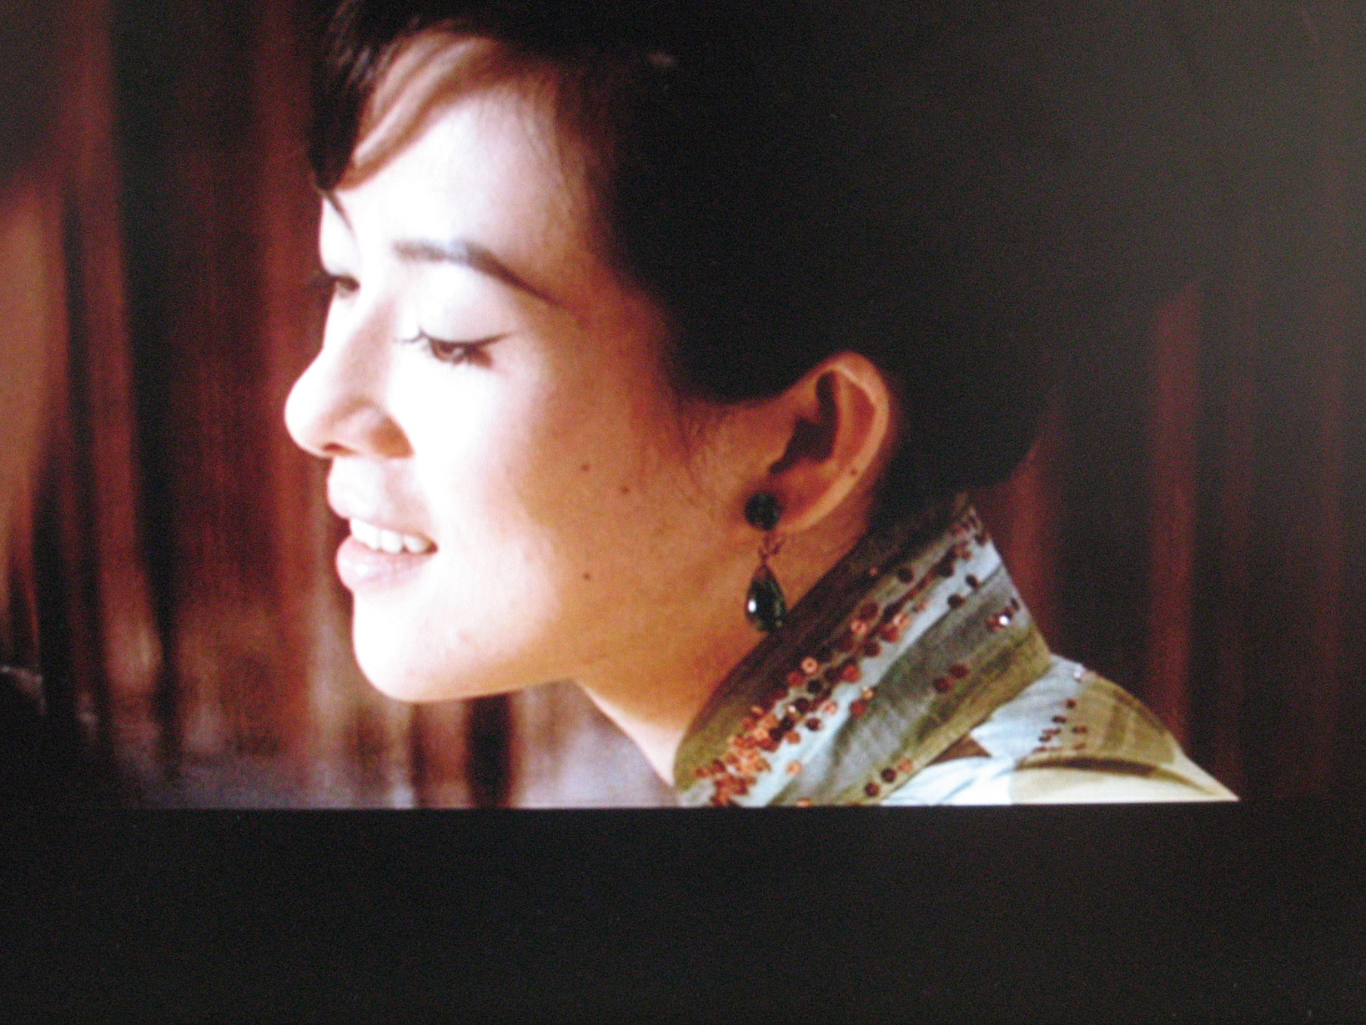
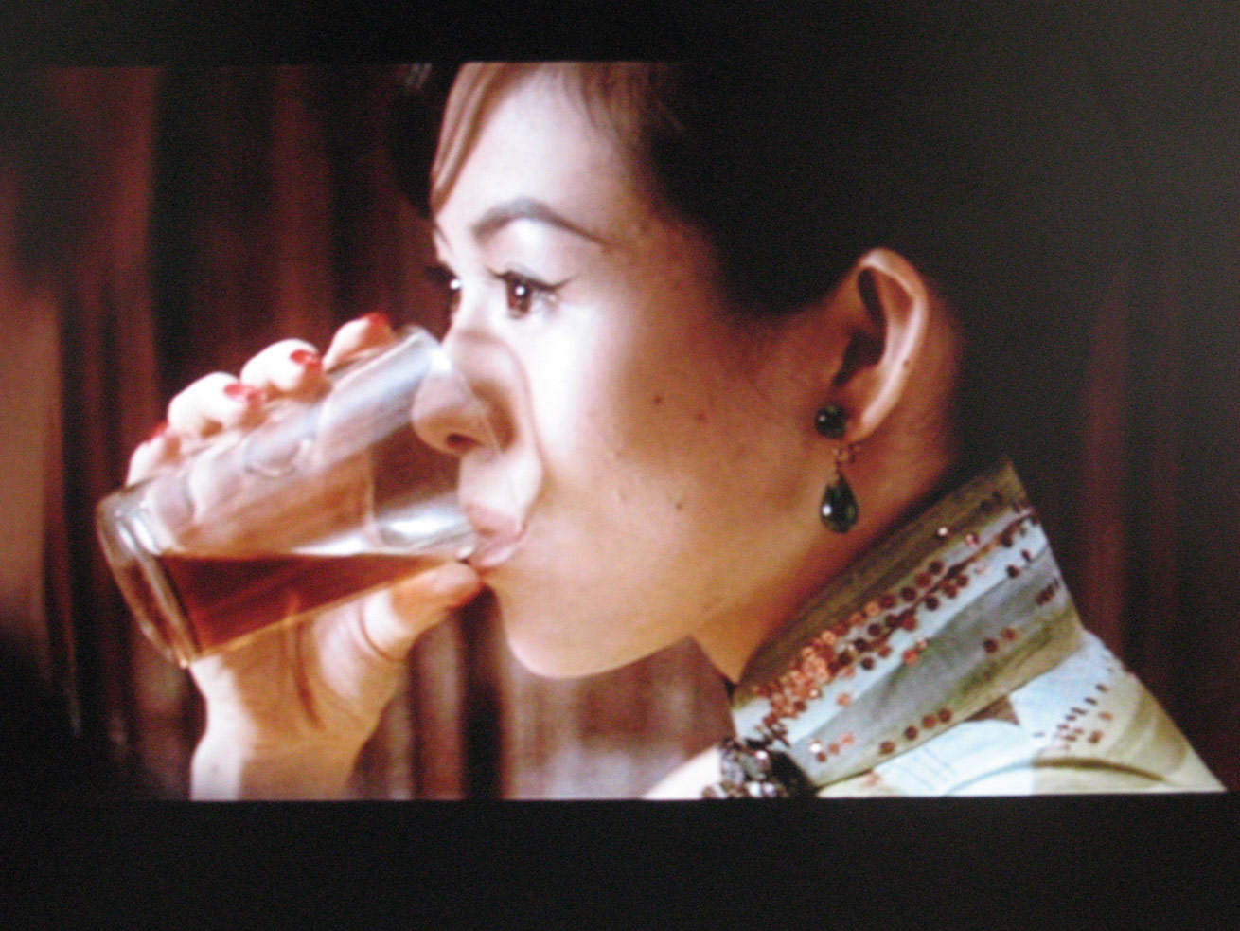
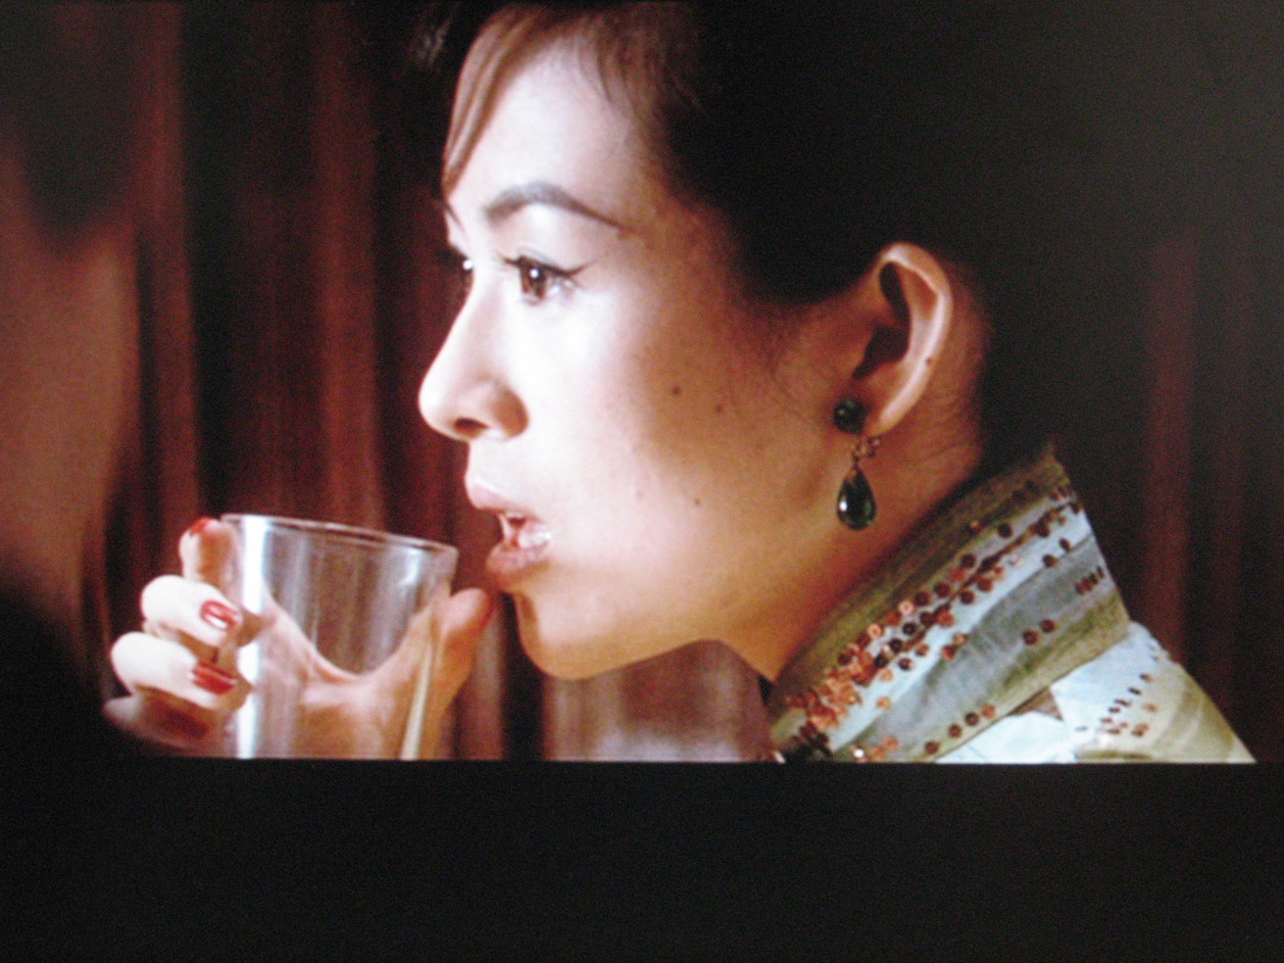
Film as a Revolutionary Medium
The camera
Film portrays a space consciously explored by man.
The act of reaching for a lighter or a spoon is familiar routine, yet we hardly know what really goes on between hand and metal, not to mention how this fluctuates with our moods.
Kidnapping of the actor’s aura .
Notes:
Benjamin: The close-up makes space expands… it reveals entirely new structural formations of the subject.
Film portrays a space consciously explored by man.
The act of reaching for a lighter or a spoon is familiar routine, yet we hardly know what really goes on between hand and metal, not to mention how this fluctuates with our moods.
Won Kar Wai “2046”. 2004
In the Mood for Love, 2000 Hong Kong
Happy together, 1997
Chungking Express, 1994

Slide 41
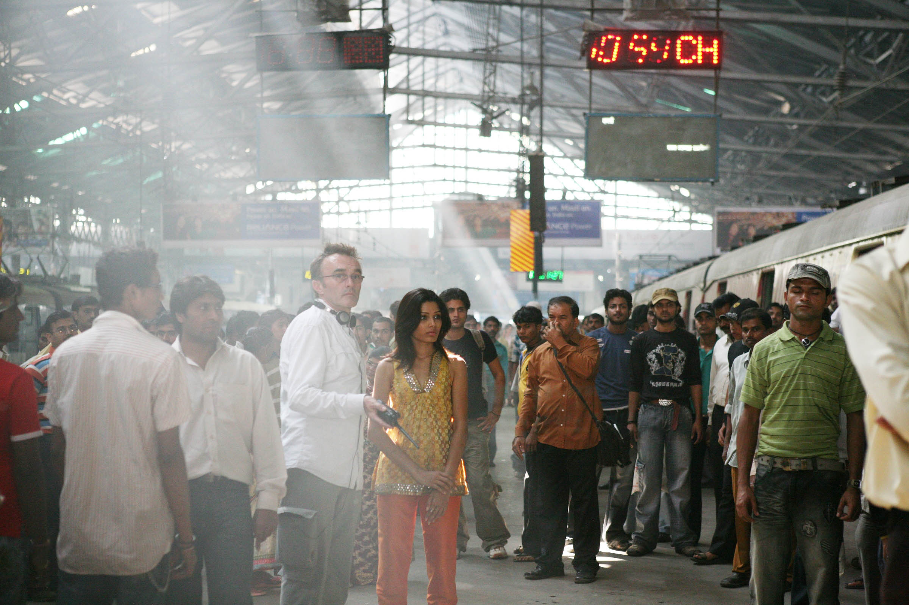
Film as a Revolutionary Medium
Technology
The Beautiful semblance of live is created through an artifice: The lie of technology
Set/ Lighting/ camera moves/ camera takes/ special effects/ Editing/ Post production
The right metaphor for the film process is surgery

Slide 42
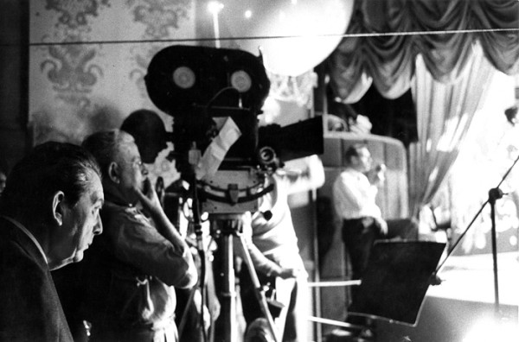
Film as a Revolutionary Medium
The camera
We don’t identify with the actor’s work, we mostly identify with the camera, since we “see” through its position, point of view and flow of movement The Editing of the camera shots become our eyes, witnessing the story.
Notes:
we identify ourselves with the editing of the camera shots, that become our eyes, witnessing the story.

Slide 43
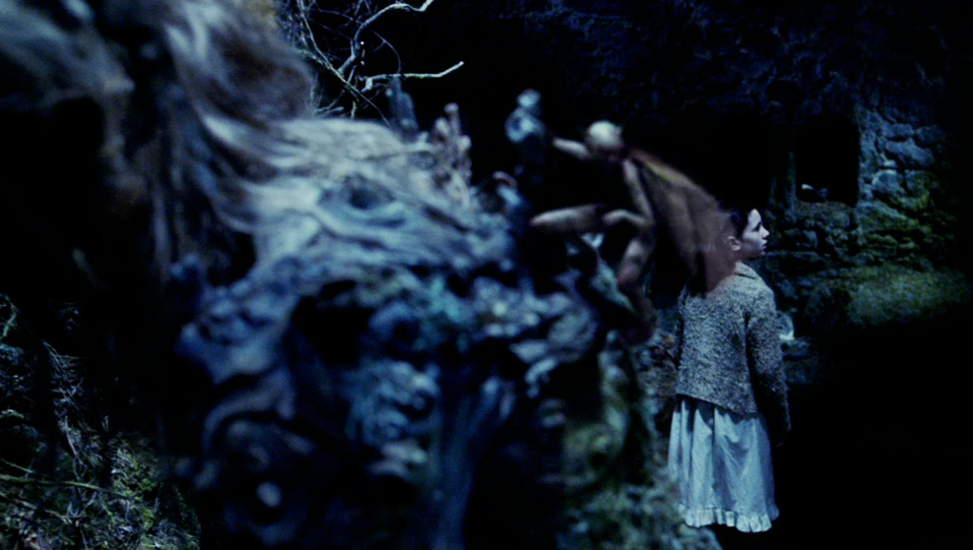
Film as a Revolutionary Medium
Technology
The actor’s work is a very small part of the production. The film is created in the Editing room. Its Illusionary nature is the result of cutting.

Slide 44
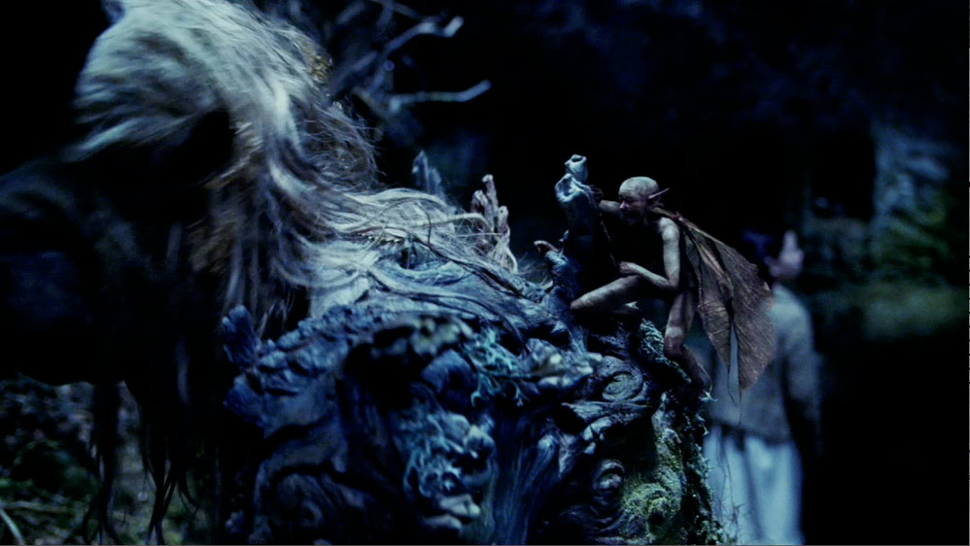
Film as a Revolutionary Medium
Technology
The reflected image (of the actor) has become separable, transportable.
Notes:
The manner in which man presents himself to mechanical equipment.

Slide 45
Film as a Revolutionary Medium
Technology
Does the actor needs to be a movie-star, a personality built up outside the studio?
Notes:
The filmed behavior lends itself more readily to analysis because it can be isolated more easily.
By focusing on hidden details of familiar objects.. The film extends our comprehension of the necessities which rule our lives.

Slide 46
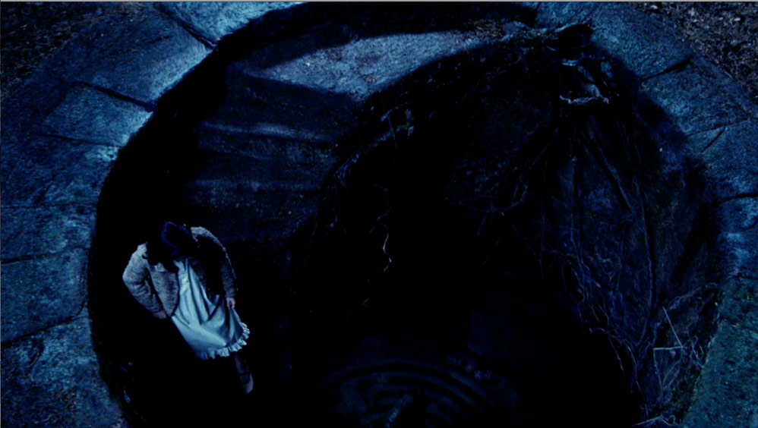
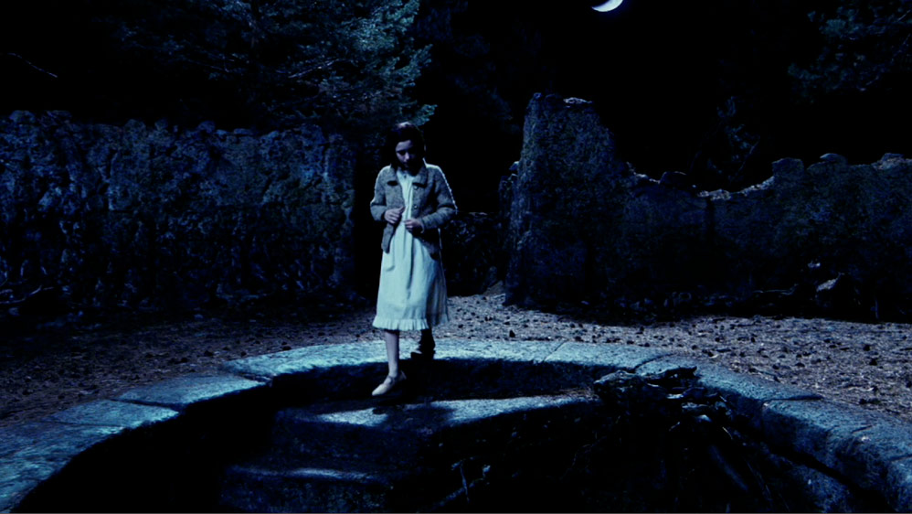
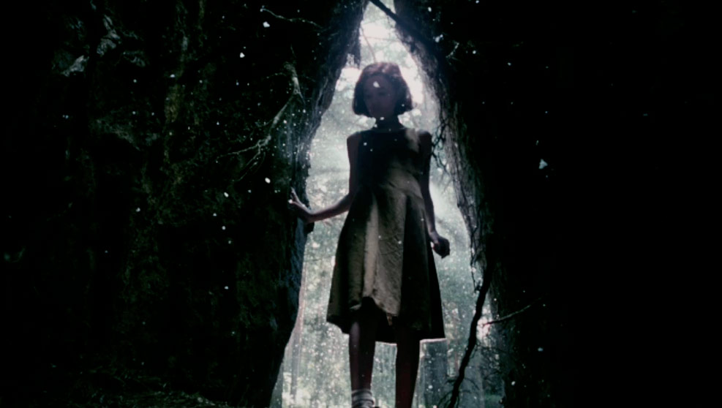
Film as a Revolutionary Medium
Technology
We remember the actor’s performance scattered through the shots. Its efficacy really depends on the director’s job.
Notes:
The character’s aura is re-created with the support of all the different aspects of the film, based on the actor’s aura.
The film has enriched our field of perception with methods that can be illustrated by Freudian theory.

