Slide 1
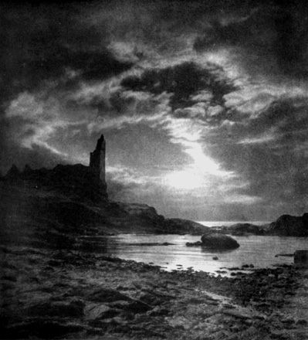
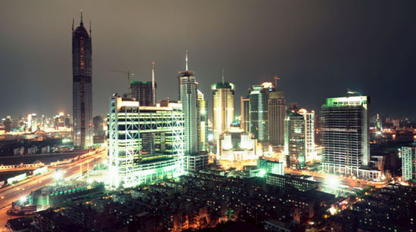
Societies of
The pre-printing world
and
The electronic age
Will share beliefs which
are based on myths and
The unexplained.

Slide 2
As society moves forward with the
Convenience of technology
Society reverts backwards to rely and trust
Human emotions.

Slide 3
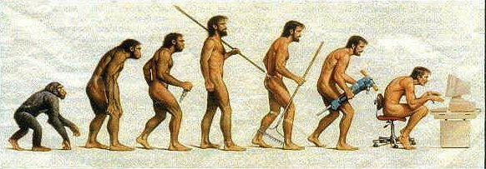
Are in fact results of our technology “carpentered” world or
The way that we & our ancestors have constructed dwelling since we emerged from caves.”
“What we feel to be intuitive notions of space and time

Slide 4
Pre-printing World
Visual
“When the constant was
Invented as a meaningless
Abstraction, vision detached
Itself from the other senses
And visual space began
To form”
-M. Mcluhan

Slide 5
“The world grows
Dark every night
but
Never really silent.”

Slide 6
“Vision
and hearing give us
first reports on
aspects of the world
with which
we are not yet
engaged.”
Electronic age

Slide 7
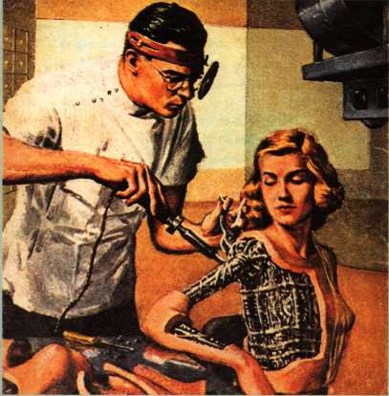
“We want media to
recapture elements
Of that biological
Communication”
-M. Mcluhan
“We want media
to Extend our
Communications beyond
The biological boundaries
Of naked
seeing and hearing”

Slide 8
“We become what we behold”
“We shape our tools,
and
thereafter our tools shape us.”
-M. Mcluhan

Slide 9
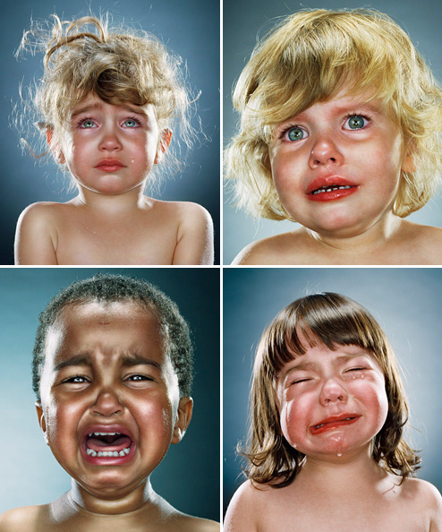
“A world in
which
humans begins
Become
commodities”
-M.Mcluhan
“The effect
of electric technology
had at first been anxiety”

Slide 10
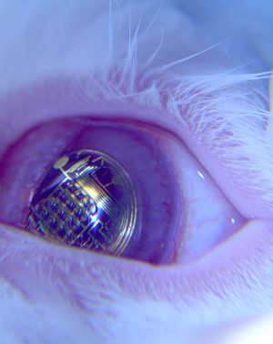
As society becomes more dependant on technology people are changed by technology versus people changing technology

Slide 11
Information
newspaper
TV
More
logic?
internet

Slide 12
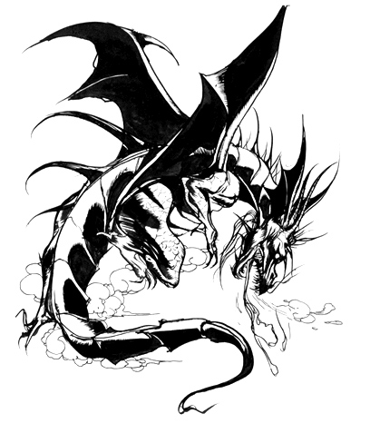
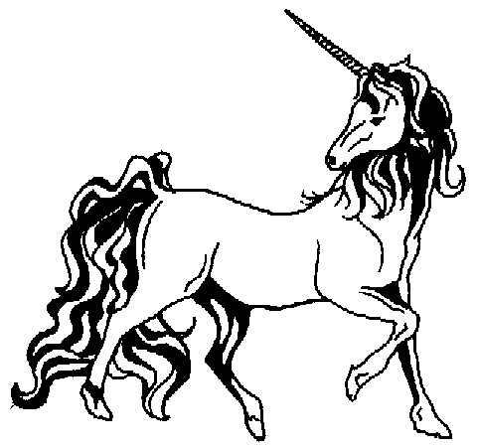
Humans
of both the
pre-printing world
& the electronic age
Rely on faiths and
Myths to explain the
Unknown.

