Slide 1
Hot & Cold Media Marshall McLuhan
Katie Anderson
MAT 103 : Fall 2009

Slide 2
Hot vs Cold
Hot and cold are temperatures of different media. Each media encourages different degrees of participation from the viewer.
HOT
Hot media is well filled with
data from high quality sources.
It is considered high definition and
intensely engages a single sense.
Hot media presents complete
Information and does not leave
much to be filled in or completed
by the audience.
COLD
Cold media provides less data
for the viewer. It is considered
low definition and loosely
engages multiple senses. Cold
media presents little information
and invites high levels of
participation and completion
by the audience.

Slide 3
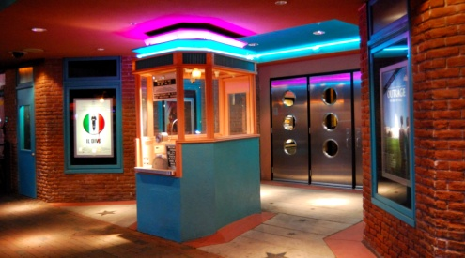
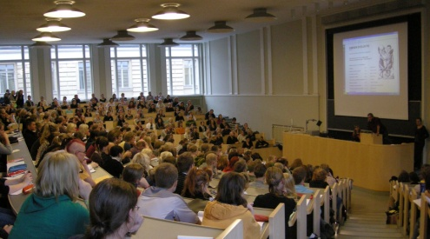
Hot Media
Hot media fully engages the participants requiring less participation.
Lower participation creates a passive audience.
Explosive - Intense - Bright - Clear - Loud - Dramatic - Excludes - Intoxicating
Dazzling - Instructive - Definitive - Overpowering - Linear - Logical - High Definition
Printed Books - Newspapers - Lectures - Motion Pictures - Photography - Radio

Slide 4
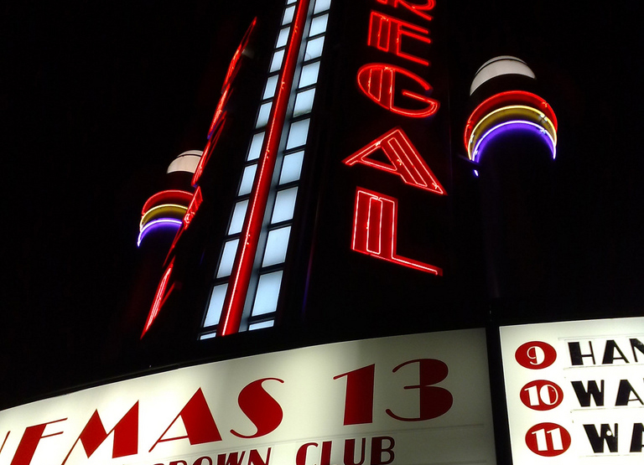
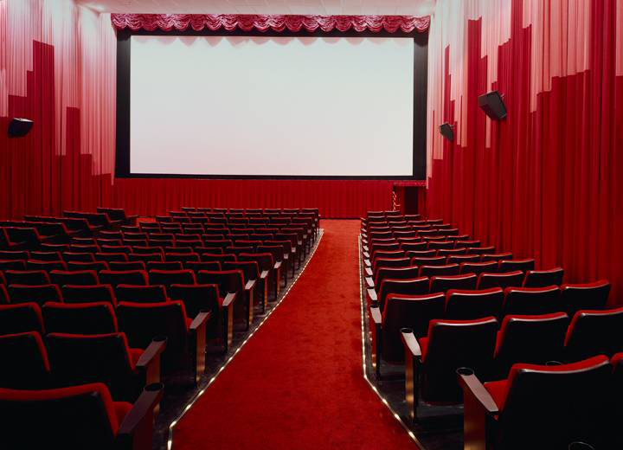
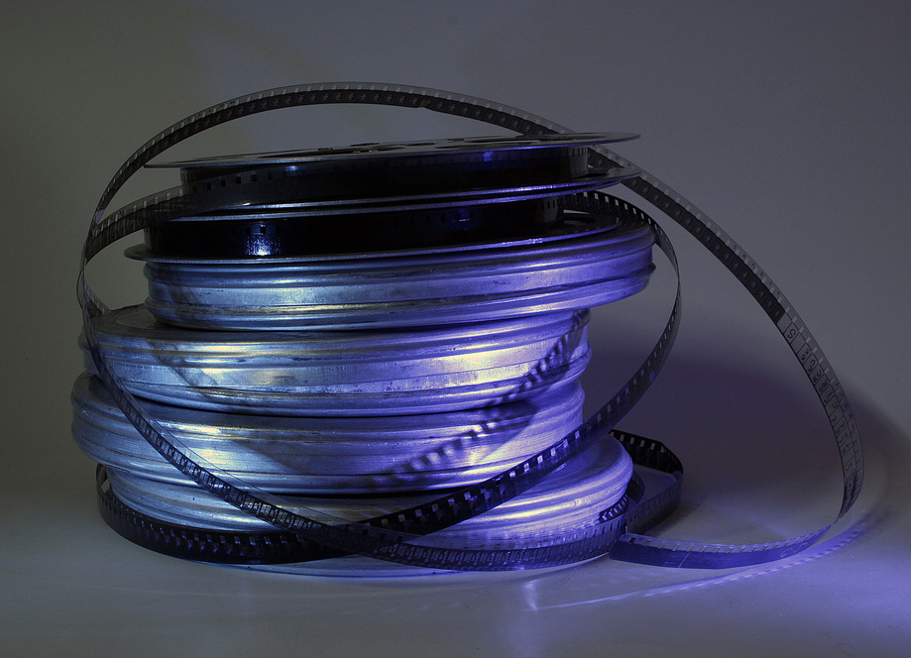
HOT
FILM
High Definition
Low participation
Demands viewer’s attention
Intense, bright, and intoxicating

Slide 5
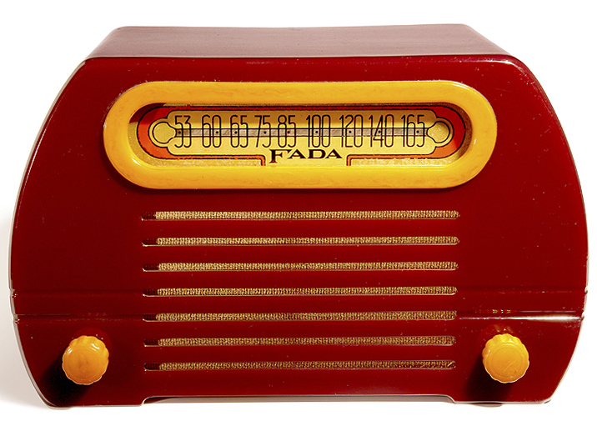
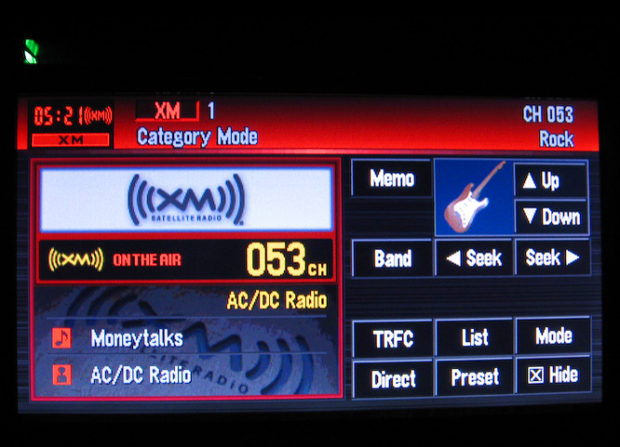
HOT
RADIO
High Definition
Low participation
Intense focus on the ear
Clear and complete audio

Slide 6
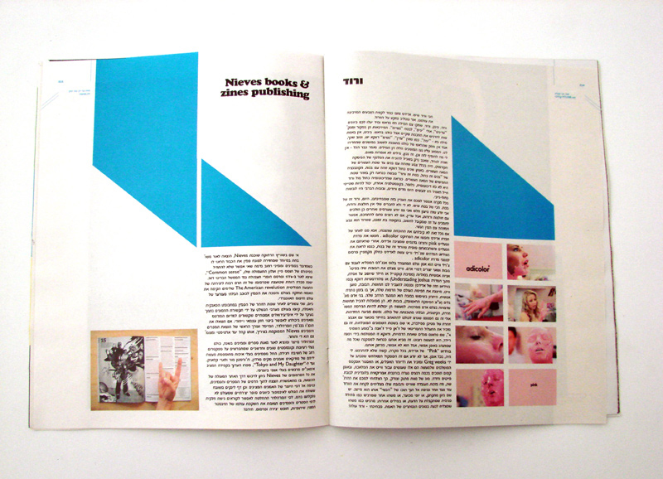
HOT
PRINTED WORD
High Definition
Low participation
Provides complete information
Sequential, linear, and logical

Slide 7
HOT
PHOTOGRAPH
High Definition
Low participation
Sharp in definition
Visual emphasis

Slide 8
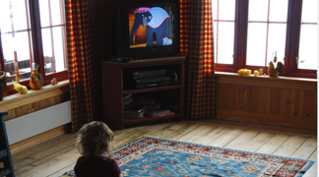
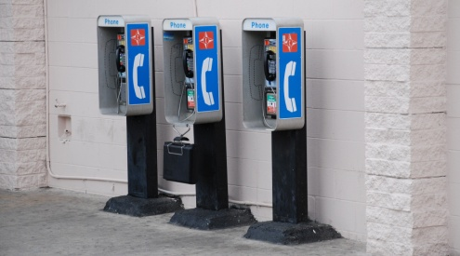
Cold Media
Cold media invites participation by the incomplete information it offers.
Higher participation creates an active audience.
Understated - Fleeting - Blurred - Soft - Intimate - Seducing – Includes
Intriguing - Incomplete - Detached - Light - Low Definition
Television - Seminar - Cartoons - Hieroglyphics - Telephone

Slide 9
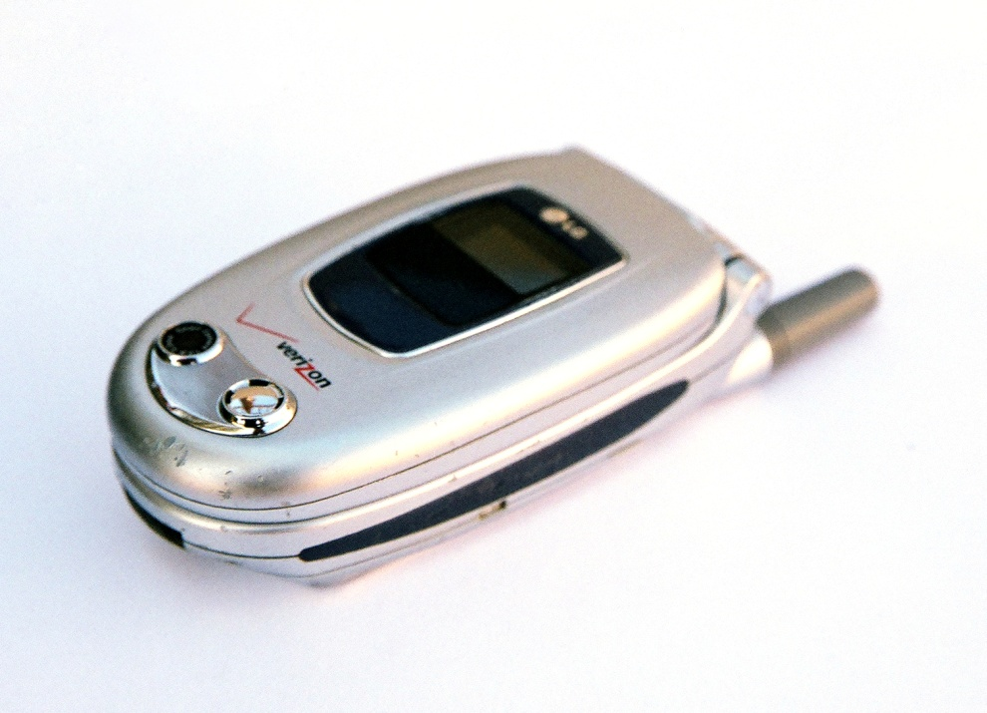
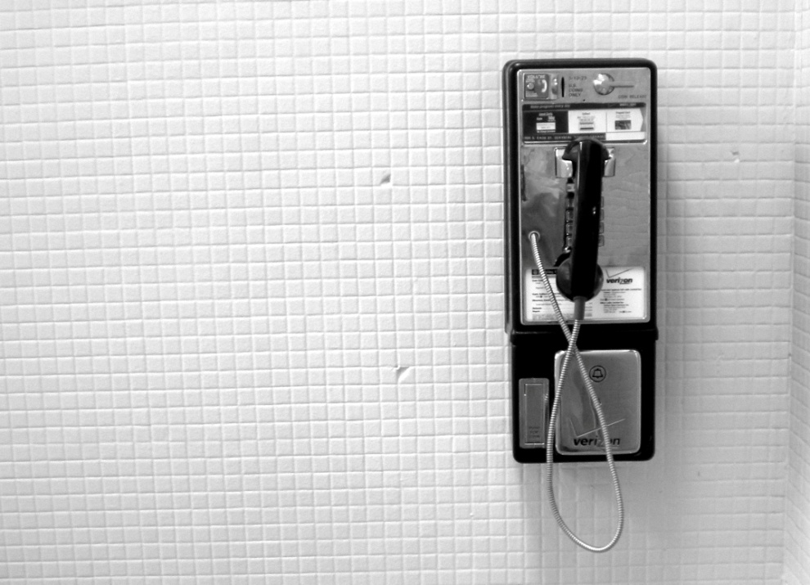
COLD
TELEPHONE
Low Definition
High Participation
Ear is given minimal information requiring much to be filled in by the listener

Slide 10
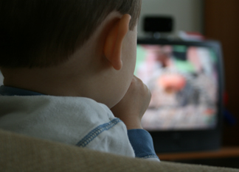
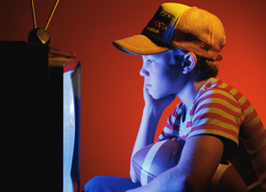
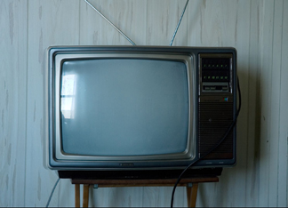
COLD
TELEVISION
Low Definition
High Participation
Requires more effort on the part of viewer to determine the meaning

Slide 11
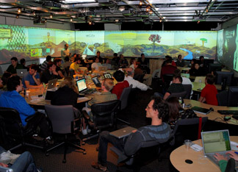
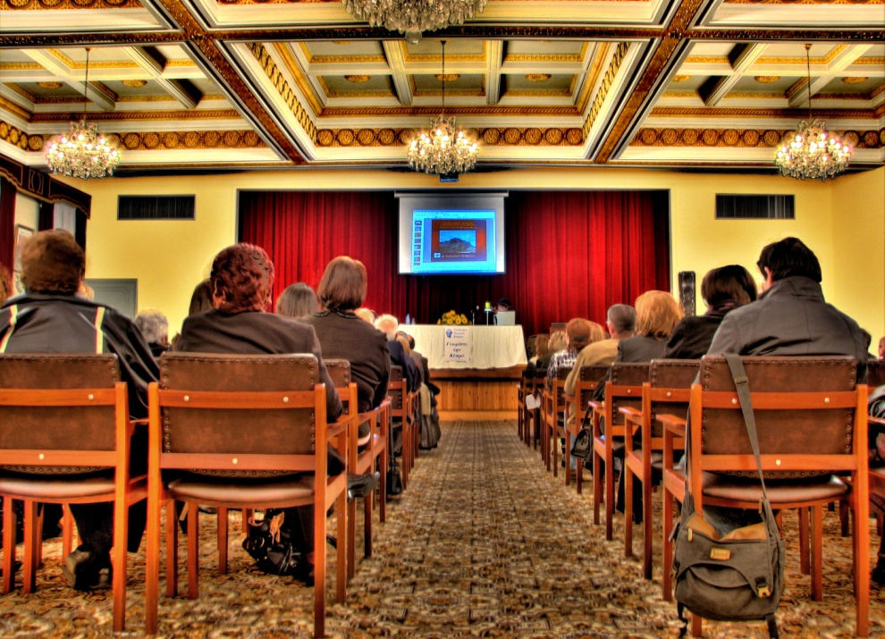
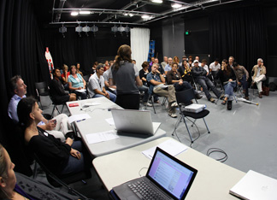
COLD
SEMINAR
Low Definition
High Participation
Requires participation from the
audience to complete the information

Slide 12
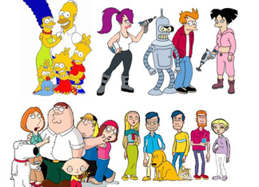
COLD
CARTOON
Low Definition
High Participation
Minimal visual information is provided
requiring effort to fill in the details

Slide 13
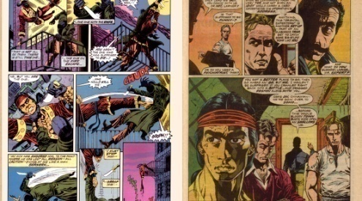
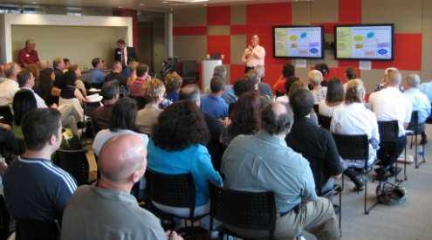
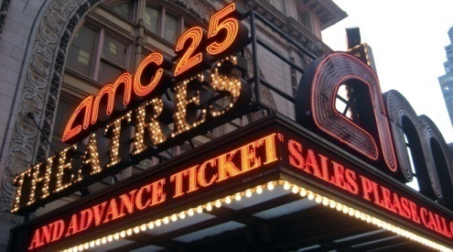
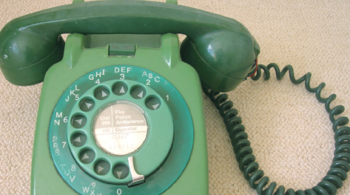
Hot & Cold
Hot and cold mediums have very different effects on the user.
The temperature of a medium comes from the degree of intensity of its engagements.
Hot media offers complete information and requires
low participation from the audience.
Cold media offers incomplete information and requires
high participation from the audience.

Slide 14
The End

