Slide 1
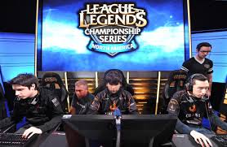
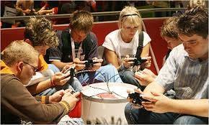
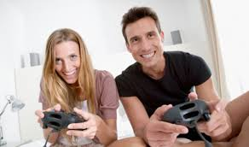
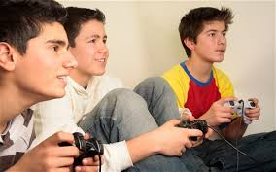
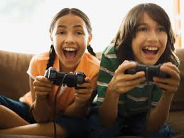
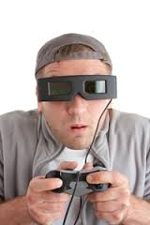
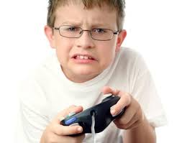
A Gaming Society
By Alex Crapo

Slide 2
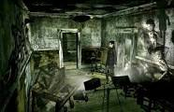
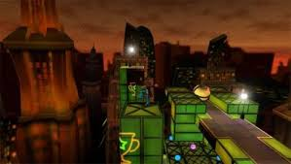
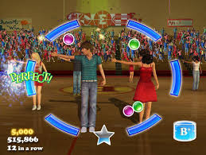
Still images
Has grown to be an art form
Still Images
Moving images
Text
Audio
Three-dimensional
Navigable Space
Art Form
Moving images
Audio
Text
Video Games
3D
Navigable

Slide 3
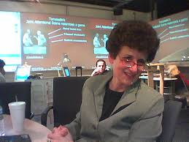
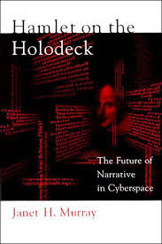

Slide 4
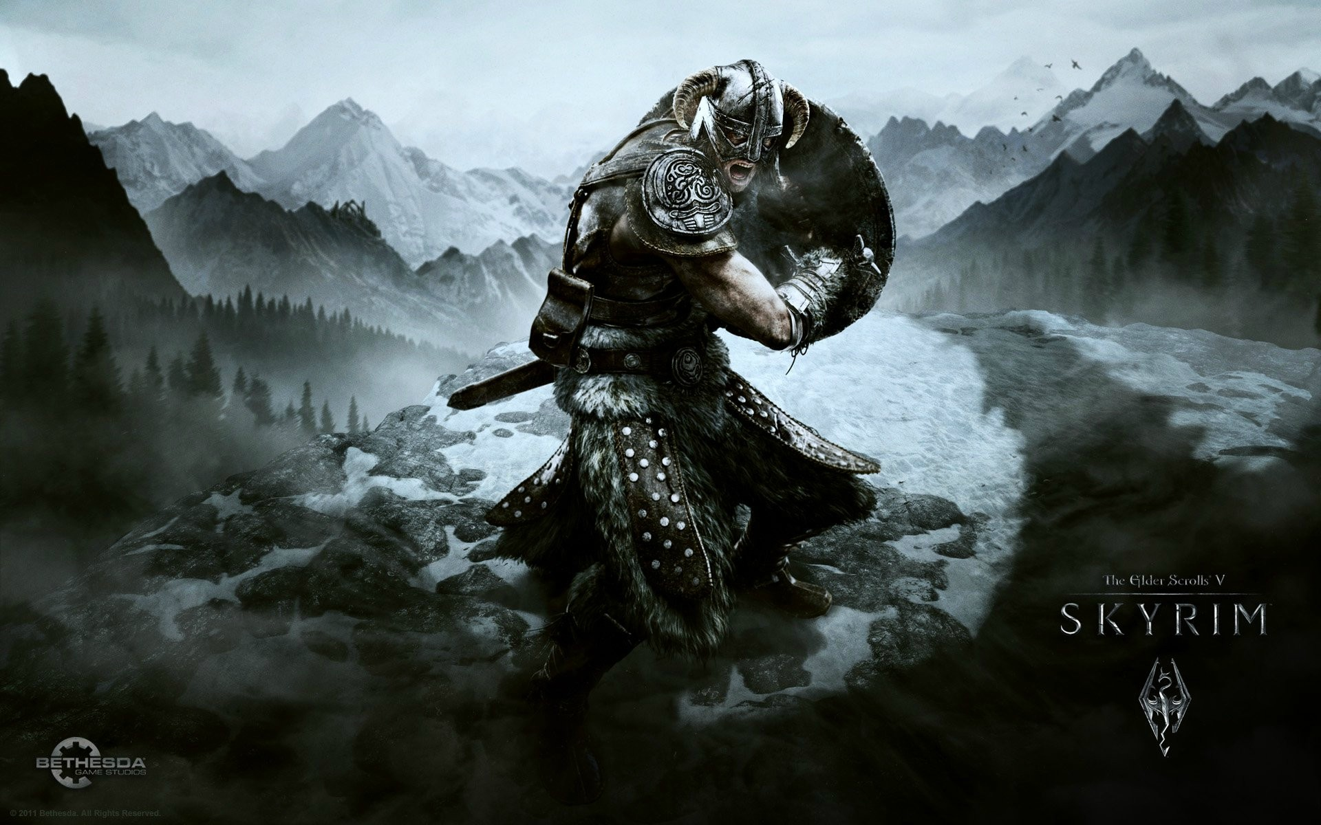
Murray’s Thesis
Cyberdrama
Active Audience
Game-story
Games are always stories

Slide 5
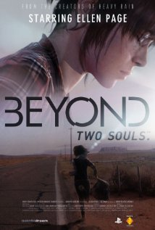
What is Cyberdrama?
Cyberdrama is an enactment of the story in the particular fictional space of the computer.

Slide 6
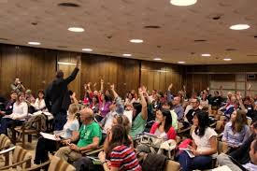
Active Audience
Hamlet on the Holodeck discusses a short scene where the audience
Members actively changed their behavior, probably unconsciously This was
a great, relatable, example..
Not Passive
Lots of people are actively involved in situations but are unaware of the part of that when people take the information given and process it using their lifestyles, knowledge, and experiences

Slide 7
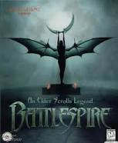
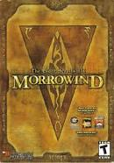
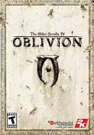
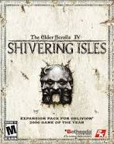
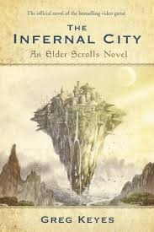
Games and Stories
Game-Story
Games have quickly progressed into new formats made possible by the rapid advancement of gaming technology. They are able to use more of the building blocks of storytelling then ever before.
Stories that have one plot line can be turned into a game with multiple options and opportunities to change the outcome.
Two important structures shared by
games and stories:
The Content
and
The Puzzle

Slide 8
The puzzle
A contest between the player and game-designer

Slide 9
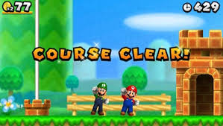
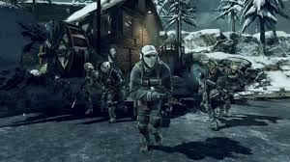
The contest

Slide 10
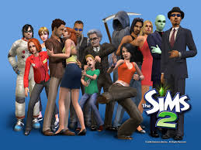
Simulation…
… the imitation of a real world processes
Social Simulation explores social interactions
between multiple artificial lives.
Kinds of simulation
Government simulation
Sports Simulation
Vehicle simulation
Train Simulations
Biological simulation
Social Simulation
Business Simulation
Construction and management simulation
Trade Simulation
Photo Simulation
Medical Simulation

Slide 11
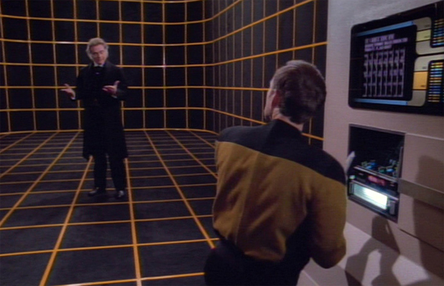
The Hamlet in the Holodeck
The Holodeck (a simulation tool) allows users to create their own alternate reality that Simulates the real world.

Slide 12
Learn a Lesson
“ We rely on works of fiction in any medium, to help us understand the world and what it means to be human.”
Despite Janet Mcgonigal pointing out so many flaws in cyber technology, she believes that we can learn more, increase communication, and the gaming industry will continue to grow.

Slide 13
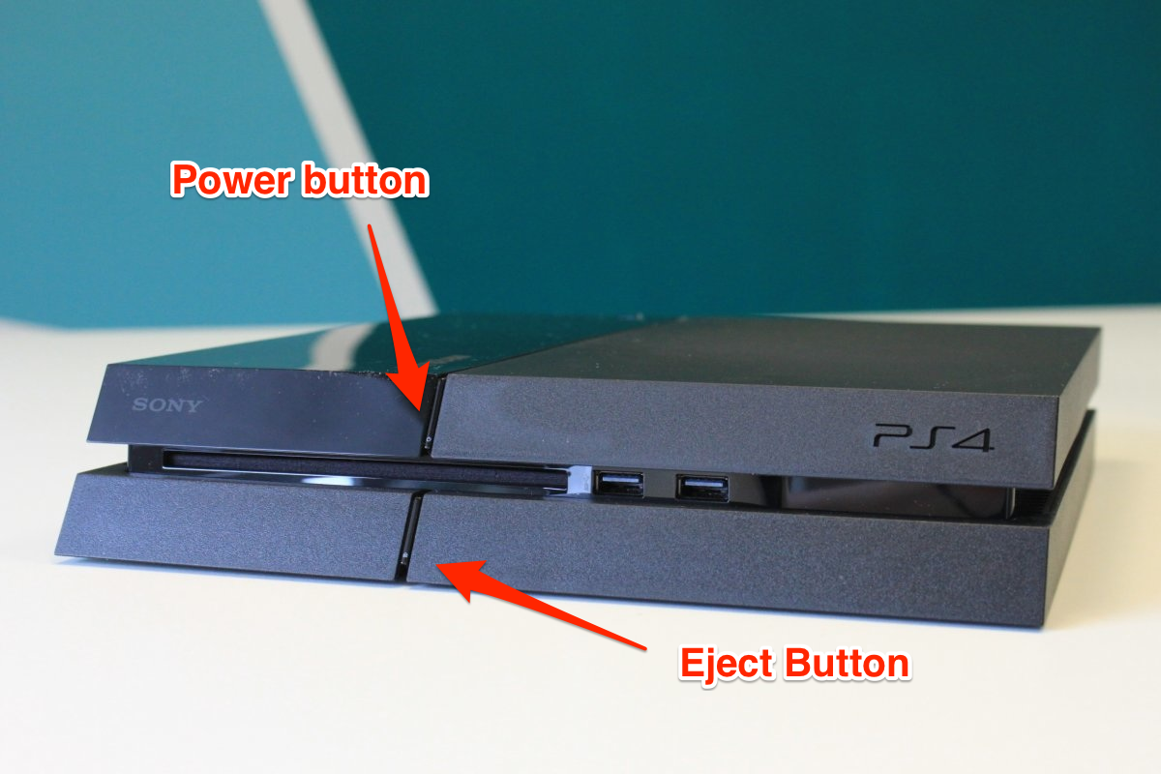
Turn it off!
Some people are afraid that an alternate reality will suck them in and change who they of other uses are.
Captain Janway of the voyager, finds her way out of the simulation she had immersed her self in one simple way…. She turned it off!
People can seek comfort in their ability to turn of the video game and control their own lives

