Slide 1
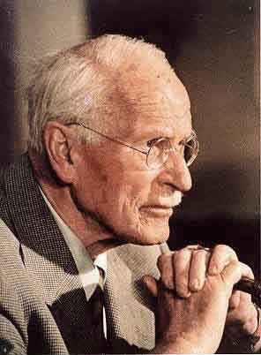
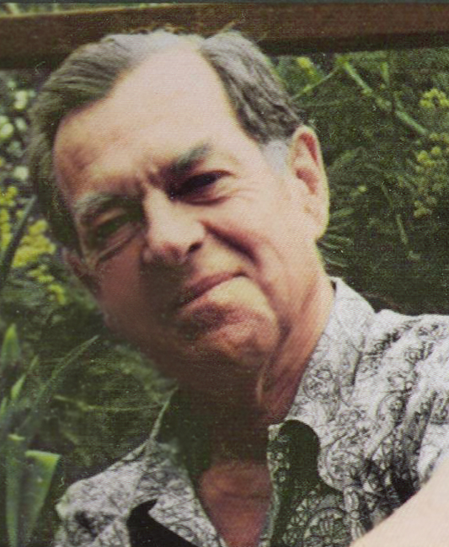
The Hero
By Janet Valentine
for Introduction to Multimedia

Slide 2
Carl Gustav Jung
Jung’s interests were unusually diverse:
• Dream Analysis
• Philosophy
• Alchemy
• Astrology
• Occultism
• Mythology
And the “Collective Unconscious”
Carl Gustav (26 July 1875 – 6 June 1961) was a Swiss psychiatrist, an influential thinker, and the founder of analytical psychology. He was one of the best known pioneers in the field of dream analysis.
Although he was a theoretical psychologist and practicing clinician, much of his life's work was spent exploring other areas, including Eastern and Western philosophy, alchemy, astrology, sociology, as well as literature and the arts.
Jung's most famous concept, the collective unconscious, had a deep influence not only on psychology but also on philosophy and the arts. His interest in occultism, Eastern religions, the I Ching, and mythology helped launch the New Age movement. Many original psychological concepts were proposed by Jung, including the Archetype, the Collective Unconscious, the Complex, and Synchronicity.

Slide 3
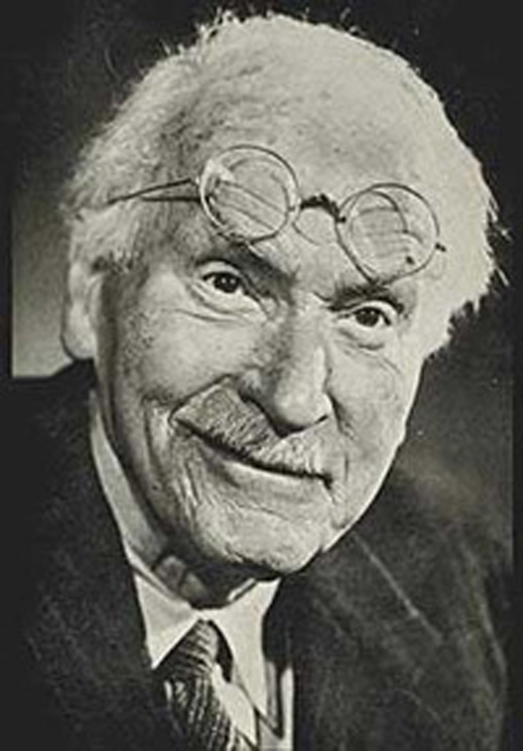
C.G. Jung’s “Collective Unconscious”
Carl Jung's father started Carl on Latin when he was six years old, beginning a long interest in language and literature – especially ancient literature. Besides most modern western European languages, Jung could read several ancient ones, including Sanskrit, the language of the original Hindu holy books.
He studied medicine at the University of Basel. While working under the famous neurologist Krafft-Ebing, he settled on psychiatry as his career. After graduating, he took a position at the Burghoeltzli Mental Hospital in Zurich under Eugene Bleuler, an expert on schizophrenia. His early training in ancient religious texts and mythology combined with his psychology training and his creative mind and he developed a set of theories of consciousness. He proposed that the psyche consisted of ego, or the conscious mind, the personal unconscious, and the collective unconscious.
Collective unconscious is like a "psychic inheritance." It is the reservoir of our experiences as a species, a kind of knowledge we are all born with. There are some experiences that show the effects of the collective unconscious more clearly than others: The experiences of love at first sight, of deja, and the immediate recognition of certain symbols and the meanings of certain myths, could all be understood as the workings of the collective unconscious. Grander examples are the creative experiences shared by artists and musicians worldwide, the spiritual experiences of mystics of all religions, or the parallels in dreams, fantasies, mythologies, fairy tales, and literature.

Slide 4
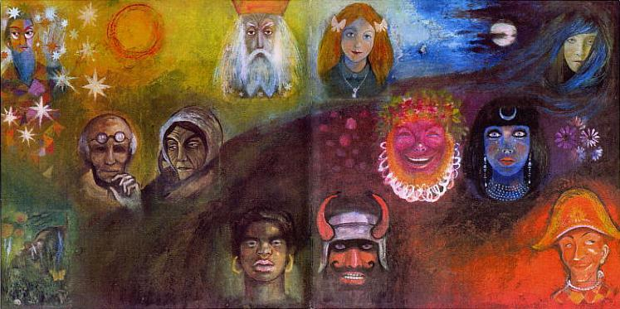
Archetypes Heroes & Others
The collective unconscious is populated by archetypes.
Jung also called them dominants, mythological or primordial images, but archetypes won out over these. An archetype is an unlearned tendency to experience things in a certain way.
The archetype has no form of its own, but it acts as an “organizing principle”
on the things we see or do. Classic archetypes include the mother, the father, the shadow, and the hero. The foremost of archetypes is the hero, a person who bravely overcomes great difficulty in order to realize his destiny. He could be described as a role-model, urging each of us to vanquish adversity and pursue our own quest.
This painting shows Jung with an archetypical wise woman. You can also see a king, a maiden, a priestess, a warrior and other dreamlike archetypes.
Jung’s hero meets with certain characters, events and obstacles on his quest. Those are often recognizable from one myth to another, while the characters in hero myths conform to archetype definitions as well.
The hero myth is the ultimate formula of self-realization. Other myths, even such of seemingly greater magnitude, like those of creation, the flood, or apocalypse, could more or less be seen as components of the hero myth, symbolizing certain premises or necessary processes of the hero quest.

Slide 5
Joseph Campbell
Campbell wrote many books on mythology and archetypes:
• The Hero with a Thousand Faces -1949
• The Masks of God -1959-68
• Myths to Live By -1972
• The Power of Myth -1988
• The Hero’s Journey -1990
• Mythic Worlds, Modern Worlds -1993
(partial list)
Scholar of Literature, Mythology and Religion
Joseph John Campbell (March 26, 1904 – October 30, 1987) was an American mythologist, writer and lecturer, best known for his work in comparative mythology and comparative religion.
As a child Campbell became fascinated with Native American culture after his father took him to see the American Museum of Natural History in New York. He soon became versed in numerous aspects of Native American mythology. This sparked a lifelong passion for myth and a fasacination with the thematic threads in mythology that appeared to exist throughout many human cultures.
In 1924 Campbell traveled to Europe with his family. On the ship back, he encountered Jiddu Krishnamurti; they discussed Asian philosophy, sparking in Campbell a powerful interest in Hindu and Indian thought.
In 1927 Campbell received a fellowship provided by Columbia University to study in Europe. Campbell studied languages, quickly learning to read and speak French and German after only a few months of study. A new world of exciting ideas opened up to Campbell while studying in Europe. Here he also discovered the works and writings of Sigmund Freud and Carl Jung.

Slide 6
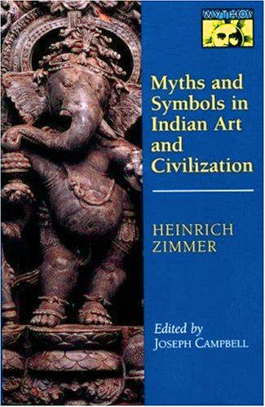
Joseph Campbell’s Heroes
Campbell's ideas regarding myth and its relation to the human psyche were deeply influenced by the work of Carl Jung. Campbell's conception of myth is closely related to the Jungian method of dream interpretation, which is heavily reliant on symbolic interpretation.
In 1940, Campbell met Indologist Heinrich Zimmer; the two men soon became good friends.
Campbell looked upon Zimmer as a mentor. Zimmer taught him that myth (rather than a guru or spiritual guide) could serve as a personal mentor, in that its stories provide a psychological road map for the finding of oneself in the labyrinth of the complex modern world.
After Zimmer's death, Campbell was given the task of editing and posthumously publishing Zimmer's papers, which he would do over the following decade. Through Zimmer, he was able to finally meet Carl Jung, in 1954.
The role of the hero figured largely in Campbell's comparative studies.
In his book The Hero with a Thousand Faces, published in 1949, Campbell introduced the idea of the monomyth, outlining the analysis of countless myths and fables from all over the world, and the archetypal patterns that appear in them.
Heroes were important to Campbell because he felt they conveyed universal truths about self-discovery, one’s role in society, and the relation between the two.
Zimmer relied more on the meanings and symbology of mythological tales as a source for psychological realization than upon psychoanalysis itself.

Slide 7
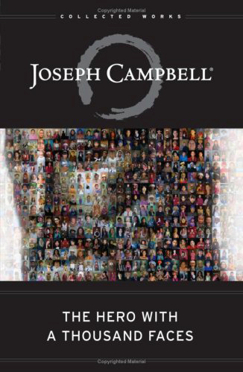
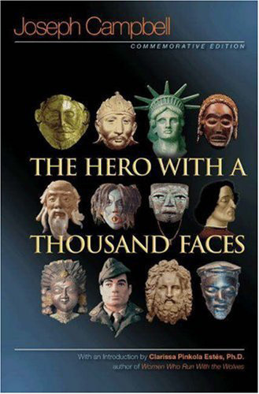
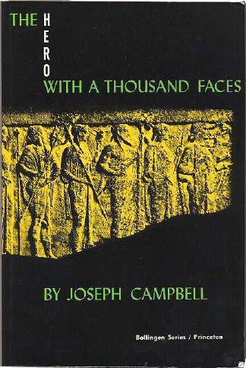
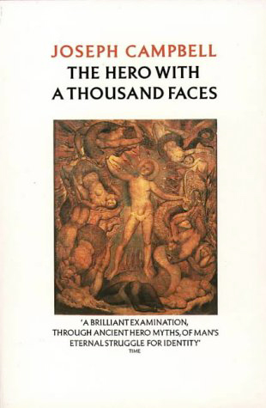
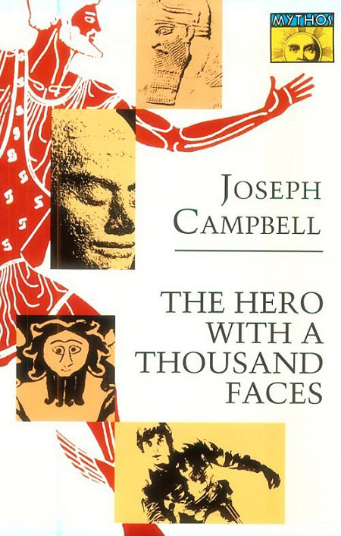
The Book with 1000 Covers
Campbell’s hero book touched a nerve and became a best-seller.

Slide 8
The Hero’s Journey
Separation
1. The Call to Adventure
2. Refusal of the Call
3. Supernatural Aid (Gandalf, Yoda, Utnapishtim)
4. The Crossing of the First Threshold
5. The Belly of the Whale (passage into the dark side)
Initiation
1. The Road of Trials (dangers along the way)
2. The Meeting with the Goddess
3. Woman as the Temptress (the Sirens…)
4. Atonement with the Father
5. Apotheosis (battle with the villain archetype)
6. The Ultimate Boon (fire, immortality)
Return and reintegration with society
1. Refusal of the return
2. The Magic Flight (the escape of Prometheus, the Ruby Slippers…)
3. Rescue from Without (Gwaihir the Eagle)
4. The Crossing of the Return Threshold
5. Master of the Two Worlds
6. Freedom to Live
Campbell found that many of the centuries-old myths from around the world share a similar structure, a pattern which he called the monomyth.
In the monomyth, “A hero ventures forth from the world of common day into a region of supernatural wonder: fabulous forces are encountered…a decisive victory is won: the hero comes back from this mysterious adventure with the power to bestow boons on his fellow man”.
The stages of the hero’s journey, shown here, represent “a magnification of the rites of passage,” according to Campbell. Myth, he believed, represents our psychological conflicts and triumphs.

Slide 9
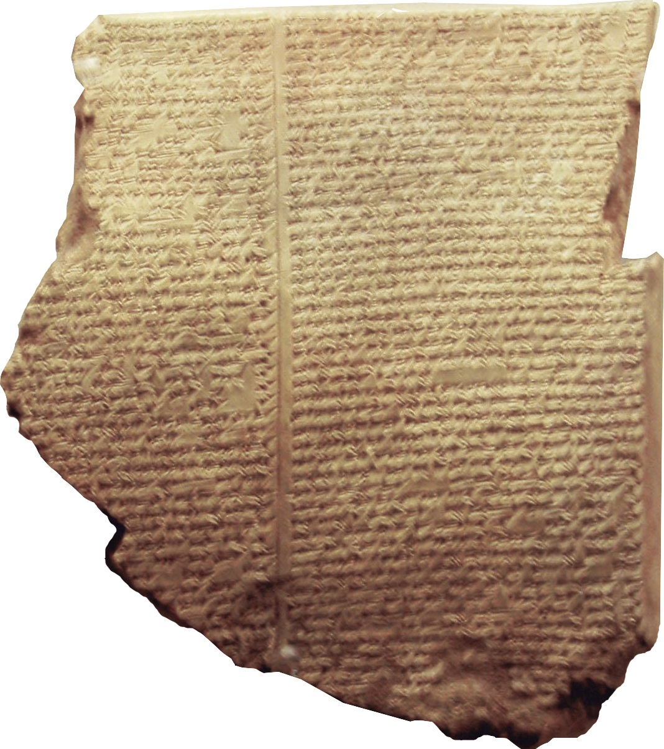
Heroes in Mythology
Campbell cites classic examples of the monomyth - Odysseus, Prometheus, Buddha, Muhammad, Moses and Christ.
Let’s take a look at how the Hero archetype permeates our written history, by finding examples in ancient mythology, twentieth-century fiction, and human history–reality.
GILGAMESH
The epic myth of Gilgamesh has many classic hero elements. Gilgamesh was one-third man and two-thirds god, and had superhuman strength. He is actually listed as a king in Sumerian history. He meets a feral man, Enkido, and fights him but they become friends and allies (embracing his shadow self). Gilgamesh and Enkido have a series of adventures, seeking wealth, power and immortality.
They have violent battles, first with a guardian, defeated by Enkido (supernatural help), and the bull of heaven, sent to harass them by Ishtar, after Gilgamesh rejects her (meeting the Goddess). Enkido dies, and Gilgamesh, despairing and terrified of dying, seeks out the undying Utnapishtim to ask him the secret of how to avoid death (the ultimate boon). He meets Siduri, a wine-making woman, who gives him shelter and advises him to accept his human fate and enjoy life while he can (woman as temptress). Siduri actually helps him find Utnapishtim.
The cuneiform markings on this ancient tablet tell the story of Gilgamesh, an ancient Sumerian mythological hero.
Gilgamesh is one of the oldest recorded stories in the world. The story was rediscovered in the mid-nineteenth century A.D. People were amazed when they read this most ancient of stories, and learned that the flood story in Gilgamesh was a close analogue of the flood story in the Hebrew Bible.

Slide 10
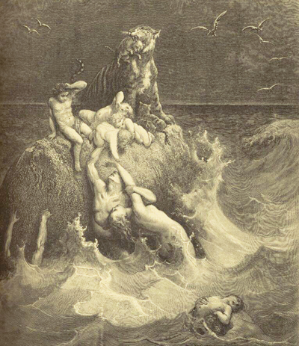
Utnapishtim & the Great Flood
It is the story of the Flood (remarkably similar to the Flood story in Genesis). Here is an example of an archetypical motif. The motif of the flood, along with the virgin birth, are found again and again in myth. Campbell touched on this in one of his conversations with Michael Toms:
TOMS: You mentioned the Flood. Like the Virgin Birth, it also is a motif that runs through all cultures.
CAMPBELL: Yes. There are very few cultures that don’t have a Flood motif. That’s a basic idea: the dissolution of the world which takes place every night when we go into the flood of our own unconscious. It’s the analogue of the mythological Flood: at the end of the cycle, there’s a flood. The American Indians have lots of Flood stories.
Illustration by Gustave Doré
Flood legends are thought to have a basis in very ancient history. Around 12,000 years ago an instability of the earth caused the movement of the north pole, causing a shift in the axis of the earth. The north pole shifted from the area of Hudson Bay, Canada in North America to its present location. This 30 degree shift in latitude had tremendous consequences for several thousands of years thereafter, because the slowly melting ice raised the levels of the oceans, which thereafter caused recurring floods throughout the world.

Slide 11
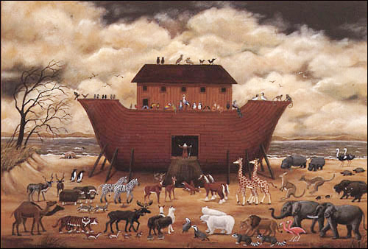
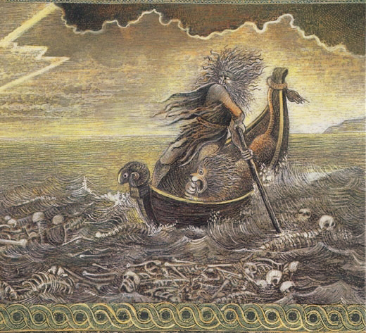
Gilgamesh Returns
Utnapishtim explains that he was given eternal life for surviving the Great Flood. Gilgamesh is disappointed when he is told that all men die. He almost secures a magic plant that can restore youth, but it is taken from him by a serpent (magical motif animal).
This story is familiar to us, not only because we recognize this snake as a precursor of the more sinister one that appears in the Garden of Eden, but because we recognize it as a symbol. In the Sumerian world, Ningizzida, the god of the serpent, is "the lord of the Tree of Life" (119).
Ultimately Gilgamesh does not bring any magic elixir or great boon to his people, but after his earlier conquest of Humbaba, the guardian demon of the cedar forest, Gilgamesh and Enkidu cut down the cedar forest and in particular the tallest of the cedar trees to make a great cedar gate for the city of Nippur. They build a raft out of the cedar and float down the Euphrates to their city, where they are greeted as heroes.
Other heroes in ancient mythology include the Egyptian Osiris, Greek Bellerophon, Scandinavian Siegfried, Japanese Kintaro, Chinese Da Yu, English Beowulf, Welsh Pryderi fab Pwyll, Irish Cú Chulainn, Blackfoot Star Boy, and African Sunjata.
The Flood story is familiar to us not only because it anticipates Noah's story in the book of Genesis, but because it is the story of life, the story of destruction and renewal.

Slide 12
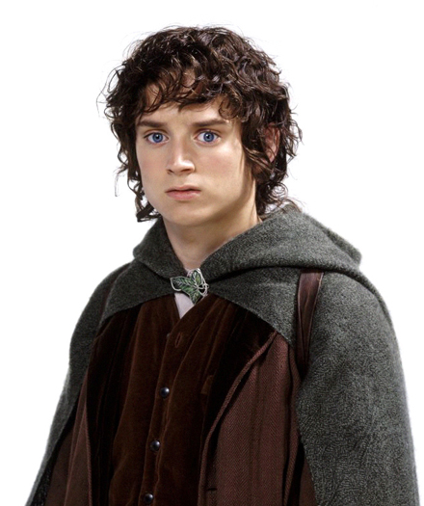
Heroes in Fiction
FRODO BAGGINS
There are countless heroes in fairy tales and fiction, but J.R.R. Tolkien created particularly compelling heroes in his Lord of the Rings trilogy.
Frodo Baggins is a classic hero. He tries to refuse the call, but is persuaded by supernatural aid #1, Gandalf the wizard.
Troubles along the way include terrifying orcs (goblins), a Balrog (a monstrous ogre), and the slithering, sinister Gollum, originally a hobbit but warped beyond recognition by the evil power of the magic ring that Frodo has been given–a perfect Shadow archetype!
Frodo takes refuge with elves both in Rivendell, and Lothlorien, where he meets Galadriel, the equivalent of the Goddess.
There have been few heroes as reluctant to embrace the adventure as Frodo Baggins–and few whose story has been told so eloquently.

Slide 13
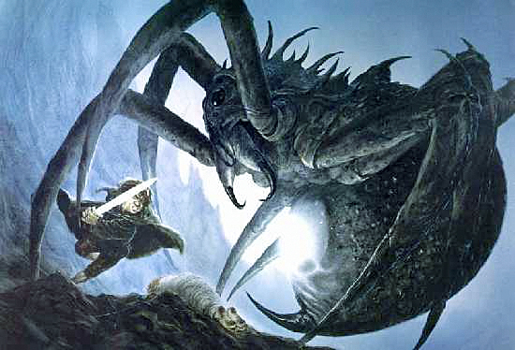
The Spider’s Lair and the Mountain of Fire
The conclusion of Lord of the Rings brings Frodo deep into the “belly of the whale” in Mordor. He battles with giant spider Shelob, (from whom he’s rescued by his companion/ally Sam), and wrestles with his shadow/self Gollum at Mount Doom, a volcano.
Volcano myths were developed by ancient people to explain events that otherwise seemed terrifyingly random and cruel. Pele is the most well-known of all volcano gods. There are countless stories about her, from traditional myths to Hawaiian versions of the modern "ghost hitchhiker" urban legend.
After they succeed in destroying the evil Ring (boon), the hobbits are rescued by the great eagle Gwaihir (rescue from without). After their return, Aragorn, the other classic hero character in Lord of the Rings, is crowned King of Gondor and Arnor, and has defeated Mordor (later re-destributing its conquered lands to the former slaves that tilled the fields in its southern regions). Aragorn then marries Arwen, daughter of his father-figure Elrond, uniting the worlds of Elf and Man. (master of the two worlds)
An Archetype We Love to Hate
The spider is an archetype that is featured in mythological fables and cultures throughout the world since ancient times.
In ancient Egypt, the spider was associated with the goddess Neith in her aspect as spinner and weaver of destiny. In African folklore, the spider is personified as Anansi, the trickster god and character from later in African mythology.
The Navajo have the creation myth of Spider Grandmother, who created all things through the shimmering threads that came from her belly.

Slide 14
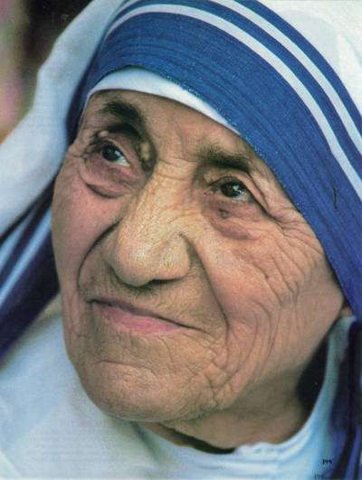
Heroes in Real Life
Mother Teresa was born Agnes Gouxha Bojaxhiu to a peasant family in Macedonia. At an early age she had recognized the special problems associated with poverty. Horrified by its dehumanizing effects, she firmly committed herself to try to help. Despite the protestations of her family, at age 18 she decided to leave home and join with the Congregation of Loreto nuns working in Bengal, India.
In 1952 she started a hospice. She and other nuns searched for people who were sick or dying on the streets in Calcutta. They helped and cared for them at the home. She once said, “I see God in every human being.”
In the later 1950's, she began a leper colony called the “Town of Peace.” She also started orphanages and schools for the poor. She was awarded the Nobel Peace Prize and many other prizes; each time she donated the prize money to her charitable centers.
Surely this too is a hero’s life. I’m not a Catholic, in fact I’m a pantheist, but I see Mother Teresa as a hero. We can’t even imagine what horrors she has survived in the Belly of the Whale known as poverty. Through her selfless caring, she taught us that the humblest among us can be true heroes.
Today, projects by the Missionaries of Charity include homes and schools for orphaned children, mobile clinics, leprosy centers, food kitchens, and peace centers for the dying. And the Missionaries of Charity are no longer limited to India. They have greatly expanded and dispensed aid on an international level.

Slide 15
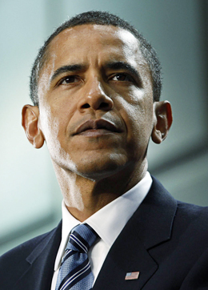
Born to Heroism?
Our 2008 Presidential election introduced dueling heroes, one a hero of two worlds and one a war hero. The younger hero prevailed, carried to victory by the young who hadn’t had a hero before, and embraced the familiar myth.
It is interesting that both Obama and McCain have the hero problem of mysterious birth. Even though Obama’s origins are documented, there is continuing insistence by some that he is not a native-born American. Meanwhile, John McCain was born outside the U.S, in the Panama Canal zone, which caused a bit of controversy as well.
Mysterious birth is another part of the hero myth. A prominent feature of a hero across different mythologies are the shadowy circumstances surrounding his birth.
Heroes are often born in difficult or obscure circumstances and brought up in a different family than their own. (Horus, Romulus, Moses, Lohengrin, King Arthur, Frodo Baggins, Jesus, Harry Potter).
Master of Two Worlds
Barack Obama’s double dualism makes him a good hero for our troubled times.
Half black and half white, and by his parents half Christian and half Muslim, he straddles two often opposing sides, uniquely suited to rise above and transcend the differences.

Slide 16
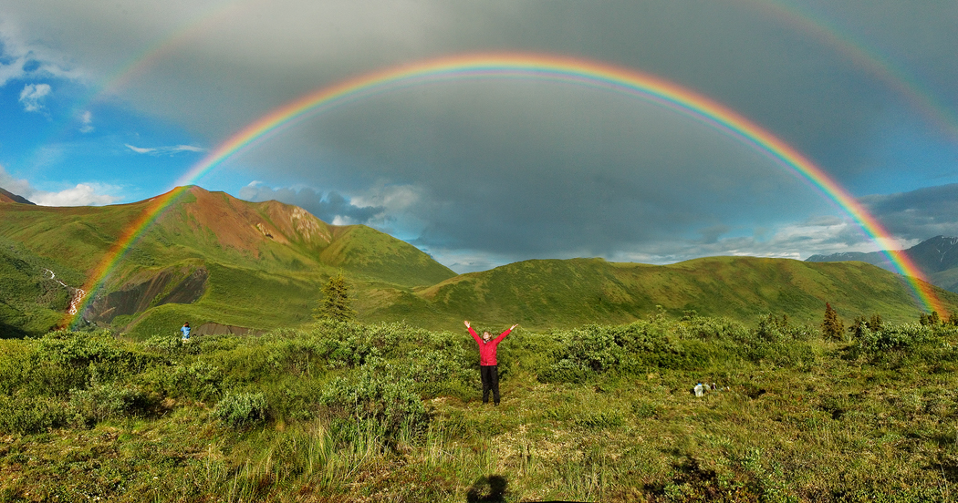
Be Your Own Hero!
Campbell concluded Hero with a Thousand Faces with this message to his readers:
“The modern hero…cannot, indeed must not, wait for his community to cast of its slough of pride, fear, rationalized avarice…. It is not society that is to guide and save the creative hero, but precisely the reverse. And so every one of us shares the supreme ordeal…not in the bright moments of his tribe’s great victories, but in the silences of his personal despair.”
We can embark on a hero-quest: examining our life and our challenges, identifying the archetypes and banishing fear and doubt as a hero would, whether applying for a job, teaching your children, or running for public office. We can all be heroes.
Heroes will always be with us because heroes are us. They are us when we refuse the call (hit the snooze button, drop out of school), when we befriend the dwarf (meet
someone different from
ourselves), get supernatural aid (from a teacher or attorney or doctor), meet the
Goddess (fall in love), slay the dragon (win a lawsuit, get a promotion, earn an A), and bring home the elixir (the paycheck, the bonus, your new novel, painting, invention, or widget).

