Slide 1
Marshall McLuhan
(July 21, 1911 – December 31, 1980)
Canadian philosopher of communication theory. His work is viewed as one of the cornerstones of the study of media theory, as well as having practical applications in the advertising and television industries.

Slide 2
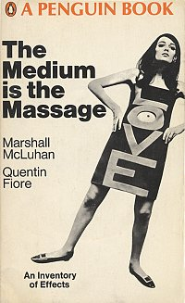
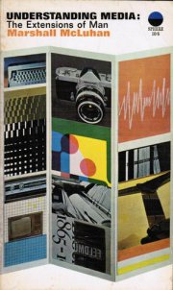
Understanding Media,
The extensions of man
(First published in 1964)
“Message” played as:
“mass-age”,
“mess-age” and
“massage”.
Notes:
The phrase was introduced in his most widely known book, Understanding Media: The Extensions of Man, published in 1964. McLuhan proposes that a medium itself, not the content it carries, should be the focus of study. He said that a medium affects the society in which it plays a role not only by the content delivered over the medium, but also by the characteristics of the medium itself.
McLuhan frequently punned on the word "message" changing it to "mass age", "mess age", and "massage"; a later book, The Medium is the Massage was originally to be titled The Medium is the Message, but McLuhan preferred the new title which is said to have been a printing error.

Slide 3
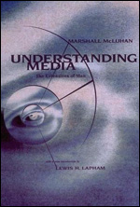
Understanding Media,
The extensions of man
Chapter in the reader:
Introduction to the MIT Press Edition,
by Harper’s editor Lewis H. Lapham.
Notes:
1994 edition
"...the most brilliant marketing mind of all belonged to Marshall McLuhan. Understanding Media is a timeless analysis of how language, speech and technology shape human behavior in the era of mass communication.
The book is a cautionary tale for marketers today who hear the Web's siren call and ignore the power of the spoken word."
—Wall Street Journal
WIRed magazine.
development of new media models and information ecologies, many of which were spawned from MIT's Media Lab.

Slide 4
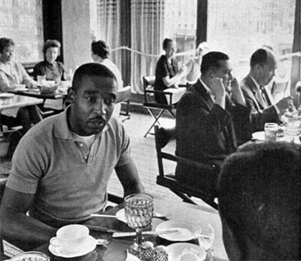
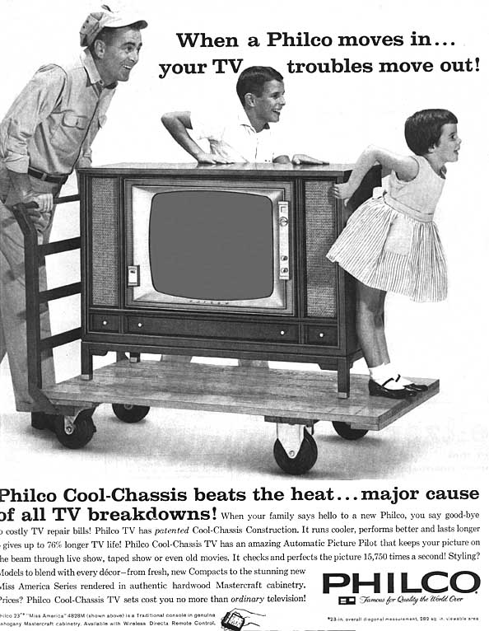
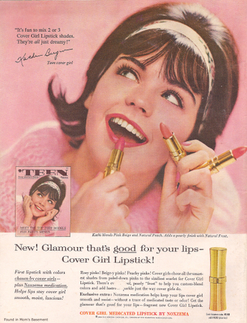
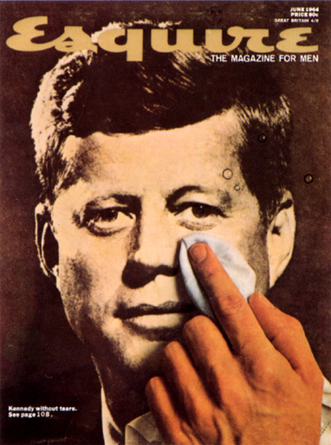
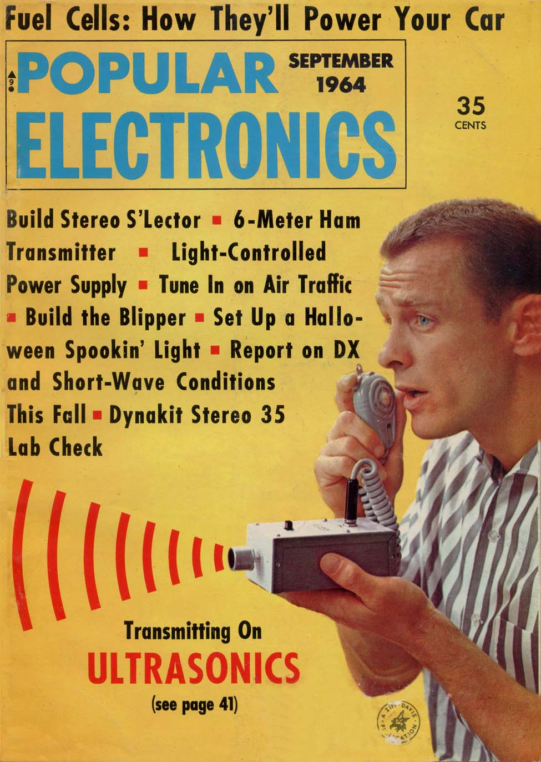
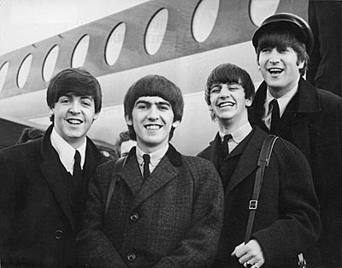
1964
Civil Rights Act
1964
Notes:
Civil Rights ACT. In a nationally televised address on June 6, 1963, President John F. Kennedy urged the nation to take action toward guaranteeing equal treatment of every American regardless of race
signed into law by President Lyndon Johnson on July 2, 1964, prohibited discrimination in public places, provided for the integration of schools and other public facilities, and made employment discrimination illegal.
After completing what would have been the final year of John F. Kennedy’s first term, President Johnson re-elected in a landslide over Barry Goldwate.
Kennedy was Killed November 22, 1963, Dallas
President Johnson declares "war on poverty," introduces a variety of federal welfare programs, including Medicare (initially proposed by Kennedy in 1960)
Three civil rights workers murdered in Mississippi during "Freedom Summer”. Race riots break out in Harlem and other U.S. cities
24th Amendment to Constitution adopted, ensuring fair voting practices
U.S. military forces launch attacks on North Vietnam in response to an alleged attack on a U.S. destroyer off the Vietnamese coast; Congress passes Gulf of Tonkin resolution that gives the President greater freedom to authorize combat actions in Vietnam

Slide 5
“Mass Media”,
… It is an indication, not of the size of the audiences, but of the fact that everybody becomes involved at the same time….
Notes:
His book introduced our present usage of the term MEDIA
Collective unconscious?
Synchronicity of the asynchronous medium?

Slide 6
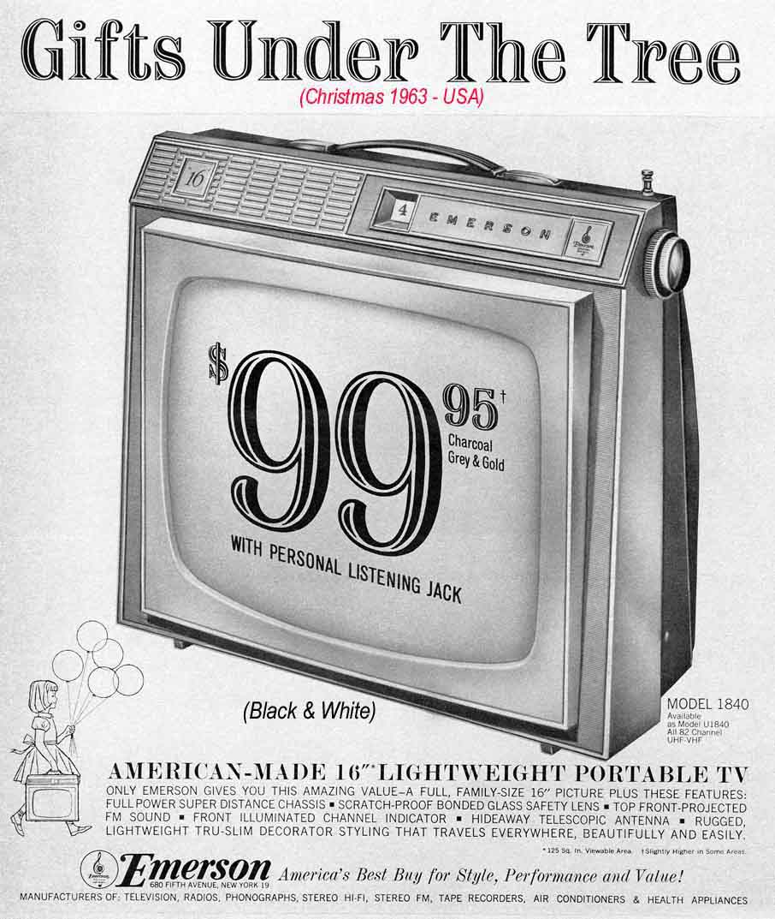

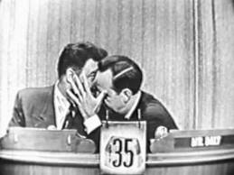
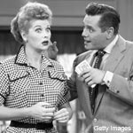
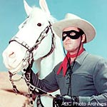
Television was
the media avant-garde
in the late 50s and 60s
Notes:
TELEVISION. Cool
Personal. In private space. PORTABLE.
TV is not narrative. It bears more of a resemblance to symbolist poetry or the pointillist painting of Georges Seurat than it does to anything else.

Slide 7

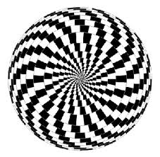


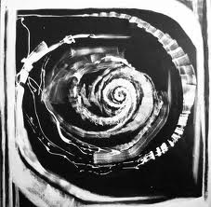
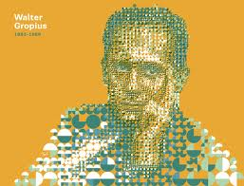
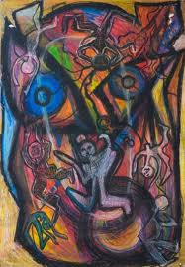
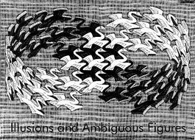


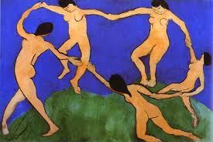

“…comprehension is inherently cool [if] it is simultaneously
involvement and detachment.”
McLuhan’s radically different approach to media analysis through human perception
Notes:
INFORMATION
Commodities come to posses more and more the character of Information: The amassment of wealth will come to depend upon the naming of things rather than the making of things.

Slide 8
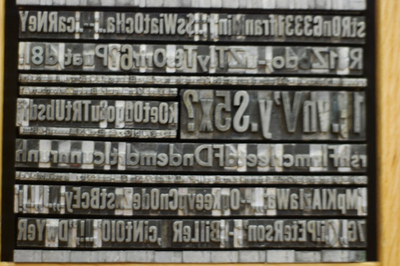

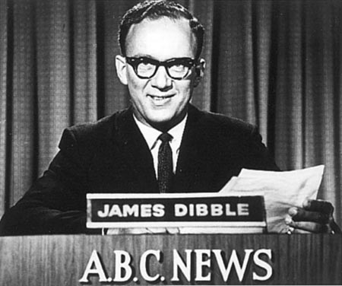
The Printed Medium
Bureaucracy and Social power
In the 1960s the 500 year Predominance of the Printing medium was coming to its end. It had left its strong imprint in Law, Religion, Academia,
Notes:
In the 1960s the 500 year Predominance of the Printing medium was coming to its end. It had left its strong imprint in Law, Religion, Academia, Bureaucracy and Social power
The Printed Medium
Academia
Law
Government
Society

Slide 9
Classic Communication theory.
Transmission of information
Receiver
Content or message
To WHOM
WHAT
Channel
Sender
WHO
According to rational thought, the Content is more important than the Channel for that content. McLuhan understood the psychological implications and consequences of the Channel: The Medium IS the Message.
Notes:
Harold Lasswell (1902–1978), a political scientist and communication theorist, was a member of the Chicago school of sociology. In his work 'The Structure and Function of Communication in Society' (1948) he defined the communication process as Who (says) What (to) Whom (in) What Channel (with) What Effect. The distinct model he propounded was known as Dance Model.^{[7]}
These first studies on communication's models promoted more researches on the topic. Wilbur Lang Schramm (1907–1987), called by communication theorist Everett Rogers as the founder of communication study,^{[8]} focused his studies on the experience of the sender and receiver (listener). Communication is possible only upon a common language between sender and receiver.^{[9]} Everett Roger's accounts later led to the basis for development communication studies.
In 1960, David Kenneth Berlo, a disciple of Schramm, expanded on Shannon and Weaver’s linear model of communication and created the Sender-Message-Channel-Receiver Model of communication (SMCR Model) exposed in his work The Process of Communication,

Slide 10

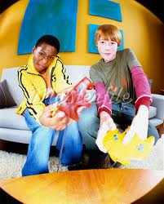
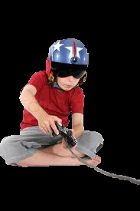
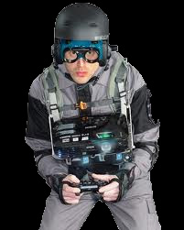
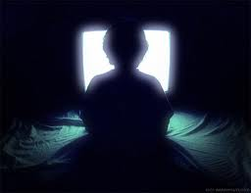
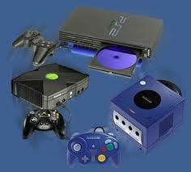
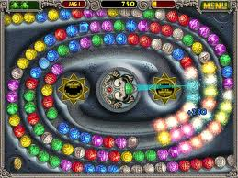
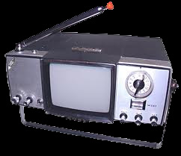

“…all media…, are extensions of some human faculty… that cause deep and lasting changes in [us] and transform [our] environment.”
“We shape our tools, and they in turn shape us.”
Notes:
Sumi Oueda, Cool media
Media extends our nervous system
“A medium is the extension of the Human body and its Central Nervous system”
The Message: Any change of scale or pattern that a new invention introduces to human affairs
CONTENT FOLLOWS FORM
The content of a medium is always another medium

Slide 11

The Global Village in the Digital Age
"The new electronic interdependence re-creates
the world in the image of a global village."
Marshall McLuhan, 1962
“The tendency of Electronic media to Compress and dissolve Time and Space”…
Notes:
Marquette Cole
The tendency of Electronic media to Compress and dissolve Time and Space
Mass Media has created an “Oral Culture” spirit
_primitive vocabulary
_Apocalliptic vision
Promise of Redemption

Slide 12
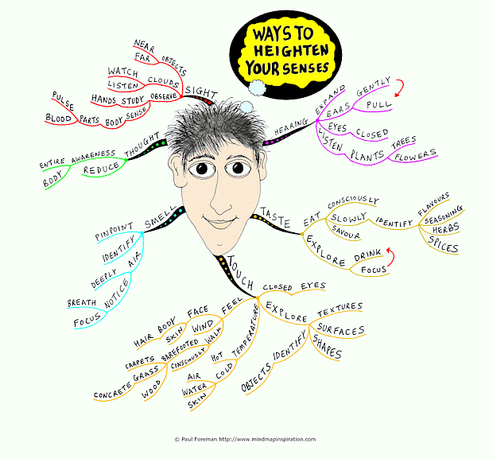
McLuhan describes pre-literate societies as “acoustically” oriented: he points out that all senses combine to form a complete concept of reality
Notes:
Thanks to William Macker

Slide 13
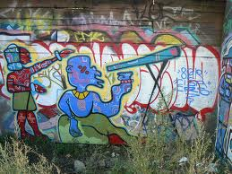
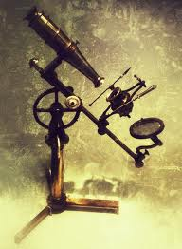
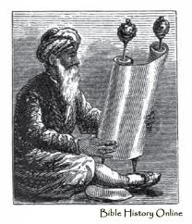
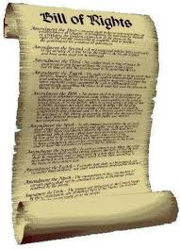
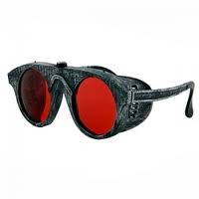
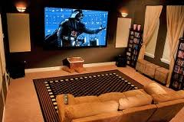

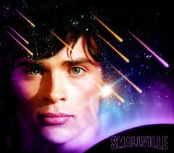

“Mechanical technologies [or extensions of humanity] were partial and fragmentary…”
“Acoustic space is organic and integral, perceived through the simultaneous interplay of all the senses…”
Notes:
Sumi Oueda, Cool media

Slide 14
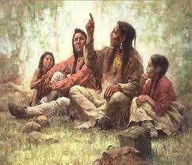
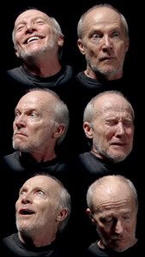
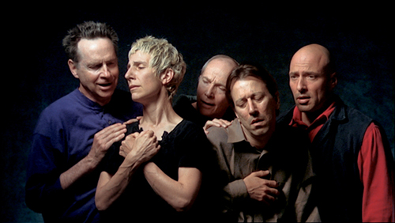
The Art of story telling involves as much drama in
Body Language as actual words
Notes:
Thanks to William Macker
Bill Viola
Since the 1970s Bill Viola’s videotapes and installations have dealt with themes of perception, memory and self-awareness. Emotions are the subject of The Passions, an ongoing series begun in 2000. In these works Viola grapples with one of the oldest problems in art: how to convey the power and complexity of emotion by depicting the faces and bodies of models – specifically, in his works, of performers.
One of the first works in The Passions series, The Quintet of the Astonished, was commissioned by the National Gallery, London, and was inspired by Hieronymus Bosch’s painting of a quartet of executioners surrounding Christ. Shot on high-speed film, permitting the action to be slowed drastically when played back, the video is an intense tableau of shifting and momentary emotions. The relationships between the figures were unplanned and exist in varying intensities over the work’s duration.
http://www.getty.edu/art/exhibitions/viola/art.html
Marina Abramović: An Artist's Life Manifesto | MOCA Gala 2011 (youtube video)

Slide 15



Human beings, in their Natural habitat, rely in all their senses to provide information from their environment
Notes:
10 canoes
The cosmology of the Yasmu people is an entirely different cosmology than ours. The universe is a different place, the way of thinking is therefore different, and the language, apart from being structurally different, describes different things. Ours is a language of classification and categorization, theirs is a language of connection and unity. Everything is all one. There is no notion of fiction in their cosmology,

Slide 16

We see visual space with only one of our five senses: sight.
“Seeing…affords us the safety of distance and detachment, but with a price tag of much greater likelihood of error…
Because we are prone to focus on one aspect of the environment to the exclusion of all else…we are more likely to misunderstand what we are seeing.”
Notes:
Danielle Pelkola

Slide 17

What is acoustic space?
“Acoustic space comes before the alphabet.
It is the world viewed through pre-literate eyes,
A world of no boundaries in which information emerges from anywhere and everywhere.
Notes:
It is the world of music, myth, and total immersion”
(Paul Levinson on Digital McLuhan).

Slide 18
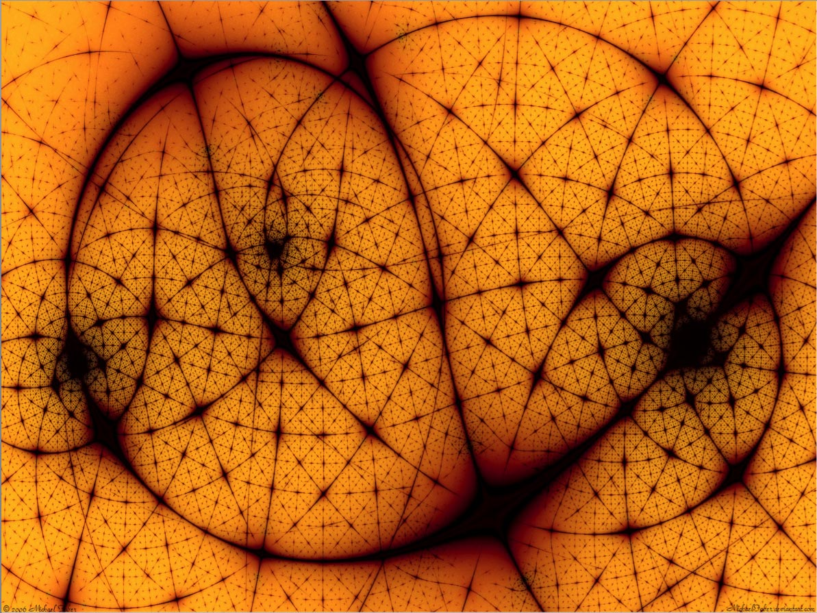
“The Electric light is pure information. We are moving out of the age of the visual into the age of aural and tactile.
The Electric age is neither an accurate representation of the tribal era nor the printed age, it is rather somewhere between the age of the non-literate and the post-literate. Its is a combination of both the prehistory cultures as well as those of the industrial age.
Notes:
Visual Age
Aural and Tactile Age: Electric Age
Tribal Era / Printed age
Non literate/Literate/ Post literate
Industrial Age

Slide 19
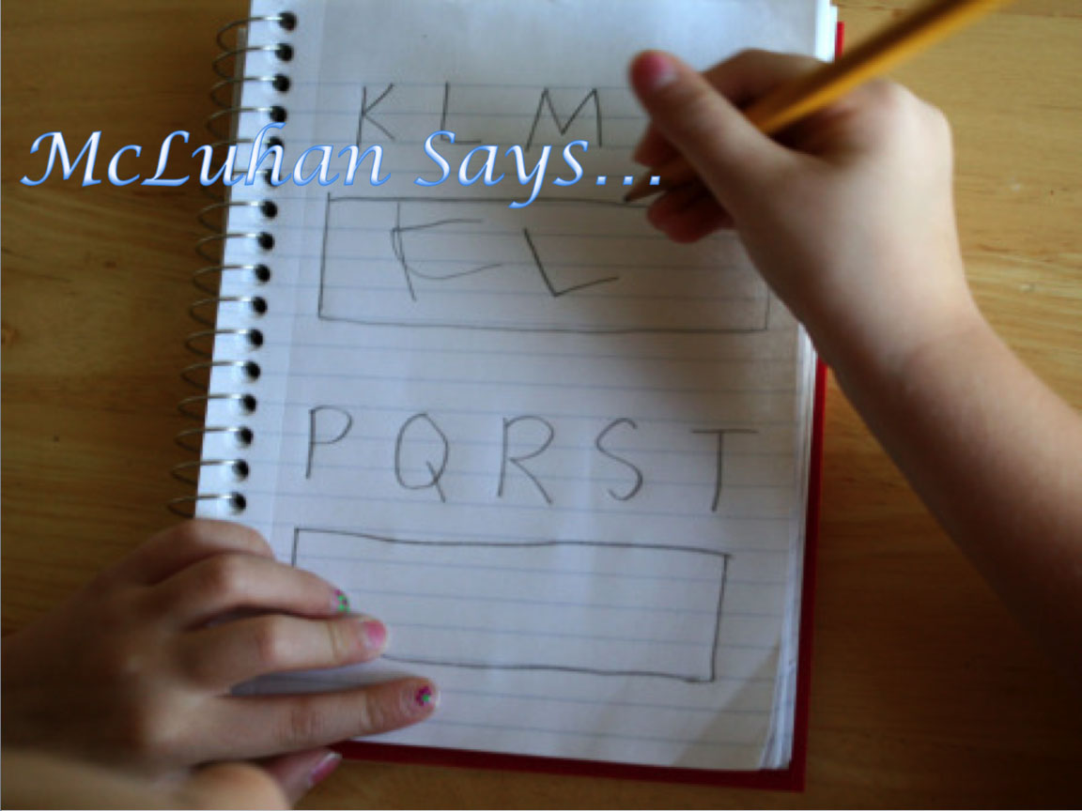
Visual Space
“What we consider normal or natural VISUAL SPACE is actually a technological artifact- a result of perceptual habits created by reading and writing with a phonetic alphabet.”
Notes:
Danielle Pelkola.
“Visual space is a side
effect of the uniform, continuous and fragmented character of the phonetic alphabet…”

Slide 20
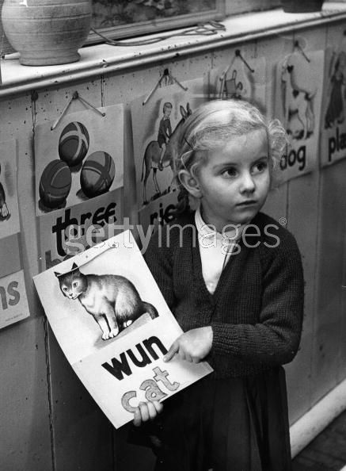
Visual
Space
McLuhan proposed that Western Society’s attraction to linearity is caused by the phonetic alphabet, which shrinks our human speech and thought into 26 characters.
The result?
A world view dominated by linear logic and the symbolic abstraction of meaning.
Notes:
Sara Mariea
The print medium encourages people to think on straight lines
To arrange their perceptions of the world in forms convenient to the visual order of the printed page.

Slide 21
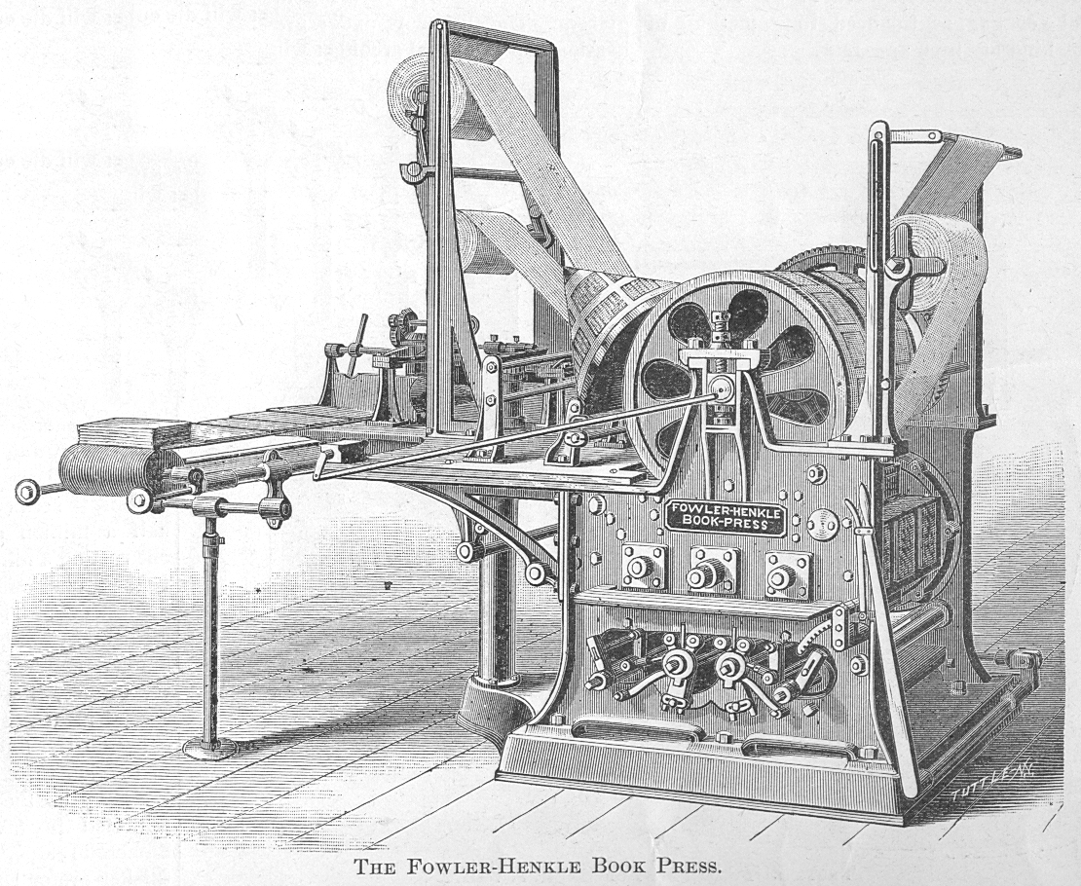
The invention of the Printing Press created individualism and nationalism.
It also broke communication boundaries allowing a single text to reach a wide population (beginning of mass media)

Slide 22


Mechanical time becomes
a Uniform succession
Time has become DURATION: something that happens between 2 points
A machine that produces uniform seconds,
minutes
and hours
On assembly-line pattern
A CLOCK

Slide 23
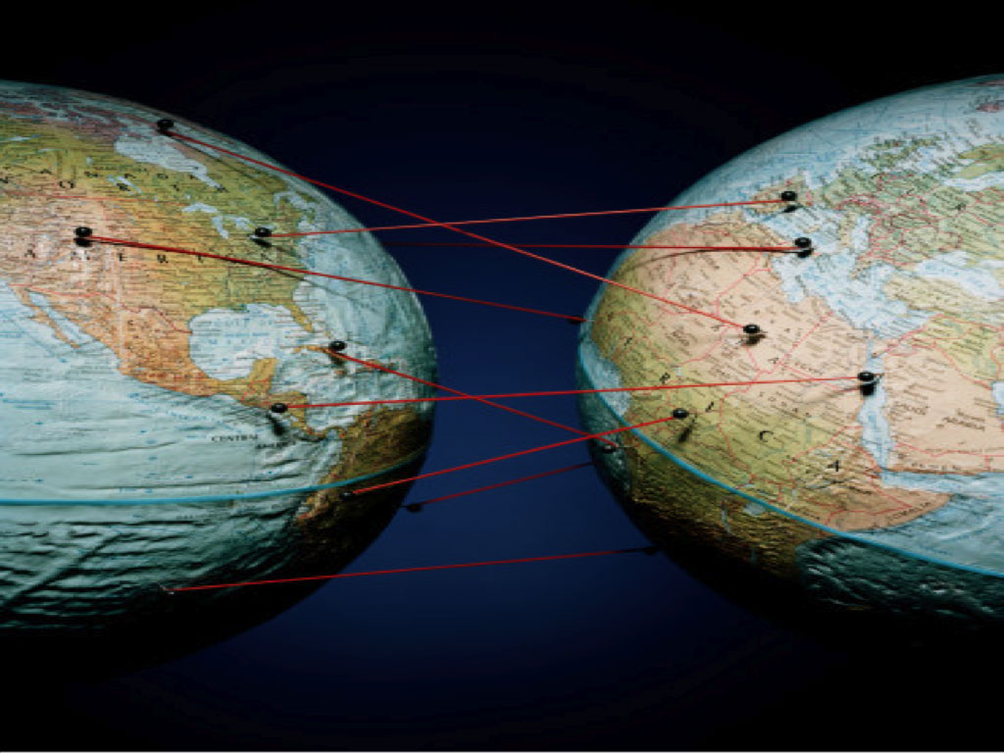
“to the extent that we abandon the visual order of print
and its corollary structures of feeling
and thought,
we discard the idea of
the townsman or citizen
and acquire the sensibilities characteristics of
nomadic and preliterate people.
Notes:
The visual order of Print
Corollary structures of feeling and thought
Discard Townsman, citizen
Acquire sensibilities of nomadic-preliterate people

Slide 24

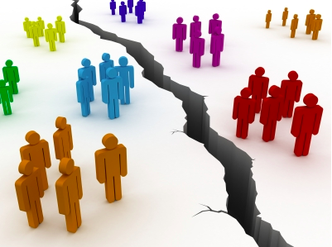
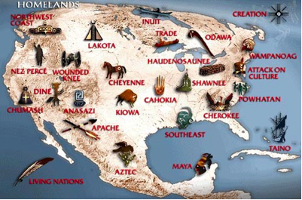
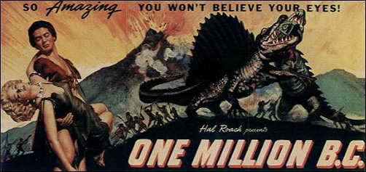

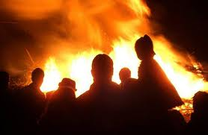

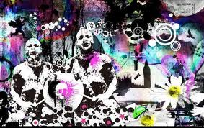
“…a totally retribalized world of depth involvements.”

Slide 25
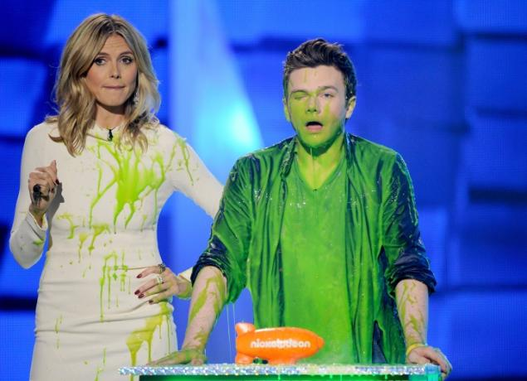



An Oral kind of perception, organization and Existence
A culture that assigns Roles, not Jobs
“ people are not expected to fit
into some Uniform and
Repeatable niche
that is not their size anywa y”
“…a totally retribalized world of depth involvements.”
Less Strict
More inclusive
Difference originates
Kinship, that organizes it’s own space
Notes:
Kid’s choice Awards MTV 2013
The Dwarf, the skew, the child… create their own spaces. They are not expected to fit into some Uniform and Repeatable niche that is not their size anyway

Slide 26


The Effects of technology do NOT occur at the level of opinions
or concepts
I don’t care about adds,
I don’t care about games,
I don’t play
I don’t read the news
I don’t watch TV
I don’t travel
I don’t date online
IT ALTERS sense-RATIOS and patterns of perception steadily and with NO Resistance

Slide 27



The Railway did not introduce transportation into Human society BUT Accelerated and enlarged
the scale of previous human functions
Breaking
distances
Creating bigger, further away cities
and new kinds of Work and Leisure

Slide 28



The Airplane by accelerating the rate of Transportation dissolves the concepts of Space and Time
Breaking
space
Dissolves the centralized structure of the City
Dissolves Closed societies and Politics (forms of Association)

