Slide 1
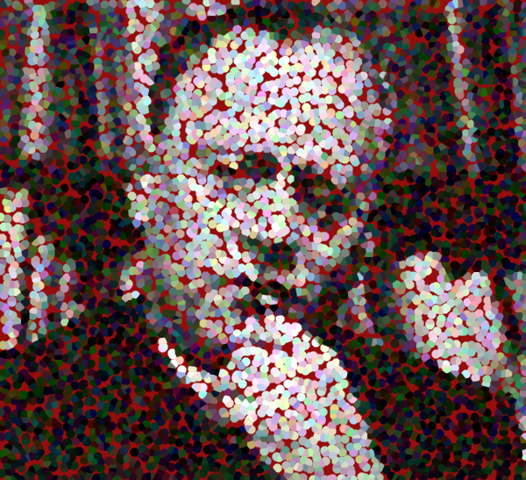
MARSHALL MCLUHAN Visual and Acoustic Space

Slide 2
SCHOLAR
EDUCATOR
MEDIA THEORIST
PHILOSOPHER

Slide 3
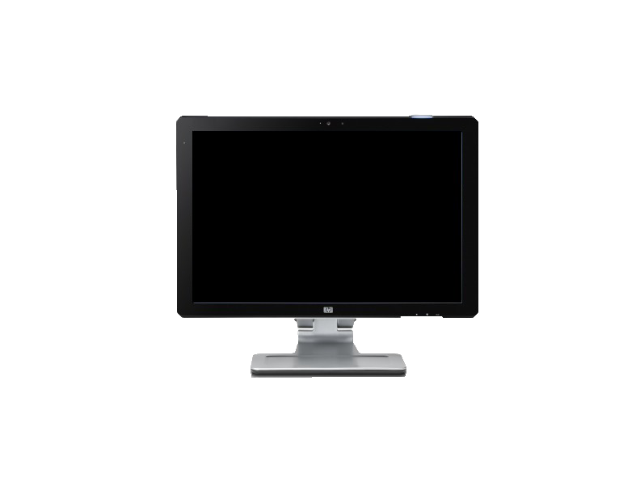
"TODAY, AFTER MORE THAN A CENTURY OF ELECTRIC TECHNOLOGY, WE HAVE EXTENDED OUR CENTRAL NERVOUS SYSTEM ITSELF IN A GLOBAL EMBRACE, ABOLISHING BOTH SPACE AND TIME AS FAR AS OUR PLANET IS CONCERNED.” MARSHALL MCLUHAN, UNDERSTANDING MEDIA, 1964.

Slide 5
VISUAL SPACE
ACOUSTIC SPACE
SEQUENTIAL
REFLECTIVE
RIGHT HEMISPHERE
OF BRAIN
LEFT HEMISPHERE
OF BRAIN
CAUSALITY
EAR
EYE
PERSPECTIVE
360 DEGREES
GRID
PLANE
MYTH
GYROSCOPIC
LINEAR
CONCEPTUALIZATION
TIME AS CYCLE
ORAL CULTURE

Slide 6
McLuhan proposed that Western Society’s attraction to linearity is caused by the phonetic alphabet, which shrinks our human speech and thought into 26 characters. The result?
A world view dominated by linear logic and the symbolic abstraction of meaning.

Slide 7
“ACOUSTIC SPACE COMES BEFORE
THE ALPHABET. IT IS THE WORLD
VIEWED THROUGH PRE-LITERATE
EYES, A WORLD OF NO BOUNDARIES
IN WHICH INFORMATION EMERGES
NOT FROM FIXED POSITIONS, BUT
ANYWHERE AND EVERYWHERE.”
-MCLUHAN

Slide 8
The characteristics of acoustic space
derive from the qualities of hearing.
It is our constant monitor.

Slide 9
Acoustic Space
TOTAL IMMERSION FROM DIVERSE SOURCES OF INPUT

Slide 10
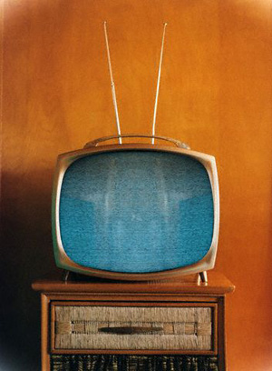
ACOUSTIC SPACE IN MEDIA
Musical, mystical, and immersive,
TV lacks perspective and creates
distance from its viewers. The same
images can be seen on television screens
all over the world.
“Just as one voice can be heard
by a multitude of ears, so single
writings cover a thousand sheets”

Slide 11
Acoustic-ONLINE
“In recognizing the extent to which current media retrieve communication systems
of the past—as in the global village, or, for that matter, the notion of television as
acoustic space—McLuhan invited us to think about the ways that current media may
someday be retrieved in the media of the future.”-Paul Levinson, Digital McLuhan

Slide 12
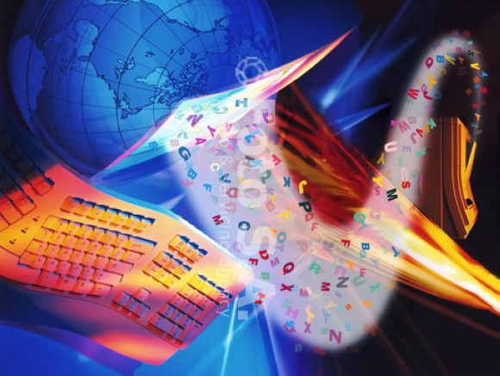
CYBERSPACE IS THE NEW ACOUSTIC SPACE!

Slide 13
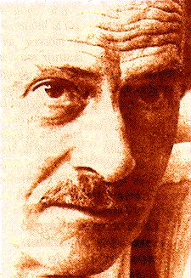
THE END.

