Slide 1
Marshall McLuhan
Hot and Cold Media
By: Ryan Paul

Slide 2
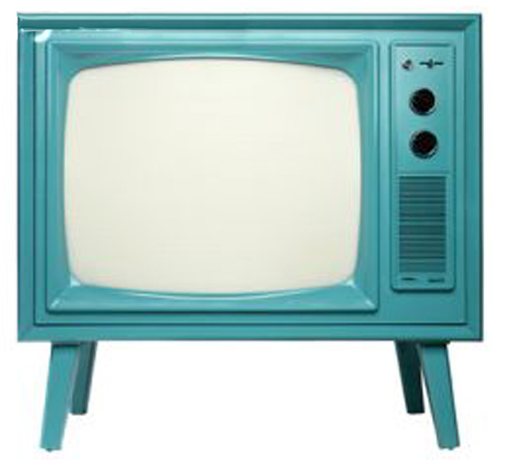
Hot and Cold Media
Different media requires a unique level of
participation at which you are involved

Slide 3
Hot Media
This is defined as ‘high definition’, where the viewer is given large amounts of information. Participation is low.
You are not spending much time filling in details, but rather absorbing the information that this presented.
Ex: Radio, Photograph, Theater, lecture

Slide 4
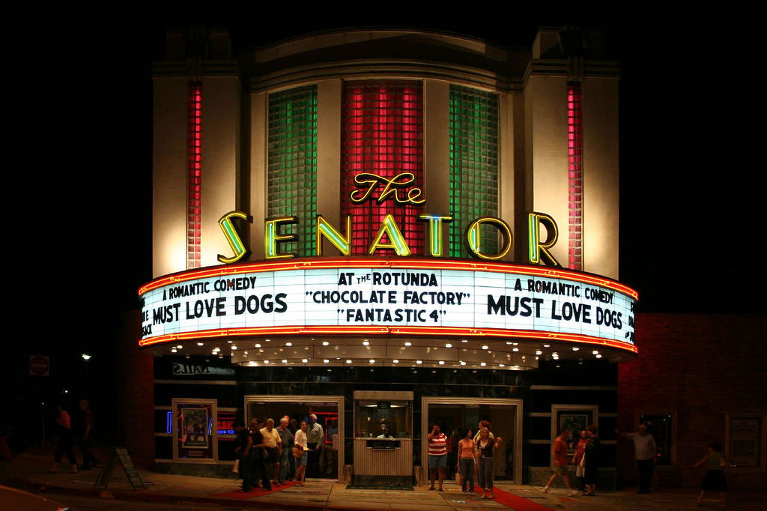
Hot Media
Theater
Participation is low

Slide 5
Hot Media
Photographs
Participation is low

Slide 6
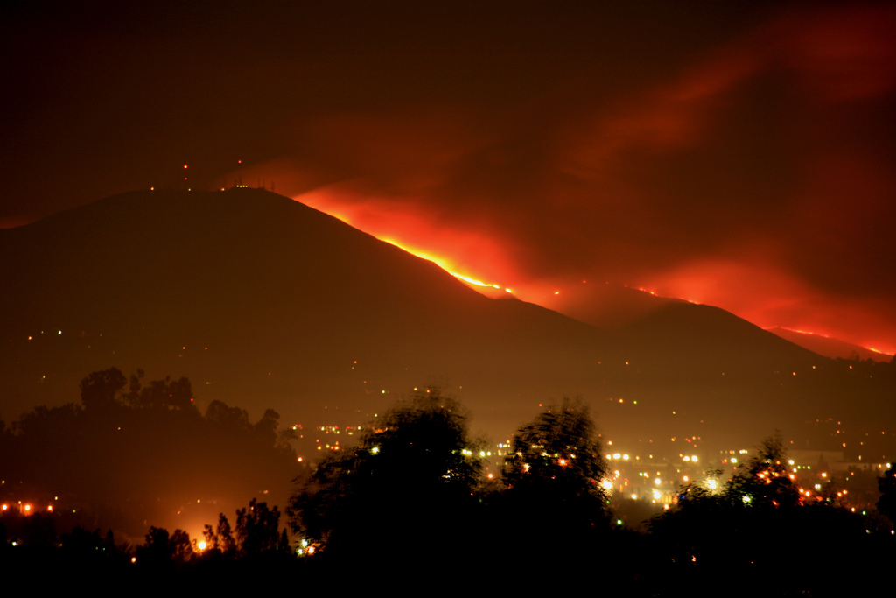
Hot Media
Photographs
Participation is low

Slide 7
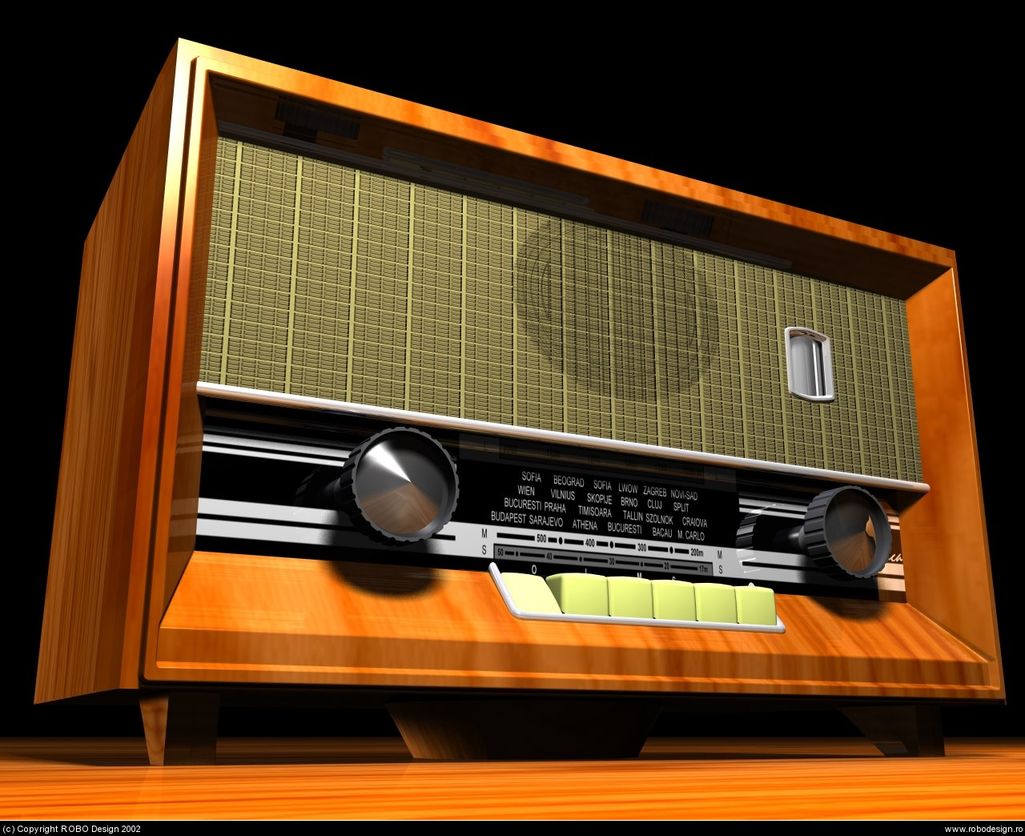
Hot Media
Radio
Participation is low

Slide 8
Cold Media
This is defined as ‘low definition’, where the viewer is given very little information, and is left to ‘fill in the blanks’. Less sensory completion or involvement. Participation is High. Generally, Cold media is not very visual, but rather audio.
Ex: Crosswords, Computers, Seminars, Televisions, Comics

Slide 9
Cold Media
Crosswords
Less sensory completion or involvement

Slide 10
Cold Media
Computers
Unless you are doing some sort of multimedia entertainment.
Less sensory completion or involvement

Slide 11
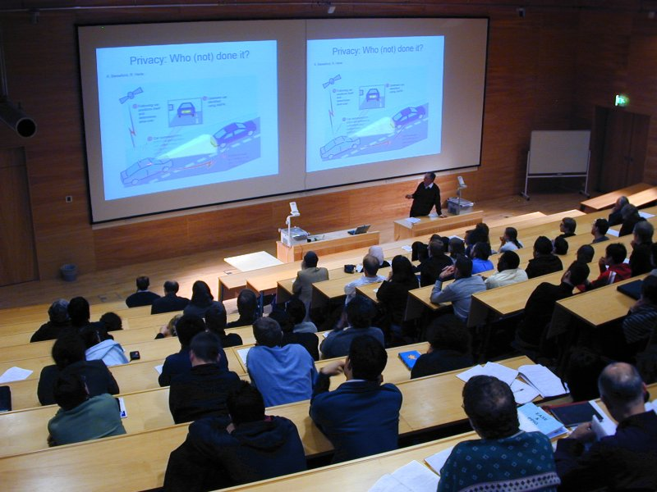
Cold Media
Seminars
Less sensory completion or involvement

Slide 12
Hot and Cold Media
McLuhan
The rules which give Hot and Cold its value is not something to be used as either “Only Hot” or “Only Cold”, but rather on more of a scale. The correct usage would be more like “Mostly Hot” or “More Hot than Cold”.
His ideas are still theories, and are evolving slightly as humanity progresses, this is what makes his ideas so powerful. This can be applied 30 years into the future.

