Slide 2
Janet H. Murray is an internationally recognized professor in the School of Literature, Media, and Communication at the Georgia Institute of Technology.
She founded one of the world's first PhDs in Digital Media and directs the eTV Lab, a research group that creates prototypes of advanced digital storytelling environments.

Slide 3
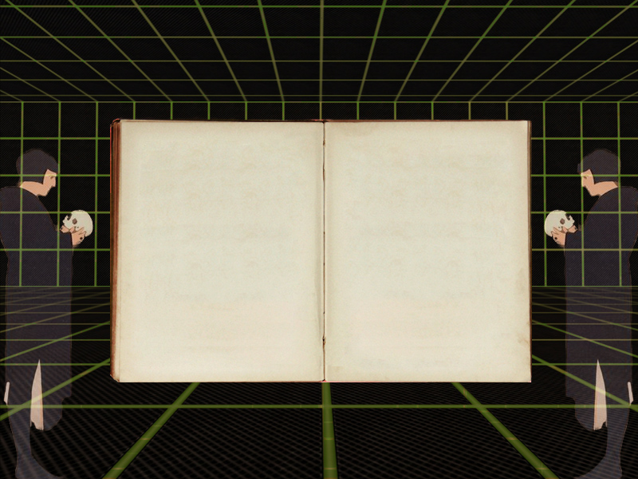
Introduction
Hamlet on the Holodeck has been inspirational to a generation of digital innovators worldwide and is still ahead of its time in imagining the creative possibilities at the convergence of computation and storytelling.

Slide 4
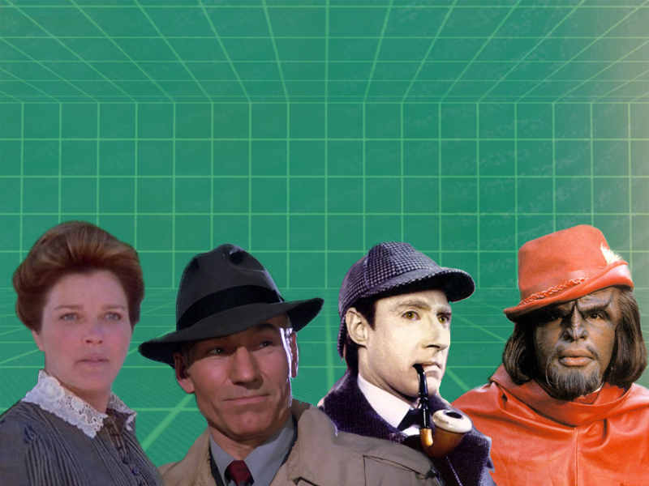
What is the Holodeck?
The holodeck introduced in Star Trek is a simulation device that allows individuals to experience realistic fantasy worlds.
Crew members can program the holodeck to construct their desired destination.

Slide 5
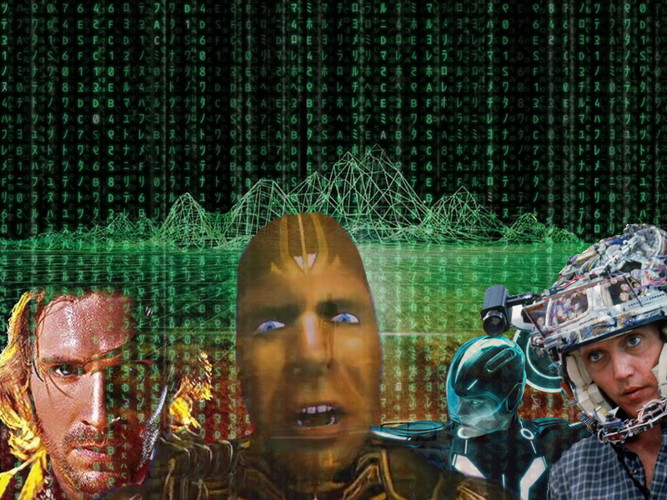
Virtual Reality in Film
Hollywood has long tradition of making movies that give us
a glimpse into futuristic visions of cyberpunk technology.
Most of these films show a bleak view of what these illusory
worlds will have in store for humanity.

Slide 6
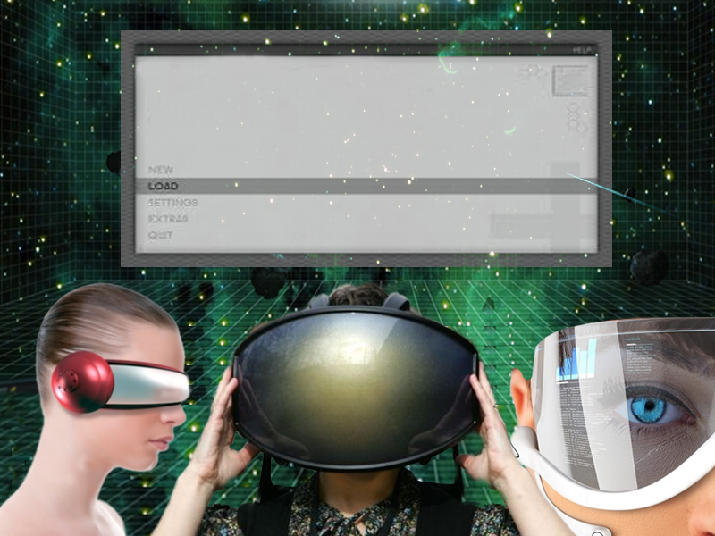
In the early 1990’s Virtual Reality made a big push into mainstream society, but only in the last few years has it returned to the publics awareness.
Although VR exists today, it’s still in its infancy.

Slide 7
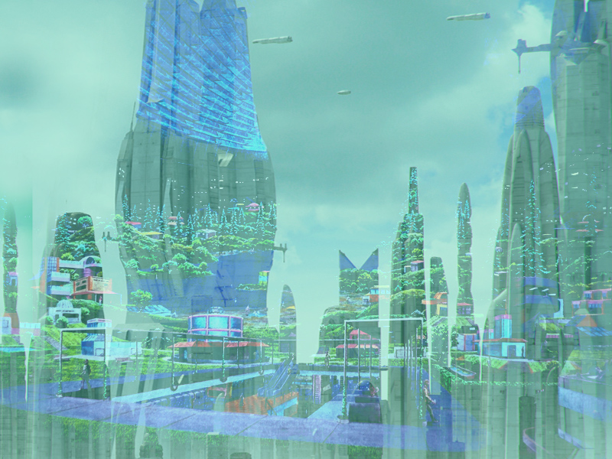
Utopian Dreams
A Utopian future uses technology to create a perfect society,
free of suffering and death.
Making a harmonious balance between man and machine.
From the novels and movies on this subject, we know that
Utopias are never really as perfect as they seem.

Slide 8
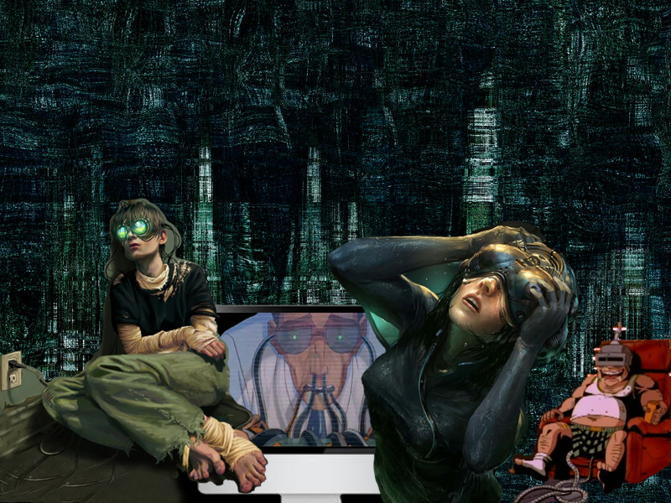
Dystopian Visions
This view of our technological future appeals to the negative
side of human nature.
We become “Savages” enslaved by the machines we created
because of our attraction to the instant stimulating impulses
immersive technology provides.

Slide 9
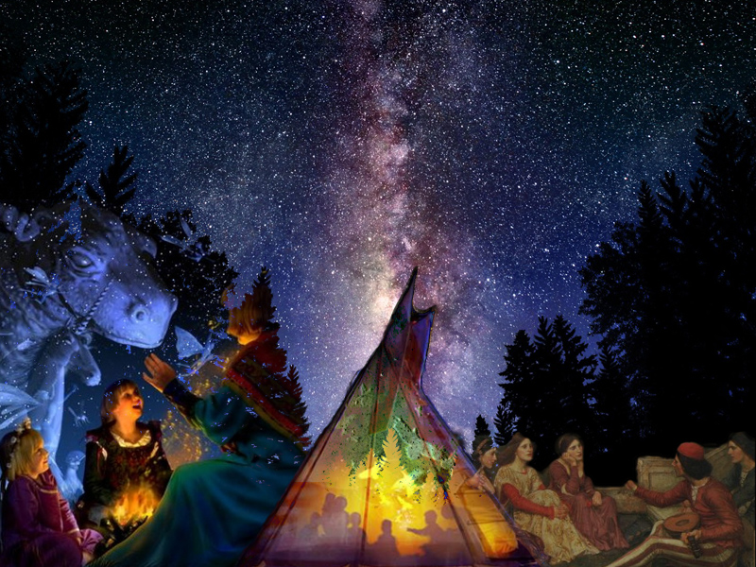
The Art of Storytelling
Our tradition of storytelling is as old as humanity itself.
For many millennia we relied on the oral tradition to
communicate archetypes and allegories.

Slide 10
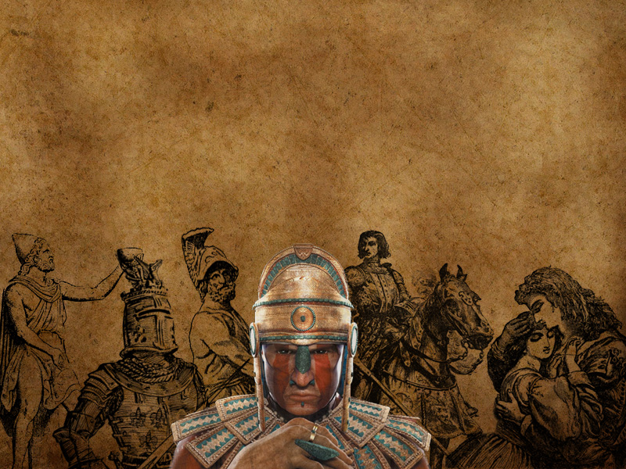
Master Archetypes
Even though the storytelling format as evolved, the core
elements of narrative traditions are just as important today.
Classic archetypal examples include The Explorer,
The Ruler, The Lover, The Magician, and The Hero.

Slide 11
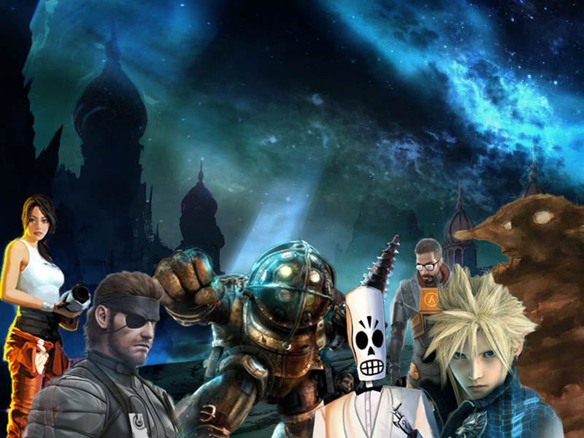
Storytelling in Games
Unlike other mediums like literature and film, video games offer
active participation an immersive adventure.
A game can use the environment as well as controlled pacing to progress the story.

Slide 12
The Dark Side of Gaming
The Video game landscape is dominated by ultra violent content.
These first person shooter type games offer a high degree
of carnal stimulation but often have little storytelling depth or
true substance beyond the run and gun killing.

Slide 13
;
At its best Virtual Reality provides an arena to
explore inner life.
An Immersive space where one can safely face the
challenges and feeling of the human condition.
Its clear within the coming decades VR will become the
dominate form of imaginative storytelling

