Slide 1
A New medium for storytelling
Author: Janet Murray
HAMLET ON THE HOLODECK
By Linda May, MAT-103

Slide 2
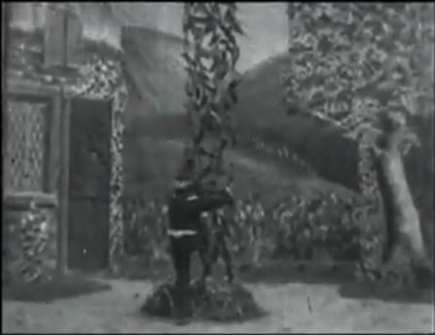
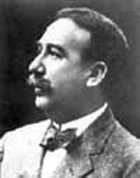
Edwin S. Porter “the father of the story film”
Jack & the Beanstalk
1869 - 1941
Hired by Thomas Edison – in 1900 he began making short narrative films.

Slide 3
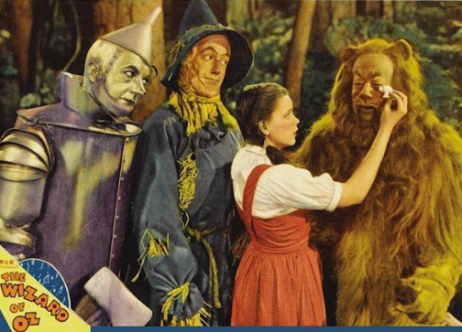
The wizard of oz
Go to sleep – wake up in an adventure.
1939 – an American Musical Fantasy

Slide 4
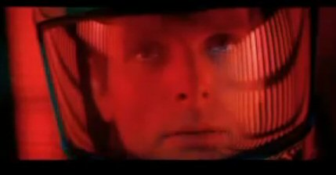
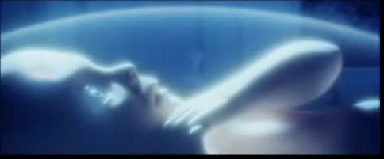
2001 odyssey
We can leave our world and experience something only dreamed about.
Then---we can be reborn into a new and different life.

Slide 5
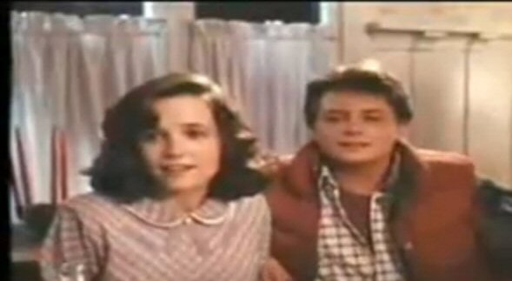
Back to the future
Go back – into the past – rewrite your life.

Slide 6
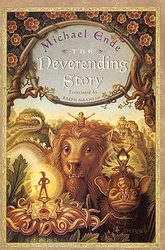
The never ending story
Read a Fantasy,
Dream a dream,
& what you see
– will be.

Slide 7
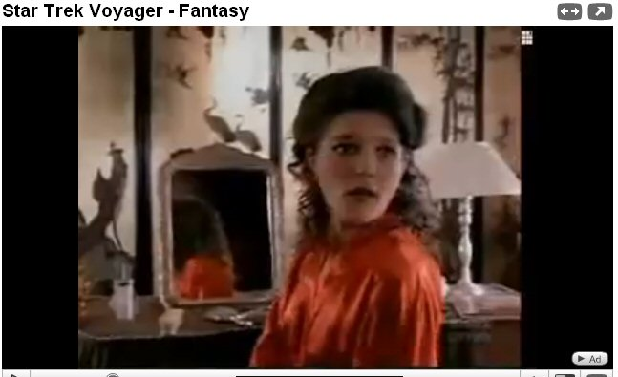
Janeway in “holosuite”
Making life better by living in a different reality.

Slide 8
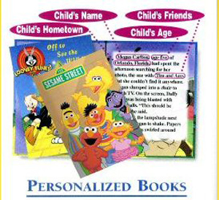
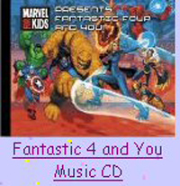
Yourself in print
You can be a character in a book,
object of a song, or the image in a game.
*** You are special ***

Slide 9
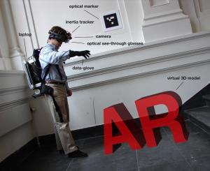
Virtual reality
True Immersive Video
Special helmet - images are projected into the wearer’s eyes –
creating the illusion that these images are part of reality.
It is as if extra elements are being added to reality.

Slide 10
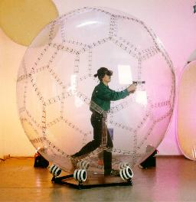
Virtusphere, Inc. #1
Locomotion
Sphere
User completely immersed into their interactive virtual experience
Hollow Sphere
Rotates freely 360°
Play gaming & entertainment inside in life-like real environment

Slide 11
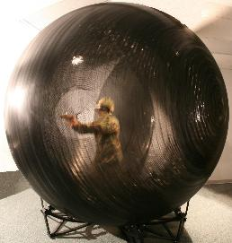
Virtusphere, Inc. #2
Locomotion
Sphere
Experience Health & Fitness realities
Enjoy Education, Museums, Events, Shows
Train Military & other dangerous jobs in simulated real environments.
Participate in Home Gaming

Slide 12
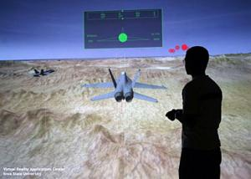
Virtual reality room
WOW☺
COOL
You’re high above the desert peaks – you’re in control of a swarm of U.S. Air Force unmanned aerial vehicles……….

Slide 13
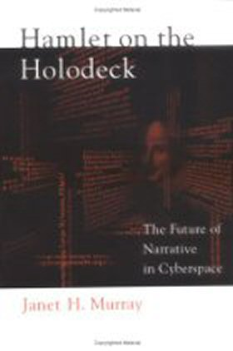
Looking to the future
Objects seen in futuristic movies are soon developed.
We look ahead, longingly, for the things Janet Murray spoke about:
Gloriously equipped Space-Stations
Medical Tricoders
Light Speed Travel
Photon Weapons
Interactive Talking Computer
Playing in a Holonovel !!!
See you in the future…….

