Slide 1
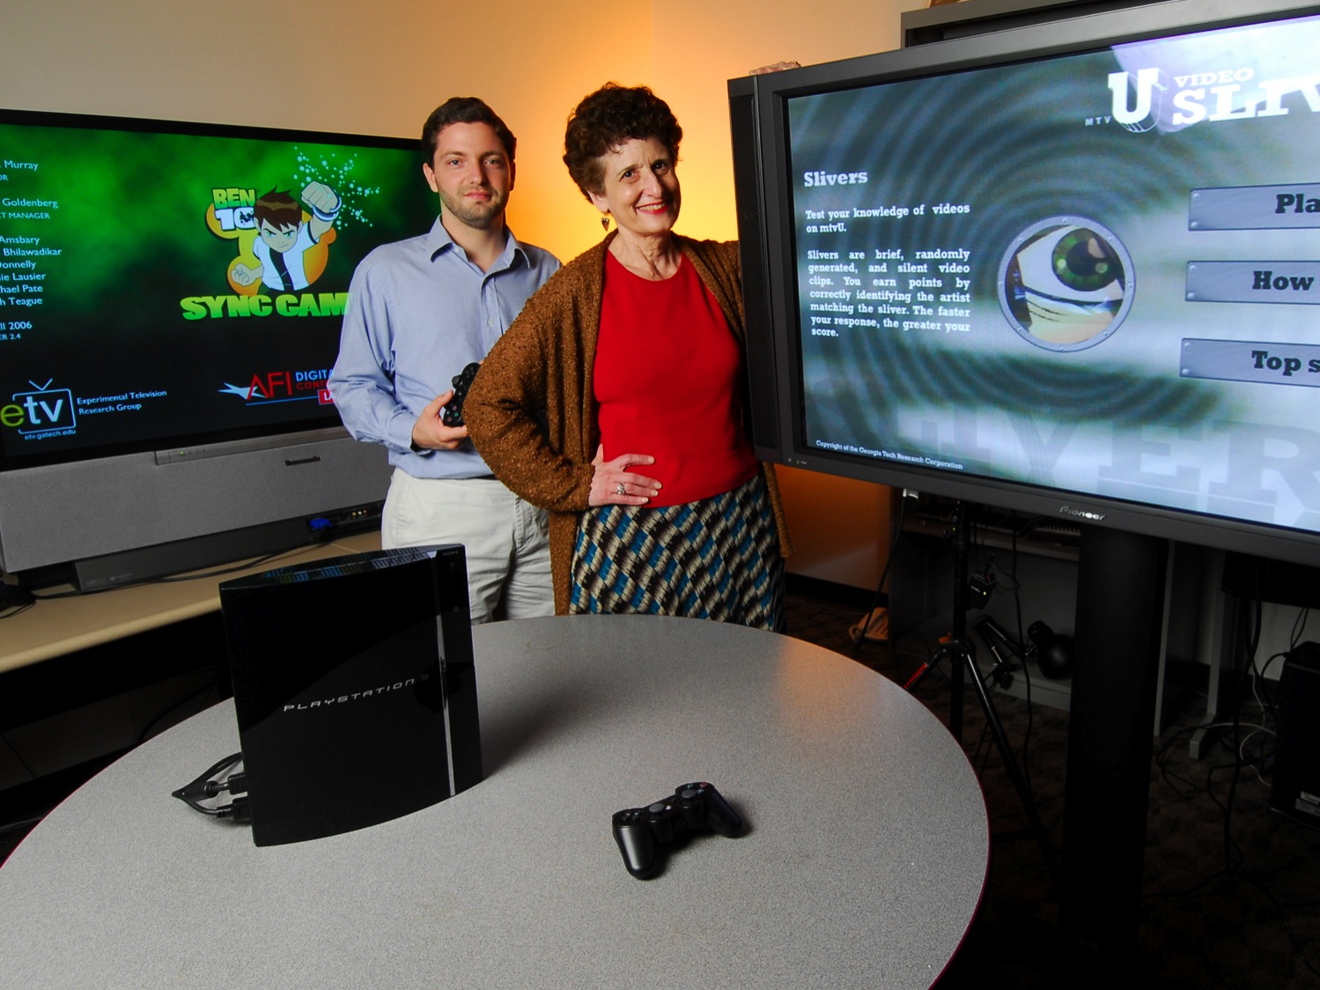
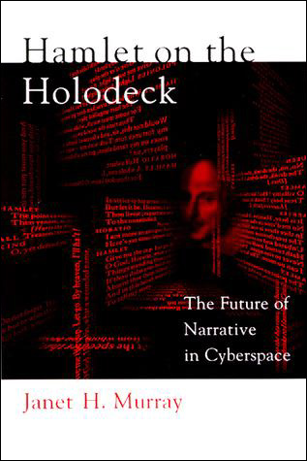
Observations on Narrative
as presented in Janet Murray’s
Hamlet on the Holodeck:
The Future of Narrative in Cyberspace
By J. Sanregret
MAT 103 Final

Slide 2
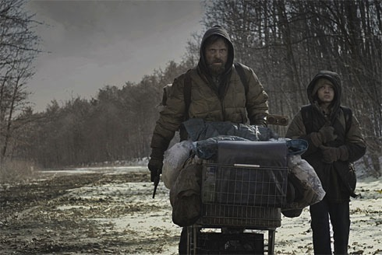
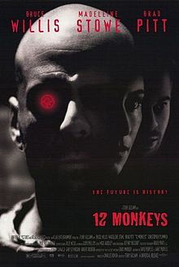
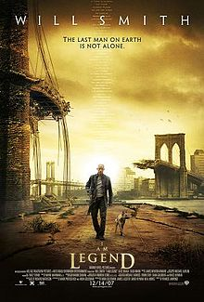
Dystopia A society characterized by misery
Speculation about the future raises the question
of whether we will live in Dystopian or Utopian times…
Technology used to control and dominate
Destruction of environment
Alienation from the natural world
War and violence
Disease and chaos

Slide 3
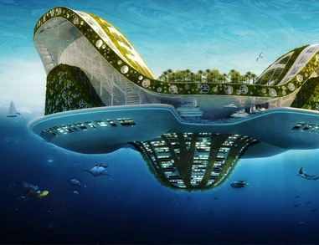
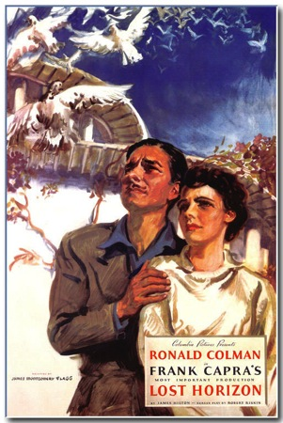
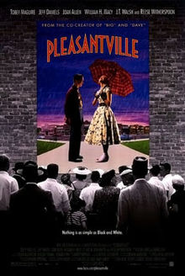
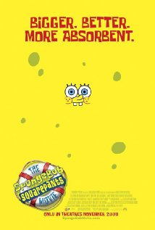
Utopia A society characterized by joy and fulfillment
Technology used to benefit and enlighten
Preservation of environment
Enjoyment of the natural world
Peace and love
Illness and strife eliminated

Slide 4
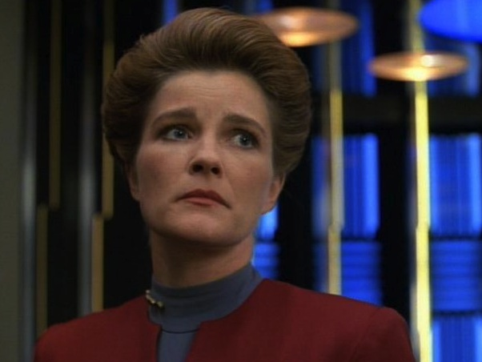
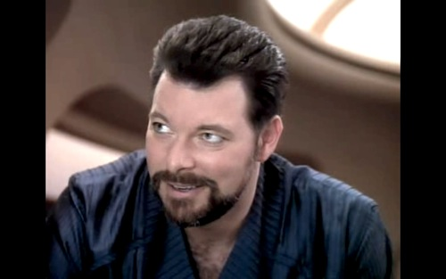
The Holonovel
A holographic program providing customized entertainment
Allows participants to assume a role in a story in 3D
The first time the word “holonovel” was used was in reference to the Star Trek episode “Sir Burleigh’s Kiss.”
“Commander Riker,
why watch holonovels of Duchess rather than,
you know, something more interesting?”

Slide 5
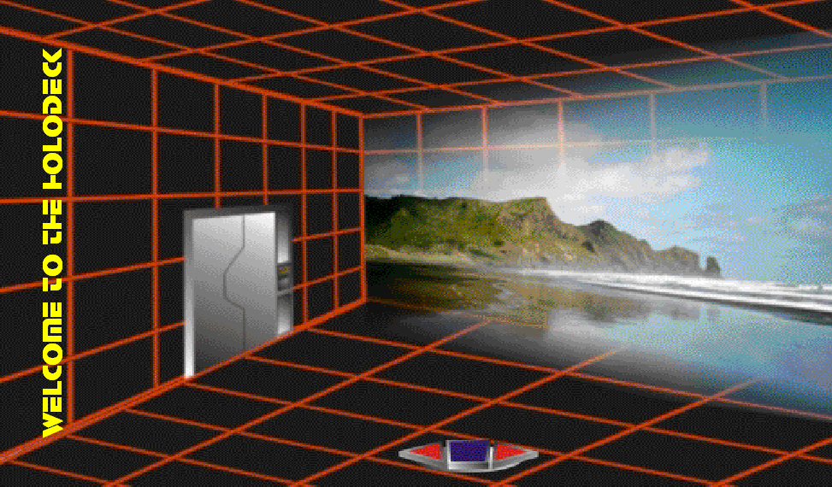
The Holodeck
An imaginary, immersive world
Can be started and stopped at will
Allows user to explore alternate realities
And alternative aspects of their own personalities

Slide 6
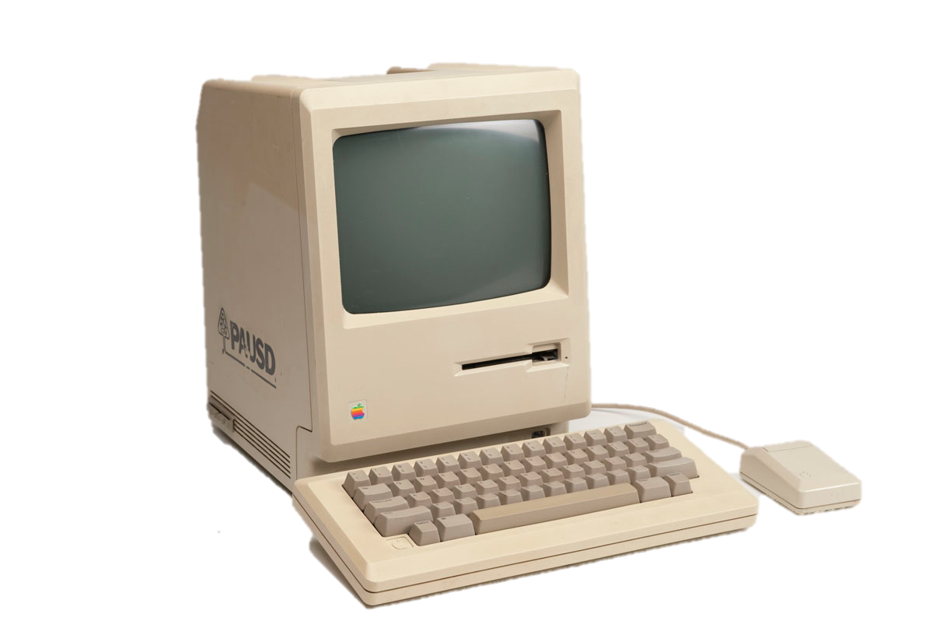
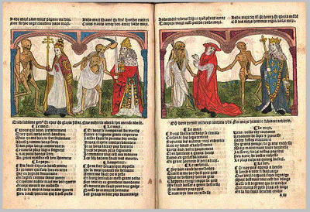
Incunabula
=
Books printed before 1501
Refers to infant’s swaddling clothes
Infers a technology in its infancy
Early computers were the incunabula of the cyberworld
Personal computers have not yet reached their maturity as a technology

Slide 7
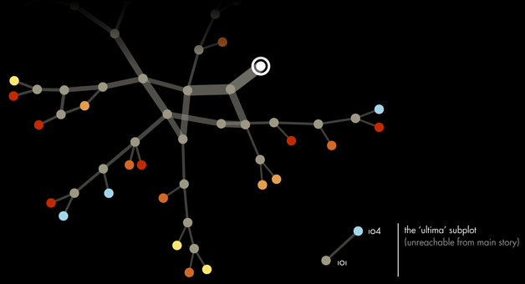
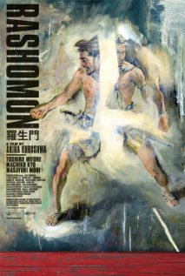
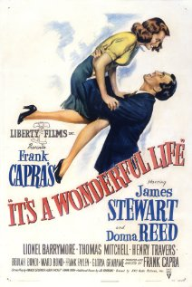
The Multiform Story
Starts from a single point
Departs from linear narrative
Explores multiple, mutually exclusive story lines
Narrative choices exist in parallel realities

Slide 8
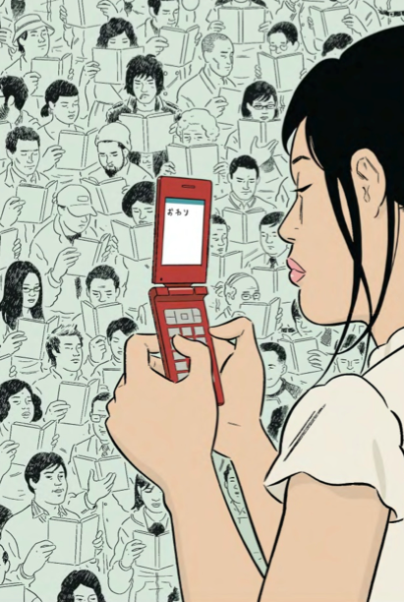
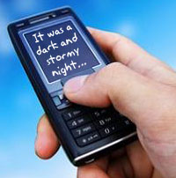
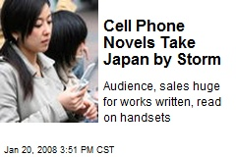
Cell Phone Novels
Called Keitai Shosetsu in Japan
Written on cell phones
Posted to mobile novel portals
Billions of monthly users

Slide 9
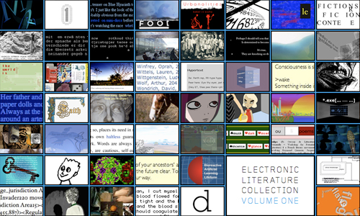
Hypertext fiction
Electronic, multi-form literature
Users choose pathways through narrative
Creating their own versions of the story
By the use of hypertext links

Slide 10
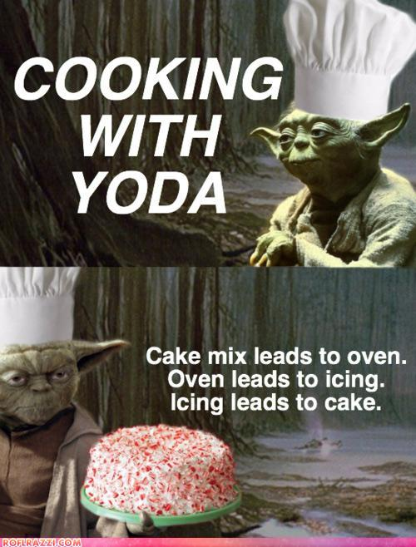
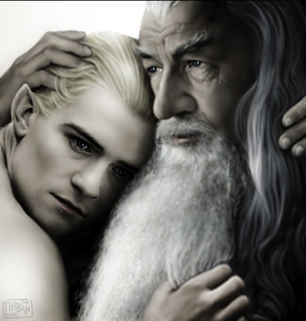
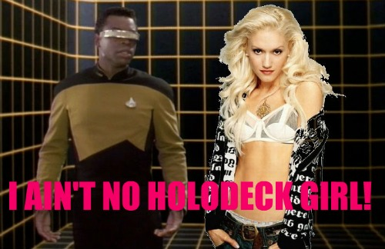
Textual Poaching
CAUTION: UNAUTHORIZED FAN ART !!!
Fans of certain series or movies, such as Star Trek, Star Wars, or Lord of the Rings can identify strongly with the characters. This may lead them to create non-authorized original art, introducing new storylines or off-genre characters. This is called “textual poaching.”

Slide 11
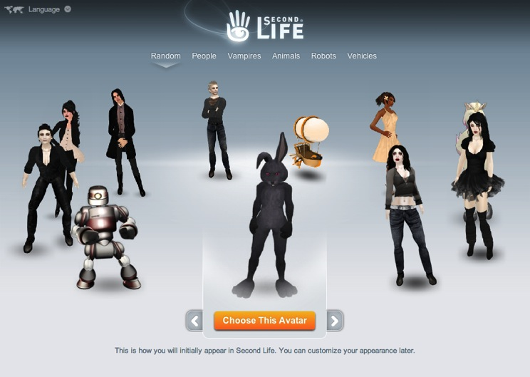
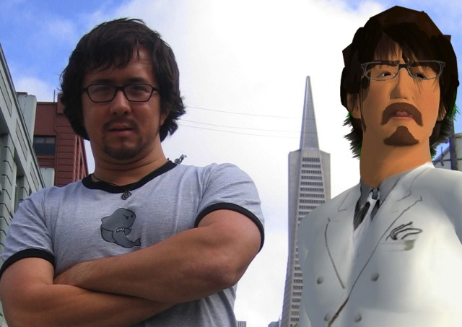
MUDs (Multi-User Domains)
A real-time virtual world, usually based on text.
Players create or choose avatars.
Narrative arises spontaneously through player decisions and actions.

Slide 12
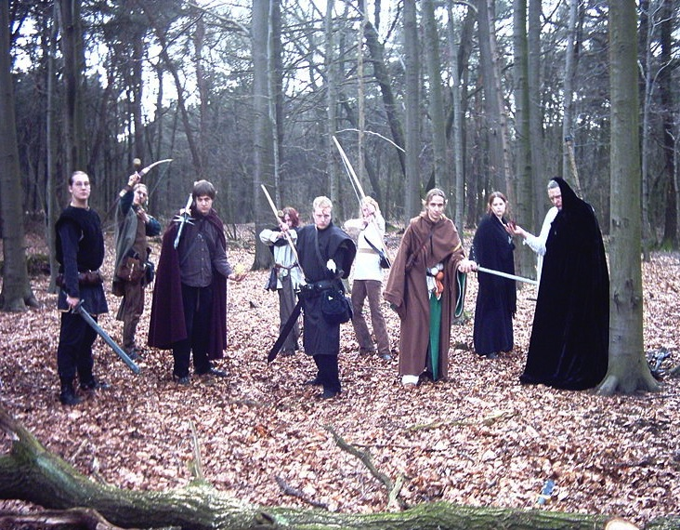
LARPs: Live Action Role Playing Games
Real-time role-playing clubs, based on fantasy literature
Narrative emerges through game play, determined by consensus-built rules

Slide 13
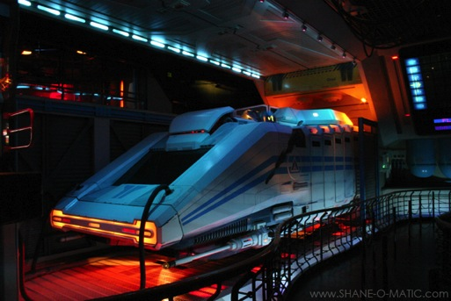
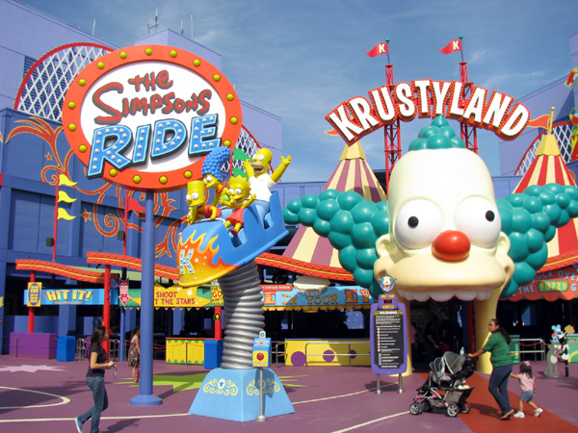
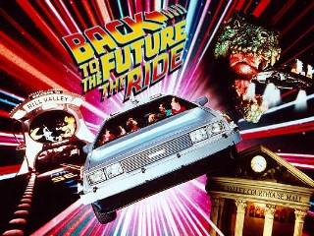
The “Movie Ride”
A total sensory experience
Viewer becomes participant
Some movie rides allow participant choices to alter the storyline

Slide 14
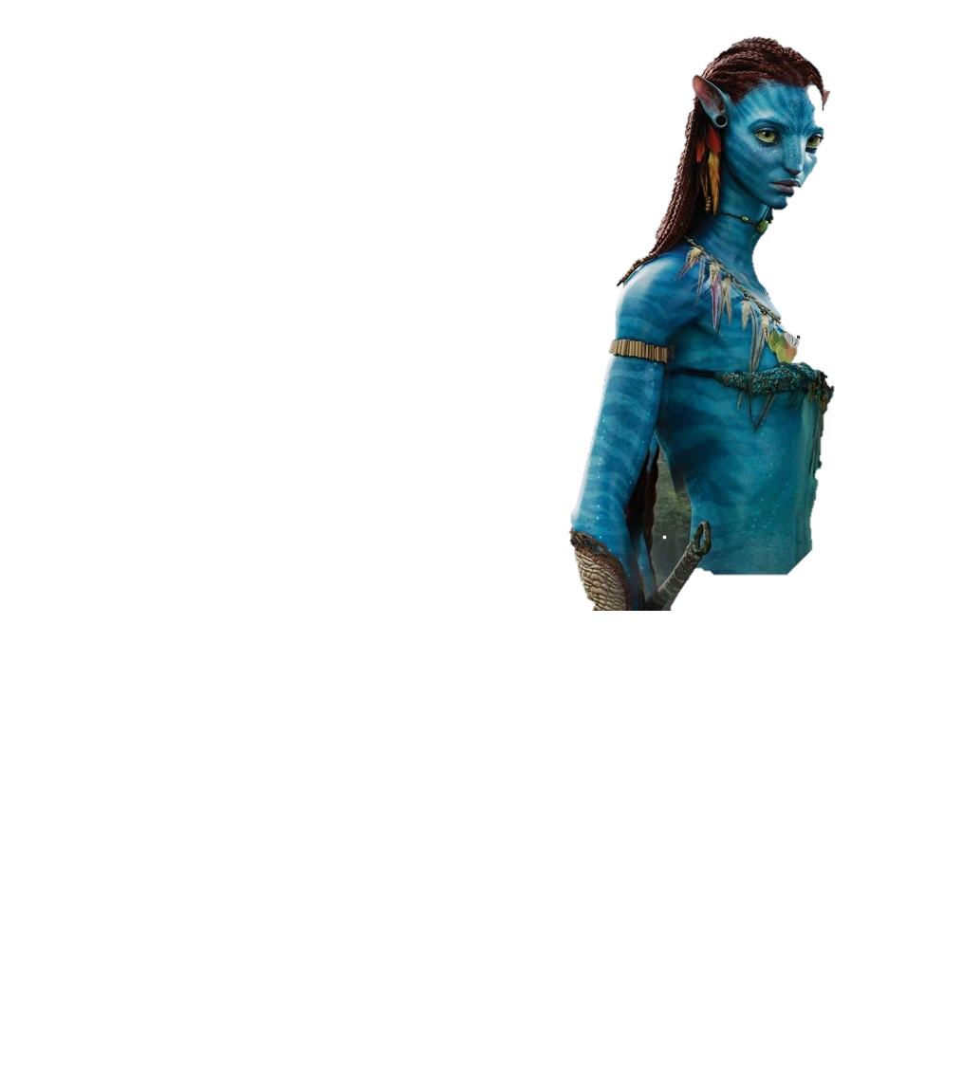
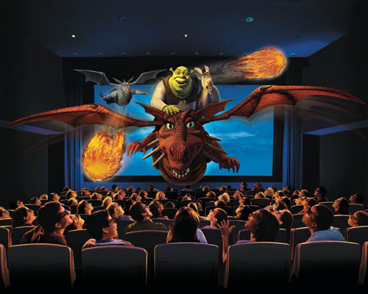
3D & 4D Experiences
Seamless immersion
Through multi-sensory stimulation
Evokes emotional response
And total user involvement

