Slide 1
Aura in Art
Based upon Walter Benjamin’s essay ‘The Work of Art in the Age of Mechanical Reproduction’.
By Gavin Plant

Slide 2
What is ‘Aura’?
Benjamin referred to aura as “the unique appearance of a distance, however near it may be.”
“To follow with the eye—while resting on a summer afternoon—a mountain range on the horizon or a branch that casts its shadow on the beholder is to breathe the aura of those mountains, of that branch.”
The mountain scene as described by Benjamin is an illustration which helps us to understand more clearly the concept of aura, showing us that distance and separation are already marked in the aura of the mountain scene by its shadows.

Slide 3
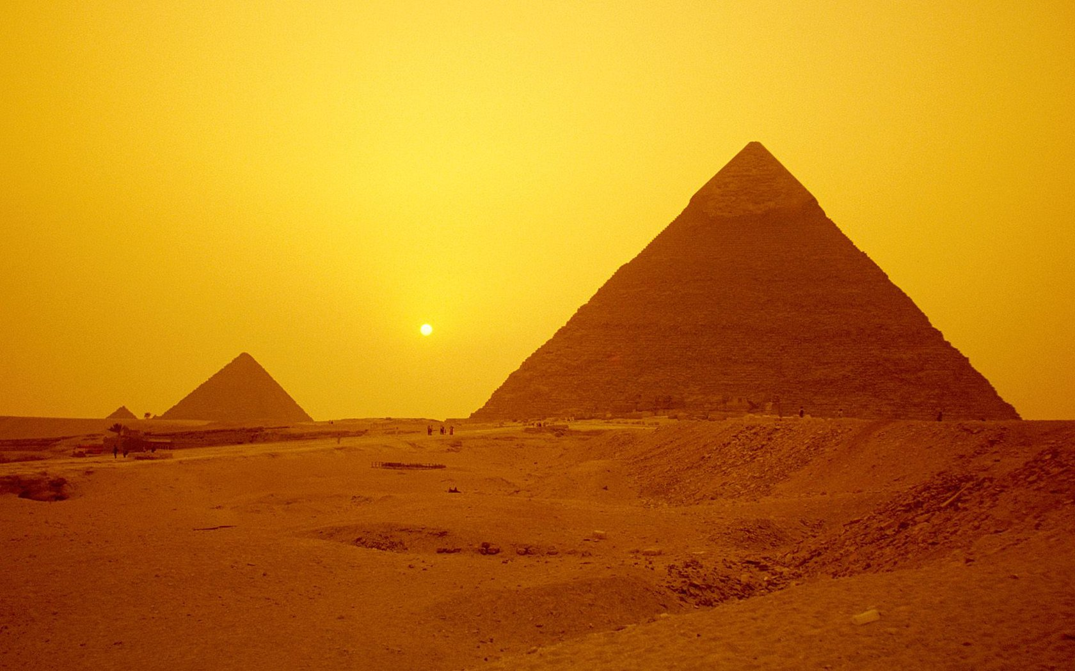
The idea of distance is important in the understanding of aura. The ritualistic value of a work of art is also instilled by it being at a distance from us.
For example, take the Pyramids or the great wall of China. More than being just a bunch of stones, they possess a certain aura in the ‘ritual’ value placed upon them. Even without personally seeing them, you can still get a sense of the awe in which these objects instill in people.

Slide 4
Benjamin also cited aura as being the difference between the singular, one of a kind object and the mechanically reproduced object.
"The uniqueness of a work of art is inseparable from its being imbedded in the fabric of tradition”
“authenticity,” “historical testimony,” “the mark of history,” all of which must be encountered in the presence of “the here and now of the work of art—its unique existence in a particular place”

Slide 5
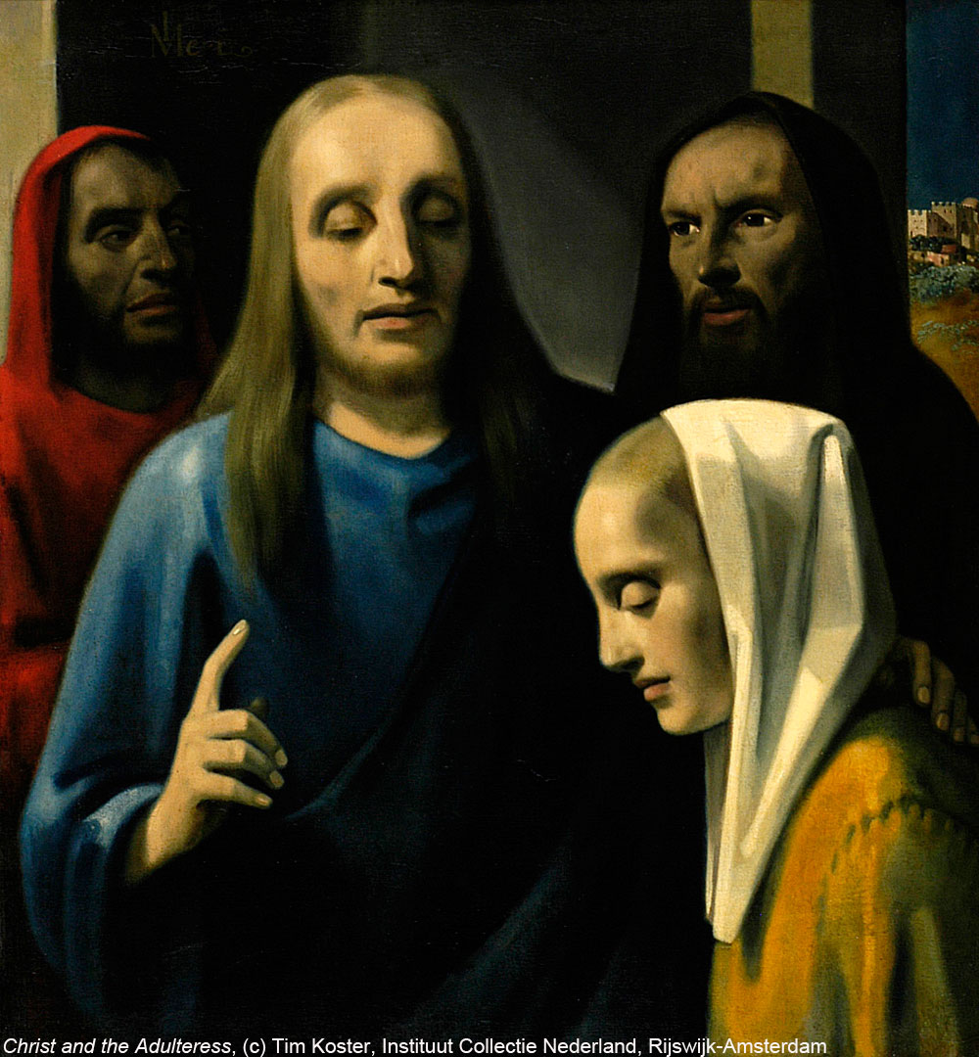
The story of Hermann Goering helps underline the significance of aura in art.
Goering was Hitler’s second in command and was an avid art collector and a very nasty individual. Even for a Nazi. After much searching, a delighted Goering was able to find a dealer in Holland who was willing to sell him a Vermeer painting at great cost.
After the war ended the dealer who sold Goering the painting was arrested and charged with treason. After being detained he pleaded his innocence and claimed to have not sold the dirty Nazi the masterpiece but rather had sold him a fake, which he had painted himself. After proving that this was indeed true, he was charged with a the lesser crime of forgery, served a year behind bars and died a Dutch hero.

Slide 6
Hermann Goering was also arrested after the War and was known to boast about his various belongings including his beloved art collection.
However, when it was revealed to Goering (who was described by his interrogator's as an ‘amicable psychopath’) that his beloved Vermeer was in fact a forgery, you could sympathize somewhat with his reaction. As his biographer put it; “He looked like as if for the first time, he had discovered there was evil in the world”.

Slide 7
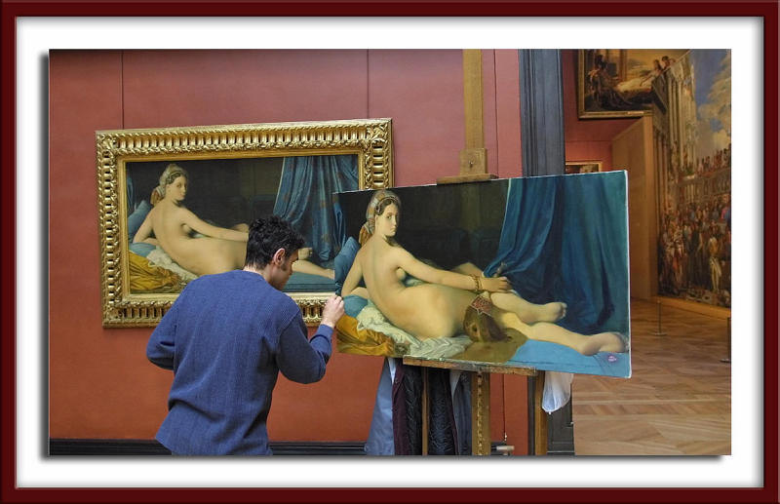
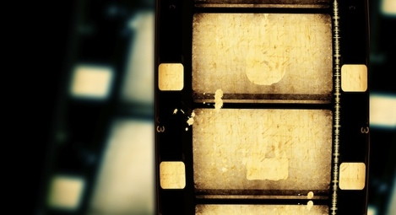
This true story highlights the truthfulness of Benjamin’s words; ‘Even the most perfect reproduction of a work of art is lacking in one element: it’s presence in time and space, it’s unique existence at the place where it happens to be.’
Benjamin could see that this kind of ‘aura’, a work of art’s uniqueness or authenticity, was threatened by the profusion of reproductive technologies which places the aura of the work of art in decline.

Slide 8
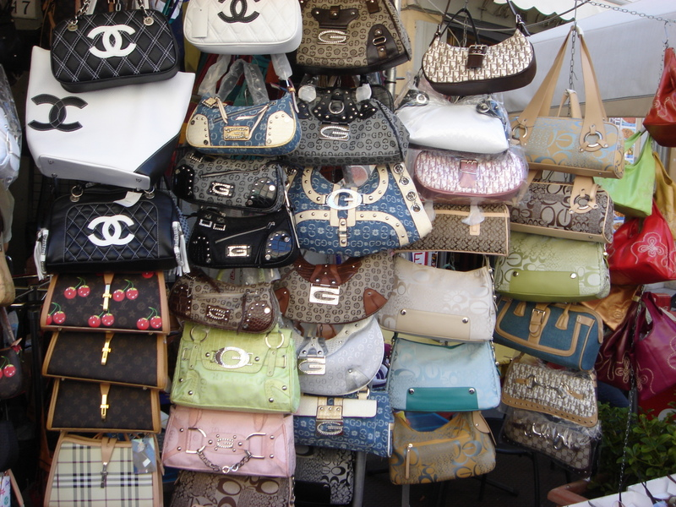
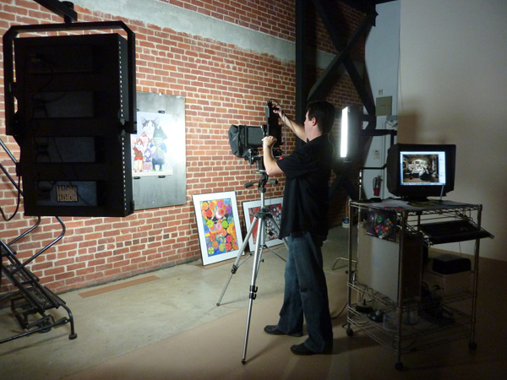
The Decay
The desire of the contemporary masses in wanting to bring things closer and overcome the uniqueness of reality.
Every reproduction made, be it a print of a famous work of art or a knock off designer handbag, takes a little away from the aura of the original object.

Slide 9
From stamping to woodcuts to lithography, there has always been reproduction in art.
With modern technology however, the reproduction of art is on a different level.

Slide 10
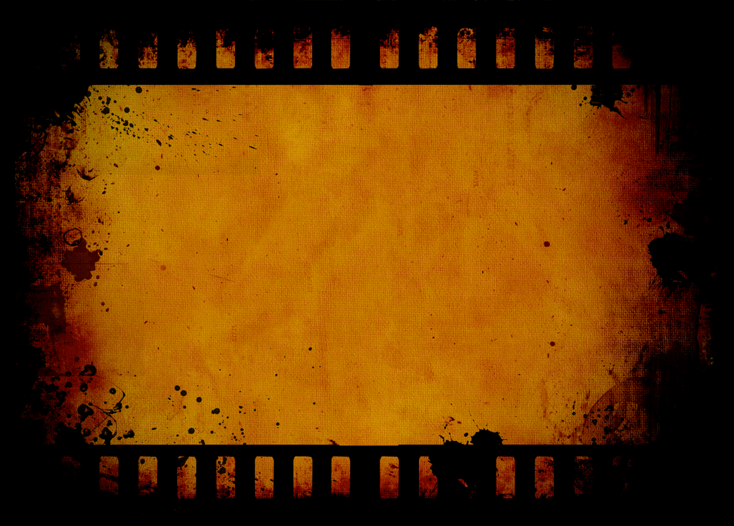
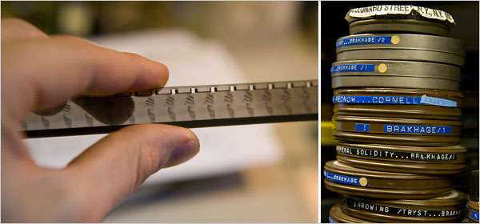
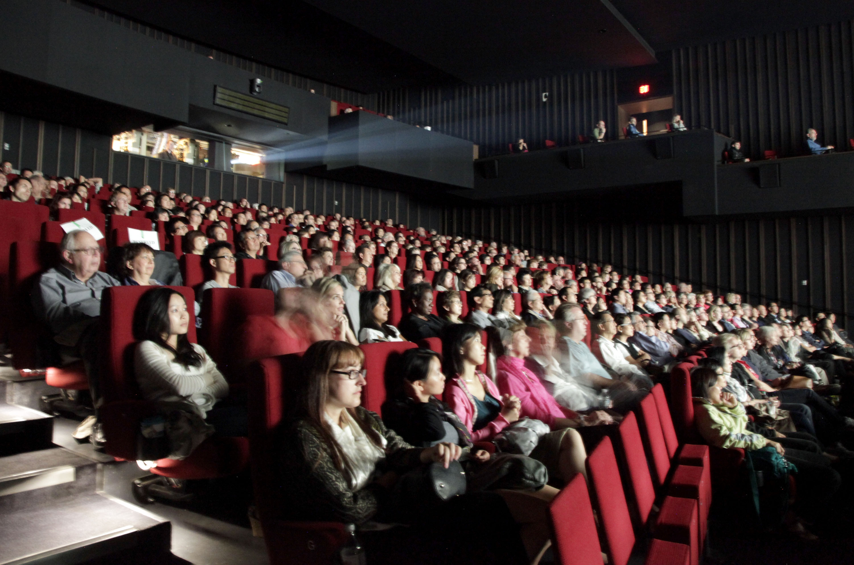
Film allows for the almost infinite reproduction of identical images. Film image is not unique and so it lacks this quality of aura. Therefore, the more film we see in society, the more aura will wane.

Slide 11
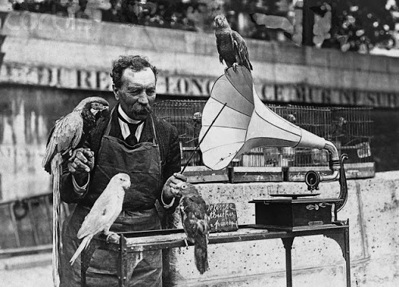
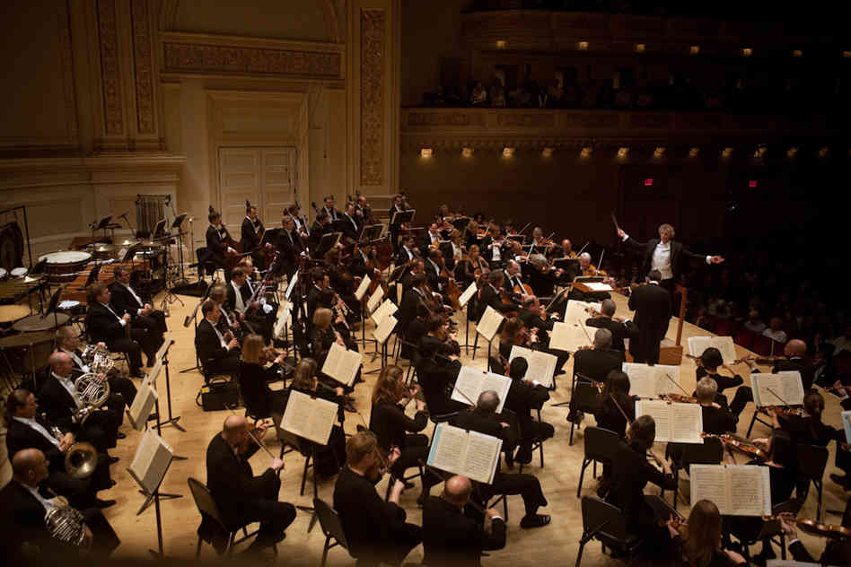
“The whole sphere of authenticity eludes technological—and of course not only technological—reproduction.”

Slide 12
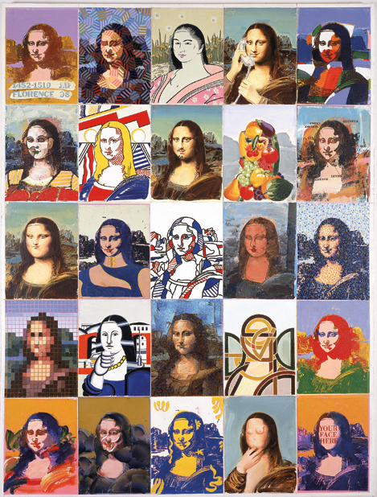
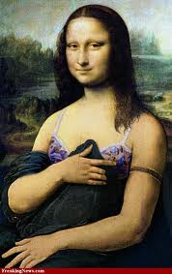
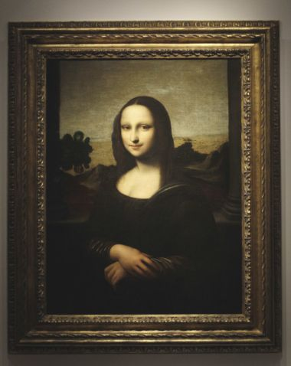
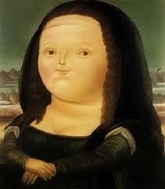
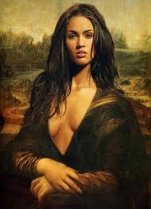
Think of the difference between someone who has always heard of the Mona Lisa, but never seen it reproduced and those of us who have seen literally thousands of reproductions. Surely, seeing the real thing is going to be a much more profound experience for someone not acquainted with Da Vinci's masterpiece through cheap reproductions.

Slide 13
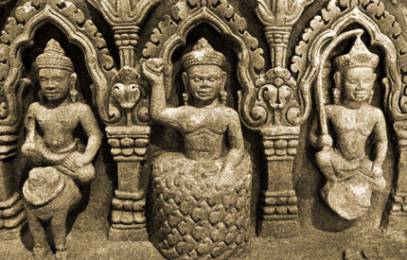
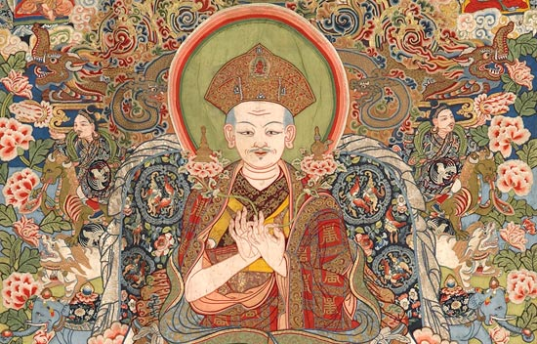
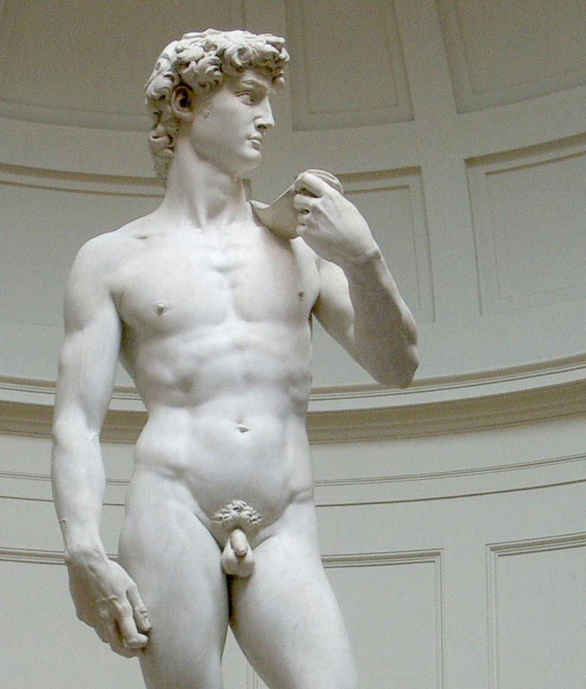
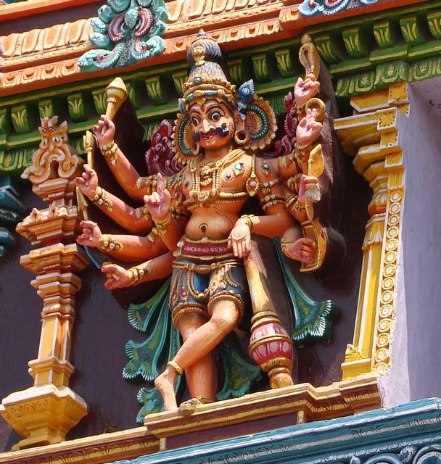
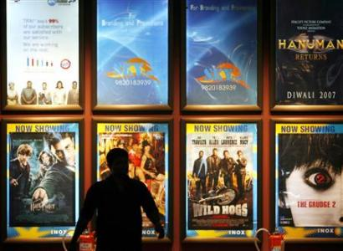
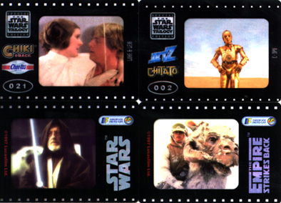
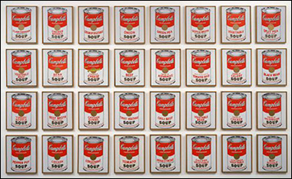
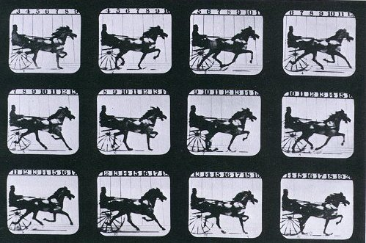
The waning of aura is important as Benjamin explains that art without aura has never been experienced in any previous culture.

Slide 14
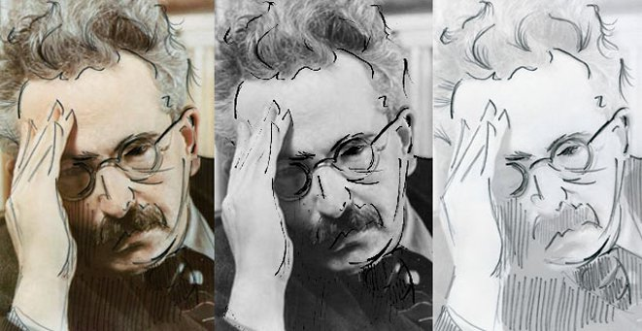
Conclusion
Today, we are constantly exposed to different forms of art in all manner of media. I don’t think that aura is a narrow concept related only to technology but is a general category of experience that can apply to any object of perception.
I believe Aura will be around as long as people still have an emotional attachment to art in all it’s many shapes and forms.

