Slide 1
Gaming as a way to understand human interaction
by: Carl Skepp

Slide 2
Name: Janet H. Murray
Born: Georgia, USA
Field: Digital Media
Training: Harvard University
Works: Hamlet on the Holodeck: The Future of Narrative in Cyberspace, The New Media Reader, Inventing the Medium
Janet Murray

Slide 3
“We use the word games as a metaphor for politic, personal life and relationship” –Janet Murray

Slide 4
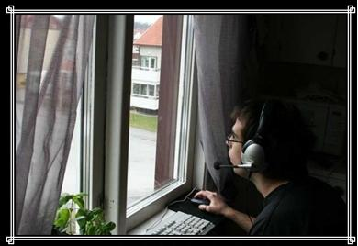
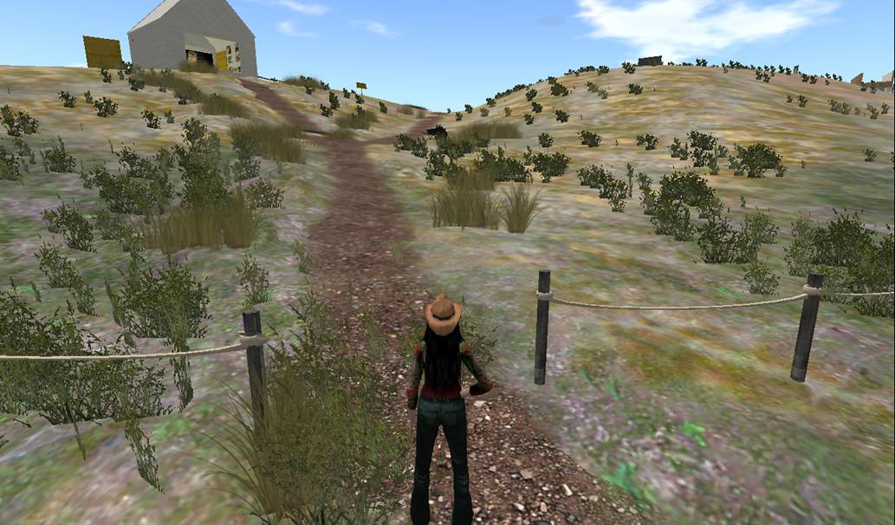
In a lot of ways, we see the world as a game

Slide 5
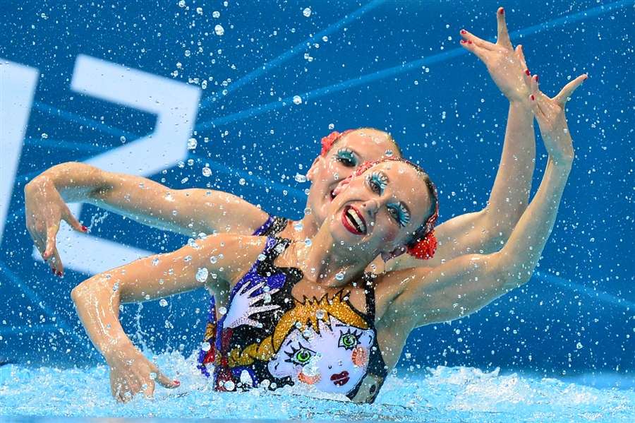
we like to be synchronized with one another,
clap hand together or fall down together

Slide 6
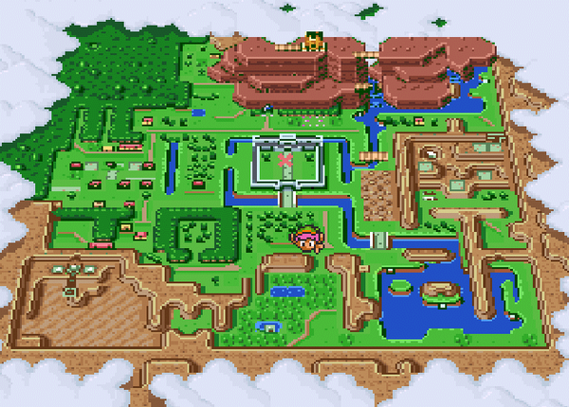
Gaming is a way to understand human interaction
Ones we learn to synchronize our behavior, we invent symbolic and forms of representation. Then we can start telling each other stories.
The games and stories has made the human brain in someway, and have form the basic layer of culture

Slide 7
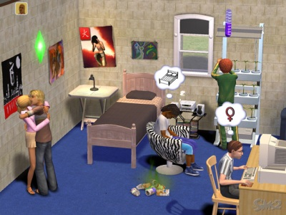
If we can describe the world as behavior
We can tell stories by making worlds with behaviors

Slide 8
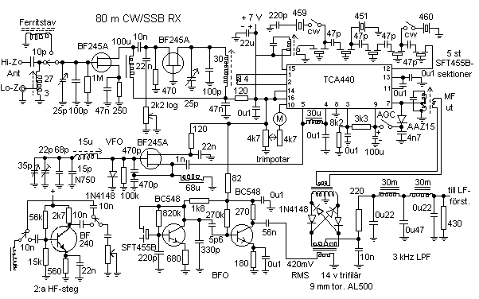
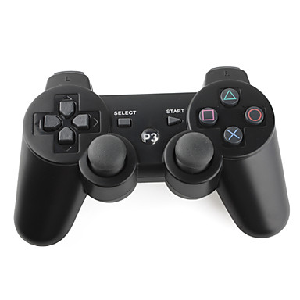
We want to put things in a story form
If we have a powerful medium such as gaming, that can hold more and express more, then we can tell more complicated stories.

Slide 9
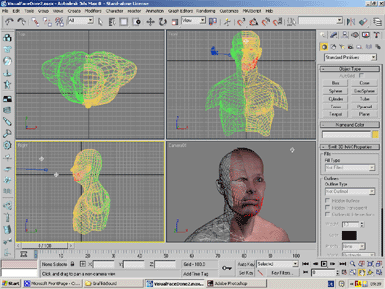
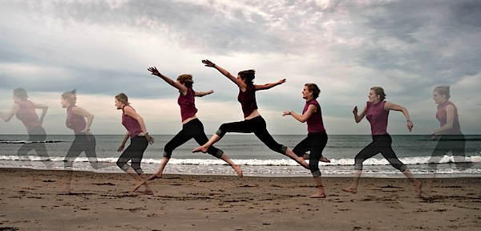
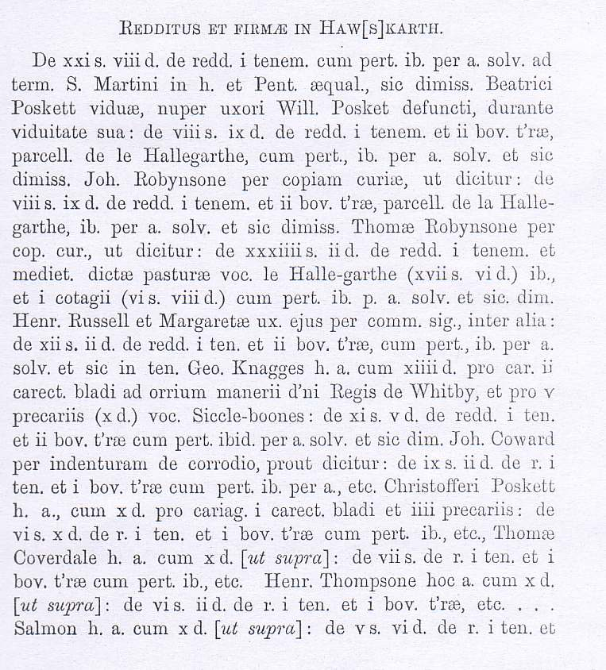
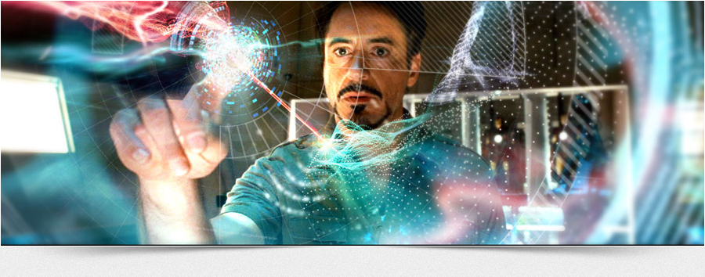
..and it’s because gaming is a medium that includes still images, moving images, text, audio, three-dimensional, navigable space. And that is more of the building blocks of storytelling than any single medium has ever offered us.

Slide 10
Stories and games are both distanced from the real world, although they often include activities that are done "for real" in other domains.
The stock market, for example is a betting game, but real world resources are exchanged

Slide 11
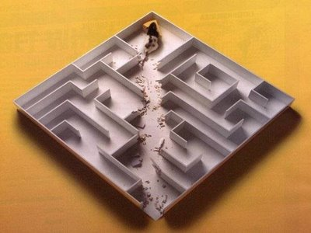
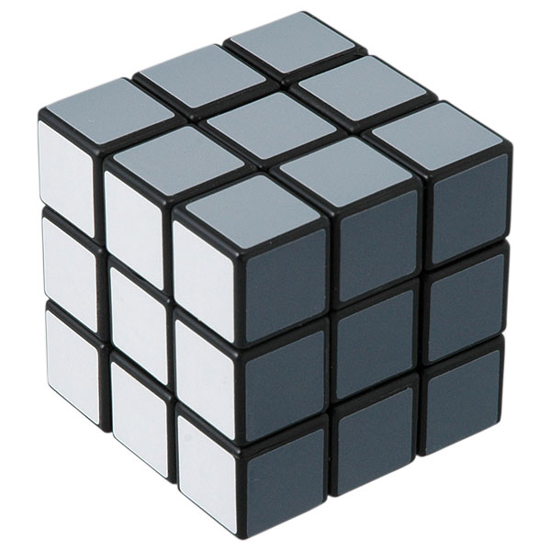
More and more, we think about life as taking place in a possibility space

Slide 12
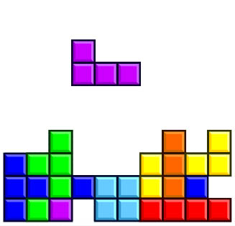
Games are always stories. Even abstract games such as checkers or Tetris, which are about winning and losing

Slide 13
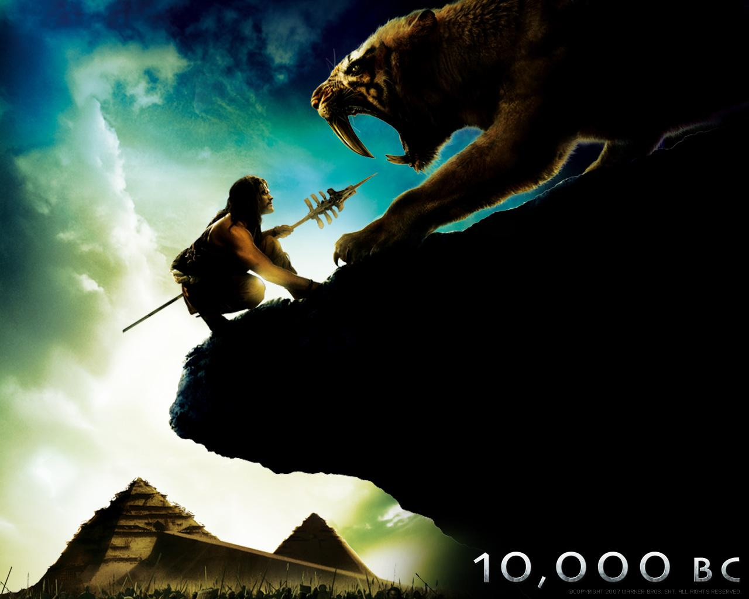
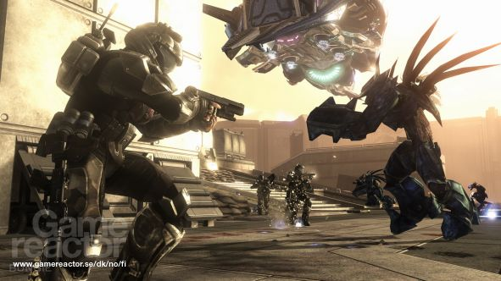
Games and stories have in common two important structures.
The first structure is the contest, the meeting of opponents in pursuit of mutually exclusive aims. It may have evolved as a survival mechanism in the original struggle of predator and prey in the primeval world

Slide 14
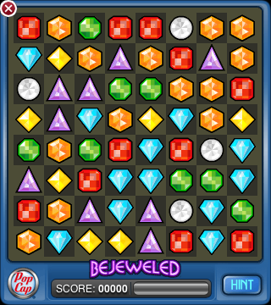
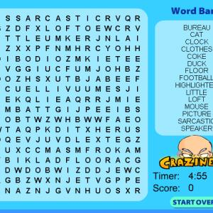
The second structure is the puzzle, which can also be seen as a contest between the player and the game-designer. In a puzzle story, the challenge is to the mind

Slide 15
“We need a new medium to express this story, to practice playing this new game, and we have found it in the computer.”
-Janet Murray

