Slide 2
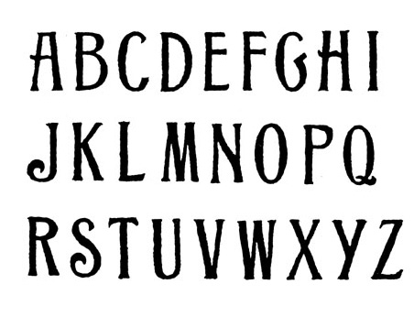
“The phonetic alphabet alone, of all forms of writing, translates the audible and the tactile into the visible and the abstract. Letters, the language of civilization, have this power of translating all of our senses into visual and pictorial space.” Marshall McLuhan

Slide 3
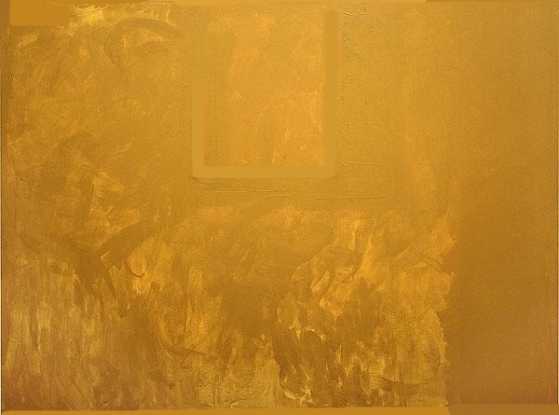
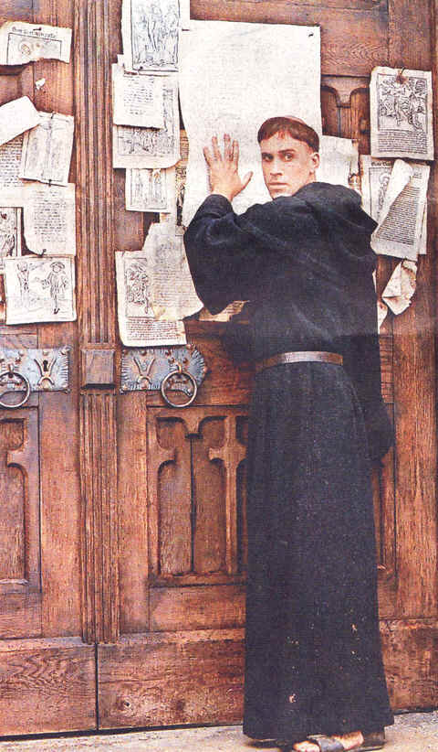
The Protestant Reformation
“The suppression of heresy had been an easier task when the authorities were confiscating handwritten texts; the cheapness and availability of printed books and pamphlets gave Erasmus, Luther and their colleagues a new tool and they used it brilliantly.”
Sears McGee et al., editors,
Kings, Saints, and Parliaments

Slide 4
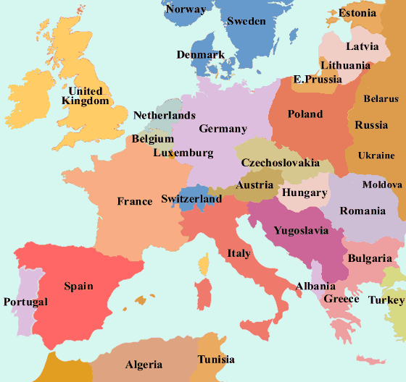
“As soon as people could see their own language in print form, they began to develop a sense of national unity.” Marshall McLuhan

Slide 6
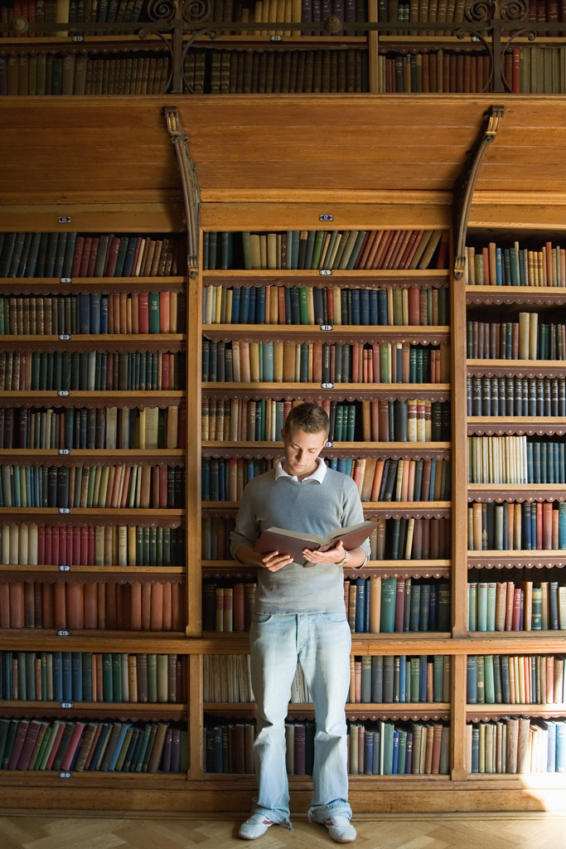
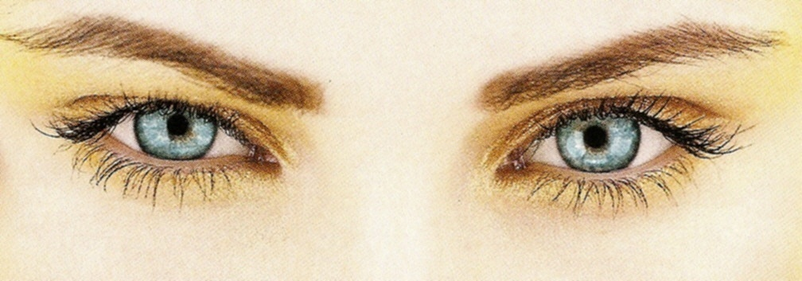
Linear organization of uniform, repeatable type
places demand upon the visual sense.

Slide 7
“Print enables thought to become abstract and separated from action”
Julianne Lynch

Slide 8
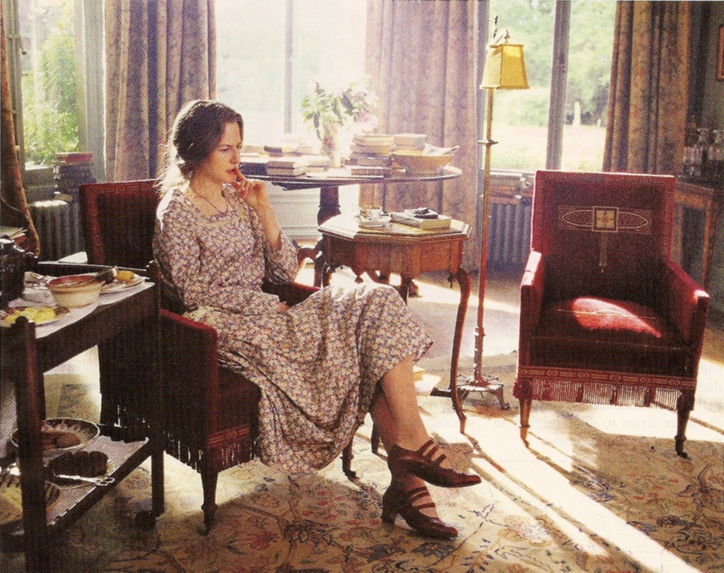
Self-expression, individualism, and private point of view are the products and goals of literacy.

Slide 9
“As a piece of technology, the clock is a machine that produces uniform seconds, minutes, and hours on an assembly-line pattern.”
Marshall McLuhan

Slide 10
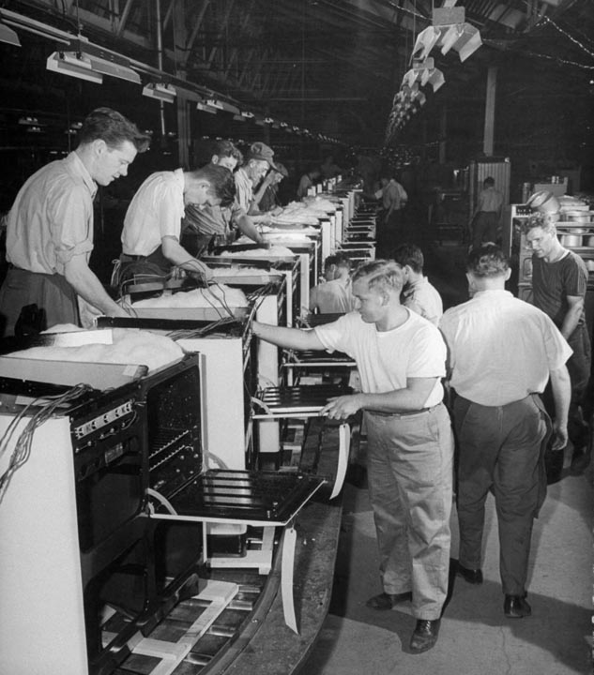
In the past, people specialized in a particular field of study or became an expert at one job by learning a specific set of skills. They made a living by doing the same work in the same way.

Slide 11
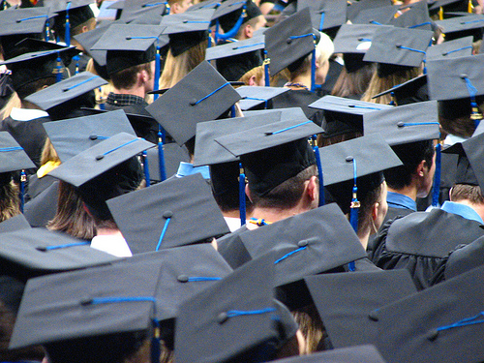
Today people must have marketable skills in order to be employable. People must keep upgrading their skills, or they may lose their ability to compete in the job market.

Slide 13
“Electric technology seems to favor the inclusive and participational spoken word over the specialist written word”
Marshall McLuhan

