Slide 1
Hamlet on the holodeck – The future of Narrative in cyberspace
By Janet Murray
Presentation made by Briitta Suopanki MAT103

Slide 2
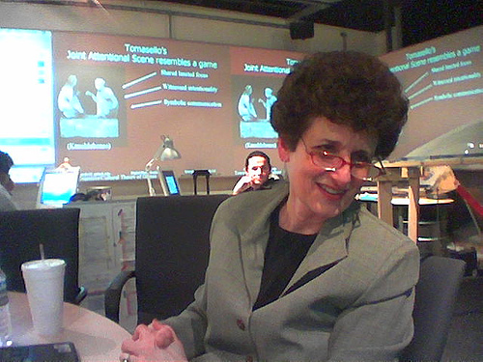
Janet Murray
Professor at the Georgia Institute of Technology
Director of graduate studies in the School of Literature, Communication and Culture
Important theorist of digital media
Notes:
Professor at the Georgia Institute of Technology
Director of graduate studies in the School of Literature, Communication and Culture.
Known as an important theorist of digital media and an advocate of new educational programs in digital media.

Slide 3
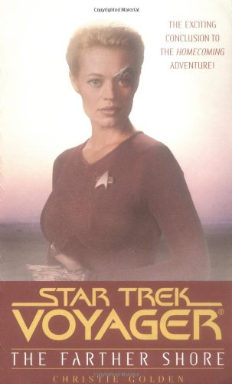
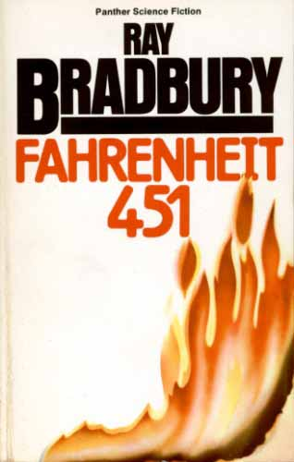
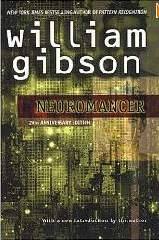
From books to …
When the printing press first came, books where printed and read, cover to cover.
Notes:
In her book, Murray talks about movies that from the beginning are books like Startrek: Voyager, Fahrenheit 451 and Neuromancer.
When the printing press first came, books where printed and read, cover to cover.
The books had almost always the same type of elements in them: the hero, love and destruction. We can see the same continuity in movies today; they follow the order of linear production.

Slide 4
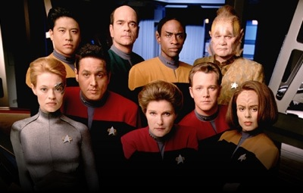
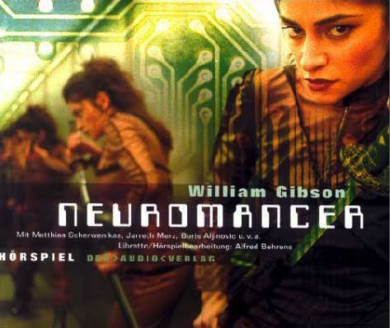
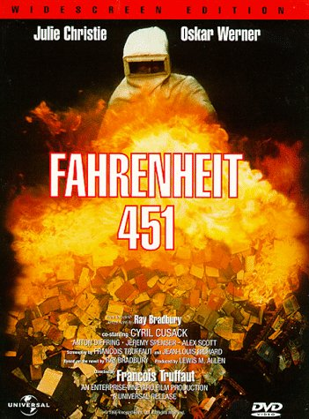
… movies
From books, to movies
From linear storytelling to
non-linear storytelling
Notes:
After the printing press, things started to happen. New technology came such as the movie camera which meant new ways of communication. Murray talks about how linear storytelling expands and becomes new media as time goes by, movies.
As media develops the movies do the same. We can see how the twentieth century novels, films and plays try to push against and not use the linear storytelling.

Slide 5
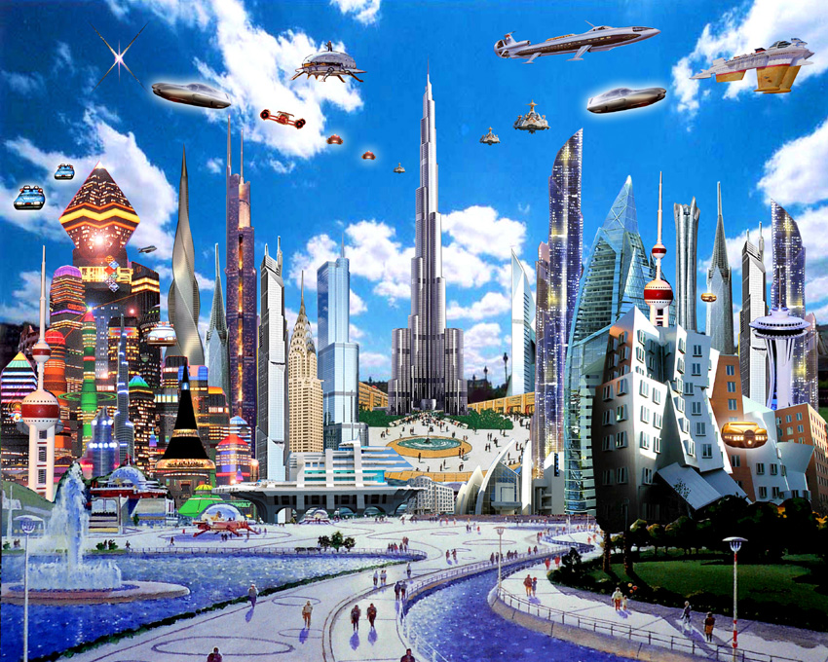
Dystopian and Utopian
Different technologies in movies:
Wars
Aliens
Destroyed planet
No life
No wars
No diseases
New increased technologies
Notes:
A dystopian movie shows the future as a disaster while a utopian movie has the vision of a good future. A dystopian movie shows for example war, aliens, an empty planet with no life and some horrible way of ending the human life. A utopian movie has the opposite look of the future, where everything is great; there are no wars, no diseases and there are great technologies.

Slide 6
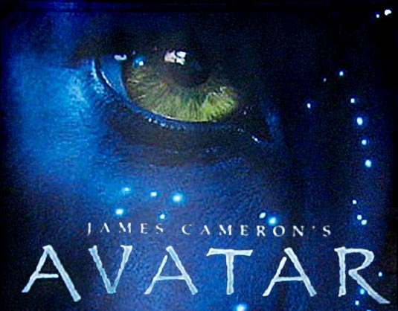
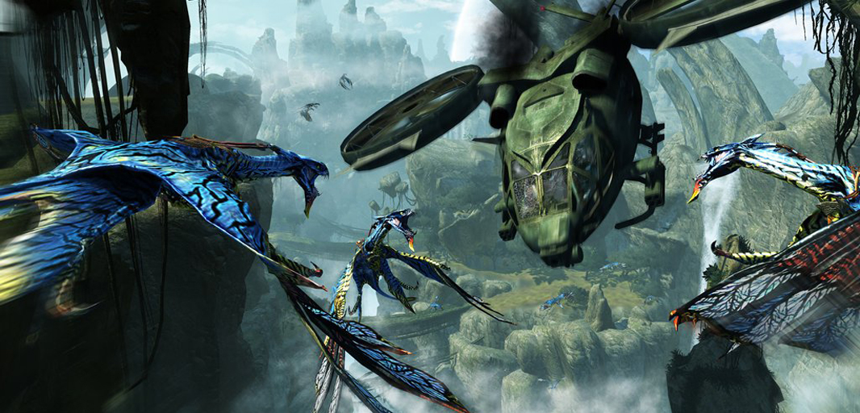
Avatar
Dystopian
A beautiful world where no humans live.
It is the machines made by humans that destroy the Avatar’s world.
Notes:
Avatar is an interesting movie where the environment is beautiful. The Avatar’s lives a life with no worries until humans tries to take over their world. Humans use technology to find out more about these creatures. Machines are built to help humans orientate in the Avatar’s world. Technology helps human become an Avatar so they can interact with other Avatar’s. It’s also the machines that help humans destroy the Avatar’s world.

Slide 7
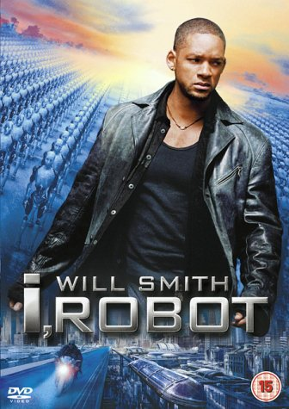
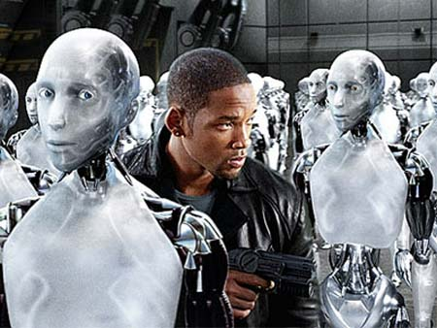
iROBOT
Dystopian
Future -
how we one day could share our planet with robots.
It is our own technology that creates our disaster.
Notes:
In this movie people created robots to live side by side with humans. Something went wrong and along the way the robots started to working against humans instead of with them. It is our own technology that creates our disaster.

Slide 8
Wall-E
Dystopian
How robots end up taking care of our planet because of our irresponsible way of taking care of it now.
Notes:
Even though Wall-E is an animated movie it still shows a critical view of the future. How lazy we humans are and how we don’t take care of our planet in the way that we should. How our world becomes too polluted for us to live on and how robots are made to clean it up.

Slide 9
Technology
We control our media
Technology has always both scared and fascinated people.
Notes:
The thing is, we control our media. As soon as something on the TV makes you feel bad you can turn it off. Technology has always both scared and fascinated people. Change the content on Facebook and people lose their minds.
People are scared of new things and technologies but still it is what we are looking forward to. There’s always something new and innovative to look ahead to, tools that help us in our everyday life. Maybe a future with robots just like the ones in I Robot or Wall-E is closer than we think.

Slide 10
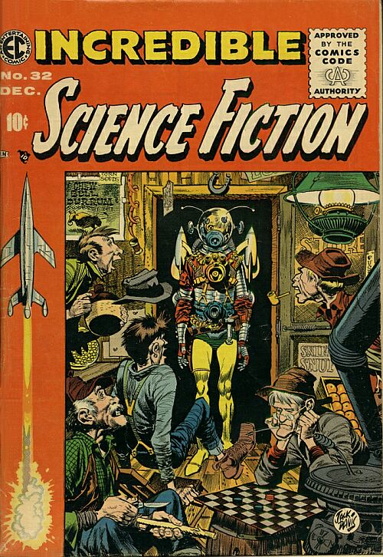
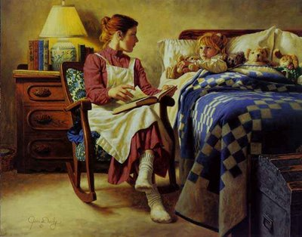
Stories are always the same
“We rely on works of fiction in any medium, to help us understand the world and what it means to be human.”
- Janet H Murray
Bedtime story
Rumor
Experience
Fiction novel
Notes:
Regardless if technology and the way we communicate develop to something beyond our minds, we will still have stories to rely on. Stories have always been a big part of the human life. We hear stories from the first day of our lives, it can be a bedtime story, a rumor, an experience someone had or a fiction novel. And there’s almost always a story behind a game, a movie or a novel.

Slide 11
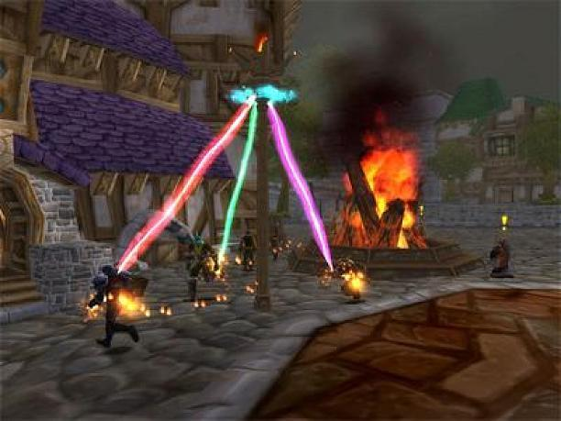
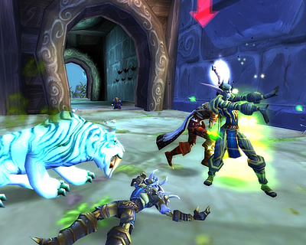
Gaming but not gaming
“If we could someday make holographic adventures as compelling as Lucy Davenport, would the power of such vividly realized fantasy world destroy our grip of the actual world?”
- Janet H Murray
Notes:
Gaming, but not gaming
Murray doesn’t really talk about gaming in the exact words but she mentions it in her text. When she talks about holographic images and a virtual world she could as well talk about gaming.
For a couple of years ago a game named World of Warcraft became really popular. It’s like a virtual environment where you play a sort of Internet role-play game in a fantasy world. The game has a sort of plot that creates a story while you’re playing.
Murray has one sentence in her book that says: “If we could someday make holographic adventures as compelling as Lucy Davenport, would the power of such vividly realized fantasy world destroy our grip of the actual world?”
The way I understand it is that games like World of Warcraft is addictive. It takes up a huge part of some people’s lives and could even make their real life suffer. Even for some people this game is their real life; a virtual fantasy world where they interact with other players who becomes their “friends.” So in my opinion, yes, a fantasy world could destroy people’s grip of the actual world.

Slide 12
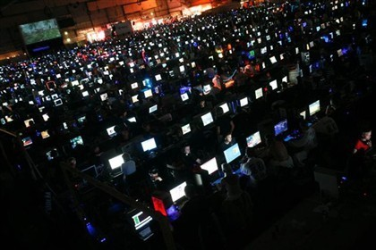
The easy stimulation of electronic games
“Critics have condemned the too-easy stimulation of electronic games as a threat to the more reflective delights of print culture.”
- Janet H Murray
Notes:
She also talks shortly about people rather using “the easy stimulation of electronic games.” And that is true; some people do rather sit inside in front of their computer than go out and meet friends in the real world. People prefer to sit and play games online than read an actual book from cover to cover.

Slide 13
Major ideas of the author
The print technology supported the development of the novel and film technology supported the development of movies.
Are we stepping into a world where everything will be learned through computers?
Notes:
The question is whether a computer or a movie can take the same place as a book has today. The print technology supported the development of the novel and film technology supported the development of movies.
The big point is the expansion of new computer formats and the possibilities that creates, how the availability of storytelling broads. We rely on works of fiction in order to help us understand the world and what it means to be human.
I don’t think that story telling will disappear. The question is how is it going to be presented?
So are we stepping into a world where books are past time and computers are the new way of learning?

