Slide 1
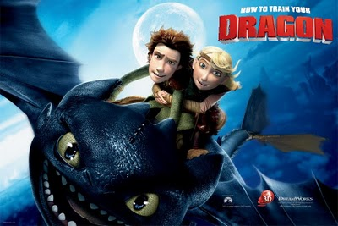
The twelve stages of the journey. in
How to train your dragon.
DreamWorks Animation 2010
Robin Wetterling

Slide 2
Joseph Campbell
Born: March 1904, New York
Died: Oct 1987, Hawaii
Known for his comparisons of mythologies and religions.
Notes:
Joseph John Campbell
Was an American mythologist, writer and lecturer.
Known for his work in comparing mythologies and religions.

Slide 3
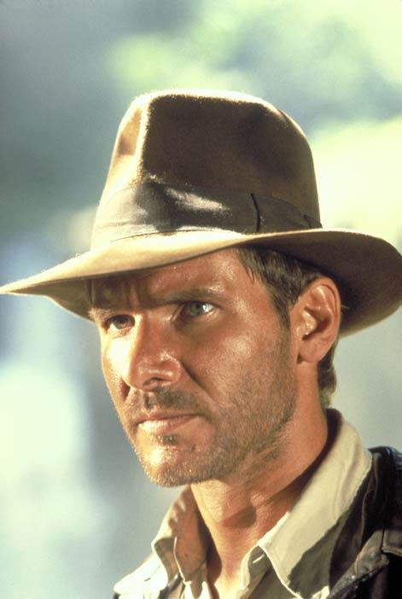
Joseph Campbell
“The Hero with a Thousand Faces”
Introduced the theory of the monomyth
Heroes important
Notes:
The role of the hero was a large part of Mr. Campbell's work and studies.
In 1949 “The Hero with a Thousand Faces” was published, in which he introduced his idea of the monomyth.
In this book Mr. Campbell introduced the twelve steps of the hero's journey which George Lucas used for creating Star Wars.
To Campbell heroes was important because they to him conveyed universal truths about one’s personal self discovery, ones role in society.

Slide 4
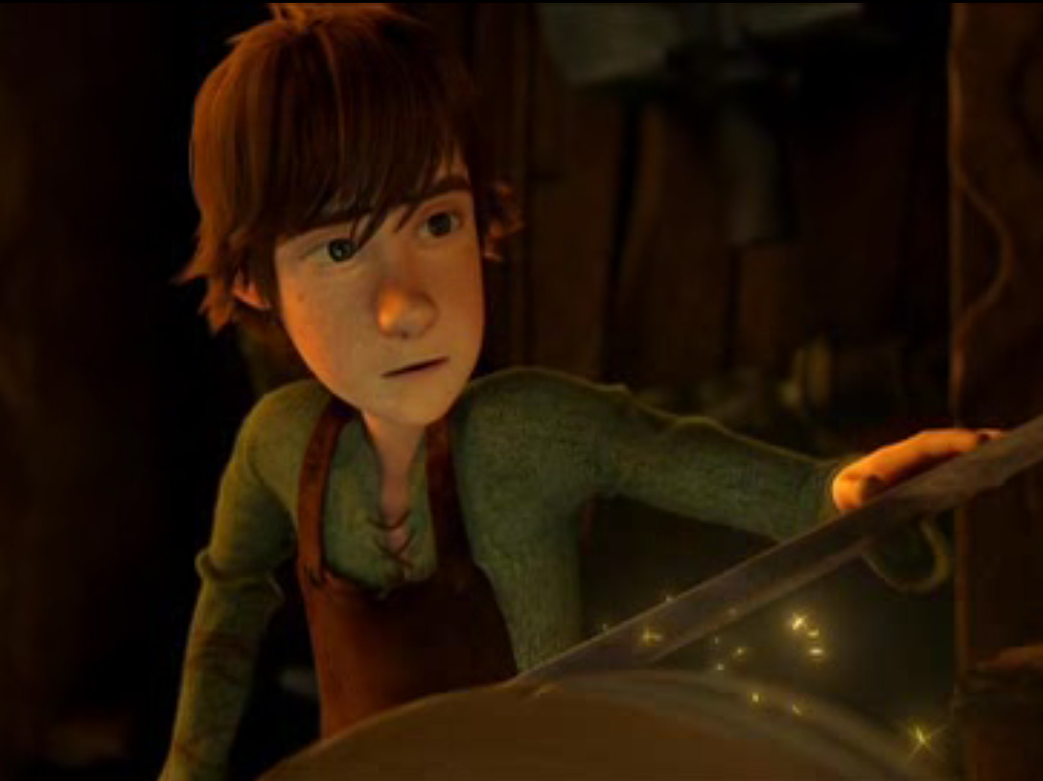
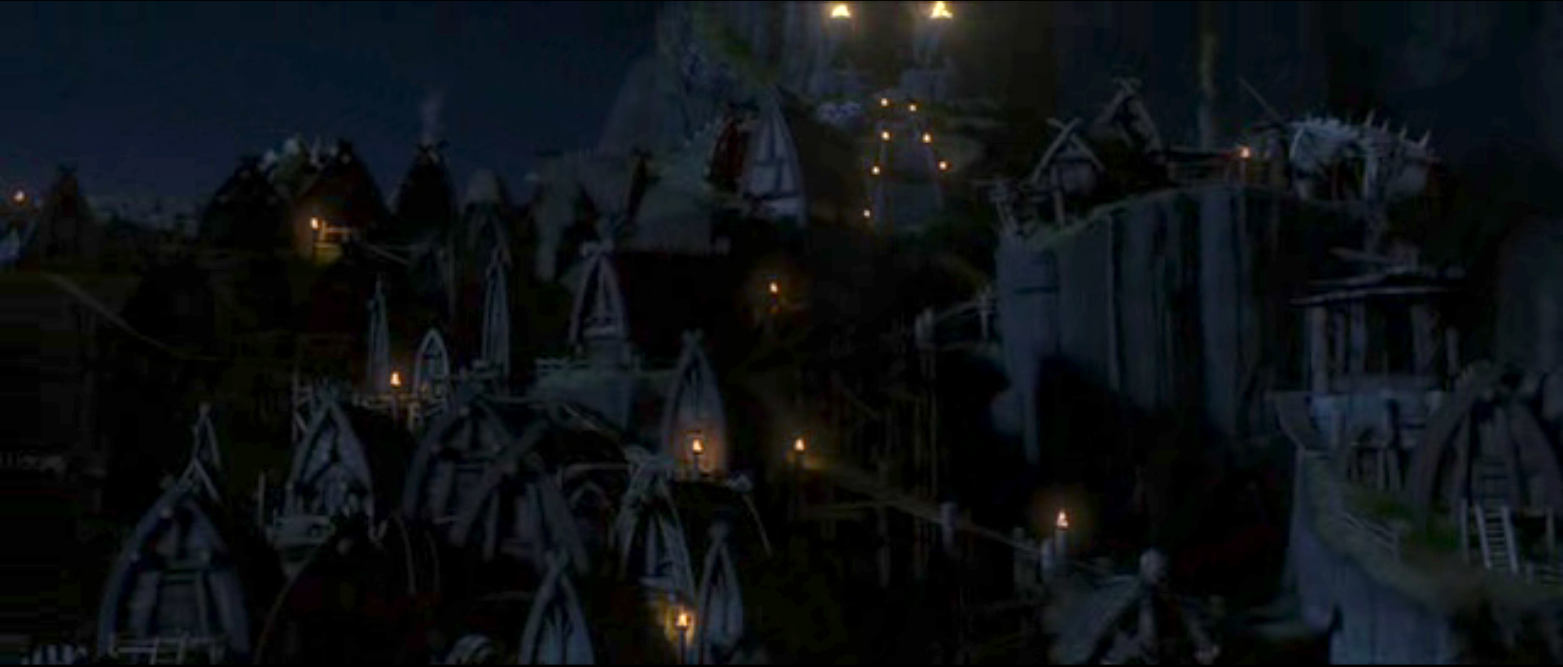
First Step
Ordinary World
First step of the heroes journey
Where the hero is comfortable
Notes:
The first step of the heroes journey is when he is in his ordinary world which he knows and are comfortable in.
This is where everything begins, and eventually also ends.
So here we have Hiccup in his natural environment. His village.
Which pretty fast will turn into a war zone.

Slide 5
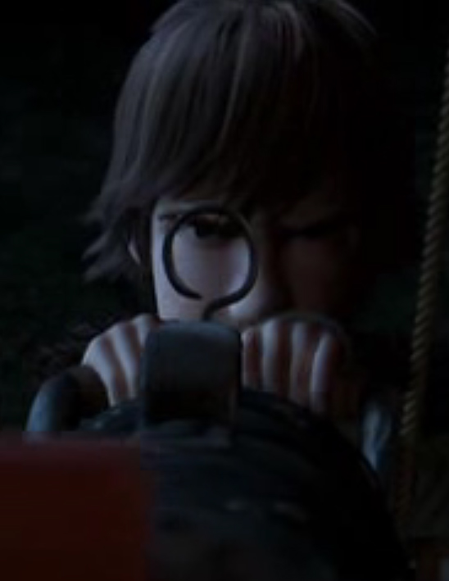
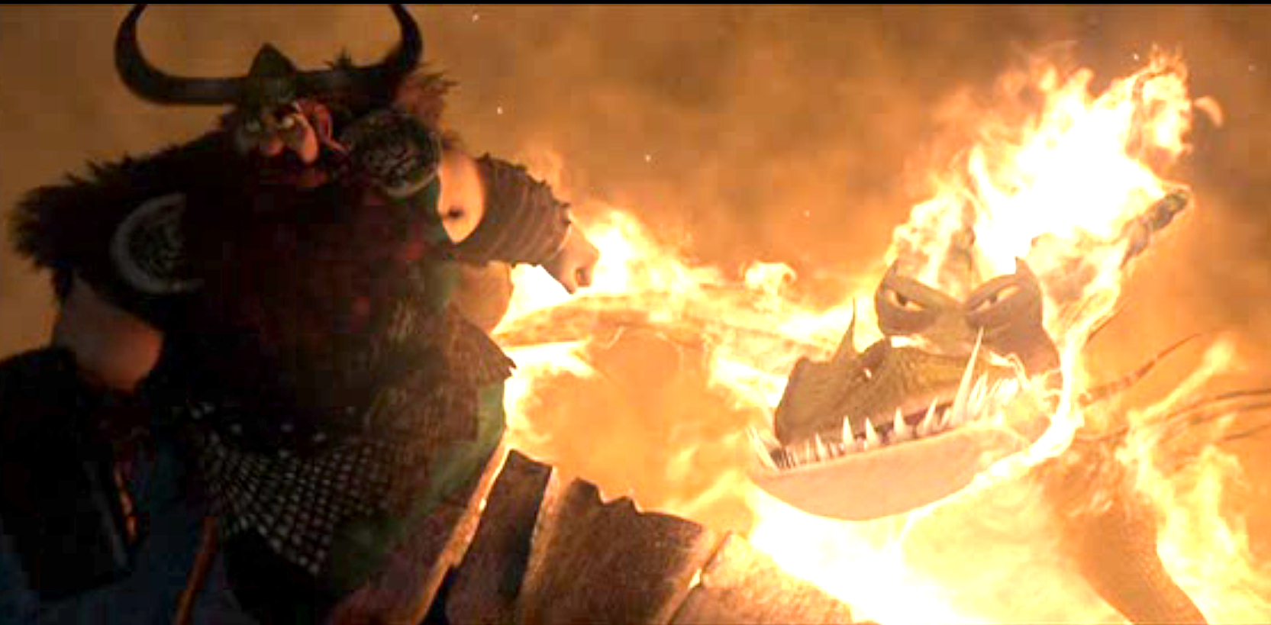
Second Step
Call To Adventure
The everyday life is disrupted.
A challenge appears for the hero.
Hiccups world is attacked by dragons and he wants to help his father so he tries to kill one of them.
Notes:
This Is where it sets the story. Where the normal everyday life is disrupted and a challenge for the hero to take on appears.
Hiccup’s village is attacked by dragons.
And he really wants to fight the dragons as a grown up, so he runs off to try to kill one of them.

Slide 6
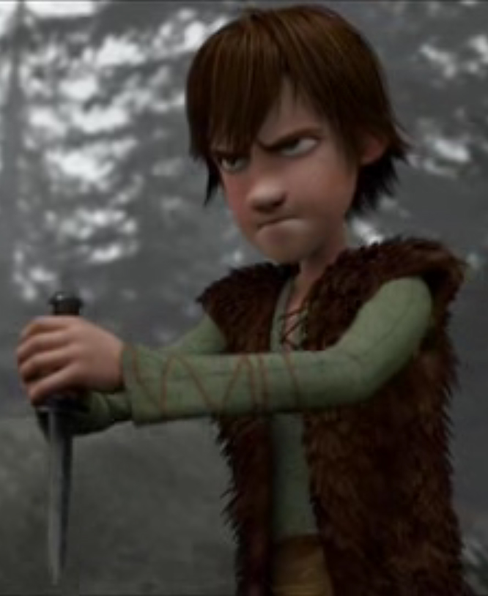
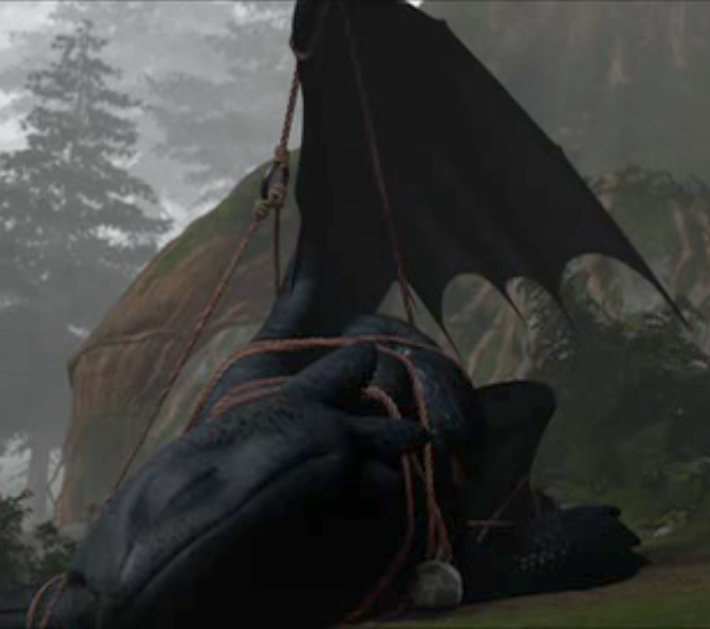
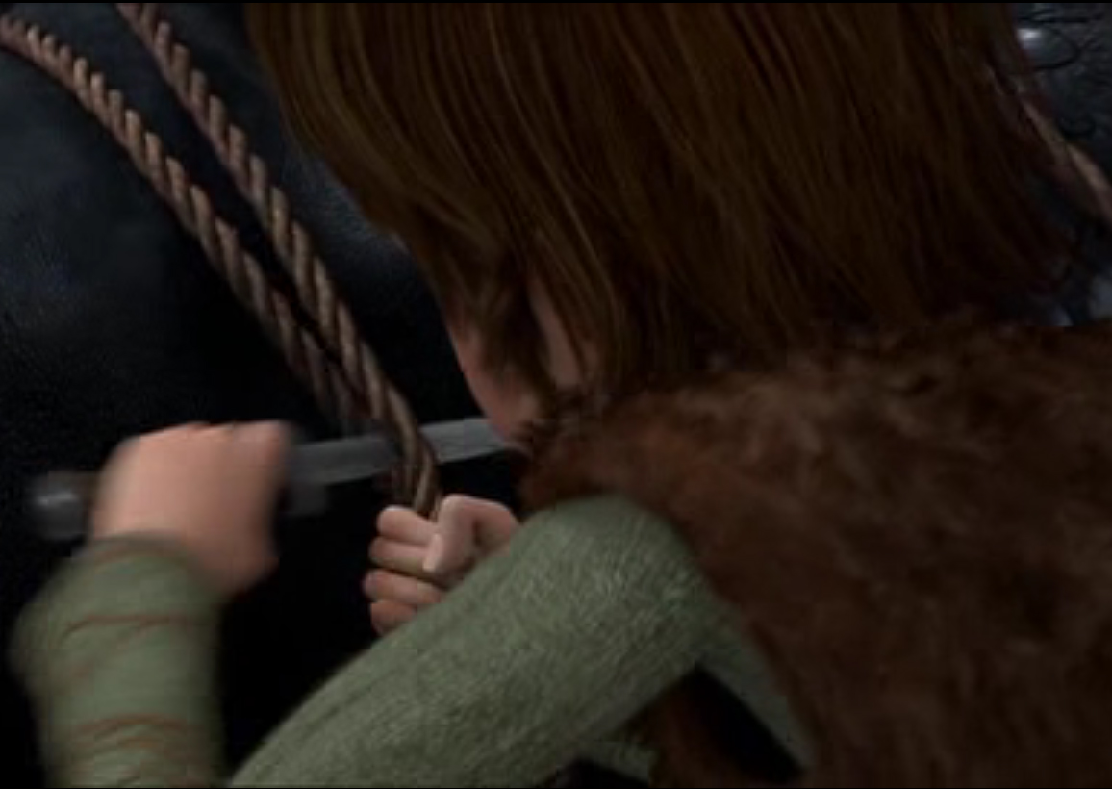
Third Step
Refusal of the Call
Often a hero refuses his call because of fear, danger or insecurity.
Hiccup tries to kill the dragon that he captured. But he sees
something in the dragons eyes, and determines to let it loose instead.
Notes:
Often in a heroes way to defeat the evil he refuses hiss call because of fear, danger or insecurity.
In Hiccup’s case he finds the dragon that he captured, but he can’t kill it. He sees something in the dragons eyes, and he cuts it loose.

Slide 7
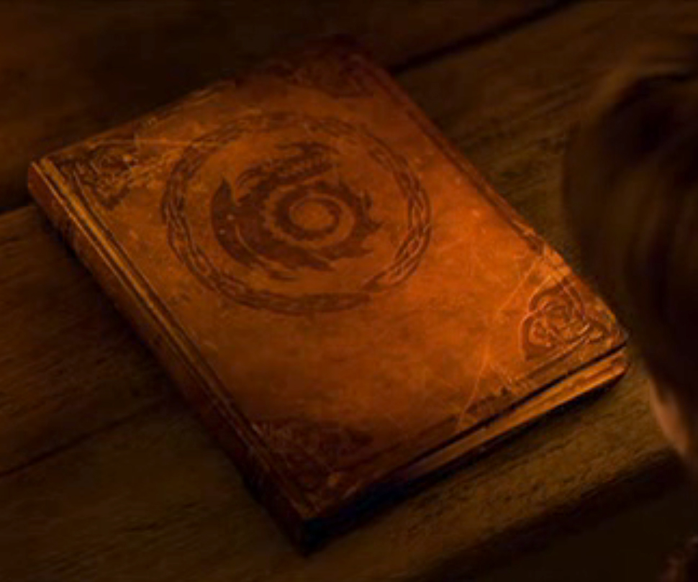
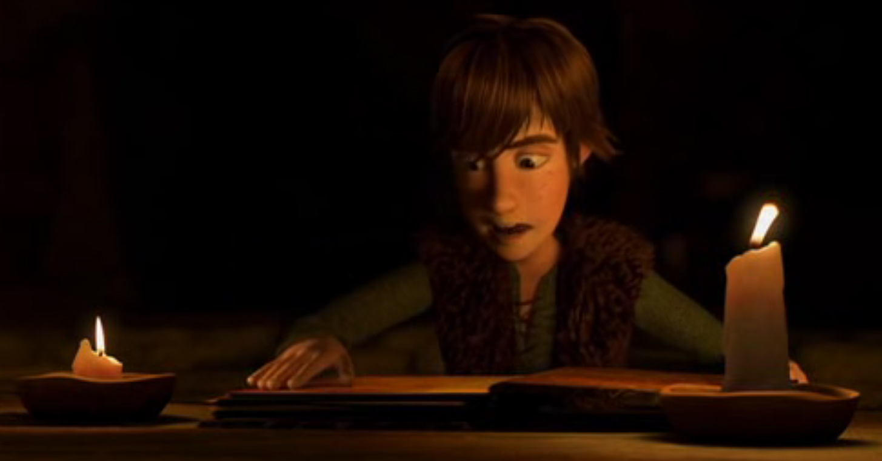
Fourth Step
Overcoming Fear
The hero meets with an advisor, mentor. Gets training, finds a map or something similar
Hiccup finds a book about the different dragons and gets curious since the dragon he captured isn’t in the book.
Notes:
In this stage, the hero often meets with an advisor or mentor to gain confidence, training, advice. Or the hero finds a map, reads a book or something similar.
Hiccup comes in contact with a book that the elders had about the different kinds of dragons there are.
He finds that the dragon he has captured isn’t in the book. He gets curious.

Slide 8
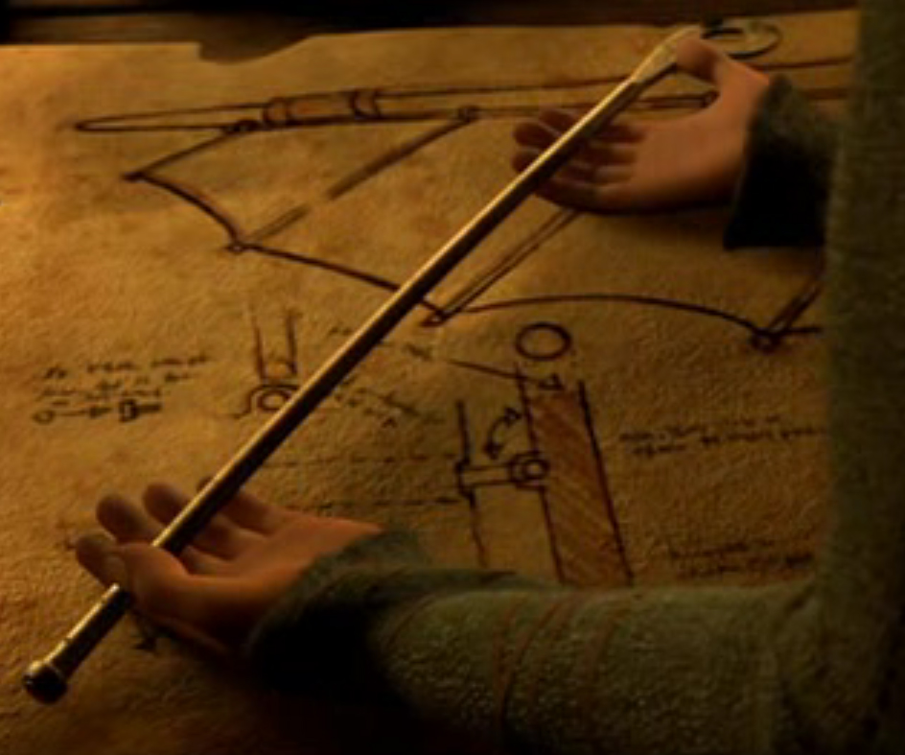
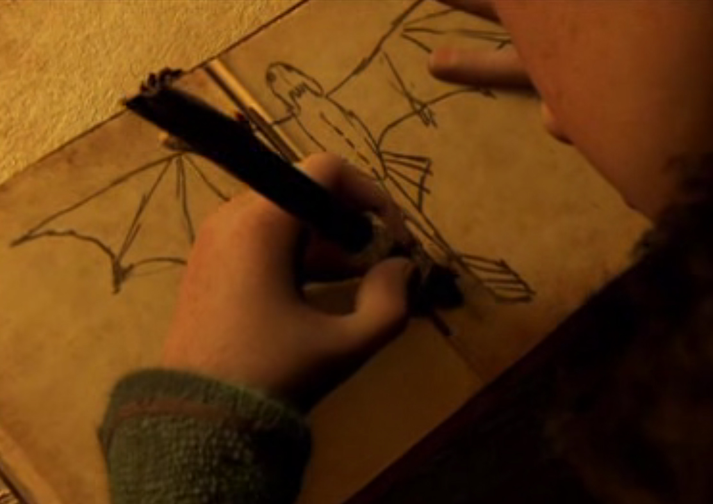
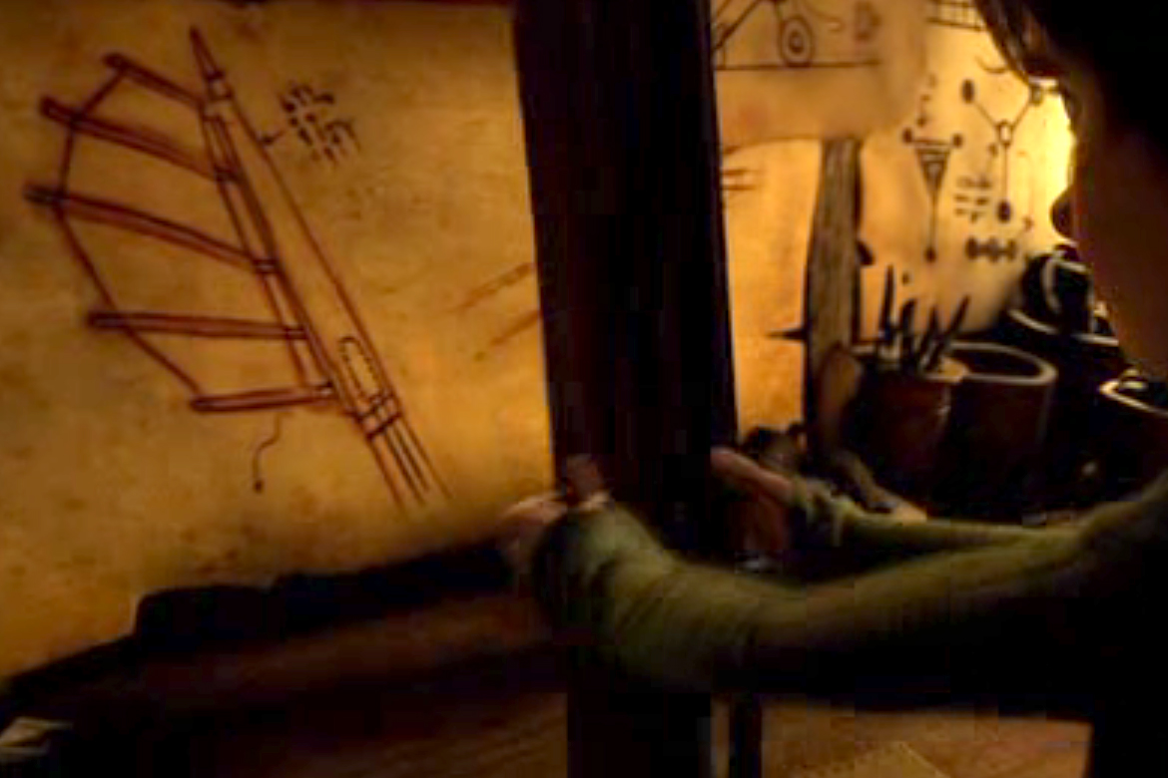
Fifth Step
Crossing the threshold
Committed to the journey and knows what to do.
Hiccup decides to help the dragon that got injured when he captured it, and starts to draw an idea for the injured fin
Notes:
This is when the hero has committed to the journey and knows what he’s got to do.
The dragon that he captured and cut loose was hurt when he captured it.
So Hiccup has decided to try to help the dragon, which he has named “Toothless”.

Slide 9
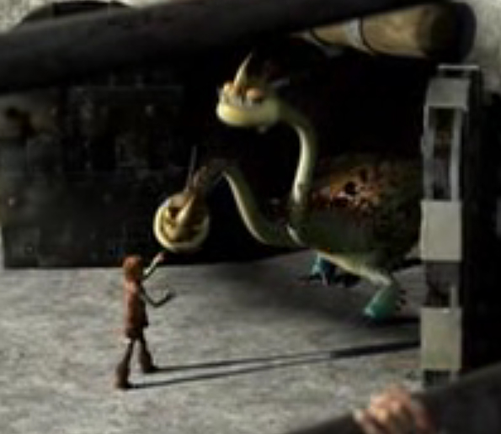
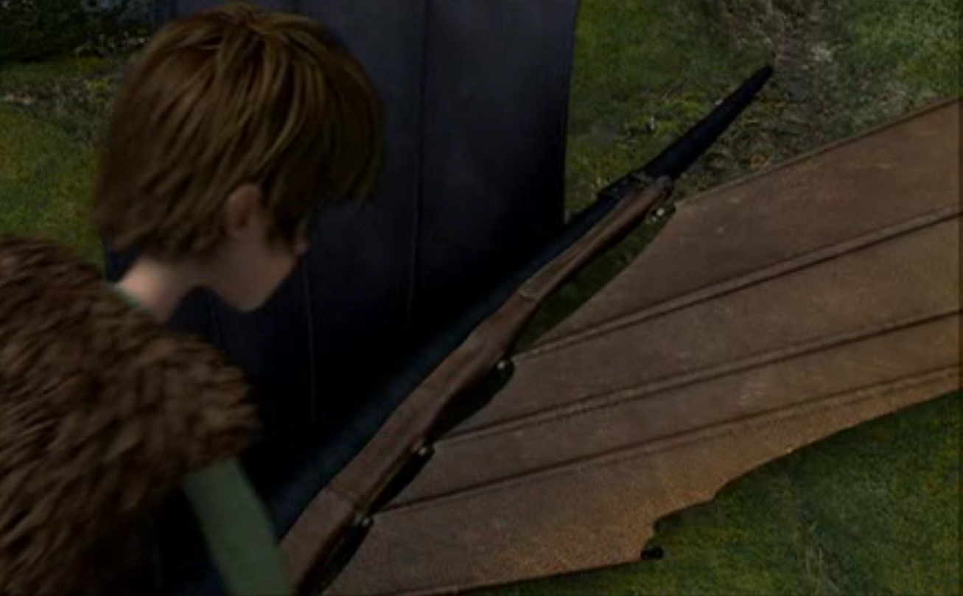
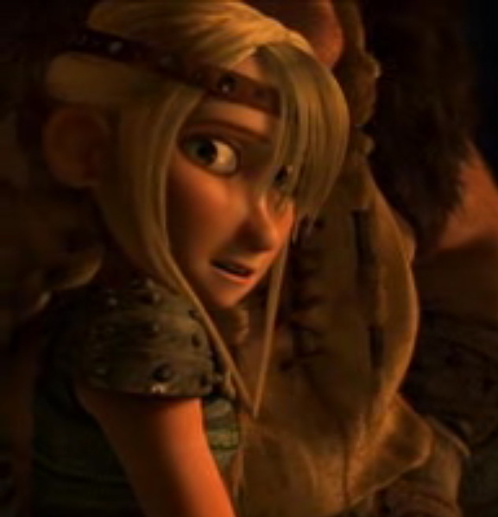
Sixth Step
Testing the new world
Encounters enemies, and also friends are being tested. Who’s on which side?
Hiccups try's out the fin he designed and also finds out
that Astrid is on his side.
Notes:
In this step, the hero encounters his enemies and also his friends are being tested. Who’s on which side? And who can be trusted?
It’s also here that they learn the rules of the “game”.
In the case with Hiccup. He tries the fin that he has designed for Toothless.
He also finds that the girl Astrid is on his side.

Slide 10
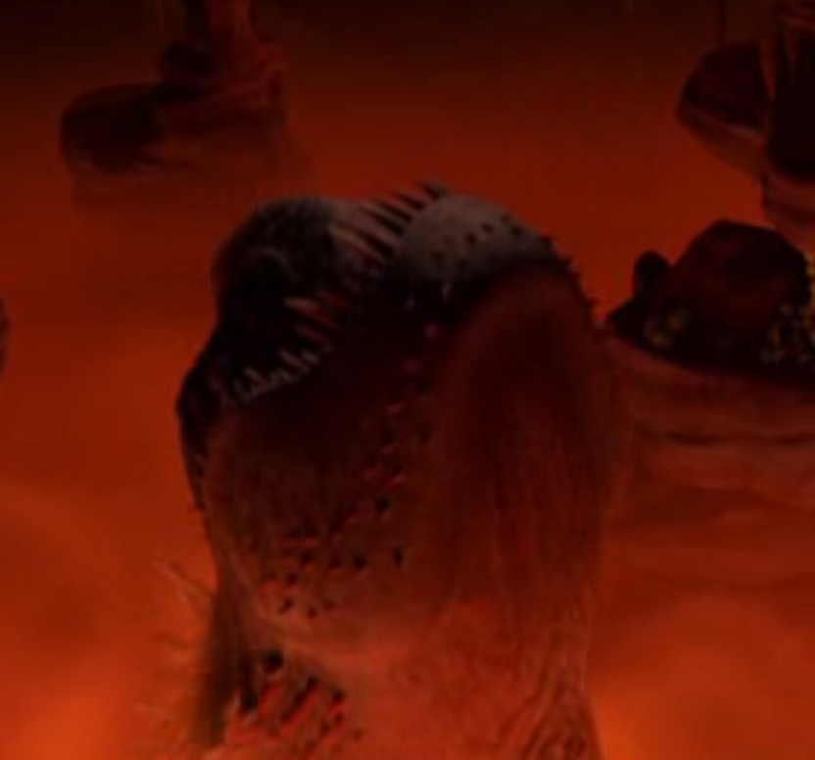
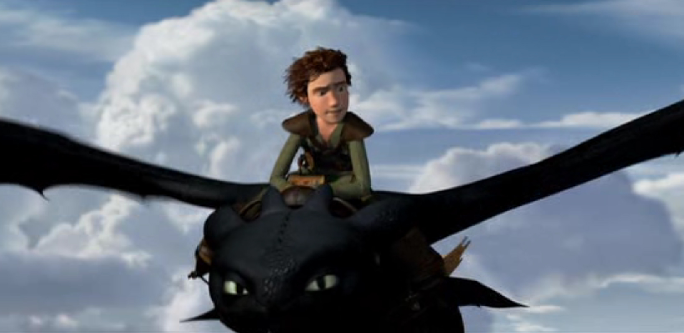
Step Seven
Approach to the inmost cave
Preparations for the big ordeal are made
Maps are reviewed, attacks planned.
Hiccup, Toothless (the dragon) and Astrid finds the big dragon’s nest
Notes:
In this step the Hero makes the preparations needed for the big Ordeal that’s coming. Maps are reviewed, attacks are planned.
Hiccup, Toothless and Astrid finds out where the big monster resides.

Slide 11
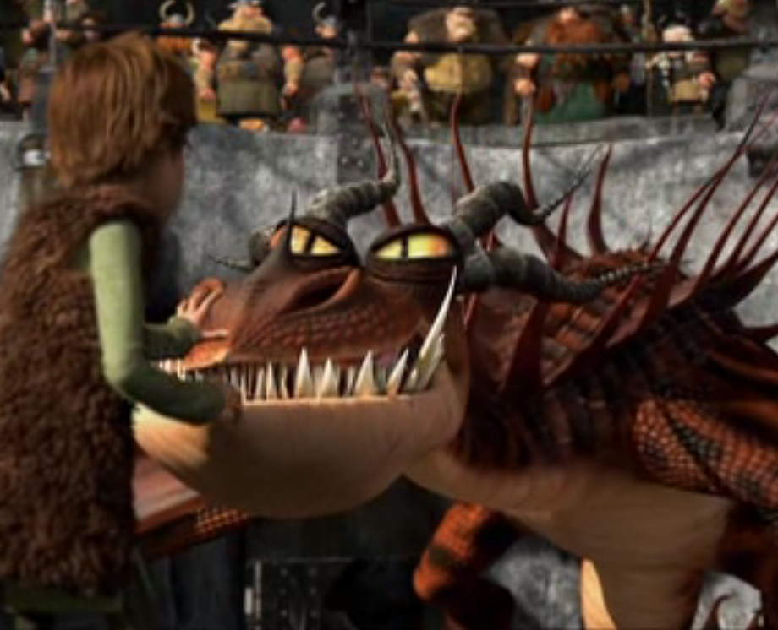
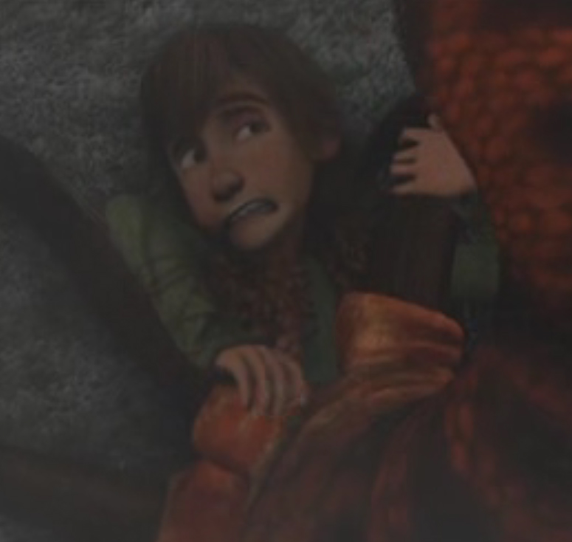
Step Eight
Ordeal
The Hero faces his biggest opponent so far.
Encounters death closely.
Hiccups almost gets killed in a fight with a dragon and Toothless comes to save his life, but ends up captured.
Notes:
In this step, the Hero often faces his biggest opponent. This is his biggest challenge.
He often encounters death, very closely.
Hiccup has the his biggest fight, he wants to show his father and everybody else that the dragons are harmless.
But his plan goes terribly wrong and Toothless comes to his rescue.
After this, the humans capture Toothless, since they don’t believe Hiccup.

Slide 12
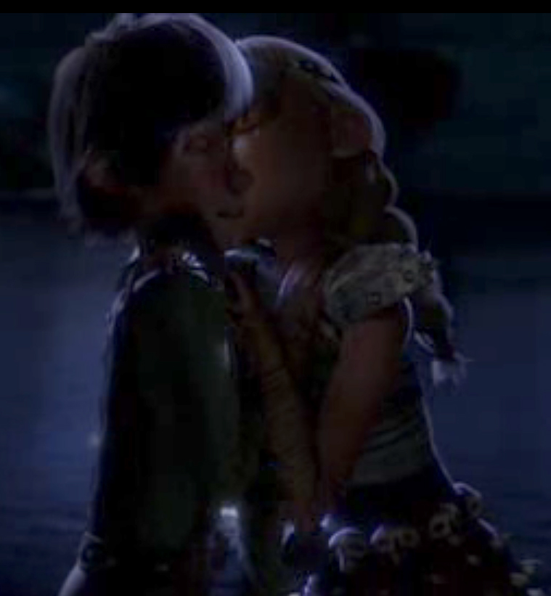
Step Nine
Reward
The hero has survived the battle and earned himself a reward. A kiss, a sword, great knowledge or a treasure.
Hiccup gets his reward after they’ve found the dragons nest in step seven. But usually the reward is here. Hiccups reward is from Astrid, she kisses him on the cheek.
Notes:
In this step, this is where the Hero has survived the battle, overcome his fear and now gets his reward.
Whether it’s a kiss, the girl, a sword, great knowledge or a treasure, he has earned the right to celebrate.
In the case with Hiccup, his story is a little bit different. He actually gets his reward between step 7 and 8. So this movie isn’t accurate on that point. This is when they have come back after they’ve discovered the nest of the big monster dragon, and before his big battle.

Slide 13
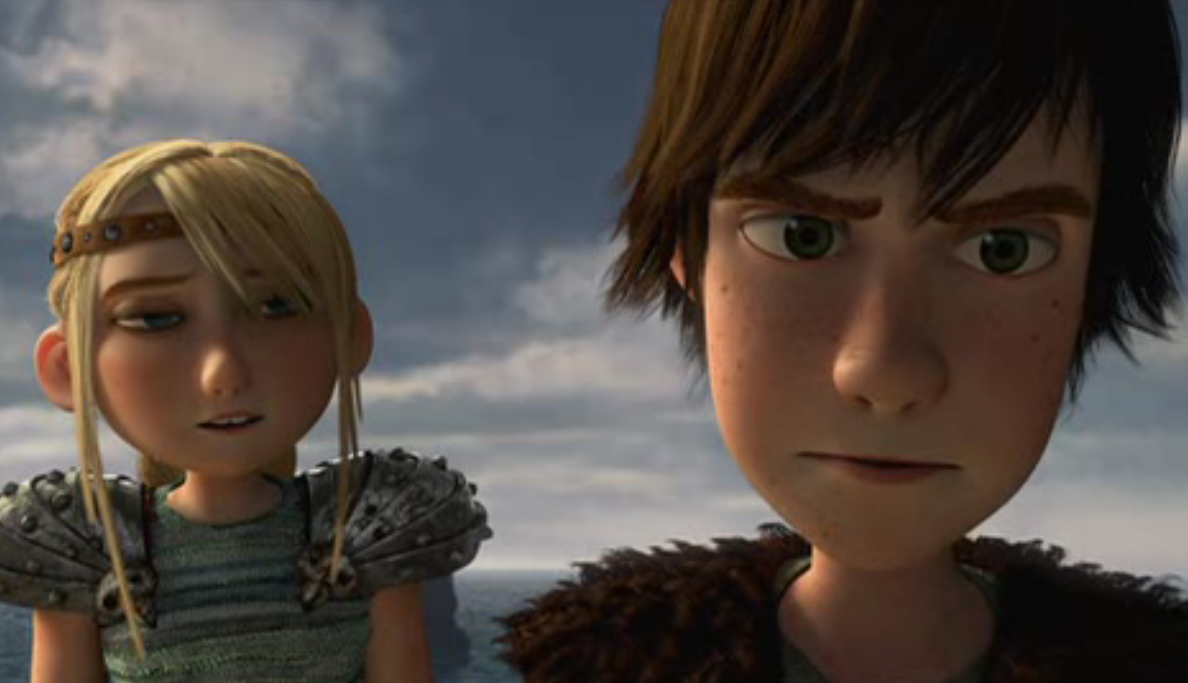
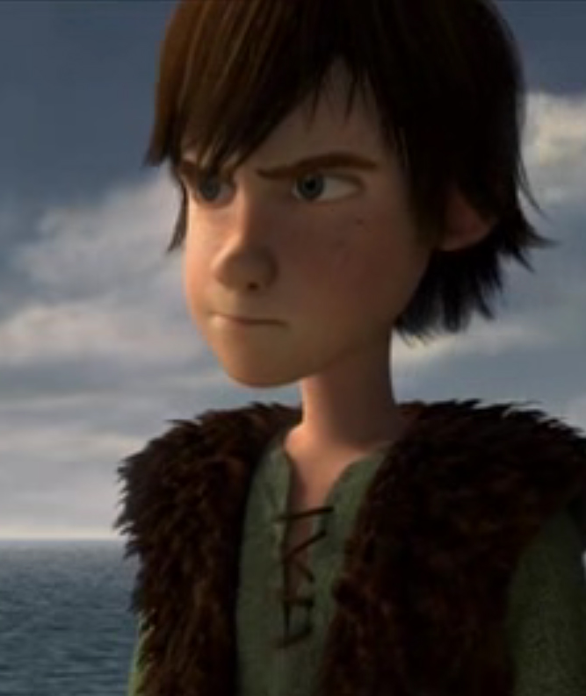
Step Ten
The Road Back
The hero has to recommit to the journey.
Often something pushes him over the edge, his mentor, or something that happens.
What pushes Hiccup to recommit to the journey is that Toothless got captured, he needs to rescue him. After a talk with Astrid, he got his plan.
Notes:
At this stage. The Hero has to recommit to the journey.
What pushed Hiccup back in action was that Toothless was captured, and now he has to save him.
If they’re going to have any chance at all of defeating the big monster dragon.
So after talking to Astrid, he got a plan.

Slide 14
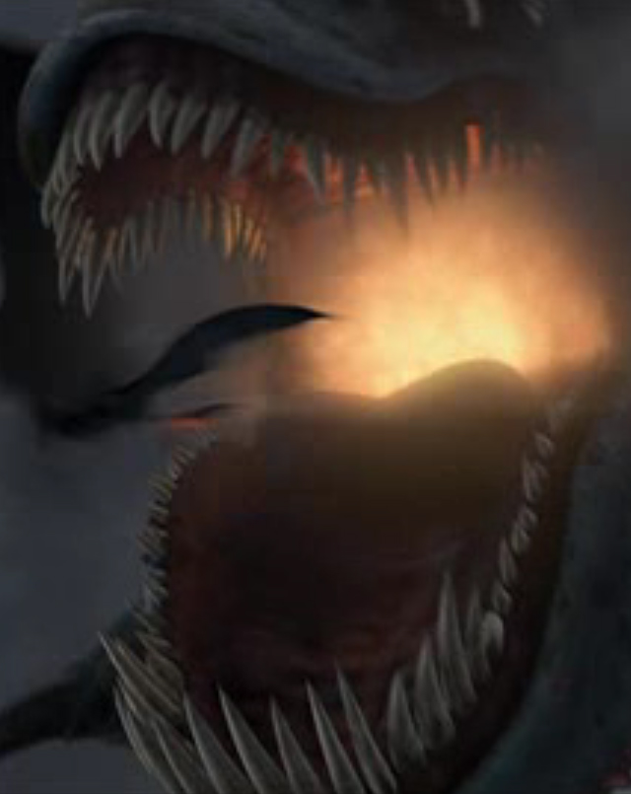
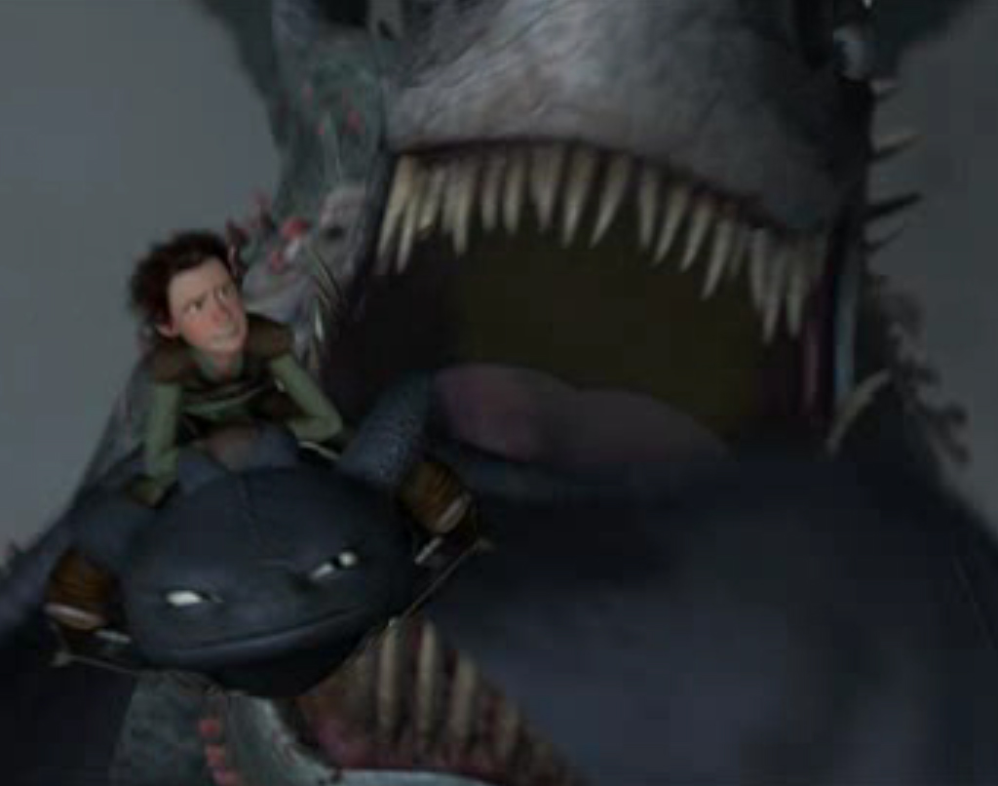
Step Eleven
Resurrection
Final, most dangerous fight.
Not just about the hero, maybe whole worlds are at stake.
Hiccup and his friends manage to free toothless and together with him Hiccup manages to defeat the big dragon.
Notes:
The resurrection is the most dangerous meeting with the Hero’s worst enemy.
It’s the final life or death fight. This final fight is not just about the Hero’s own life, it’s about something much bigger.
Other lives or whole worlds might be at stake here.
So with the help of Hiccup’s friends they manage to free Toothless and Hiccup is off defeating the big dragon. He almost offered his life defeating the dragon, but he just lost one of his foots.

Slide 15
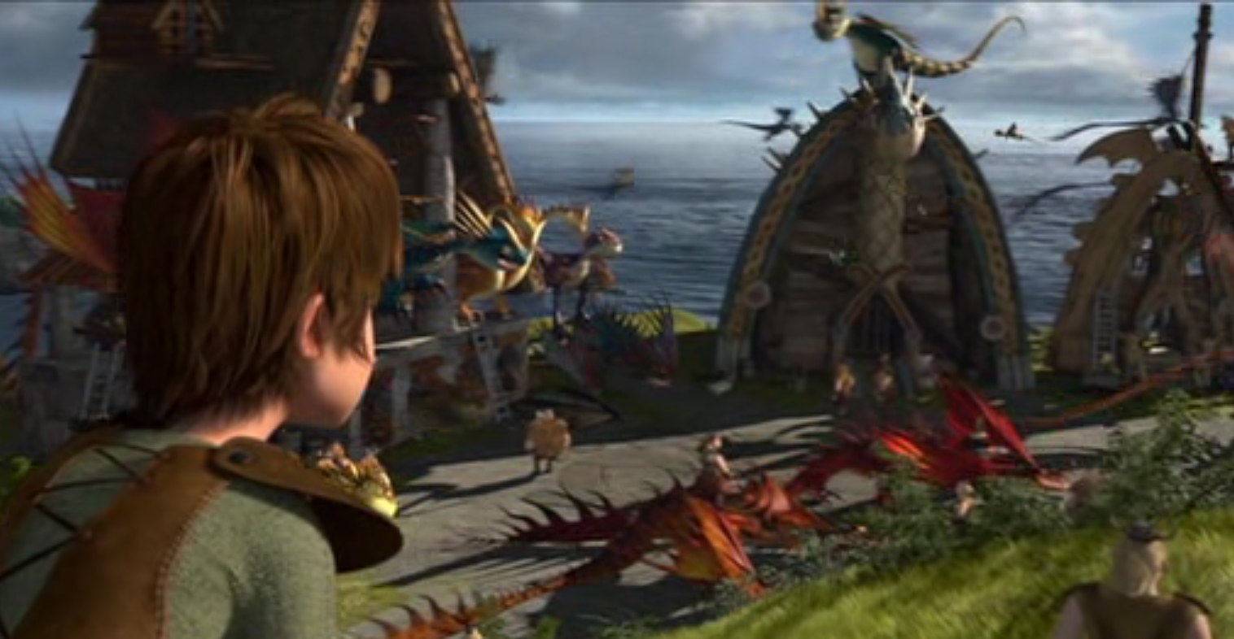
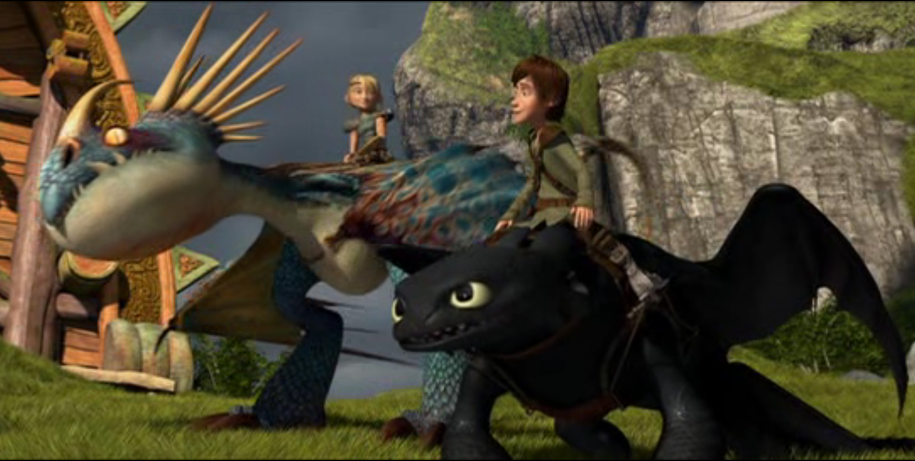
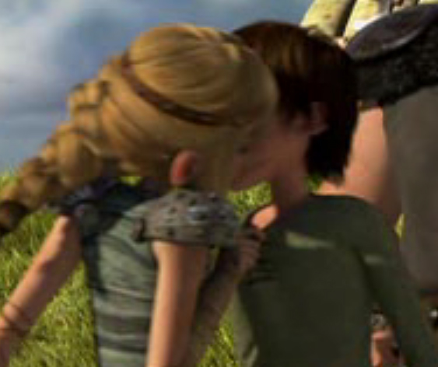
Step Twelve
Return
Return to the ordinary world
Has the “elixir” with him, that often changes the ordinary world, to the better.
Hiccup showed in the battle that dragons and humans can live together. That’s what he brings back as the “elixir”. A world where dragons and humans live together.
Notes:
The final and last step, the return with the elixir.
The Hero has been resurrected and returns to the ordinary world with the “elixir” to share with the world.
Hiccup returns to his land as a hero. He has restored his relationship with his father that now believes him. The dragon now lives together with the humans, instead of fighting with them.
Hiccup lost his foot in the fight but they have made a prosthesis to him.
And he also got the girl, off course, Astrid.

