Slide 1
Joseph Campbell & the 12 steps of the Hero’s Journey
By John DeVaughn

Slide 2
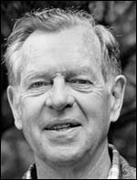
Joseph Campbell
1904-1987
Studied American mythologist, Psychology, myth, anthropology, Art, literature, philosophy but best known for his work in comparative mythology and comparative religion.
He is a man that works with the many aspects of the human experience.

Slide 3
“The Hero with a Thousand Faces” sold over a million copies.
It helps explain the idea of a hero’s journey.

Slide 4
The Myth of Man
Myth- “is the secret opening through which the inexhaustible energies of the cosmos pour into human cultural manifestation”.
They must be able to touch and inspire deep creative center based on the fairytale.

Slide 5
Rite of passage
Rite of passage is a ritual or ceremony that signifying an event in a person's life that indicate a transition from one stage to another, as from adolescence to adulthood.
A rite of passage includes three parts, separation, initiation, and reintegration.

Slide 6
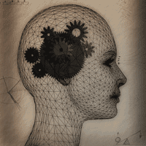
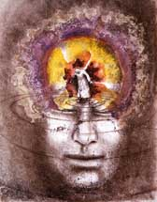
Psychoanalysis
Helps us understand what our inattentive ideas are by looking at the content of our dreams and unconsciousness.

Slide 7
The 12 Steps of the Hero’s Journey
Tiktik
Nakudu
Enemies
Baku
Evolet
D’leh

Slide 8
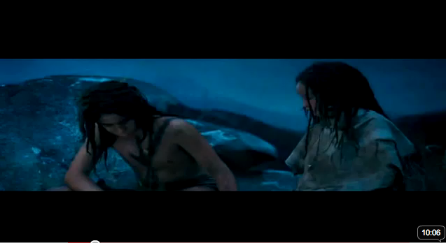
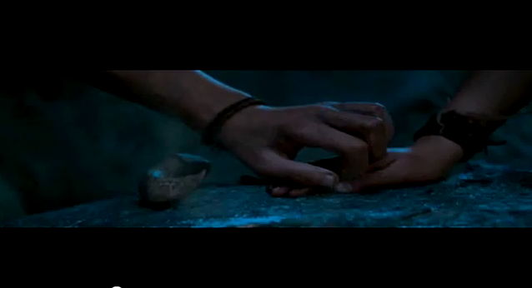
1. Ordinary World
D’leh The outcast boy, & evolet
the Prophet girl, forms a
Love bond since they are
Both alone.
Notes:
The hero is an outcast because his father abandoned the tribe and the prophet from the girl of impending danger from a tribe that has been destroyed, meet up and becomes friends, since they are alone.

Slide 9
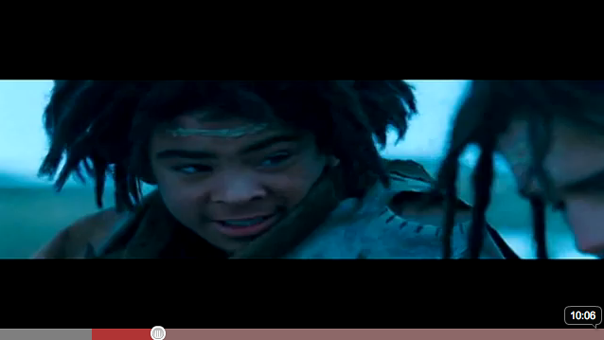
2. Call to Adventure
Baku tells D’leh In order for Evolet and him to be together is if he gets the first kill in the hunt,
Which is going be tough since another young man wants to become the leader.
Notes:
Here our hero D'Leh gets a call to action from his friend Baku that the prophecy is about to come true and who ever gets the first kill, will get the girl and become the leader of the tribe, and that the leader is going to take them to new lands.

Slide 10
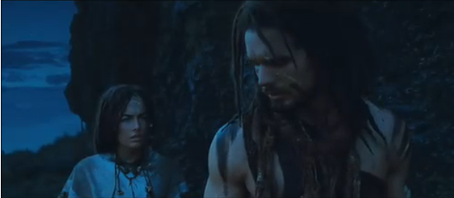
3. Respond of the Call
Evolet tells D’leh that they should runaway to be with each other,
But D’leh doesn’t want to be considered as a traitor.

Slide 11
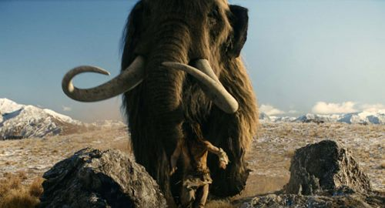
4. Overcoming the fear
D’leh overcomes his fear & faces the mammoth alone,
one-on-one

Slide 12
5. Crossing the Threshold
Here we can see Evolet getting capture,
which is going to start our hero’s journey

Slide 13
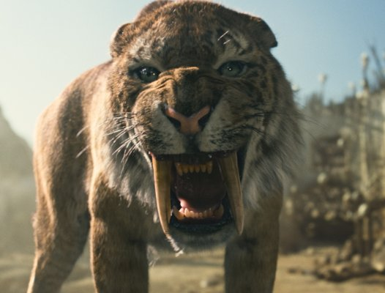
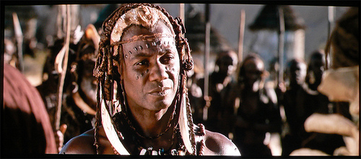
6. Testing the new World:
allies
enemies

Slide 14
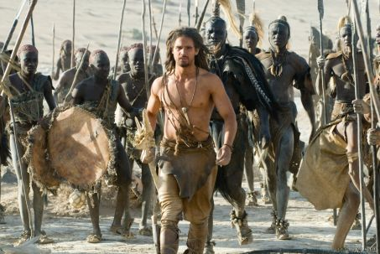
7. Approach to the Inmost Cave
D’leh gets the proof & courage that he need to fulfill the mission

Slide 15
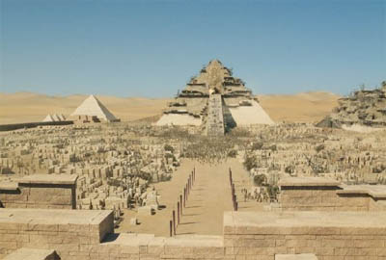
8. Ordeal
The hero D’leh has to face this god wannabe ,
in order to set the people free
Notes:
Here our hero and his followers have to face this god wannabe in order to set their people free.

Slide 16
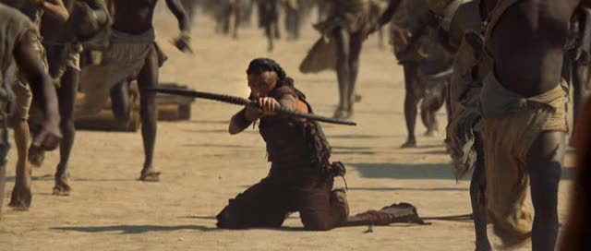
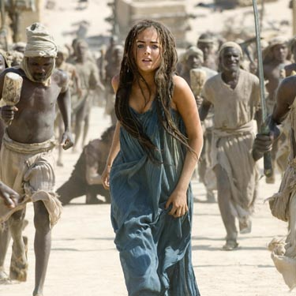
9. Reward
Evolet is now free from her captive,
but sadly she dies since her captive can’t have her.
Notes:
Our here get the girl that he has been traveling for as his reward,

Slide 17
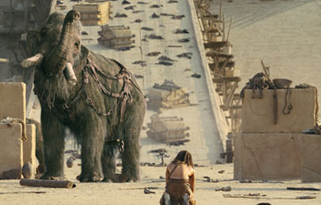
10. The Road Back
D’leh our can’t bear that he has lost his reward,
and pray’s for a miracle

Slide 18
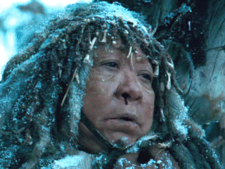
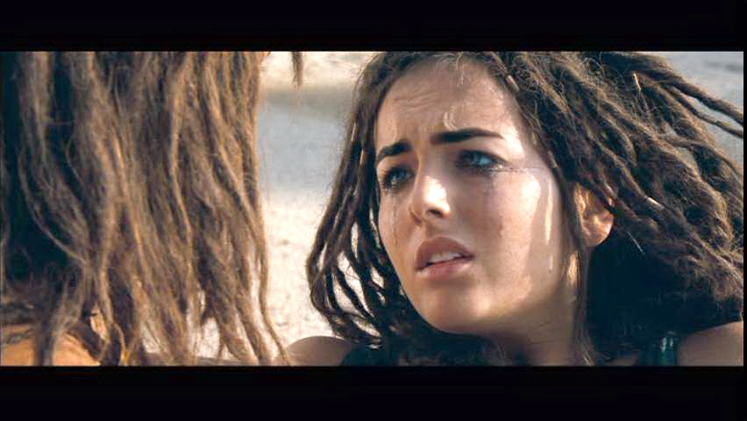
11. Resurrection
The death of the old mother the prophet one dies to,
Brings back life in another.
Notes:
The magic happen in this scene.

Slide 19
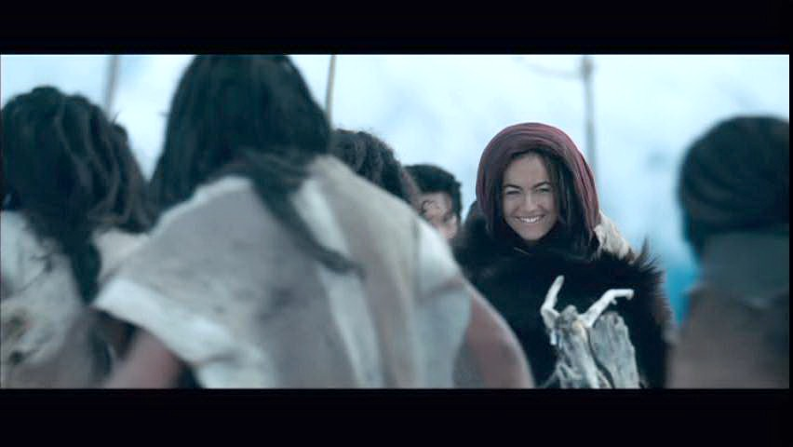
12. Return with the Elixir
D’leh, Evolet, and Baku have brought back and seeds
Which is going to help there people survive.
Notes:
Here our heroes have made it back home safe and sound, with new knowledge bout how to live, survive, off of the land, so they became the first farmers for their tribe.

Slide 20
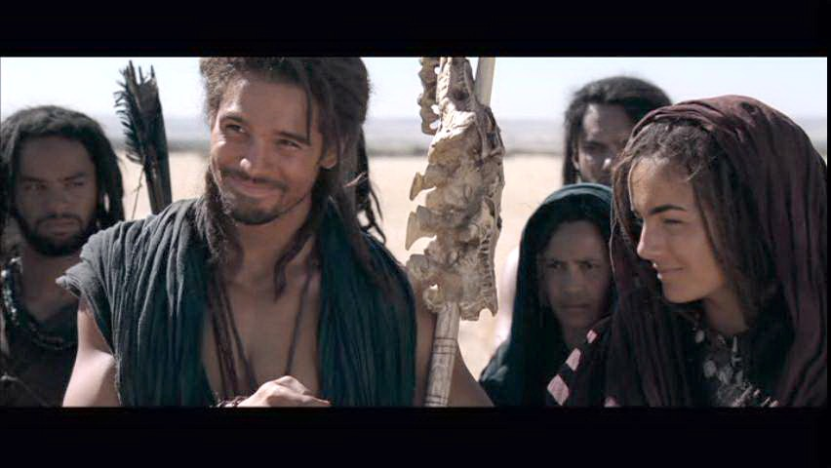
The End!!
D’leh and Evolet live a happy life leading their people.

