Slide 1
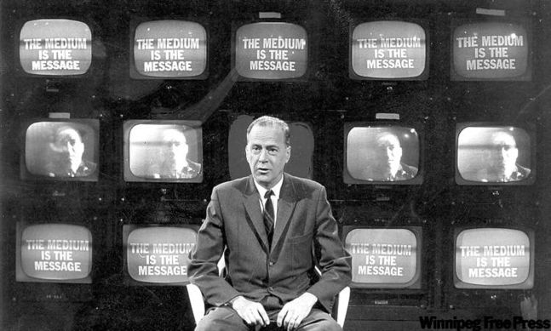
The Medium is the Message or Mess Age, Massage, Mass Age*
Marshall McLuhan

Slide 2
In 1964, McLuhan proposed that a medium itself, not the content it carries, should be the focus of study.

Slide 3
When the book came back from the typesetter’s, it had on the cover “Massage” as it still does. The title was supposed to have read “The Medium is the Message” but the typesetter had made an error. When Marshall saw the typo he exclaimed, “Leave it alone! It’s great, and right on target!” Now there are four possible readings for the last word of the title, all of them accurate: “Message” and “Mess Age,” “Massage” and “Mass Age.”

Slide 4
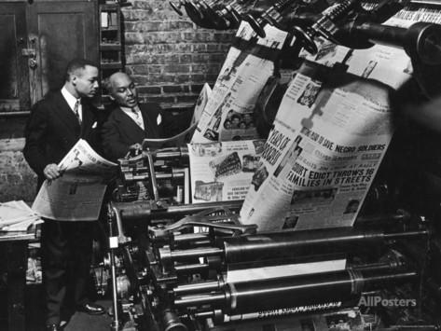
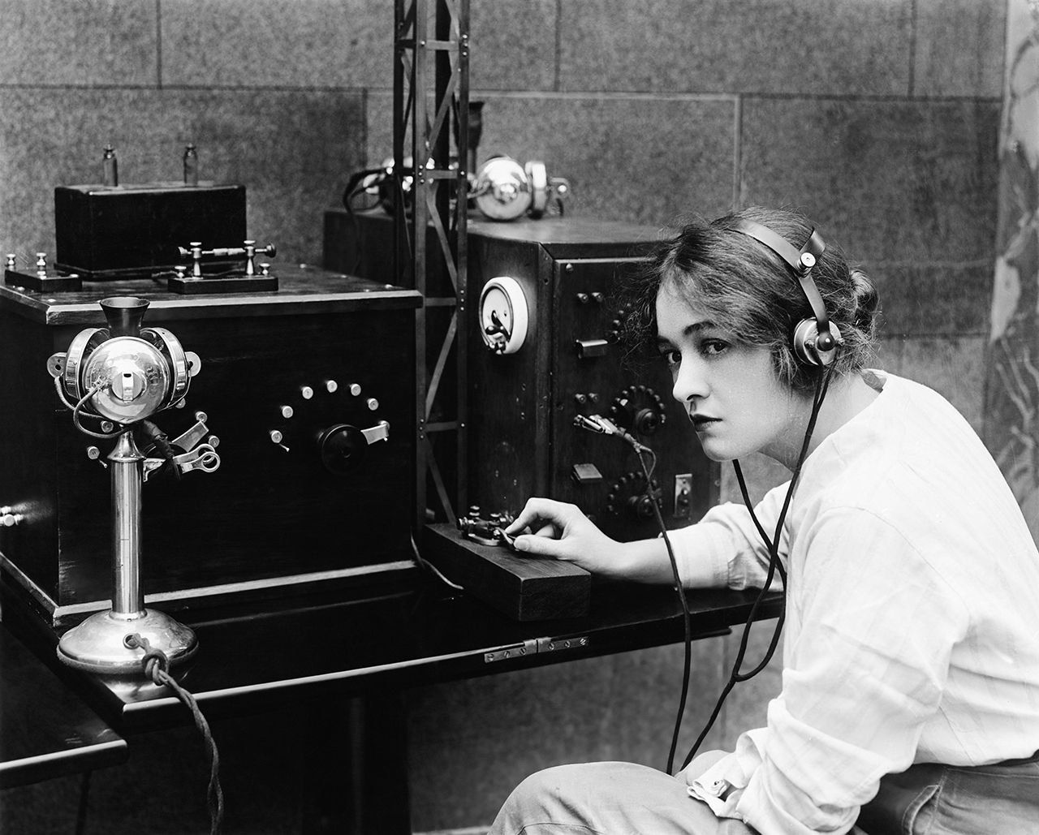
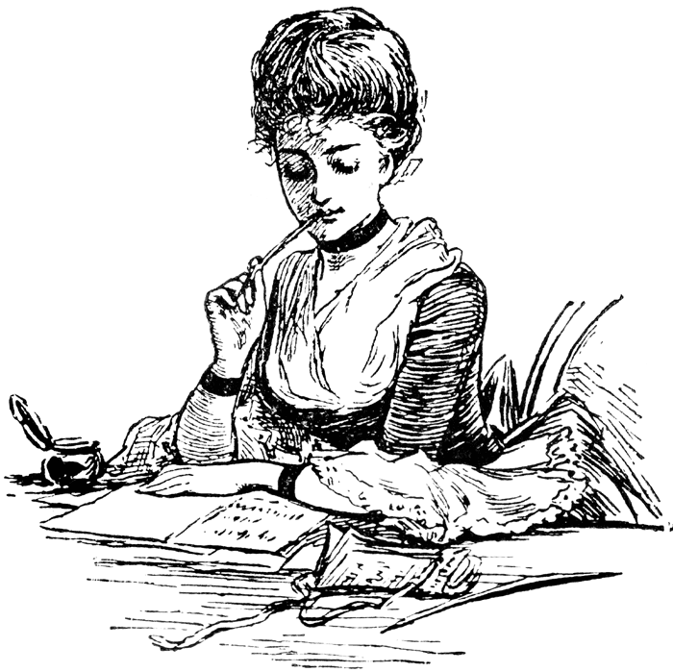
In this book, McLuhan proposed that the ”content of any medium is always another medium”:
Writing is the content of print
Print itself is the content of the telegraph
Speech is the content of writing

Slide 5
McLuhan understood "medium" in a broad sense. He identified the light bulb as a clear demonstration of the concept of "the medium is the message".
He describes the light bulb as a medium without any content.

Slide 6
A light bulb does not have content in the way that a newspaper has articles or a television has programs, yet it is a medium that has a social effect…
A light bulb enables people to create spaces during nighttime that would otherwise be enveloped by darkness.

Slide 7
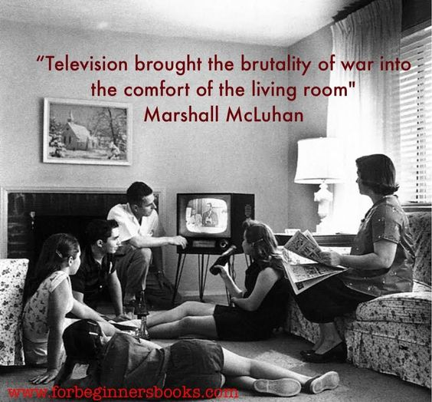
Likewise, the message of a newscast about a heinous crime may be less about the individual news story itself — the content — and more about the change in public attitude towards crime that the newscast engenders by the fact that such crimes are in effect being brought into the home to watch over dinner.

Slide 8
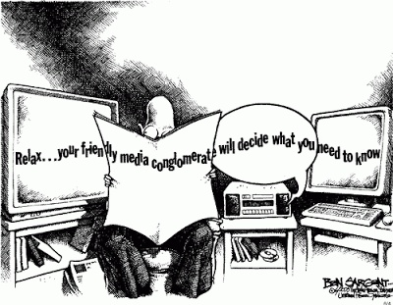
In Understanding Media, McLuhan describes the ”content” of a medium as…
…a juicy piece of meat carried by the burglar to distract the watchdog of the mind.

Slide 9
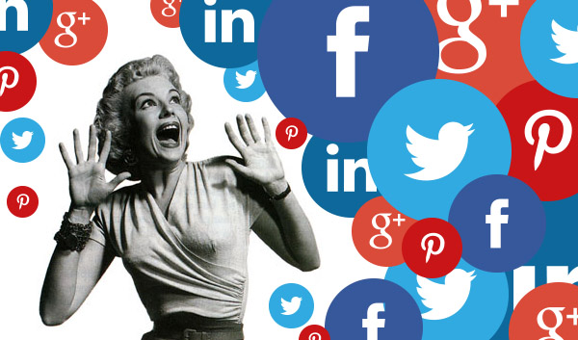
Can you relate?

Slide 10
This means that people tend to focus on the obvious, which is the content, to provide us valuable information, but in the process, we largely miss the structural changes in our affairs that are introduced subtly, or over long periods of time.

Slide 11
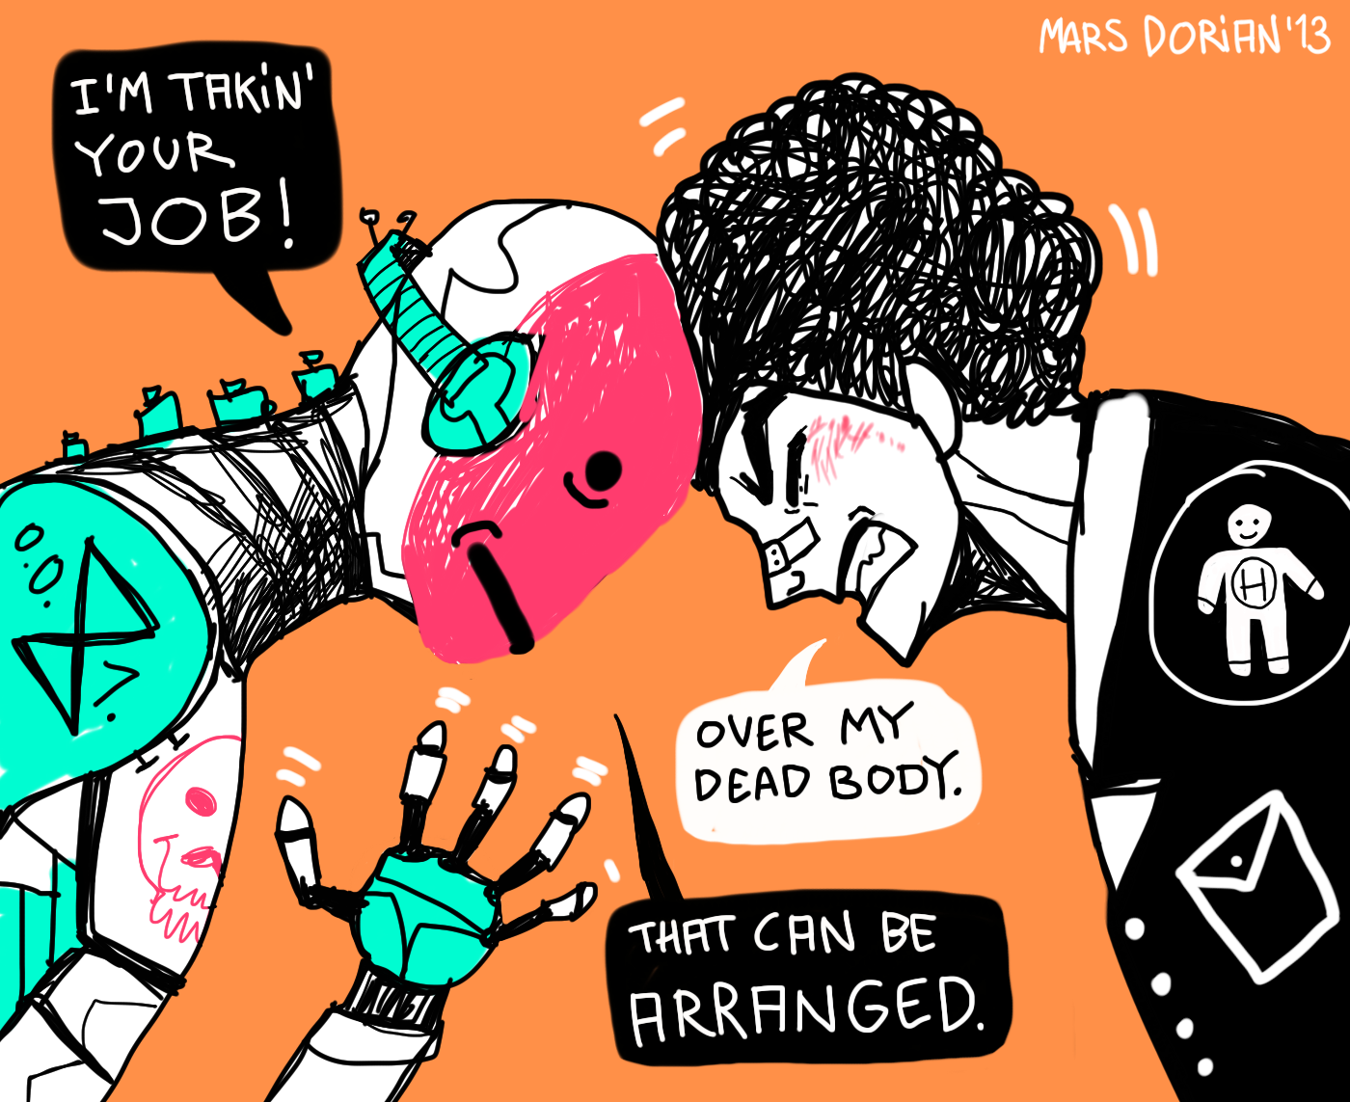
As society's values, norms, and ways of doing things change because of the technology, it is then we realize the social implications of the medium.

Slide 12
McLuhan interpreted Cubism as announcing clearly that the medium is the message.
For him, Cubist art required "instant sensory awareness of the whole” rather than perspective alone.

Slide 13
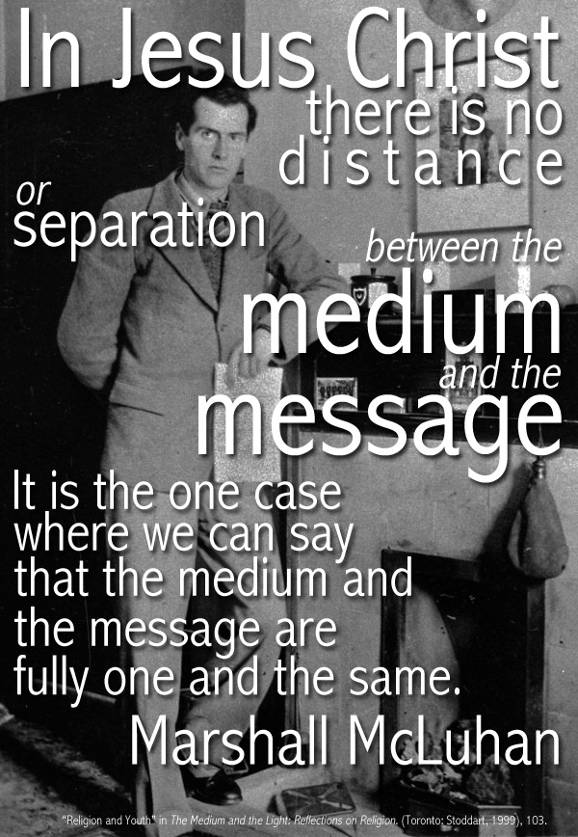
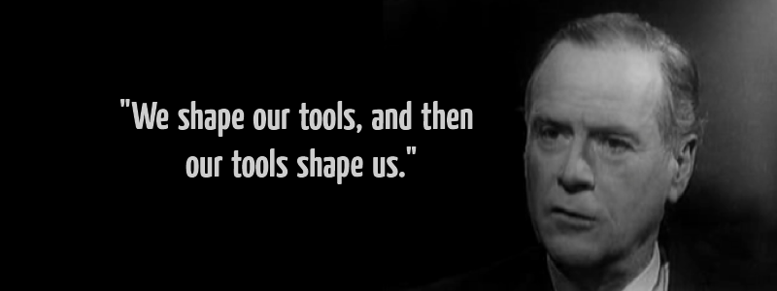
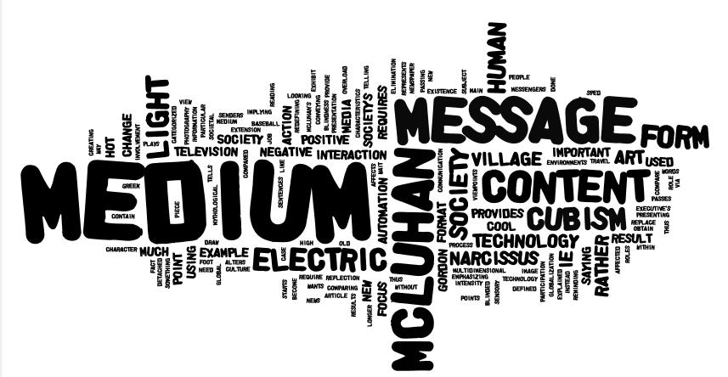
In other words, with Cubism one could not ask what the artwork was about (content), but rather consider it in its entirety.
The end.

