Slide 1
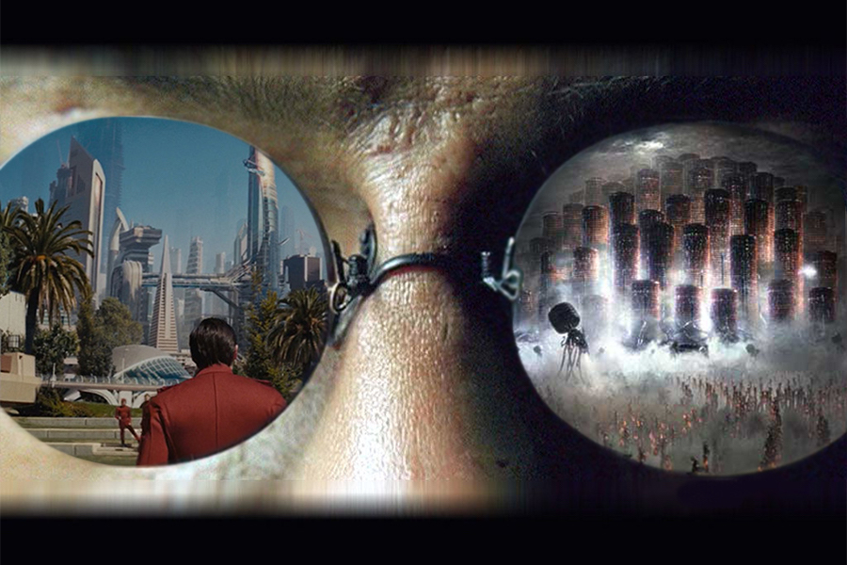
Controlling the
Controlling the
NARRATIVE
vs
REALITY
Reflections on Janet Murray’s
Hamlet on the Holodeck: The Future of Narrative In Cyberspace

Slide 2
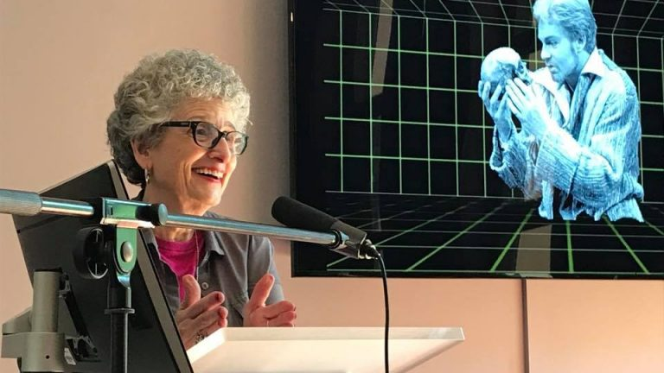
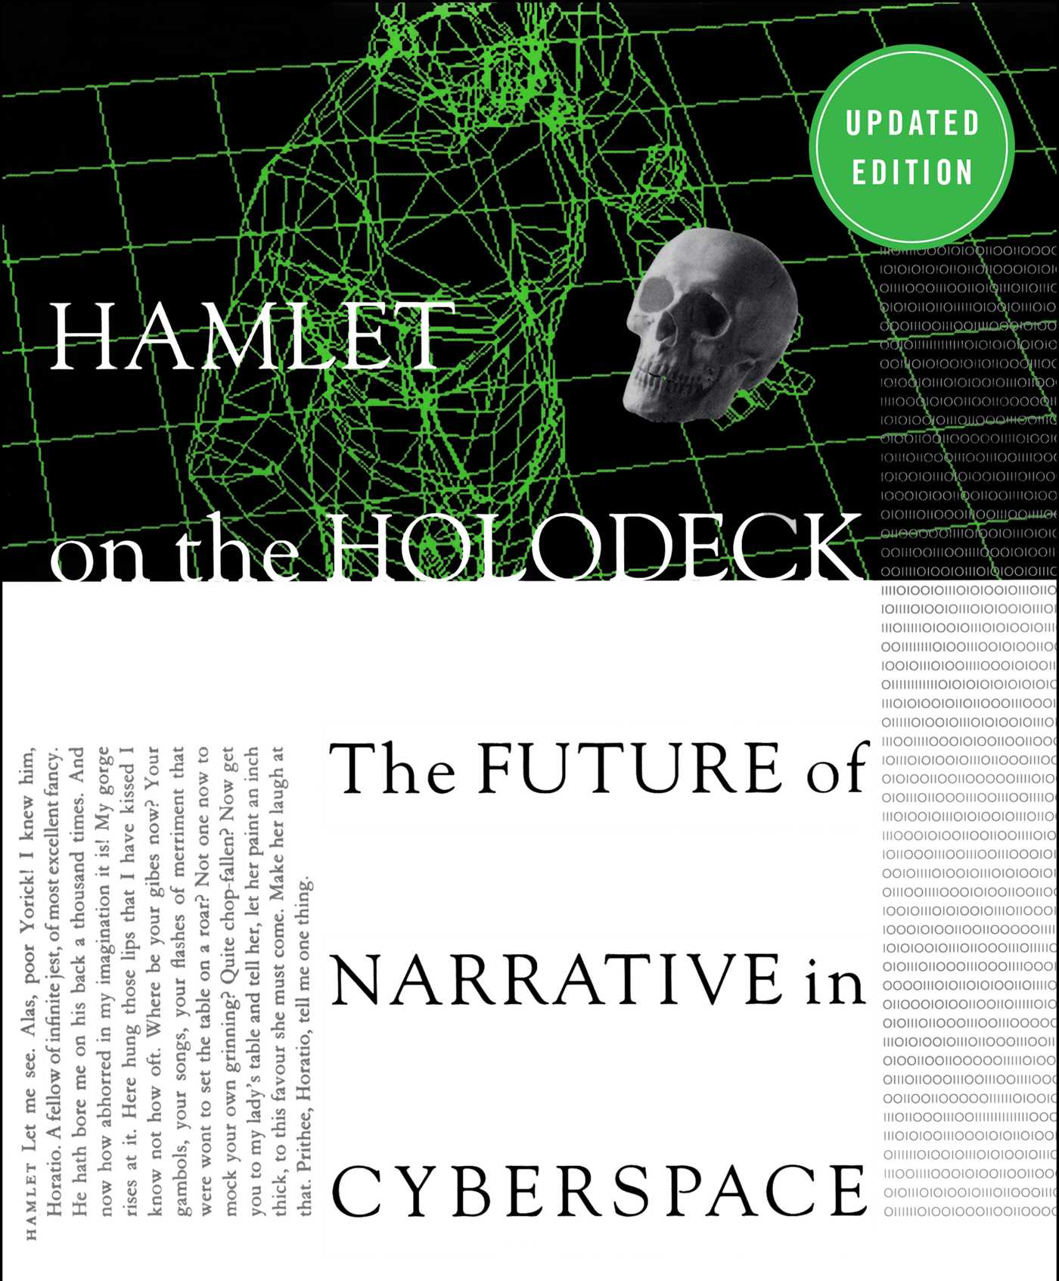
JANET H. MURRAY
Professor of Literature, Media and Communication at Georgia Tech since 1999
Hamlet on the Holodeck: The Future of Narrative In Cyberspace - 1997
Explores the evolution of narrative media and embraces the storytelling possibilities of modern interactive media, especially video games and Virtual Reality.
The reader/user becomes an active participant in the story

Slide 3
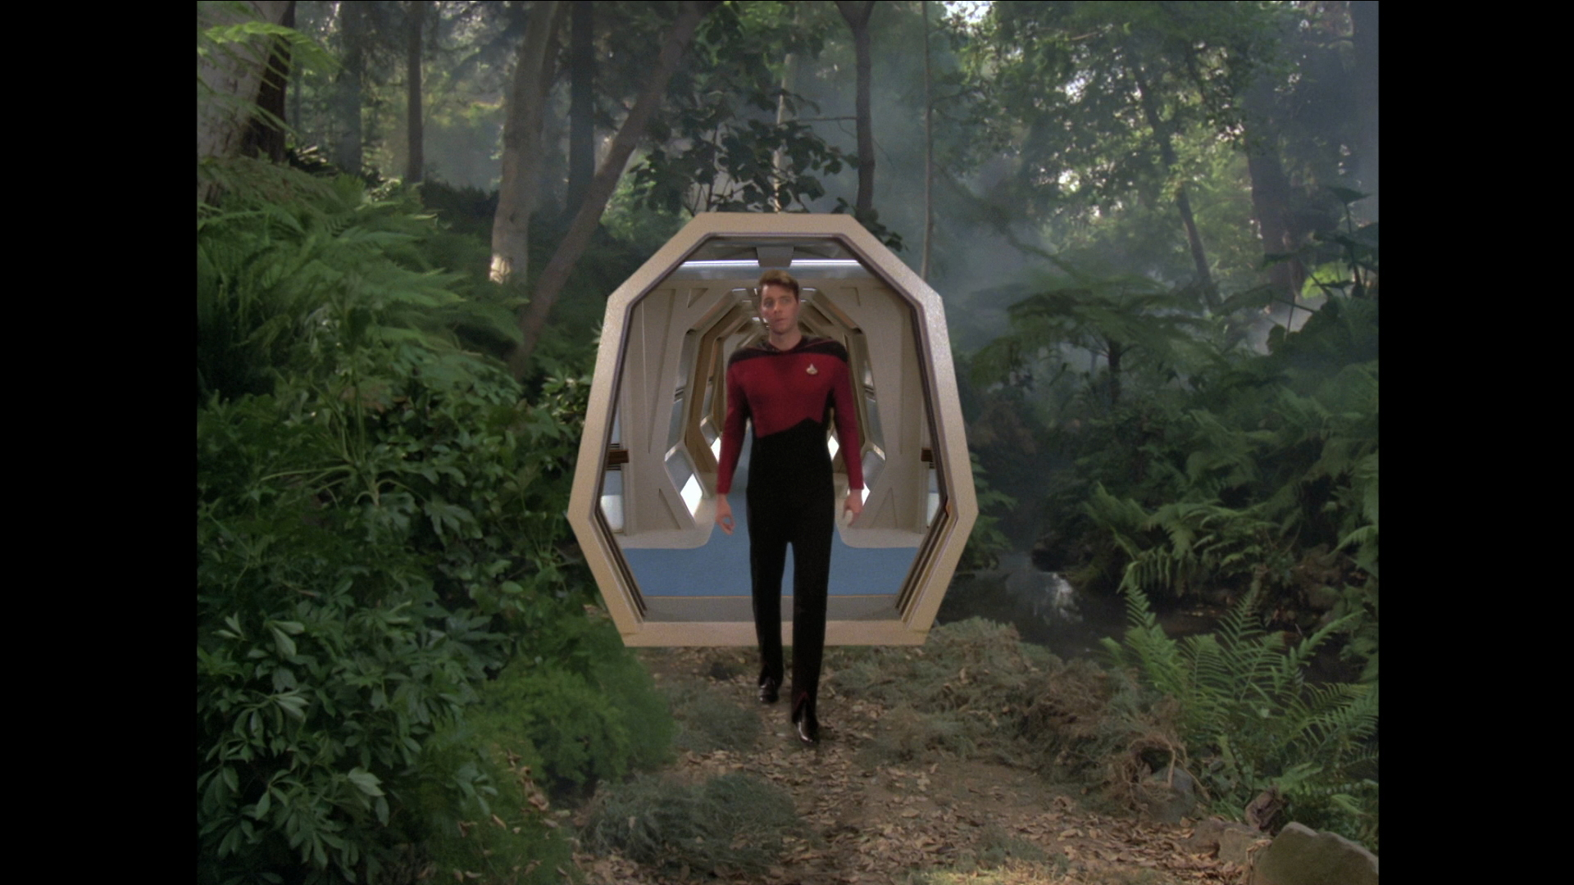
Holodeck?
A plot device used in the fictional series, Star Trek.
Provides a means through which characters can explore and interact within alternative realities.
“Universal fantasy machine”
Janet Murray

Slide 4
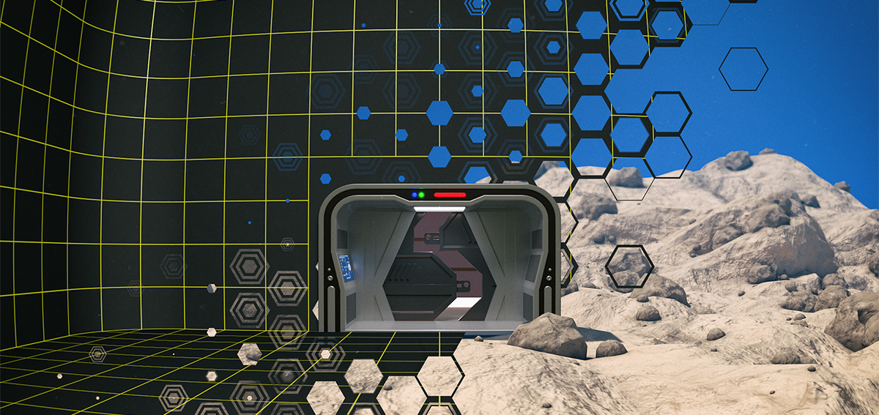
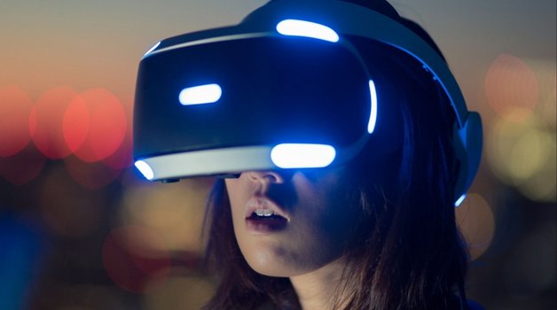
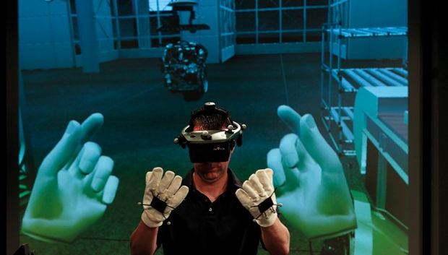
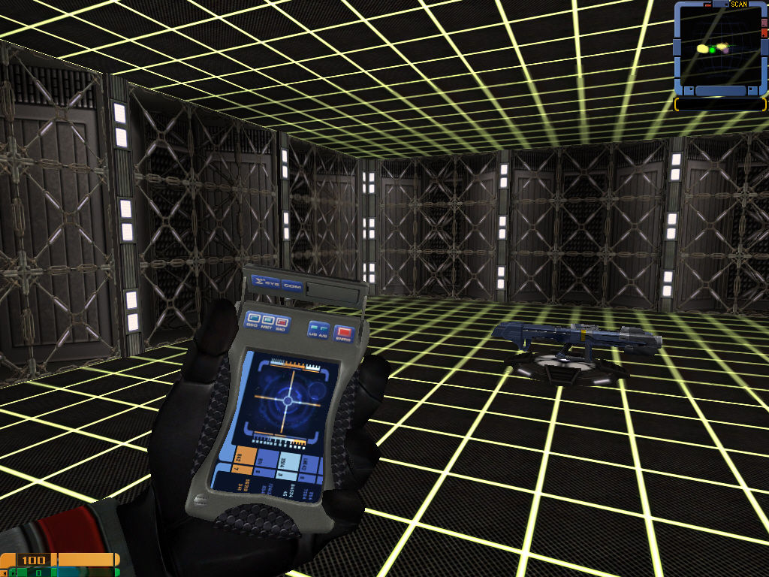
The new narrative form …
INTERACTIVITY
Murray presents the holodeck as conceptually comparable to modern interactive forms of media, in which audiences and users may interact with and contribute to the narrative.
IMMERSION
STORY INFLUENCE
VIRTUAL FREEDOM
Murray focuses on the possibilities and power of modern narrative platforms - like Virtual Reality and video games - to deliver classic storytelling components in an interactive fashion.

Slide 5
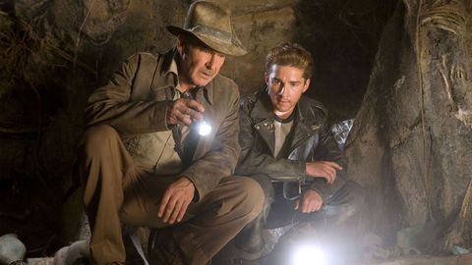
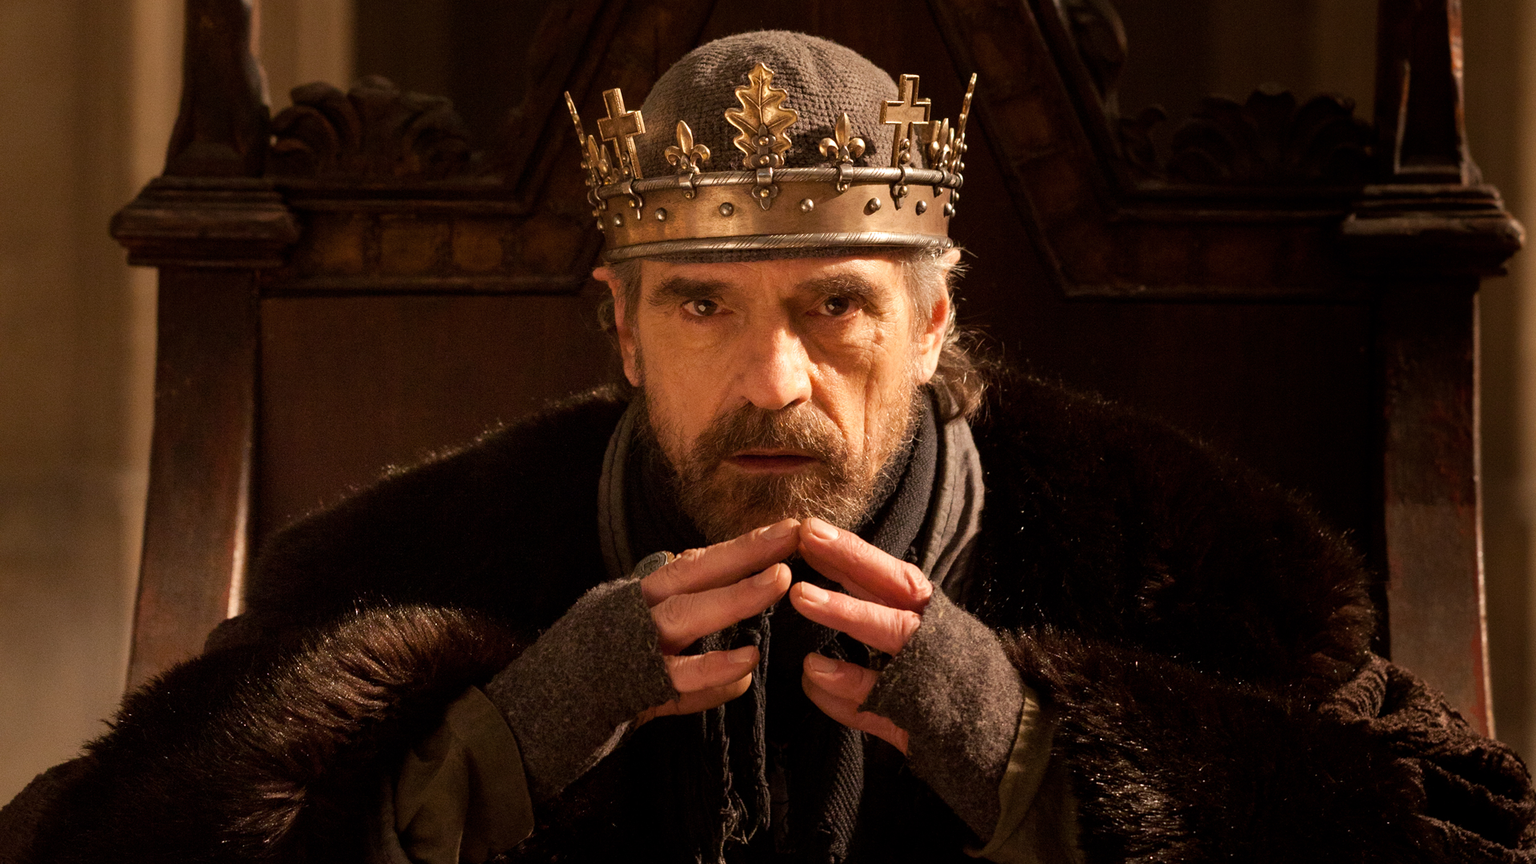
Modern narrative forms maintain many key components of classic narrative
Classic archetypes:
The Explorer
The Lover
The Hero
The Ruler
The Magician
But these new technology-driven forms of narrative add a key ingredient…
INTERACTIVITY: the ability to interact, influence and/or control where the story goes

Slide 6
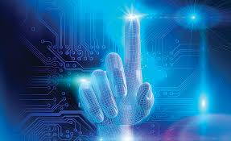
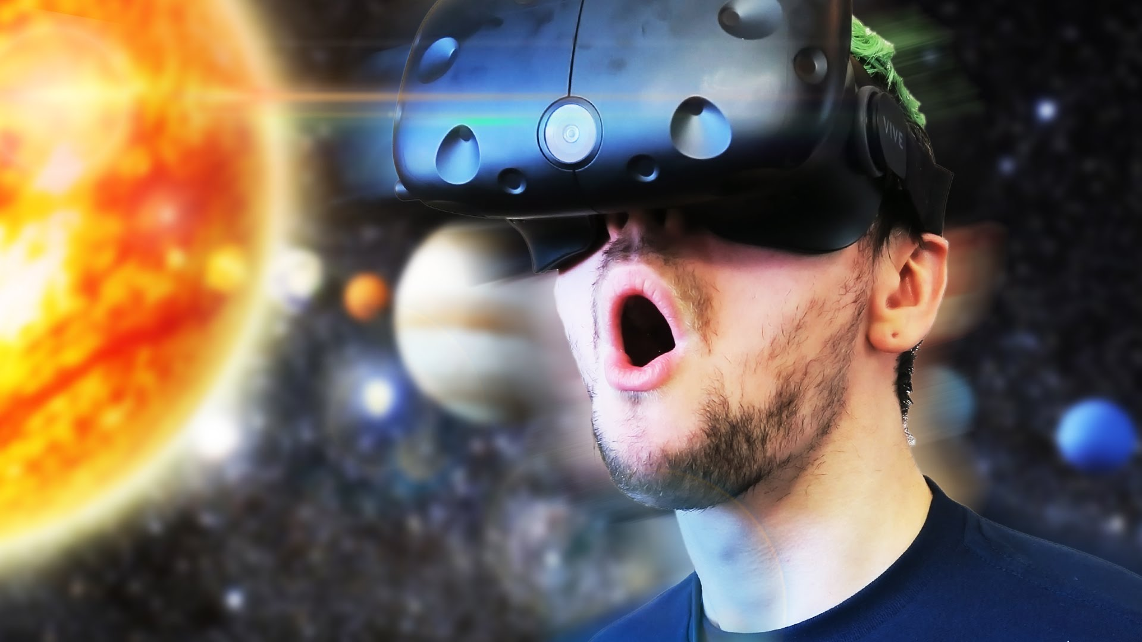
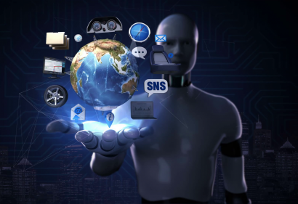
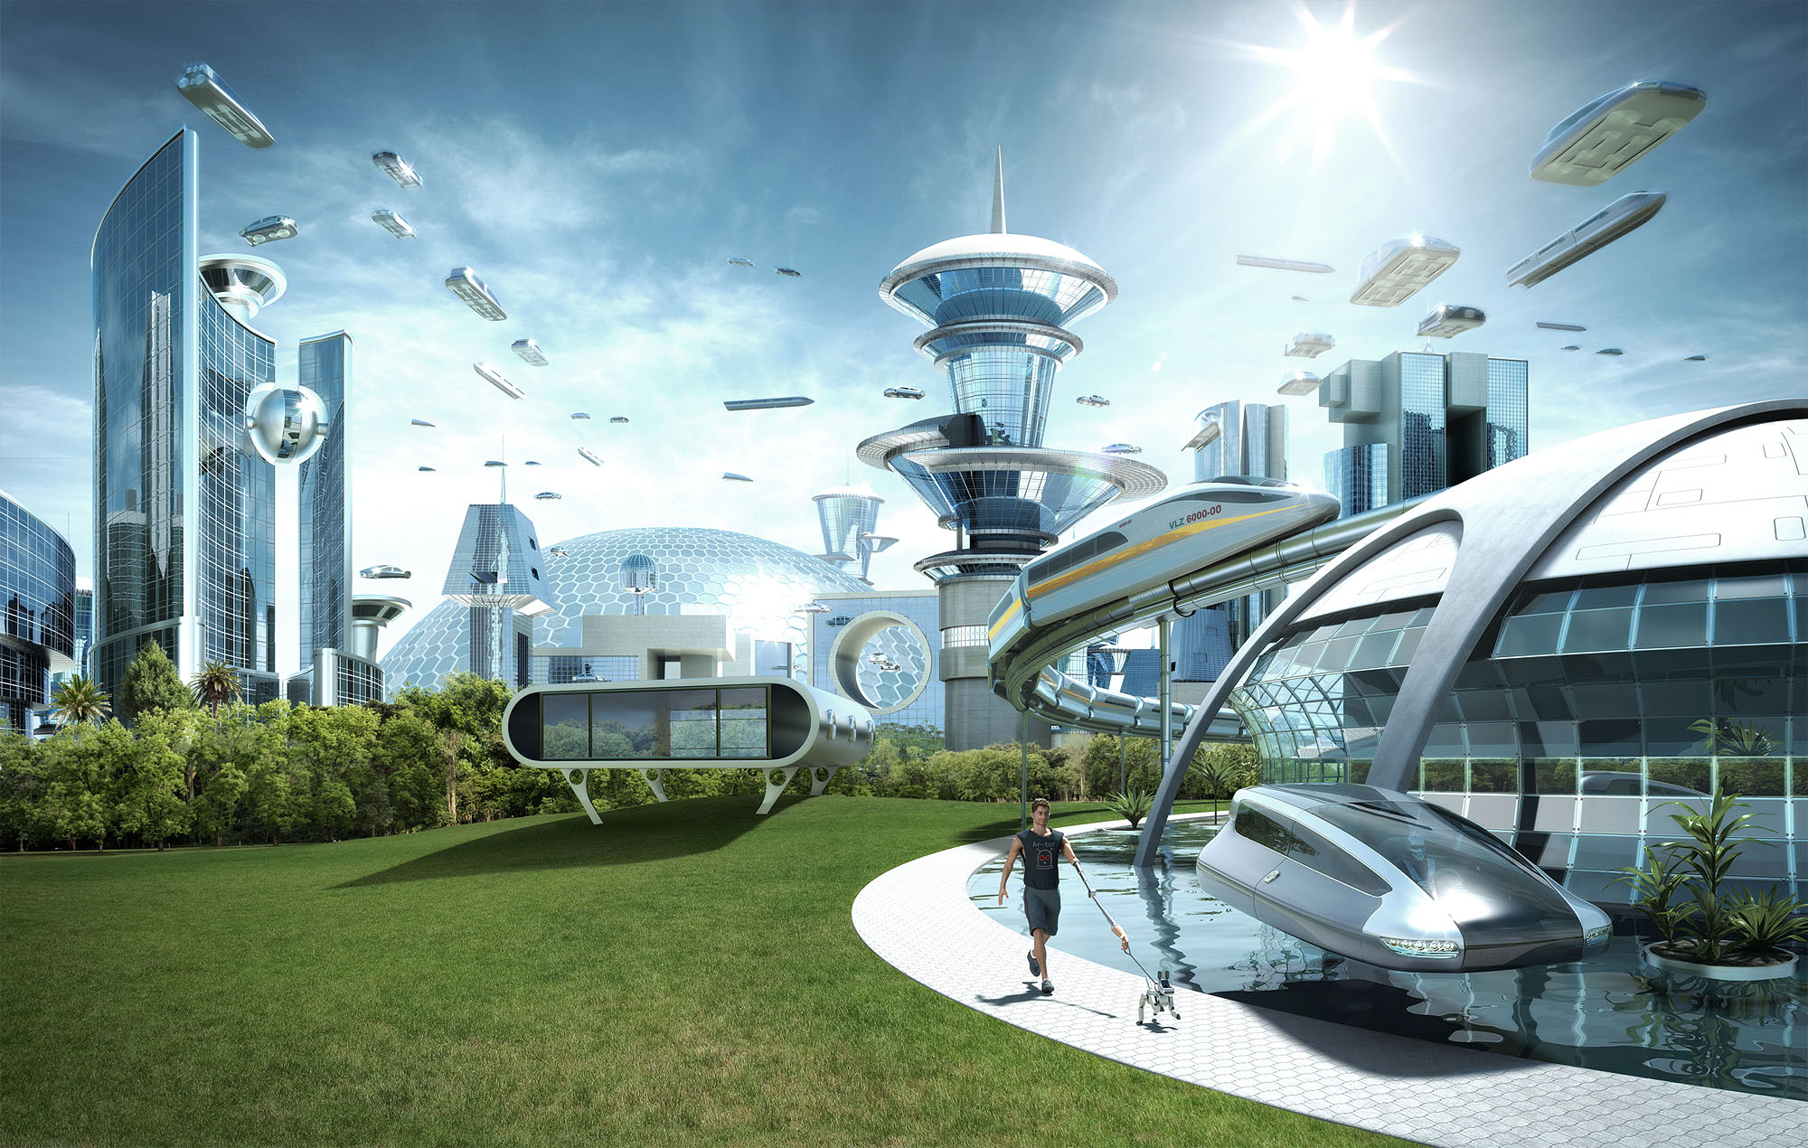
Janet Murray embraces use of technological means to advance the narrative to become a more democratic, less predictable reader/user-empowered experience and environment.
The embracing of technology, in full measure, extends to notions of futuristic technology-driven utopian societies

Slide 7
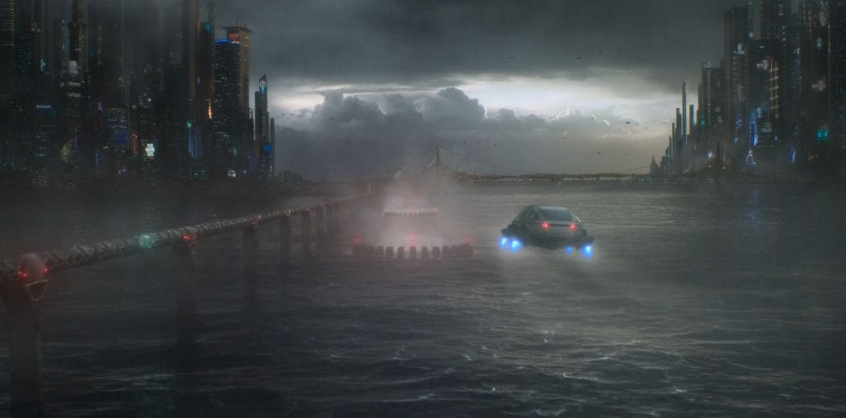
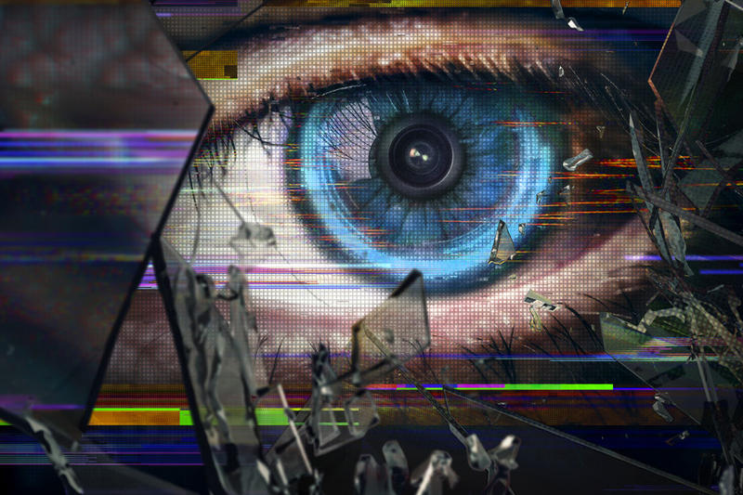
Throughout history, narrative has often depicted such futuristic utopias as resulting in dystopias
This
To
From this…
From Huxley to Orwell and from Philip Dick (Blade Runner) to James Cameron (The Terminator), these dystopian visions warn of the dangers of a future in which we rely deeply on technology as a driving force of our reality and existence.

Slide 8
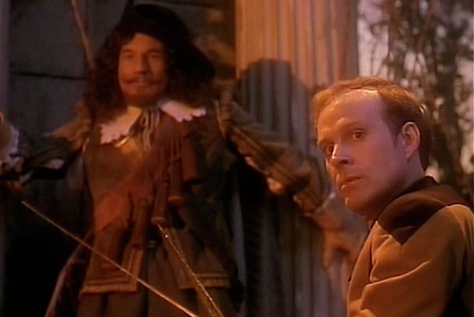
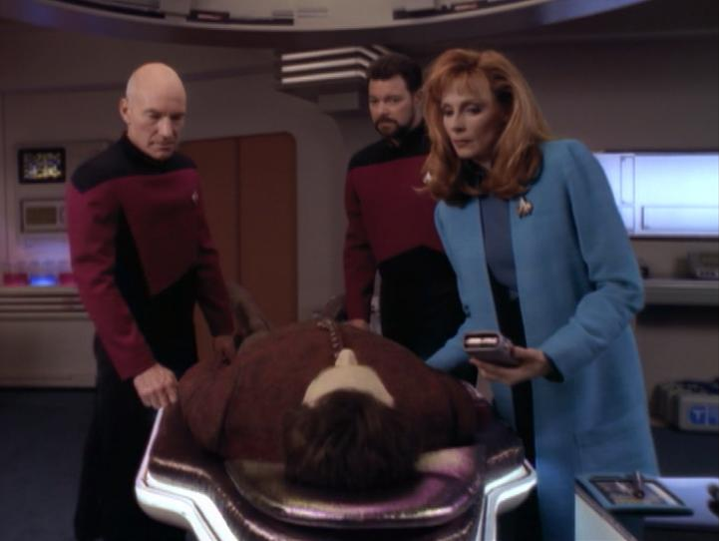
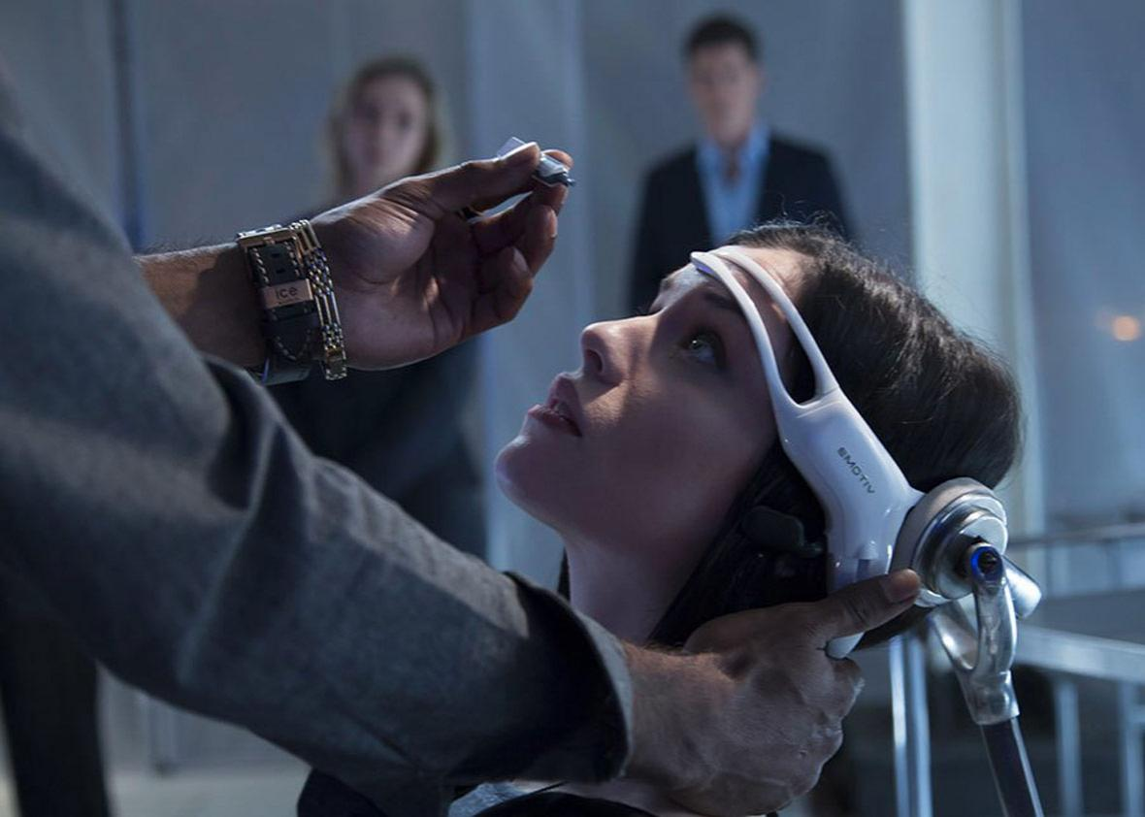
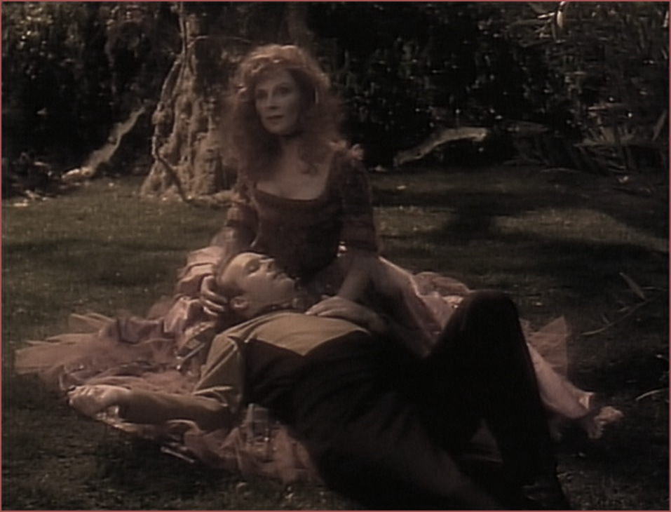
Holodeck allegories
Some episodes address catastrophic issues through the Holodeck.
Crew members become addicted to their Holodeck alternate reality experiences.
They shift priorities to their virtual holodeck realities, sacrificing engagement in their real world and lives.
Consequences arise:
Enemies take holodeck control
Ship and crew in peril
New addictions
Porn, narcissism and escapism
are fostered.
HOLO-DICTION (definition): An obsession with the holodeck Star Trek Encyclopedia

Slide 9
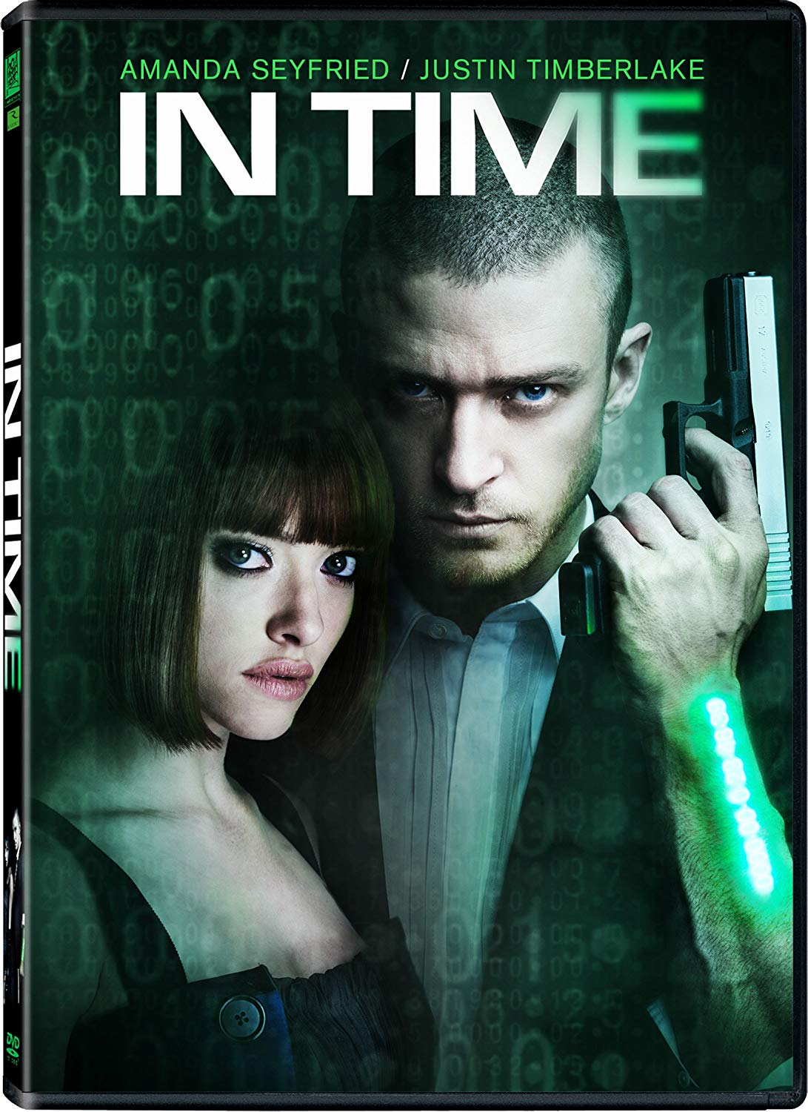
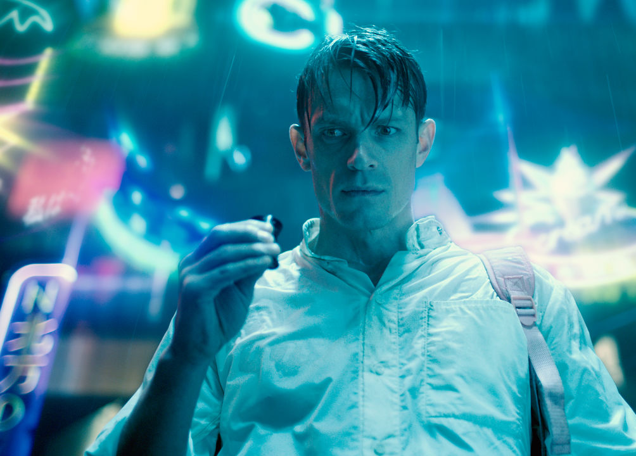
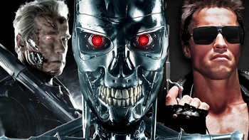
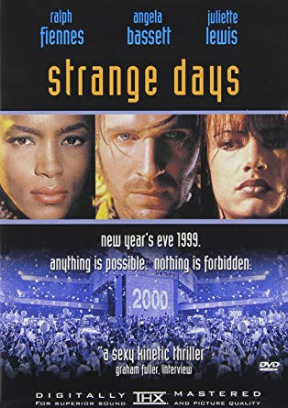
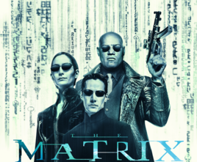
Visionary Depictions of Futuristic Dystopia
1984
ALTERED CARBON

Slide 10
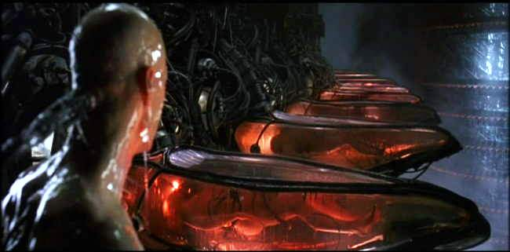
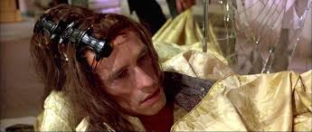
Central themes of these dystopian depictions
Greedy Devotion to technology as a means to serve humanity can result in humanity becoming reduced to subjects serving technology
In futuristic utopia, the power of the technology will ultimately be controlled by a limited, elite group of powerful individuals who may use their vast power to advance their own interests at the peril of all others
Unchecked human desire for self-gratification, when superseding our greater sense of responsibility to the world around us, can lead to our own destruction
EMPOWERMENT COMES FROM ACTION
&
COMPLACENCY / APATHY KILL INDIVIDUALITY

Slide 11
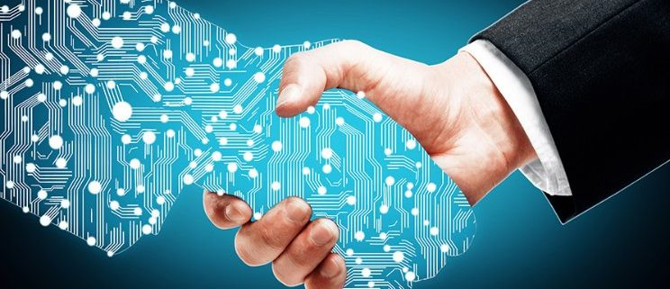
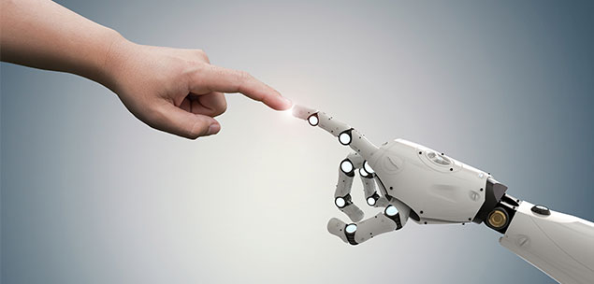
Murray embraces these new narrative media as part of the vision for technology-driven utopia.
Her observations about technology, media and narrative are astute
BUT
Adopting narrative media – especially in the form of stimulating entertainment –
as a foundation for a futuristic technologically-oriented utopian society, denies highly unfavorable, even catastrophic implications and risks.

Slide 12
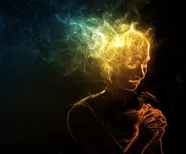
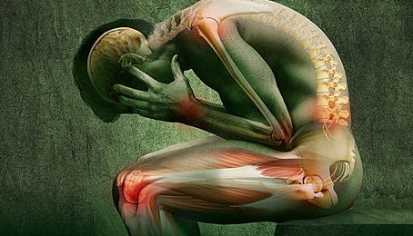
Scientifically-demonstrated harms of technology immersion
Physical
Vision problems
Chemical imbalances / irregularities
Hearing loss
Neck strain
Decreased fitness and
related health conditions
Psychological
Distraction
Compromised attention span
Expectation of instant gratification
Narcissism
Cognitive Losses
Depression
Social
Decreased social skills
Isolation
Decreased intimacy

Slide 13
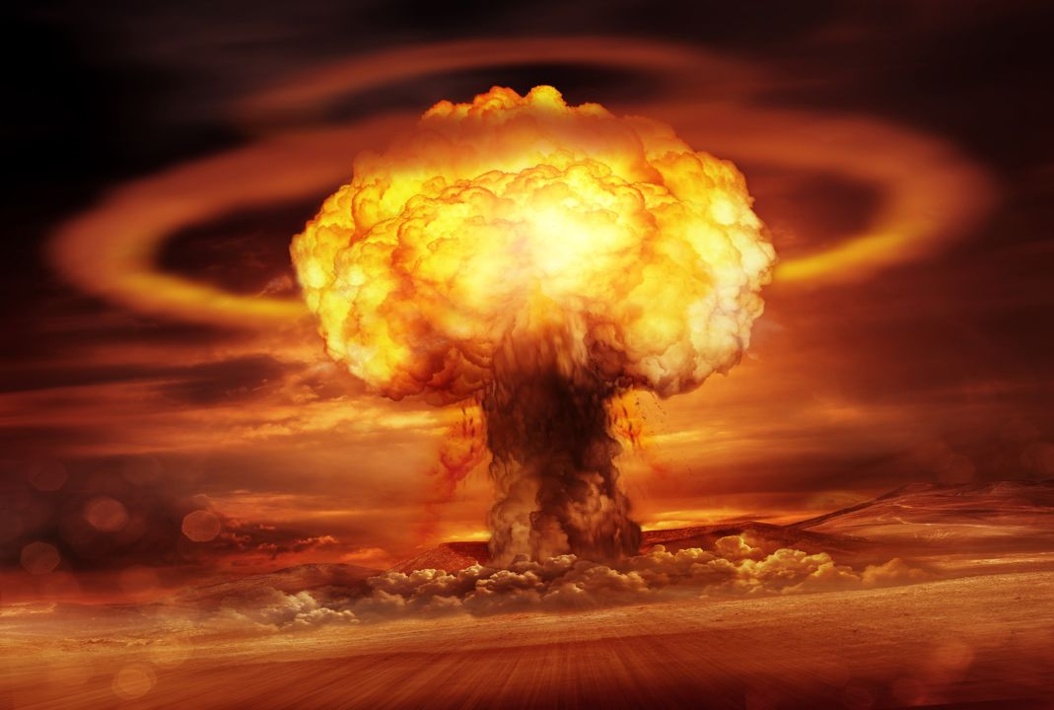
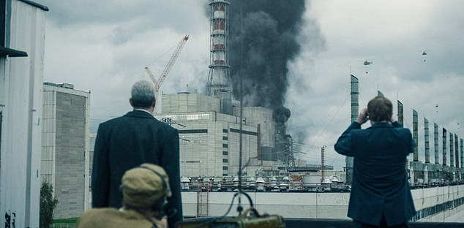
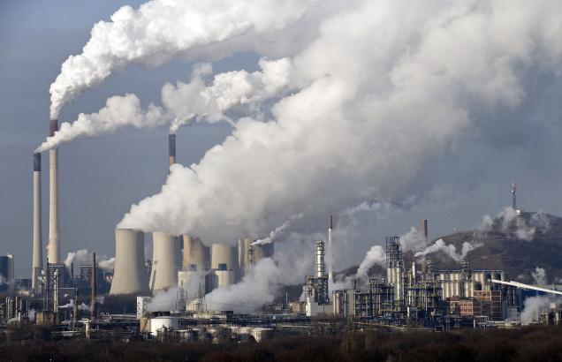
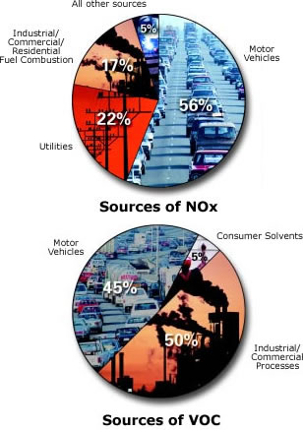
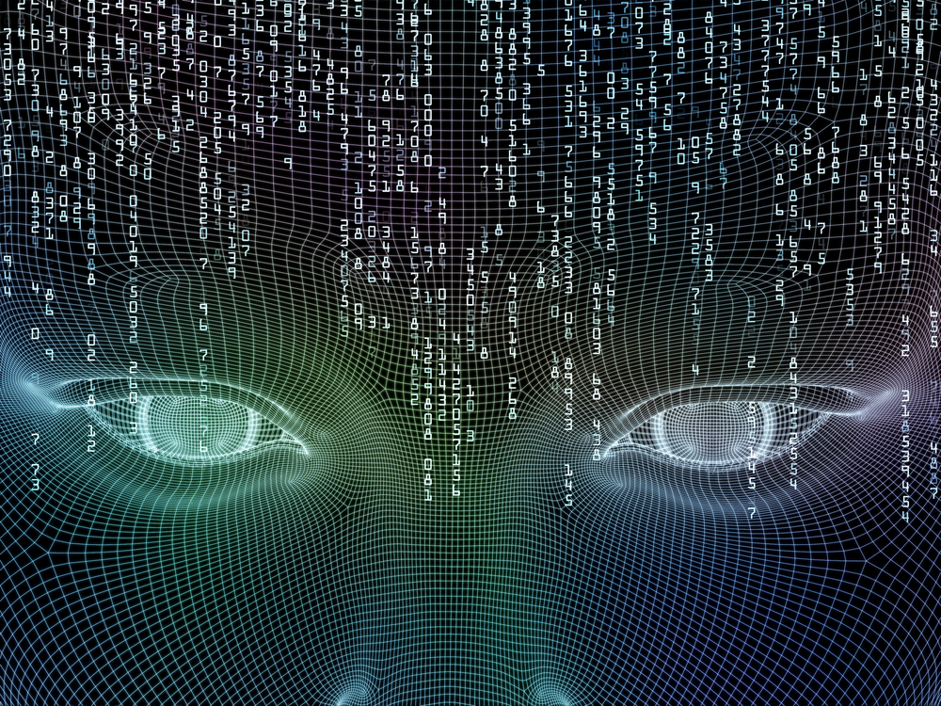
Technological “advances” led awry
The Atomic Bomb
Chernobyl Nuclear Disaster
Manufacturing & Pollution
Global Warming
Legislative end to Net Neutrality
And onward to AI ???
In all cases, the “story” and circumstances were heavily controlled by powerful authorities seeking to gain and preserve their personal interests.

Slide 14
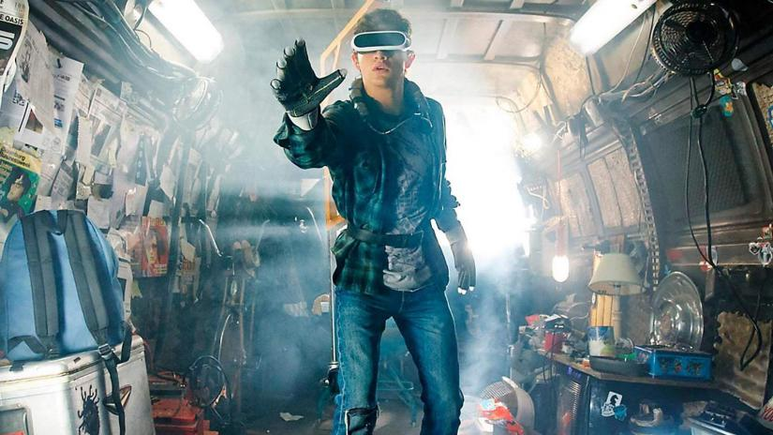
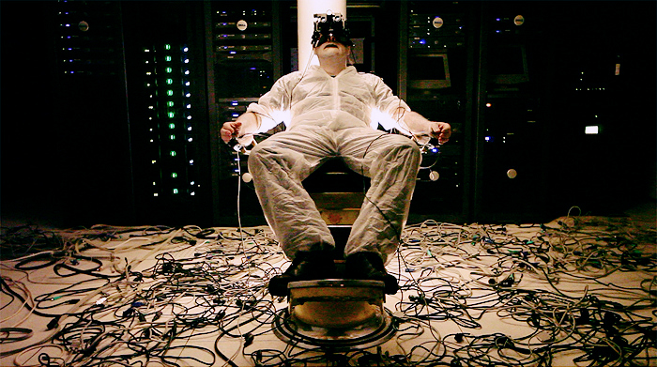
IMMERSION
Virtual
Reality SIMULATIONS
Technology
RELIANCE
Obsession
"(Murray's) utopianism colors all her arguments in this volume, leading her to ignore or play down the more disturbing consequences of technology while unabashedly embracing its possibilities. "
Michiko Kakutani, The New York Times
Physical, psychological and social damage
Disengagement from social realities and responsibilities to self-centric, narcissistic paradigm
Distraction, detachment, disengagement, apathy, complacence
Individuality becomes an internal frame of mind, rather than an active, societal engagement
CHOICE

Slide 15
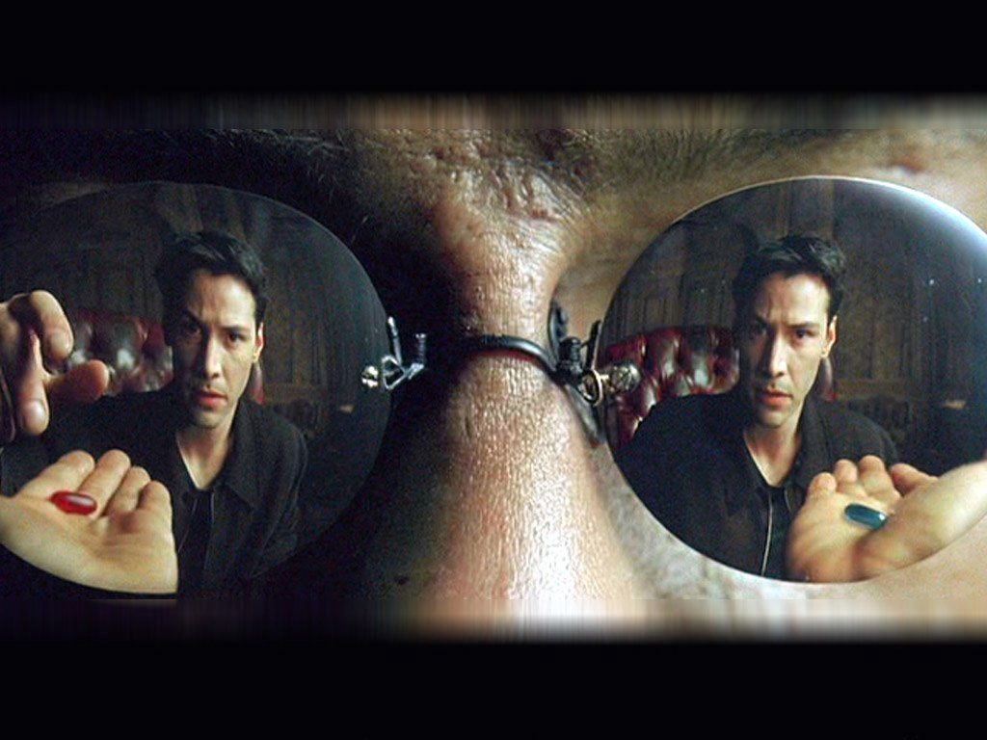
The Matrix decision
The Blue Pill = Illusion
The Red Pill = Reality
Pleasure, compliance, stability, slavery
Truth, Revelation, Risk, Independence
WHICH DO YOU CHOOSE ?
Control of your story/game
Control of your reality
OR

Slide 16
Citations
1. Hamlet on the Holodeck: The Future of Narrative In Cyberspace, Janet Murray, 1997
2. Hamlet on the Holodeck: 20 Years Later, Matt Margini, August 30, 2017
3. Hamlet on the Holodeck Review, Michiku Kakutani, New York Times, July 17, 1997
All photos contained in this work are public domain

