Slide 1
Narrative in Cyberspace
By Sergio Siria

Slide 2
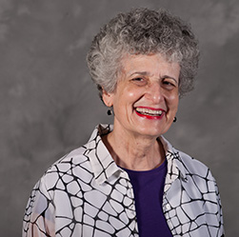
JANET MURRAY
Professor at the Georgia Institute of Technology
Developer of humanities computing applications
Advocate for digital media

Slide 3
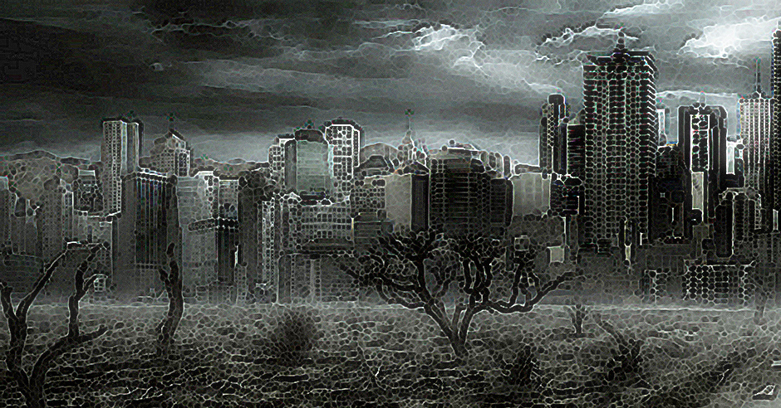
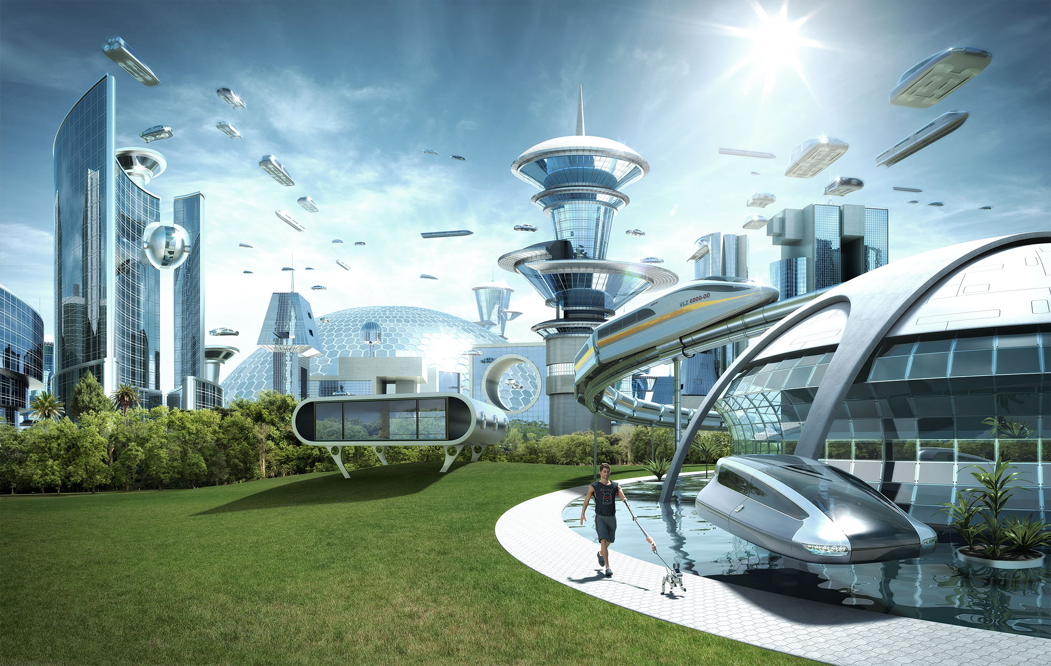
Dystopia and Utopia
Murray’s books discuss an idea that the future is unknown and could lead to two very different endings

Slide 4
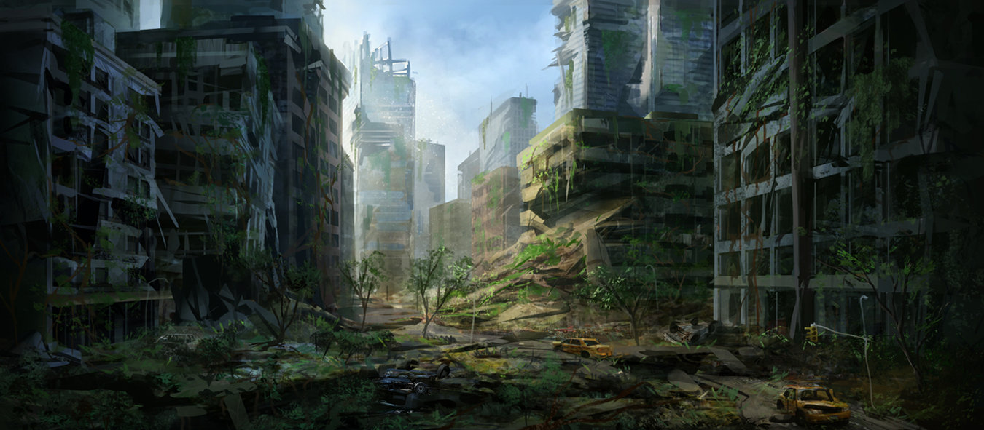
Dystopia
Society in the future is filled with misery
Alien invasions
Technology controls all or is used to control all
Destructions of planet and/or universe
Life ends through wars and/or disease

Slide 5
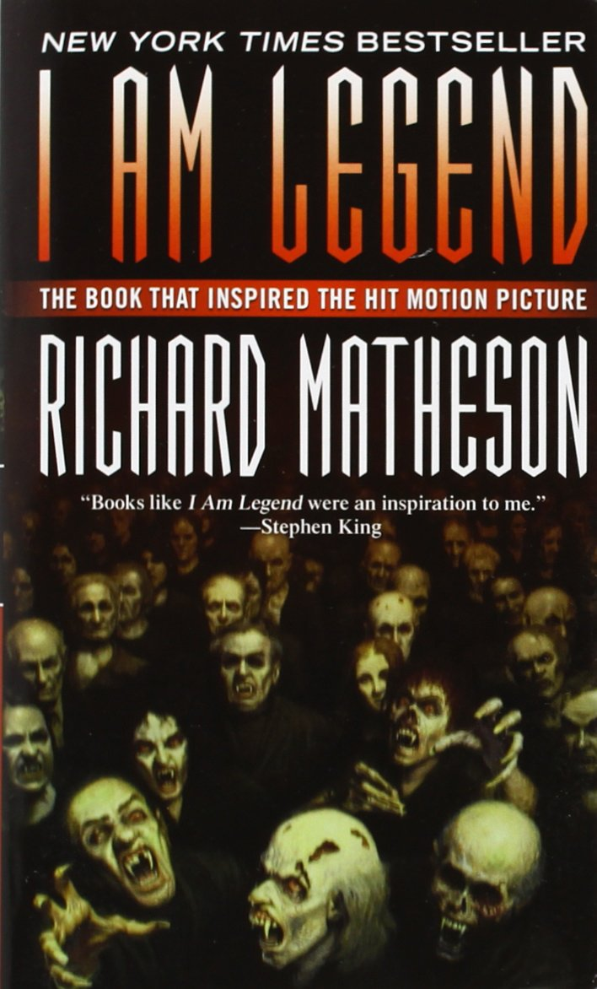
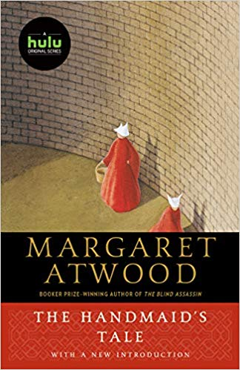
Books About Dystopia
I Am Legend The Handmaid’s Tale Oryx and Crake

Slide 6
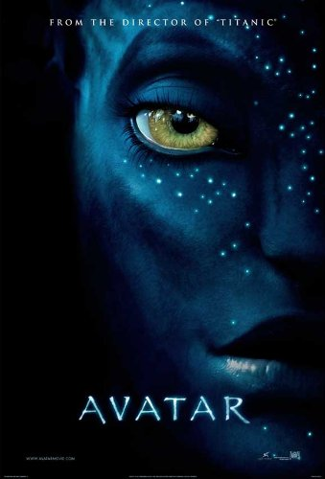
Films About Dystopia
Avatar iROBOT The Hunger Games

Slide 7
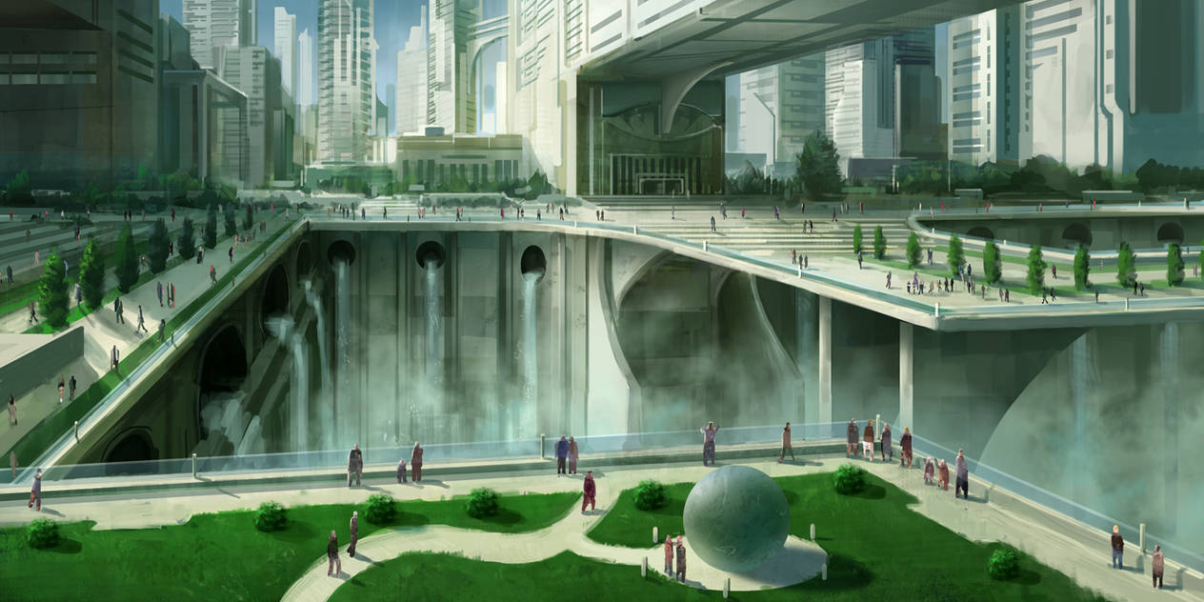
Utopia
Society in the future is filled with amazement and joy
No wars or lives lost to disease
Love and Peace
Planet and environment is protected and preserved
Technology helps and makes life easier

Slide 8
Books About Utopia

Slide 9
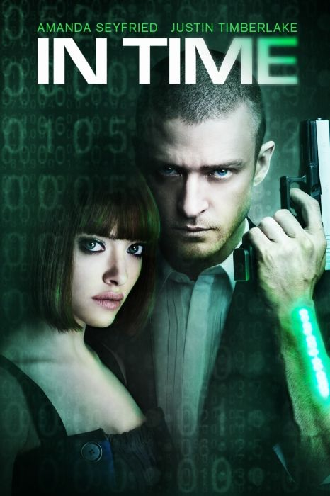
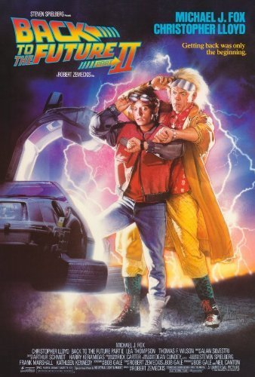
Films About Utopia

Slide 10
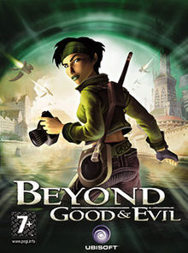
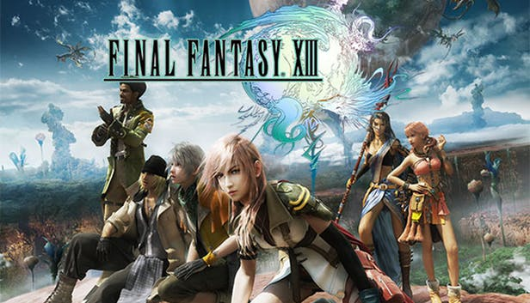
Video Games and Murray’s Ideas
Murray did not talk about video games however, similar story lines about her ideas are used
Many Role-Playing Games have become popular like Final Fantasy

Slide 11
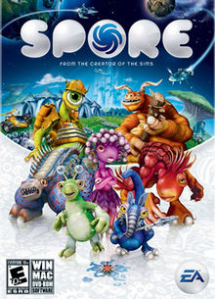
Games and People
Today, Gamers spend most of their time inside on the computers and play with friends they have met online.

Slide 12
Multiform Story
One point starts
Linear narrative avoided
Multiple story lines creates
Story exist in parallel realities

Slide 13
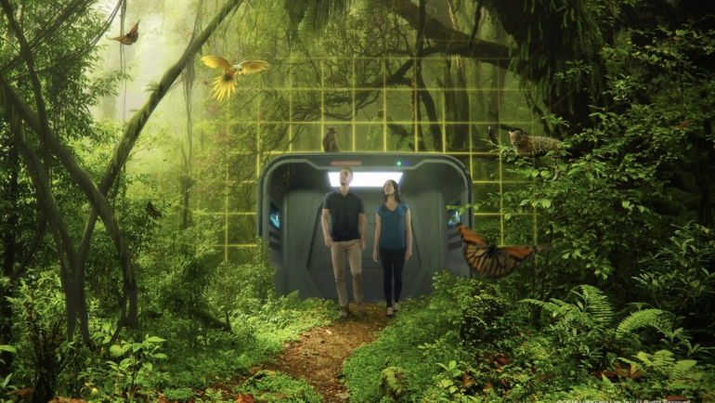
Holodeck
Another idea of Murray
Story includes
World with immersive and imaginary ideas
Users can explore the world and change it

Slide 14
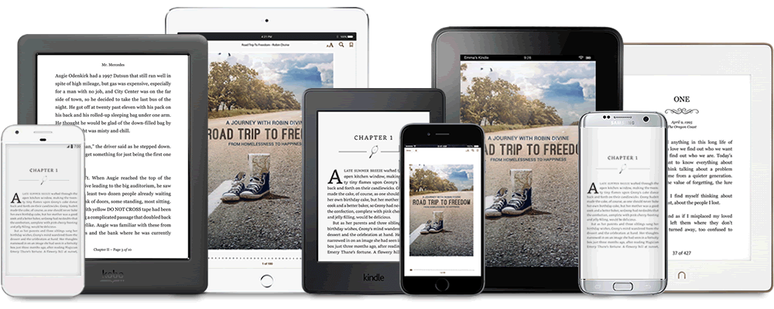
World of Technology Taking Over?
Print Technology pushed development of books with amazing stories.
Now there are new technology that no longer require books.
Although books may be slowly losing to technology, amazing stories will continue to thrive and will take on a new form.
Potentially could become online books

