Slide 1
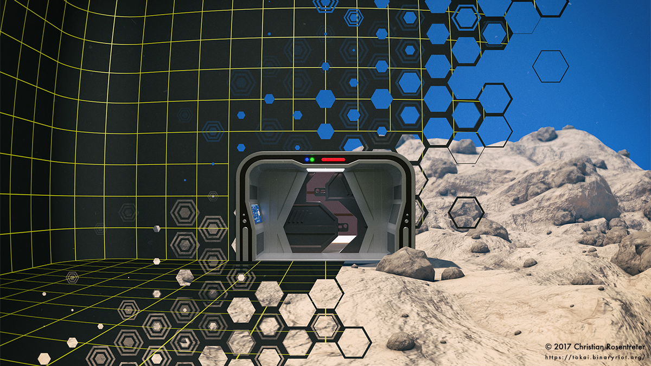
Narrative in Video Games
By Jason Torres
MAT 103

Slide 2
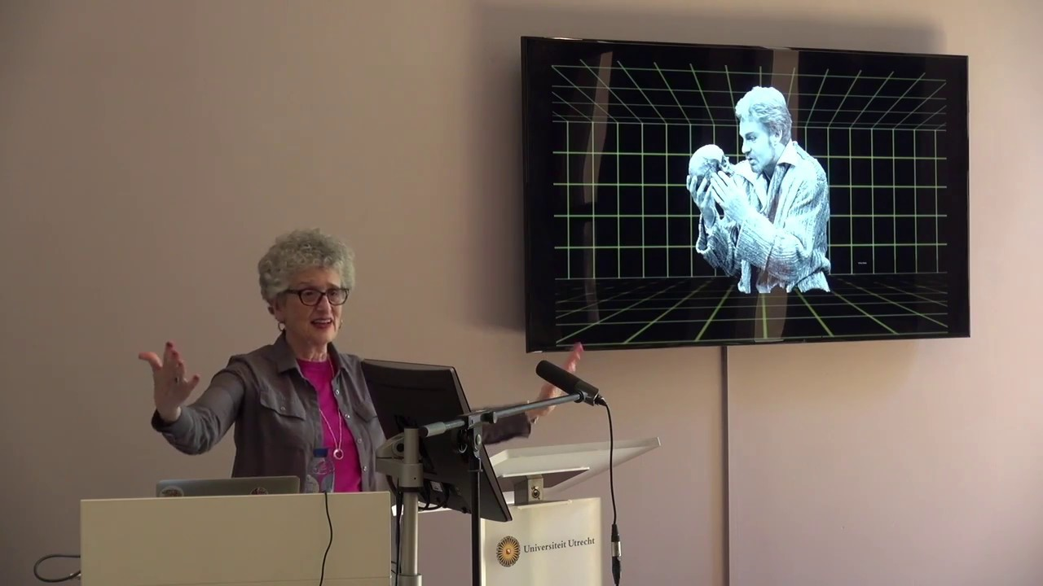
Janet Murray
Professor at Georgia Institute of Technology
Hamlet on the HOLOdeck: The Future of Narrative in Cyberspace (1997)

Slide 3
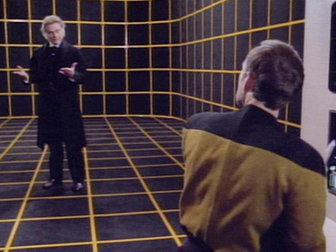
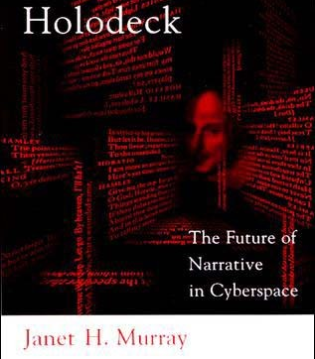
Narrative
The presentation of a story (a fixed sequence of events) by the way of discourse.
Murray says that computers are “A new medium for storytelling”

Slide 4
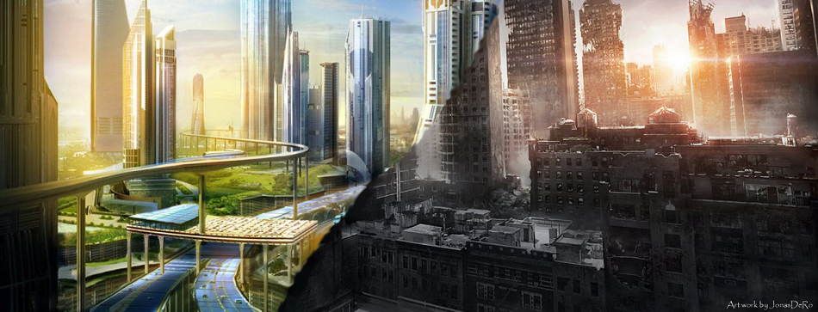
Murray’s Two Futures
Janet Murray says there are two possible visions of the future of our world.
The first being a UTOPIAN future
The second being a DYSTOPIAN future

Slide 5
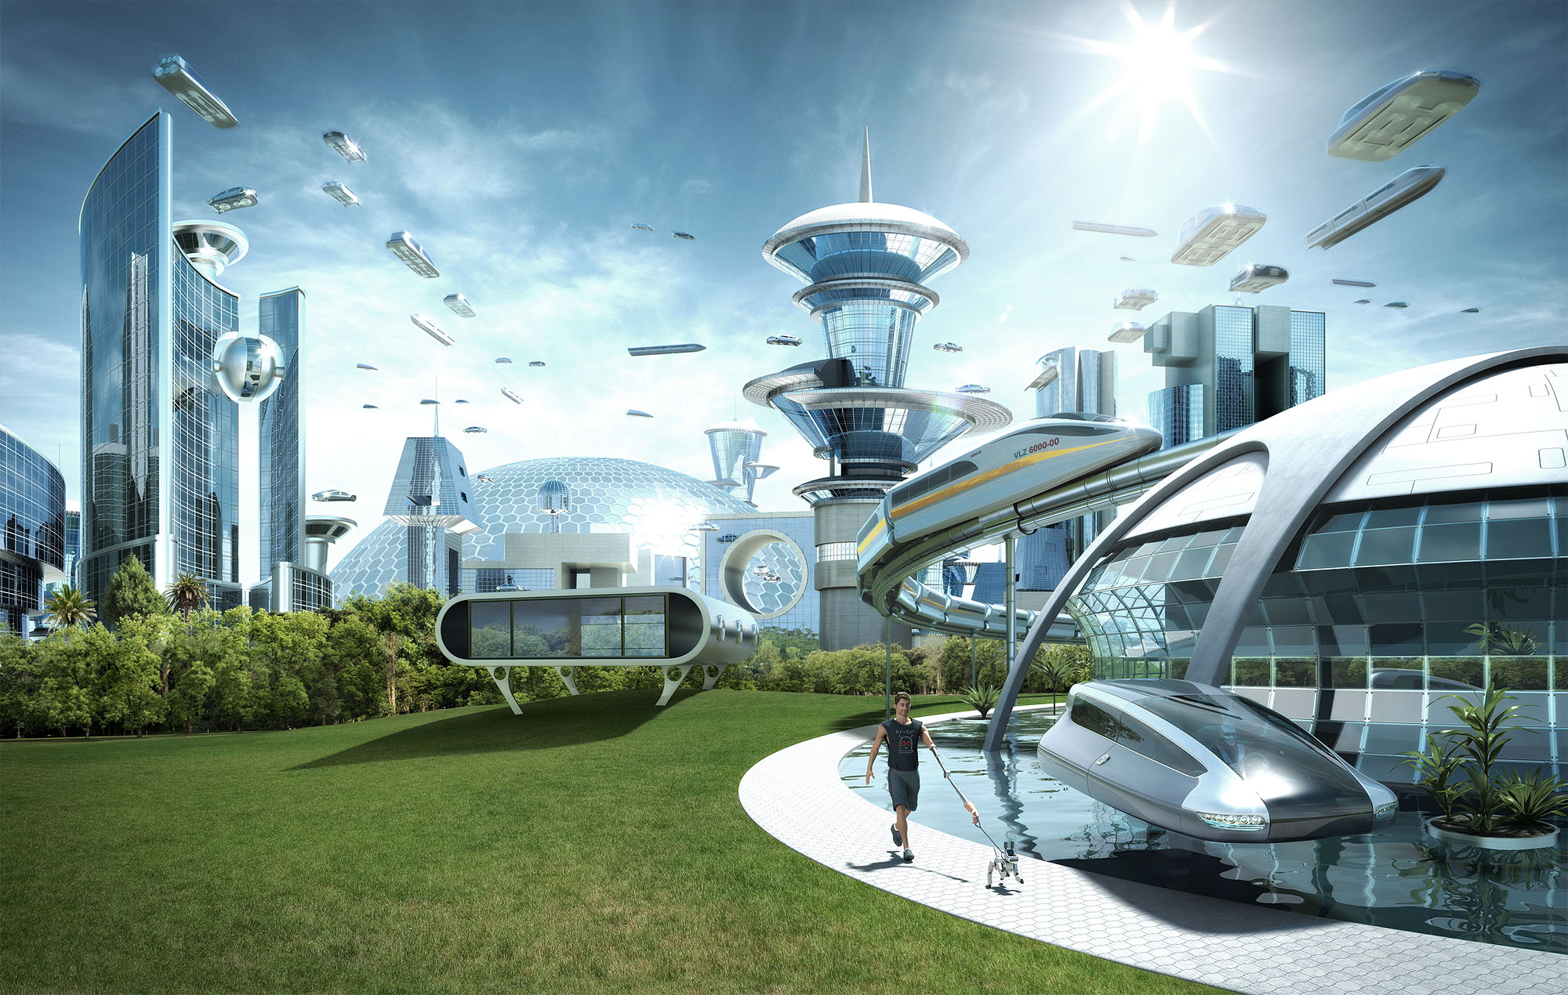
Utopia
Technology used to benefit the people
Peace and love
Have found cures for all deceases and illness
Where the environment is flourishing

Slide 6
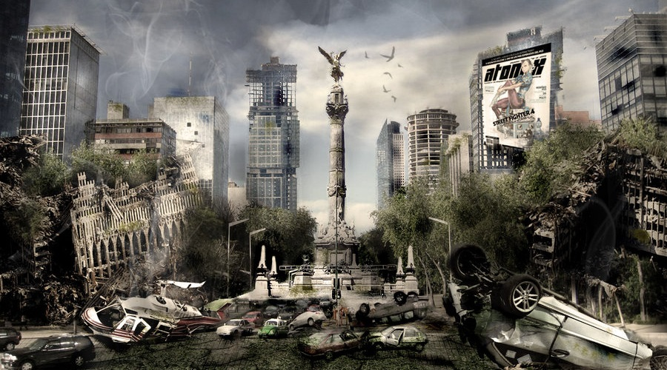
Dystopia
Technology used to control and dominate
Usually in a grimy metropolis where there is no nature in sight.
Usually taken place in a post-apocalyptic world

Slide 7
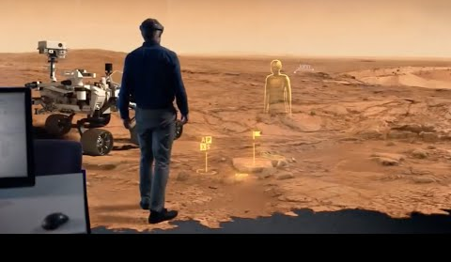
Janet Murray’s 3 Areas of Understanding
Agency (Interactivity)
Transformation (Identification)
Immersion (Suspension of Disbelief)

Slide 8
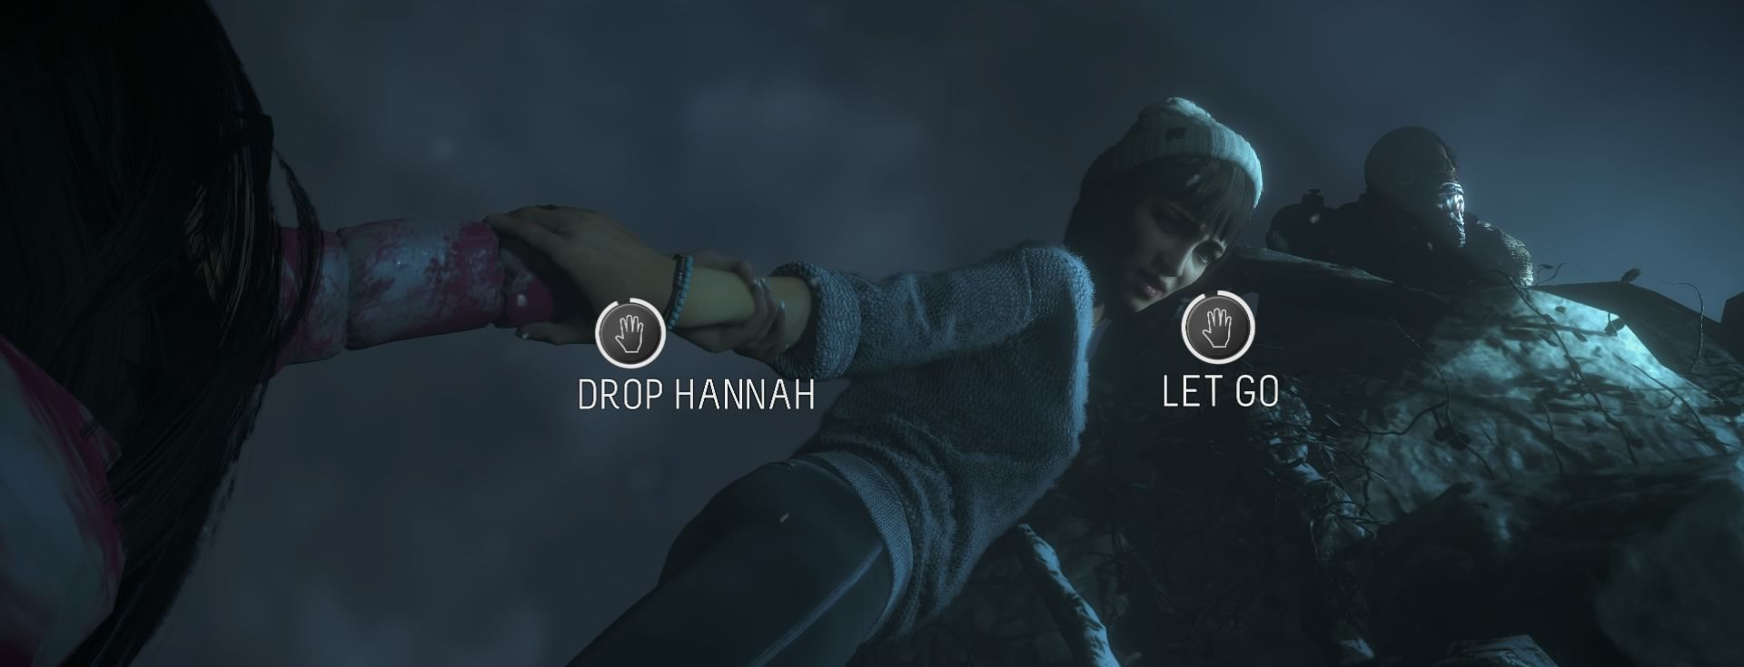
Agency (Interactivity)
“Agency is the satisfying power to take meaningful action and see the results of our decisions and choices.” – Janet Murray
Agency is the feeling that the user has an effect on the virtual environment.

Slide 9
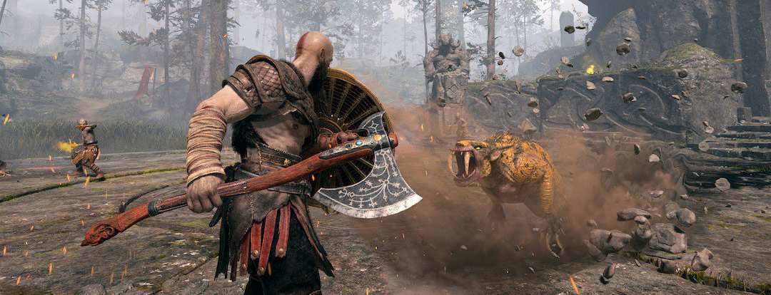
Transformation (Identification)
“It (the computer) makes us eager for masquerade, eager to pick up the joystick and become a cowboy or space fighter” – Janet Murray
Transformation refers to the computers ability to create and simulate an environment to roleplay.

Slide 10
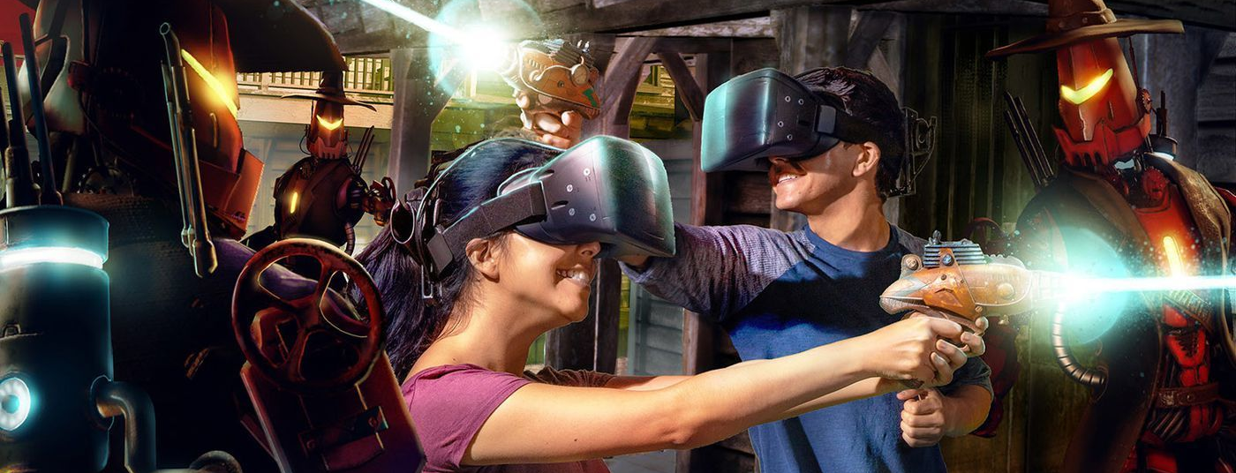
Immersion (Suspense of Disbelief)
“The experience of being transported to an elaborately simulated place is pleasurable in itself, regardless of the fantasy content. We refer to this experience as immersion. Immersion is a metaphorical term derived from the physical experience of being submerged in water.” – Janet Murray
“The convention of the world must be consistent, even if they don’t match those of ‘meatspace’.” – Janet Murray
This constant set of interactions means that a sense of flow is maintained through the virtual environment.

Slide 11
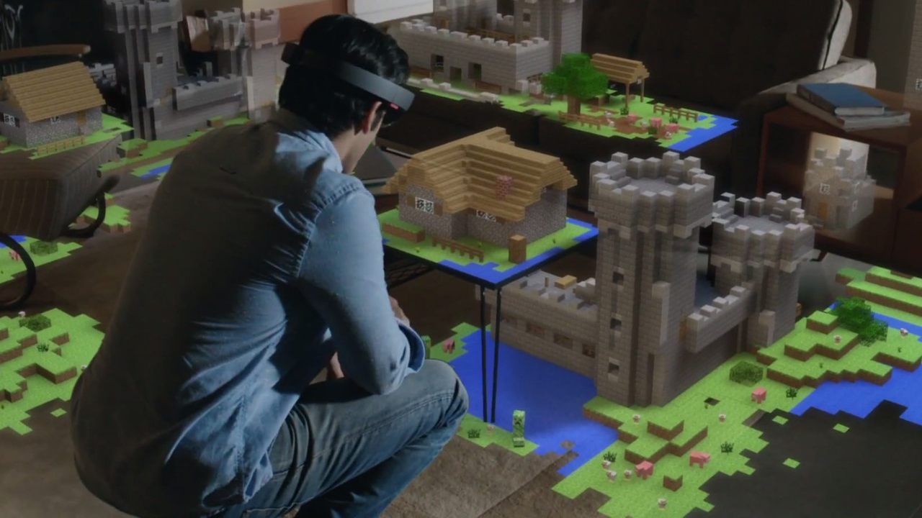
“If we could someday make holographic adventures as compelling as Lucy Davenport, would the power of such a vividly realized fantasy world destroy our grip on the actual world?” – Janet Murray

Slide 12
Narrative in Video Games
It is more simple to tell a complex & complicated story though as a gaming medium.
Gaming medium contains still images, moving images, audio, three-dimensional(3d) and navigable space.
Although the narrative in gaming maybe weak, it creates the sense of total simulation through the player’s decisions.

Slide 13
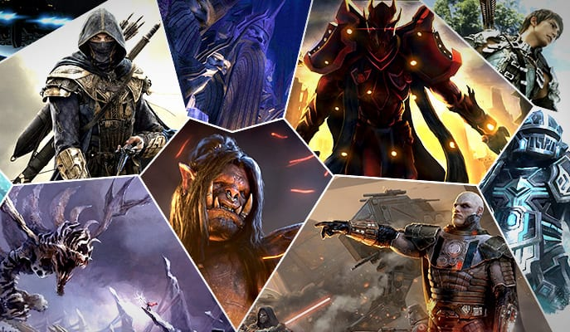
4 Popular Video Games Genres
First Person Shooter (FPS)
Massively Multiplayer Online Role-Playing Game (MMORPG)
Platformer
Real Time Strategy (RTS)

Slide 14
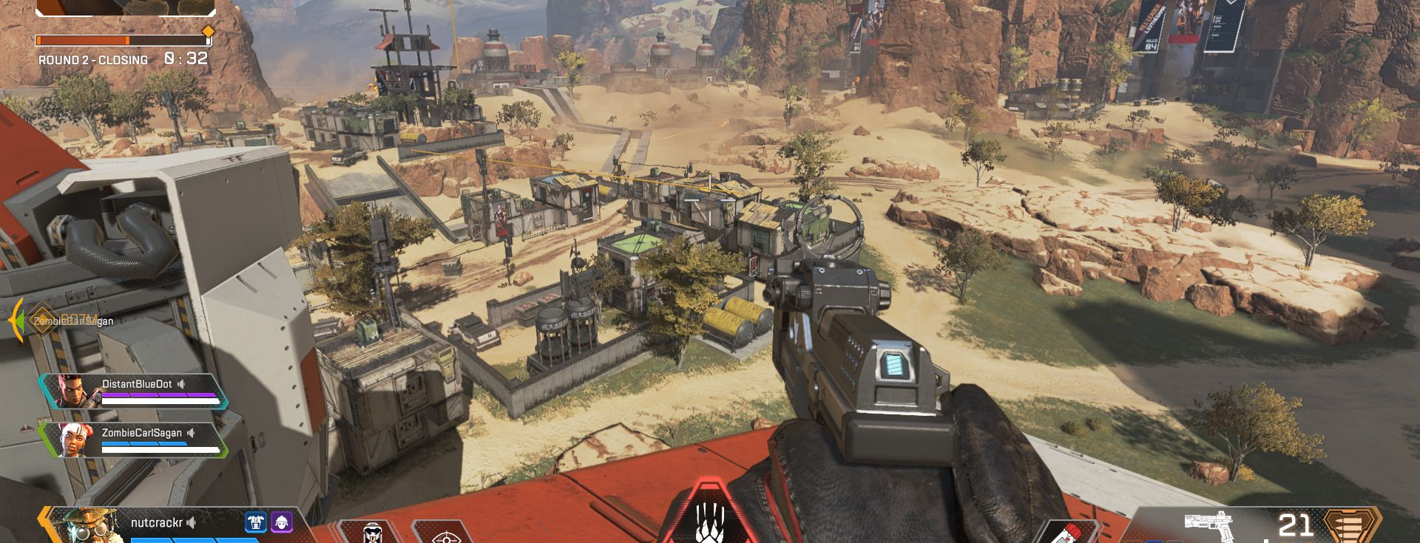
First Person Shooter (FPS)
Competition – You seek out to “kill” the opponents to become the winner of the game or match.
Comradery – You have a sense of togetherness and bound with your teammates like real life veterans.

Slide 15
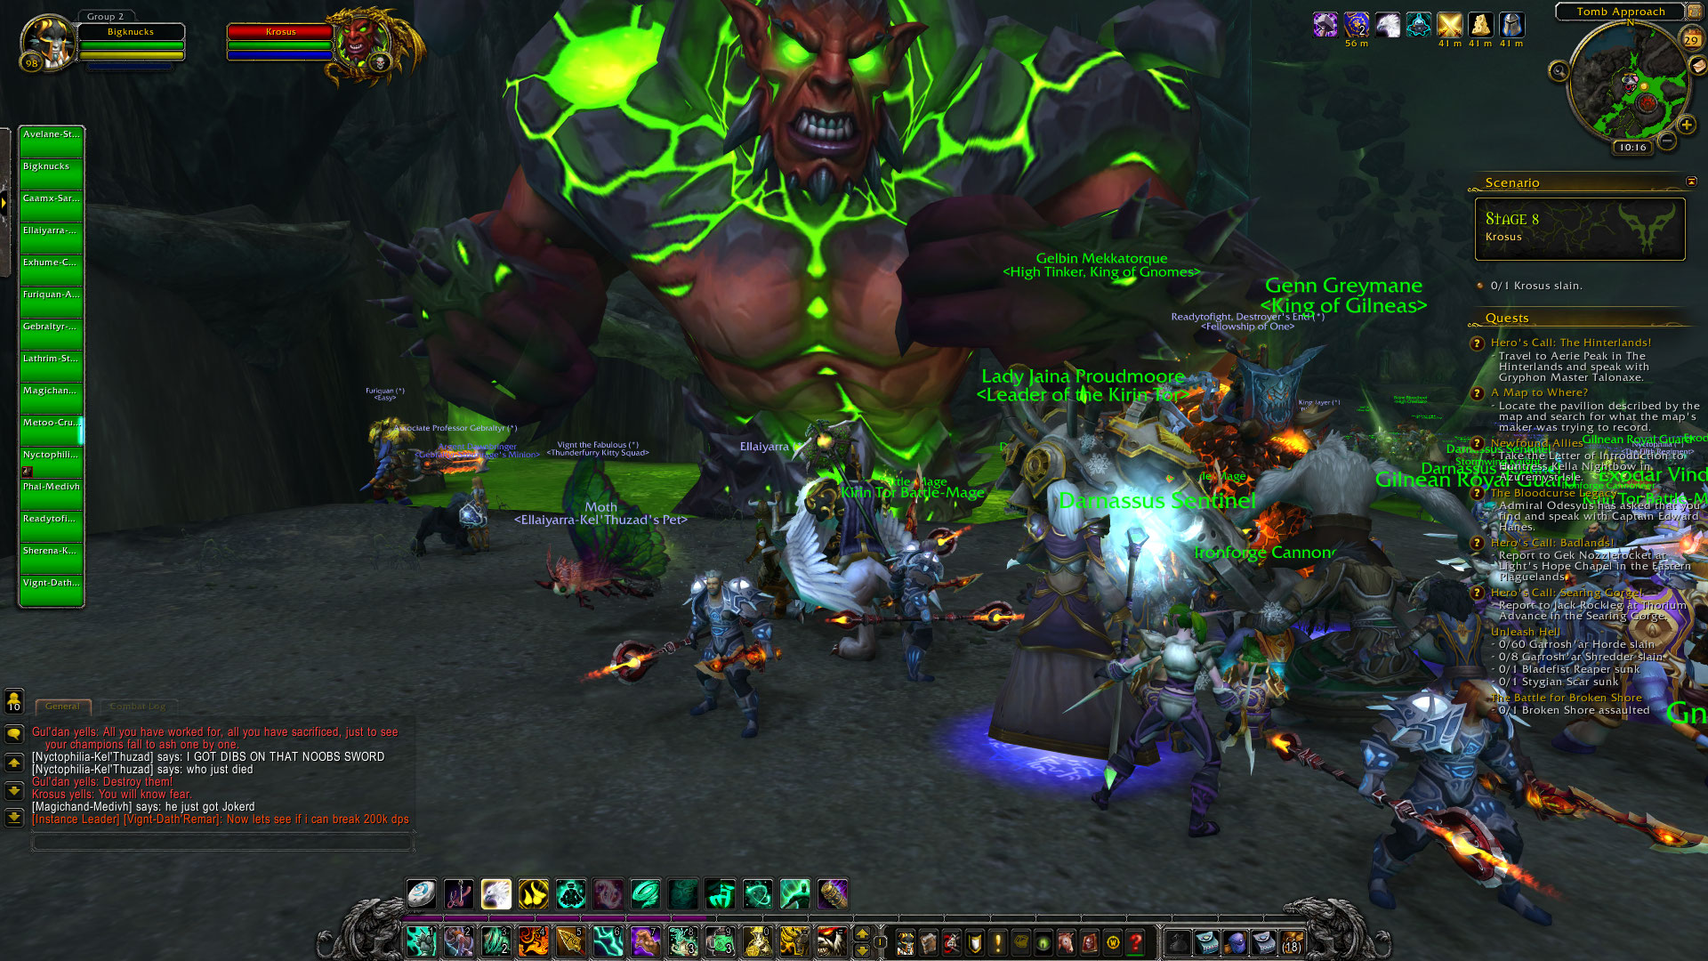
Massively Multiplayer Online Role-Playing Game
Communication Skills – You interactive with other players in game all across the world in real time.

Slide 16
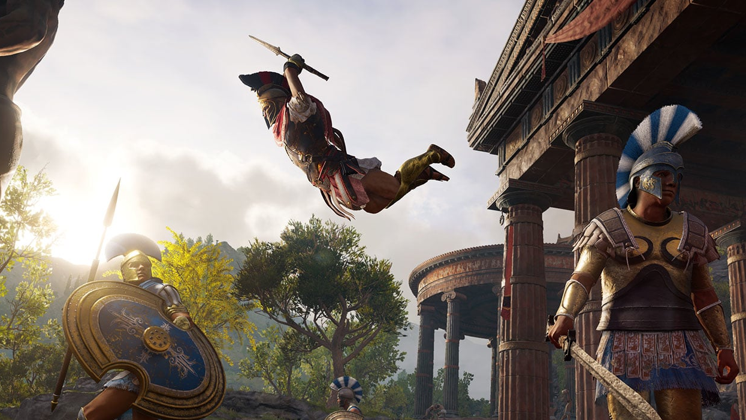
Platformer
Problem solving skills – Usually contains puzzles to advance through the story and completing puzzles has the sense of accomplishment.

Slide 17
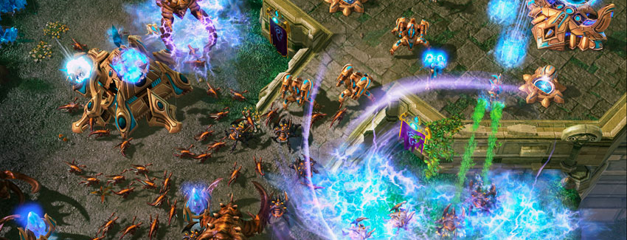
Real Time Strategy
Strategy analytics – You build and devise strategies in real time to be able to defeat your opponent.

Slide 18
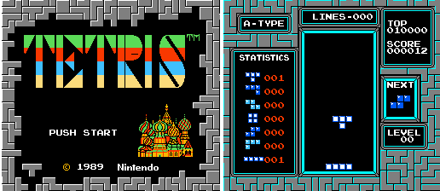
Conclusion
I think it’s a very important thing to have in video games which we rarely realize that all video games have narrative.
Even Janet Murray famously suggested that even Tetris had a narrative experience, which it was a “symbolic drama” that immersed its players in an abstracted version of the frantic busywork of postindustrial modernity.

