Slide 1
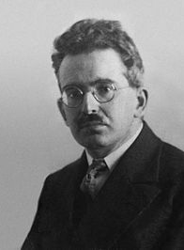
“All human knowledge takes the form of interpretation.”
Walter Benjamin
By Siyuan Yu

Slide 2
Walter Benjamin
Born 15 July 1892 Berlin
Died 26 September 1940
Era 20th-century philosophy

Slide 3
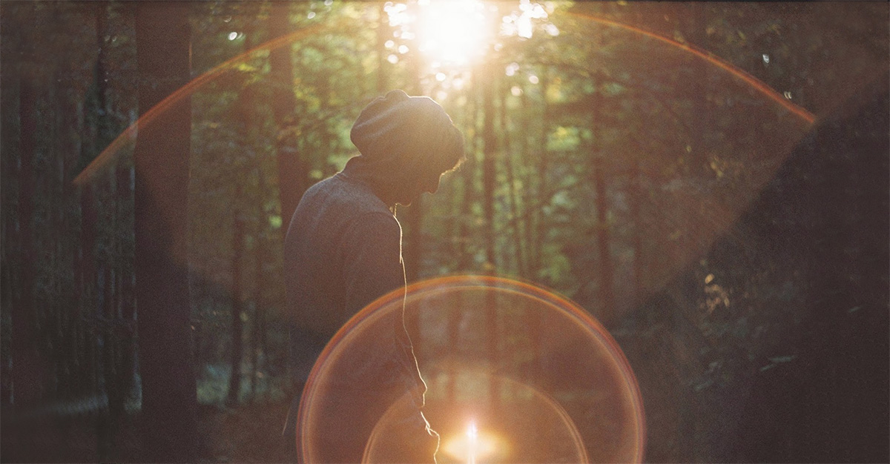
Aura
Aura is a quality integral to an artwork that cannot be communicated through mechanical reproduction techniques

Slide 4
Aura is an idea that only existed in the past. Aura is related to religion and mysticism.

Slide 5
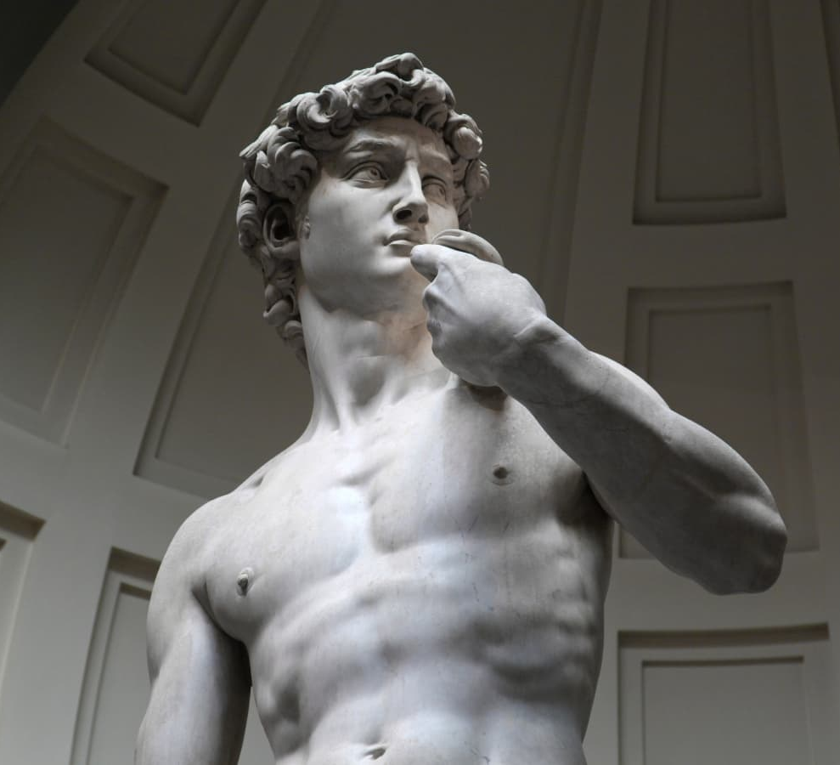
Auro is a wonderful halo symbol that appears in some works of art. For example, in some religious works, the aura is used as the background, giving the character worshipping value. Generally speaking, these works of art are symbols of gods or other things. The art of this age is unique.
Unique works of art are different from those that can now be mass-produced.

Slide 6
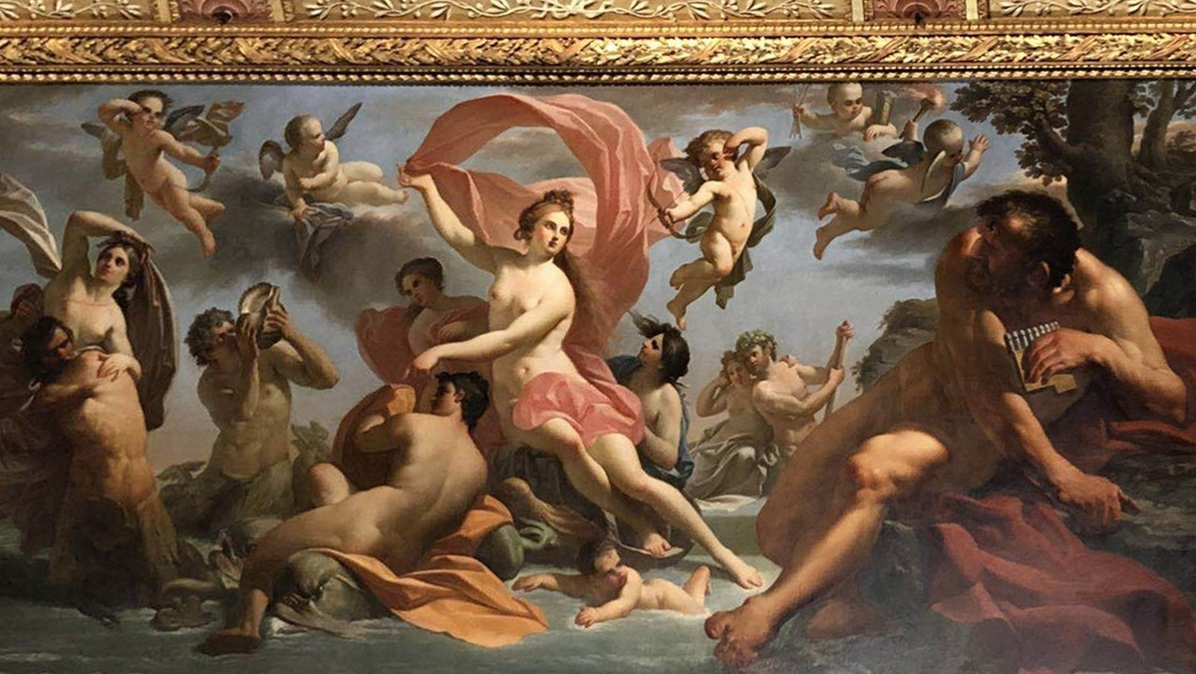
Only original works of art have an aura, and Benjamin distinguishes between these concepts and redefines what true art is.
Original works have a “aura" because they represent the unique creativity of the artist. And this kind of thing that comes from the artist, is unique.

Slide 7
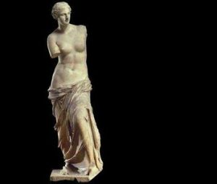
Classic Aura
The artwork made by the artist after getting inspiration has a unique artistic quality, which is the aura of artwork. Unique works of art possess ineffable qualities

Slide 8
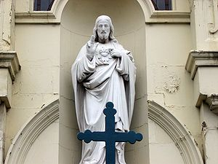
Cult value
In the original works of art in the past, the aura represents worship, power generation, authority. Like statues in ancient empires, like portraits in churches.
These works of art represent authority.
They have worshipping value.

Slide 9
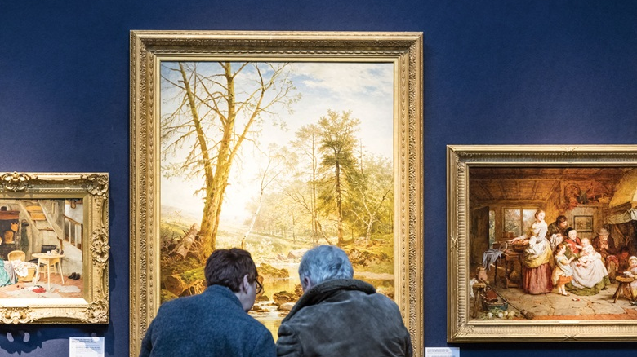
There is a big difference between modern artworks and ancient artworks. Most modern artworks can be copied in large quantities, because of technology. Compared with ancient artworks, modern artworks have no value “of worship”. That denotes the loss of the classic aura.

Slide 10
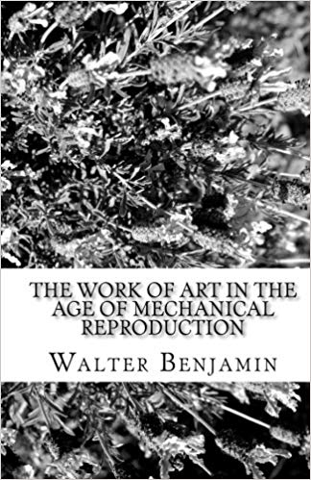
The Work of Art in the Age of Mechanical Reproduction
Artwork can be duplicated in great quantities now, the clever qi of artwork is in gradually abate.
Science and technology develop faster, the speed at which aura is lost, and the connection to tradition dilutes, works much faster.

Slide 11
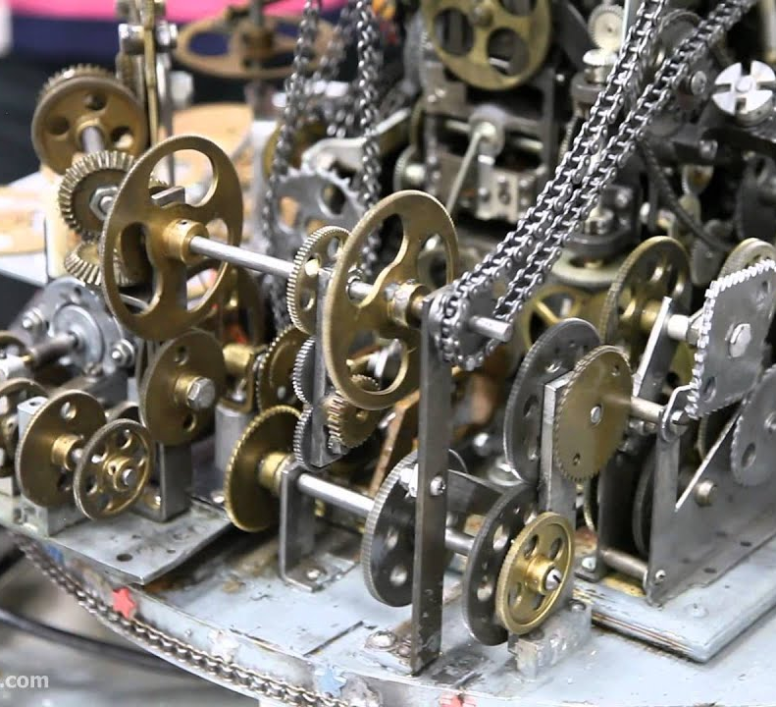
Our Times
With the development of modern technology, we can create art that is more closely related to human beings. The act of copying art also means that its value is changing.
From the perspective of appreciation, people turn from “worshipping the value of art” to “the expression of value and appreciation of art”. Therefore, a large number of works of art help to narrow the distance between people and art. That is the positive aspect of the Loss of Aura.

Slide 12
Modern people want to close the distance of "halo" and eliminate the uniqueness of art.
Compared with ancient works of art, I think it is good to bring more works of art to human life. Human beings can reproduce art.
The loss of the aura of art means that art, in its new forms can come into our lives.

Slide 13
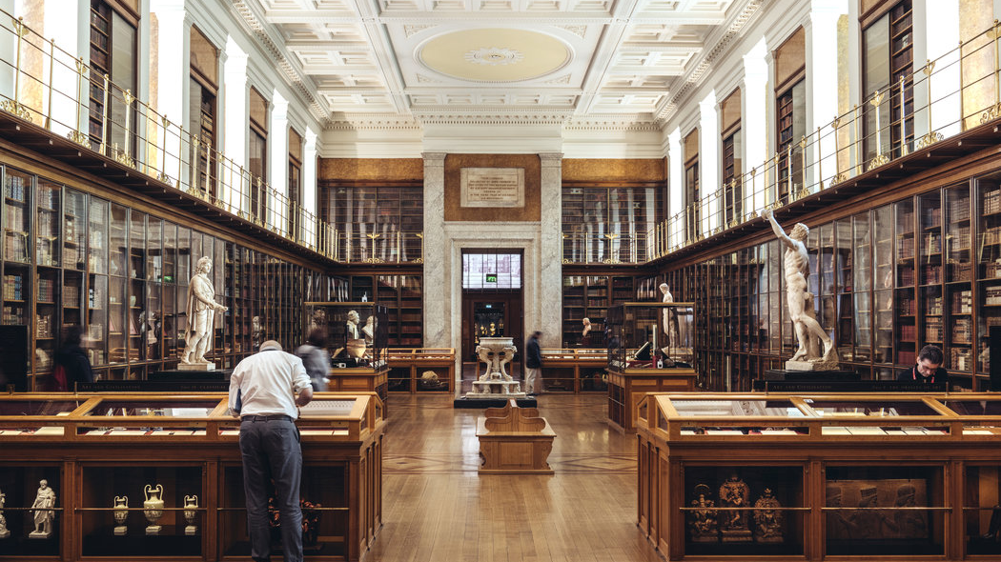
On the contrary, I think the development of technology is an indispensable help for the development of art. With the development of science and technology, the audience of artworks has spread to many classes.
Artworks that could only be owned by the rich and powerful before, can be appreciated by everyone now. Modern people no longer face artworks with worship attitude, but can appreciate them.

Slide 14
The End

