Slide 1
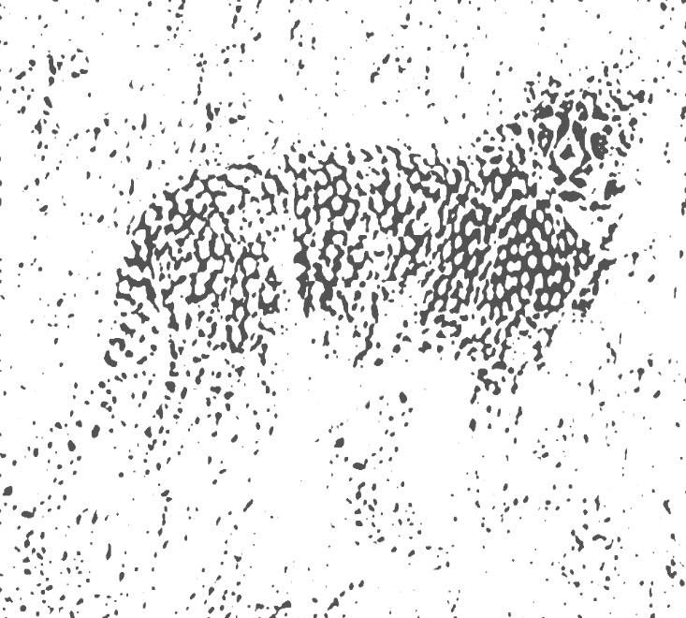
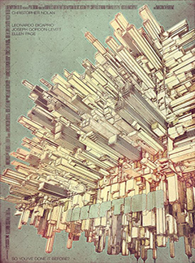
Gestalt Principles
EXAMPLES
MAT103
FALL 2018
MODULE 5 ASSIGNMENT
MERGEN GANBAATAR

Slide 2
P A R T
1

Slide 3
FIGURE
AND
BACKGROUND
You can see the proficient use of negative space in this image. The image is especially successful because it conveys its context about nature with the figure of tree, and displaying multiple animals in the background. The figure and background also makes good ambiguity.

Slide 4
FIGURE
AND
BACKGROUND
I like this music festival poster very much because the designer of this image realized very good pattern in the negative space between instruments. On top of that, this bow tie found a perfect place, making the figure easily recognizable and adding detail that tells the personality and profession of the man.

Slide 5
GROUPING
This image is composed of nothing but spots. It has no line or figure, but we’re able to group and tell that there is a leopard because of the concentrated spots that makes a little patterns.

Slide 6
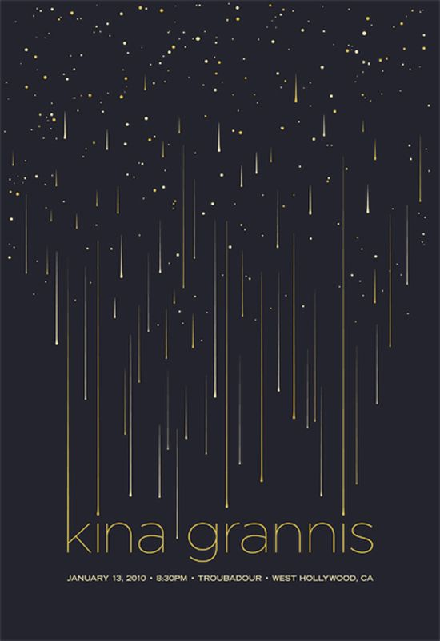
GROUPING
If this image didn’t use shooting starts going in same direction, it wouldn’t have been appealing as it is because we perceive objects going in same direction as a whole. I think if they were all going crazy to every directions, the viewer will not even recognize that they are stars.

Slide 7
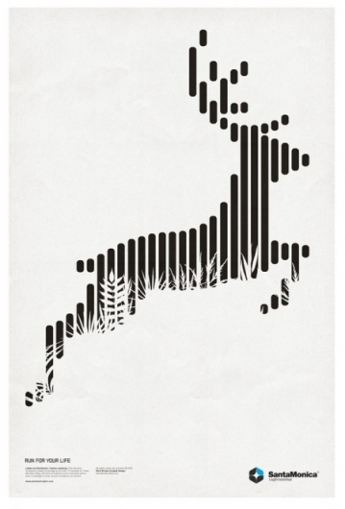
PROXIMITY
We see this image as a deer because we group these horizontal lines by Proximity.

Slide 8
PROXIMITY
The birds that surrounds this tree reserve the shape of the tree. From a distance, it looks like there’s only a tree because we see identical objects near to each other as an one whole.

Slide 9
SIMILARITY
Our eyes immediately see a complete hawk even though it has only one wing. This is because of wing-like shape the lightening figures make. This image not only uses Similarity, but also uses the principle of Proximity.

Slide 10
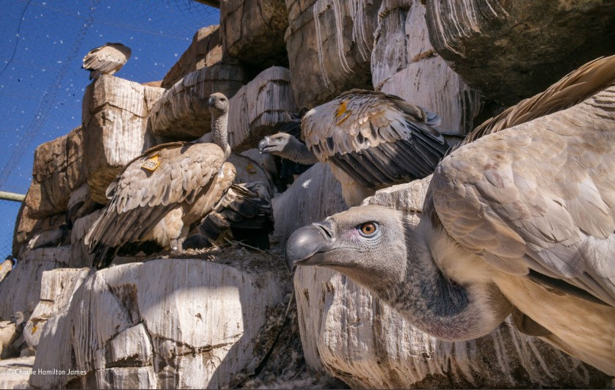
SIMILARITY
In this case, Similarity is used to make ambiguity. At the first glance, the viewers are most likely to see it as just giant rocks.

Slide 11
CONTINUITY
Because we read or write from left to right we have tendency to look anything likewise. I started reading the words just to realize that they are made of actual tools they indicated. The objects in this illustration is not so interesting, but what’s interesting to me is the huge potential use of Continuity in everything; in this case, typography.

Slide 12
CONTINUITY
I find this illustration very powerful. By utilizing Continuity, the designer made so creative way of describing the wave and flow directions of these drinks and food.

Slide 13
CLOSURE
I think this image is magical. Actually, our eyes and brains are even more magical. Even though we’ve never seen something like this in real life, we still can perceive these upper and lower bodies belong to same person. Perhaps, it’s employing multiple principles at the same time like Closure and Similarity.

Slide 14
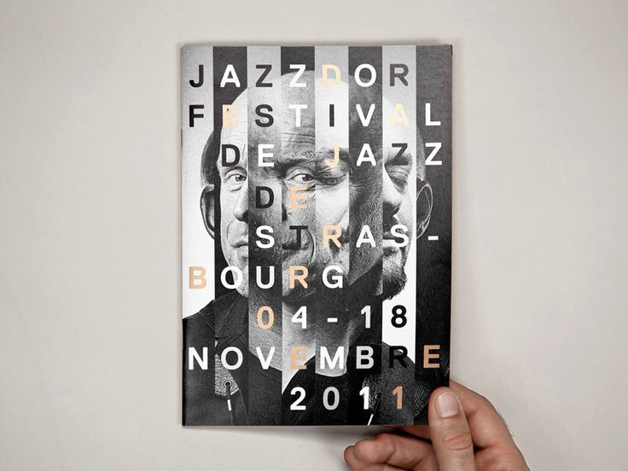
CLOSURE
We have no trouble distinguishing the parts of two faces. Not only that, someone who knows these people will easily recognize the faces and tell the names!

Slide 15
LEVELING
AND
SHARPENING
As you can see, this illustration is using Leveling by using saturated color right in the middle and that beautifully highlights the model’s face.

Slide 16
LEVELING
AND
SHARPENING
This image uses Sharpening because the focus goes towards light source, which is fire from a lighter, in the right bottom corner.
P.S. This is drawn and edited by me.

Slide 17
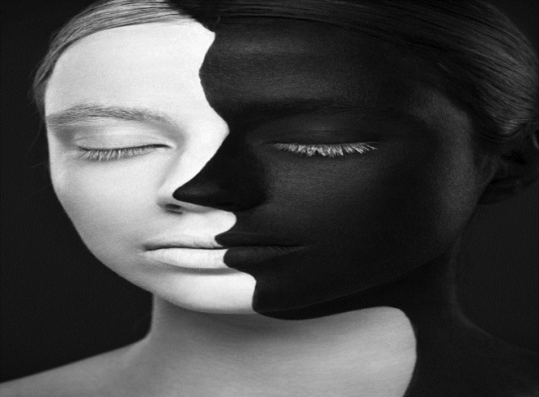
SURROUNDING
While we will tend to see the face as a whole, same black colour used in the face and the background will prevent us doing so. This will result in a very good ambiguity because of the principle of Surrounding.

Slide 18
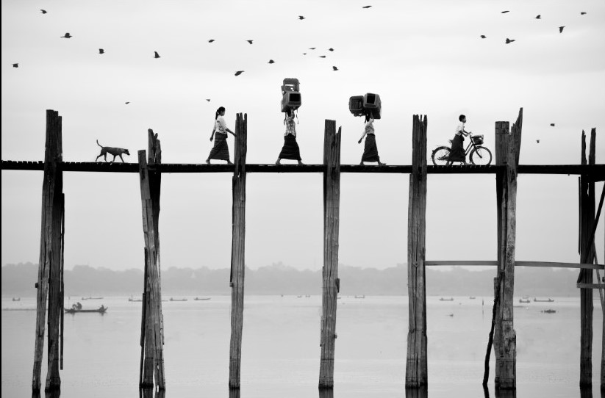
SURROUNDING
In this photograph, while we know that we focus on the bridge and dog and humans on it because they are in front, our focus is further enhanced on them by the principle of surrounding. Unsaturated colour in the background, symmetry, and principle of smallness are all well used to make this photograph masterpiece.

Slide 19
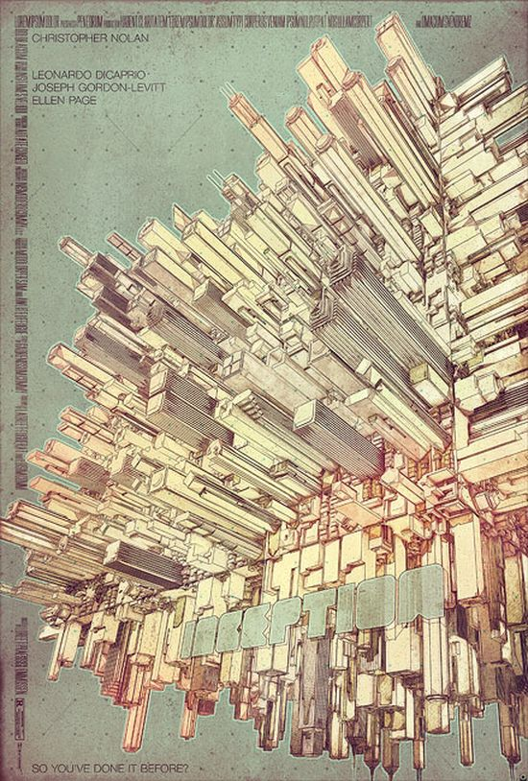
THIRD
DIMENSION
When it comes to architectural illustrations, there is no better way other than adding third dimension. We can see the designer is proficient in perspective.

Slide 20
THIRD
DIMENSION
The use of curved lines gives us feeling that the surface is rough and has volume.

Slide 21
P A R T
2

Slide 22
IMAGE OF
GREAT IMPACT #1
In my observation, this image uses three Gestalt principles: Closure, Continuity, and Sharpening.
Even though the original portrait is torn in the middle, we’re still able to tell not only it is a girl, but also she is beautiful and many other. We can imagine her left eye, nose, and lips fully with very little slices of information of them.
The pattern that appears from the back is not random. From a particular distance, it almost looks like the lips are kept from the tearing off.
At my first look, it was annoying to see that the main part of image being gone. Then I realized that there is the principle of Sharpening, and that actually made this image special. Looking generally, the pattern speaks a story. I think this image is to depict inner and outer beauty of her, or people generally, both in one photograph.

Slide 23
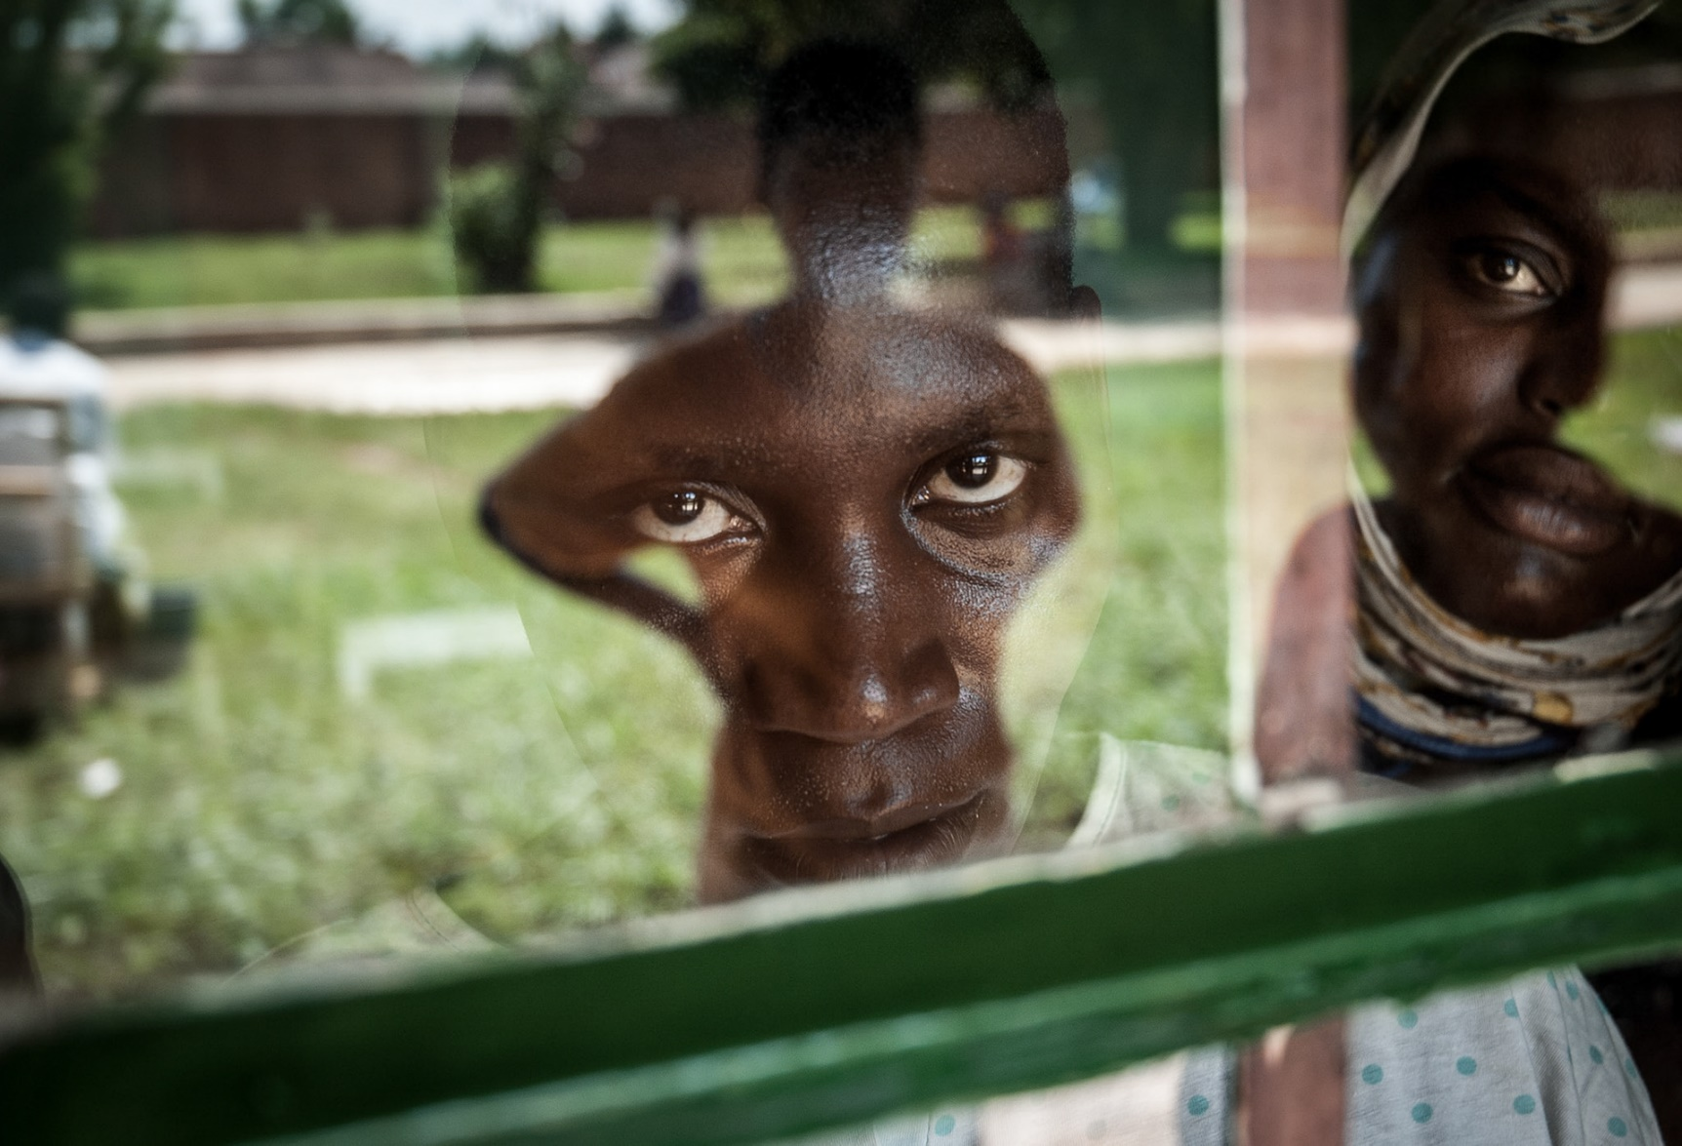
IMAGE OF
GREAT IMPACT #2
The reflection of the environment and the figure of the photographer is what makes this photograph absolutely eye-catching. Behind this effect, there are two main Gestalt principles: Leveling and Figure & Background.
Naturally, the look of this guy tells all the story in this photograph. However, the main component of this photo is Leveling. Thanks to the window that reflects the outside environment that has very dim color, it concentrates all the focus on this look while eliminating all the distractions.
The human figure in this photo also plays a big role that can’t be overlooked because it fits too well to the facial shapes, effectively highlighting the expression!

Slide 24
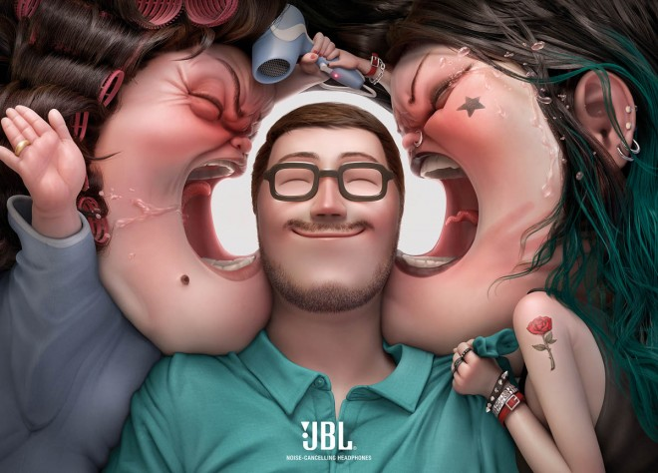
IMAGE OF
GREAT IMPACT #3
This is a creative advertisement of noise-cancelling headphone. This digital art uses Figure & Background, Leveling, Similarity, and Continuity.
The usage of negative space in this photo is easily detected. Since the headphone is being advertised, the company effectively highlighted it by placing it in the center using Leveling and there is no other negative space.
The background couldn’t be better. Every single detail is used to convey the message. If you see closer, there is a hand print on the cheek of the sister, similar in the shape of the mother’s hand. Continuity used in the sister’s hair tells that it is wet, and they are fighting over hair dryer. This is by far the greatest ad I’ve ever seen.

Slide 25
T H A N K S
F O R
W A T C H I N G

