Slide 1
Gestalt Principles
Andy Pham

Slide 2
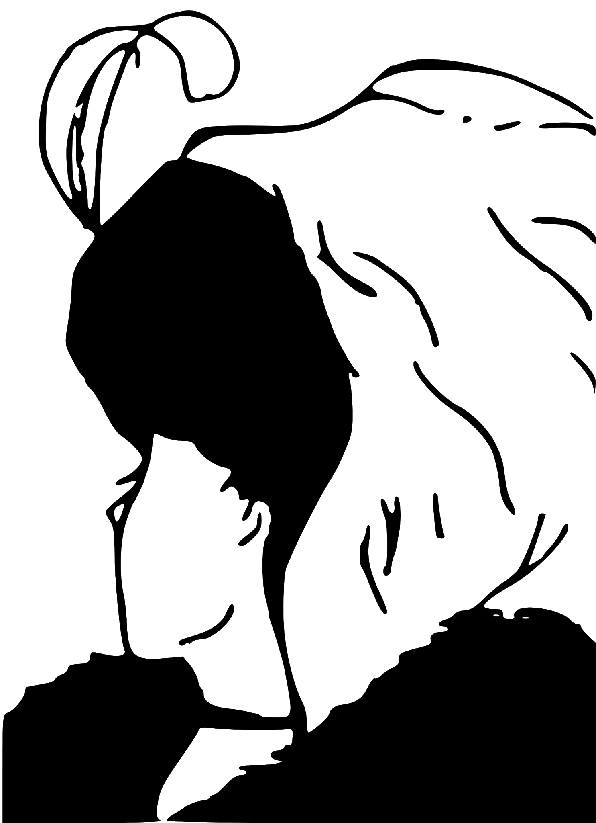
Figure and Background 1
Figure and Background is used to isolate a point of attention surrounded by a background based on the usage of color and negative space.
From here, figure and background is utilized to create two different types of women. A person viewing this image will either interpret the entity as a young woman or an old woman.

Slide 3
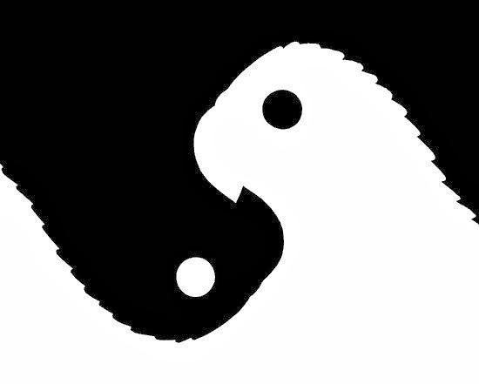
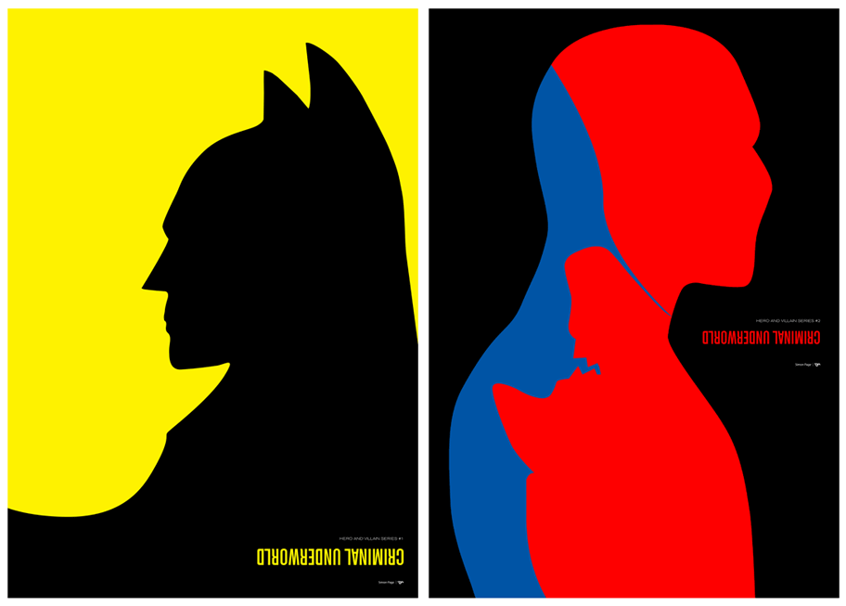
Figure and Background 2
The Negative Space can be used to perceive two different entities. People here would either perceive a white bird, a black bird or the ying-yang symbol.

Slide 4
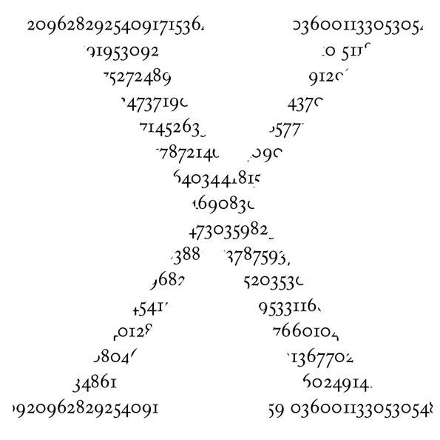
Grouping 1
The human eye typically perceives a series of similar objects/repeated elements in an image and involuntarily put them in groups.
The brain tends to interpret the bigger figure than the smaller entities that form the object.
The multiple digits are arranged in a way to create a bigger figure that our brain interprets as an “X”.

Slide 5
Grouping 2
The white dots in the image are see as groups rather than individual entities just like the digits making up the X in the previous slide.
There are two different principles that work on the concept of grouping as well.

Slide 6
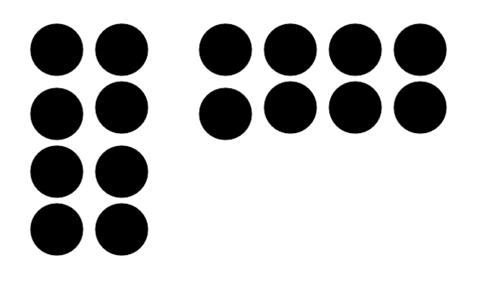
Proximity 1
A type of grouping, objects grouped together by a similar distance tend to be perceived to have a connection to one another.
The series of dots are perceived as two different groups of dots by their distance from one another.

Slide 7
Proximity 2
This is another example of proximity as the dots are arranged in specific distances to group together differently and create a interpretation of a human eye.

Slide 8
Similarity
Objects in an image that are similar to one another are considered associated with one another and grouped together.
The three heads in the image is grouped by their shape, and we tend to associate them by this similarity.

Slide 9
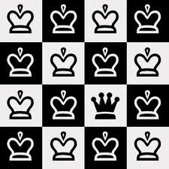
Similarity 2
In a series of similar objects, an object that is different from the rest tends to make the viewer’s eye draw focus towards that point.
Our perceptions of the chess pattern of crowns tends to focus on the different crown.

Slide 10
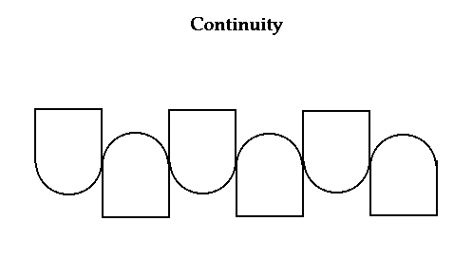
Continuity 1
Our brain tends to perceive a sequence of images going in a direction by following along the path created by the image.
Here is a pattern of shapes arranged in a way that our eyes follow along the wavy path created by the arrangement.

Slide 11
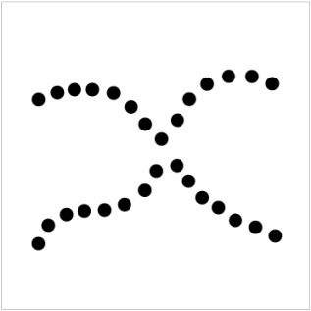
Continuity 2
If there are two paths that intersect, the brain prefers to follow along the path that has a smoother transition than an abrupt change of direction.
Here is an image of two intersecting lines formed by the dots. Our mind prefers to follow along the dots that maintain a smooth line, creating two lines rather than shapes.

Slide 12
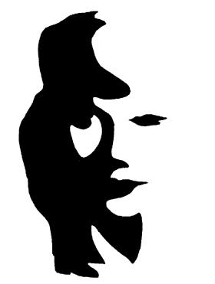
Closure 1
If an object is left incomplete in a certain way, the human brain tends to complete the rest of the image that is being interpreted.
The image shown isn’t completed, but the shapes created by the figure allow the brain to “complete” the image of a woman.

Slide 13
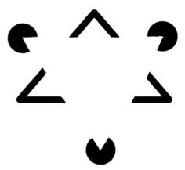
Closure 2
Our brain tends to focus on forming an interpretation of the empty space based on the other images giving a hint of shape.
Here is an image of points and pacman shapes, which the brain interprets a triangle within the empty space.

Slide 14
Leveling
Leveling forces a symmetrical placement of the objects of focus to avoid tension on the page so that everything is on an even plane.
This square is completely centered and symmetrical in the image, making the image even and non chaotic

Slide 15
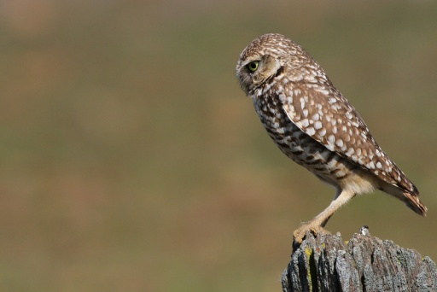
Sharpening
When the scene the image takes place in is off-center and/or asymmetrical, it creates tension that makes the object/entity more important than the rest of the image.
The off-center owl within the image draws the attention of the viewer away from the center of the image from the asymmetry.

Slide 16
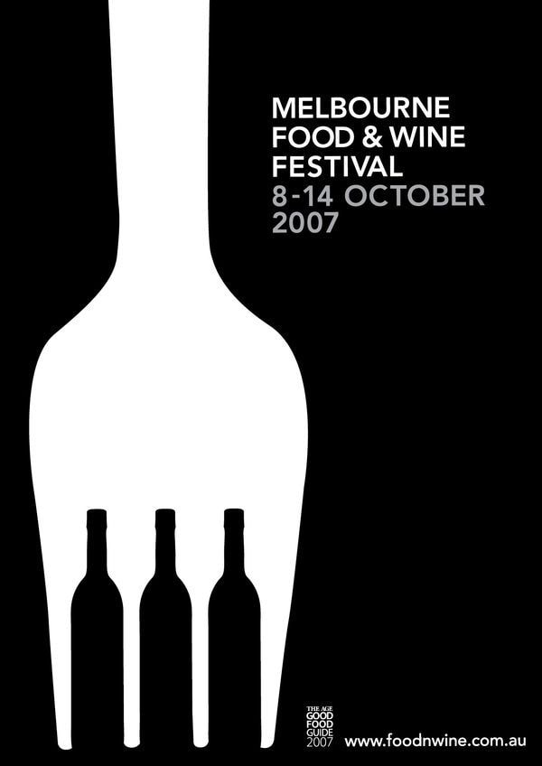
Surroundings 1
Surroundedness affects the way we perceive figures. Areas that are seen as surrounded by others are perceived as a figure.
The fork in the image is perceived by the eye from the black surroundings.

Slide 17
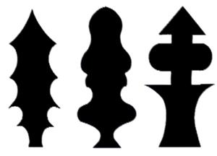
Surroundings 2
Symmetrical objects tend to be perceived as figures against asymmetrical backgrounds, making the asymmetrical background harder to perceive.
We are most likely to perceive the black figures in the image before perceiving the white background.

Slide 18
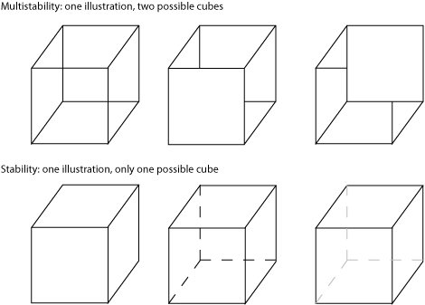
Third Dimension 1
In a 2D image, people arrange objects to form an optical illusion, allowing the brain to perceive depth when there is none.
The image contains a series of squares and rhombus arranged in different ways to create different perspectives of a cube; creating the false perception of a 3D space.

Slide 19
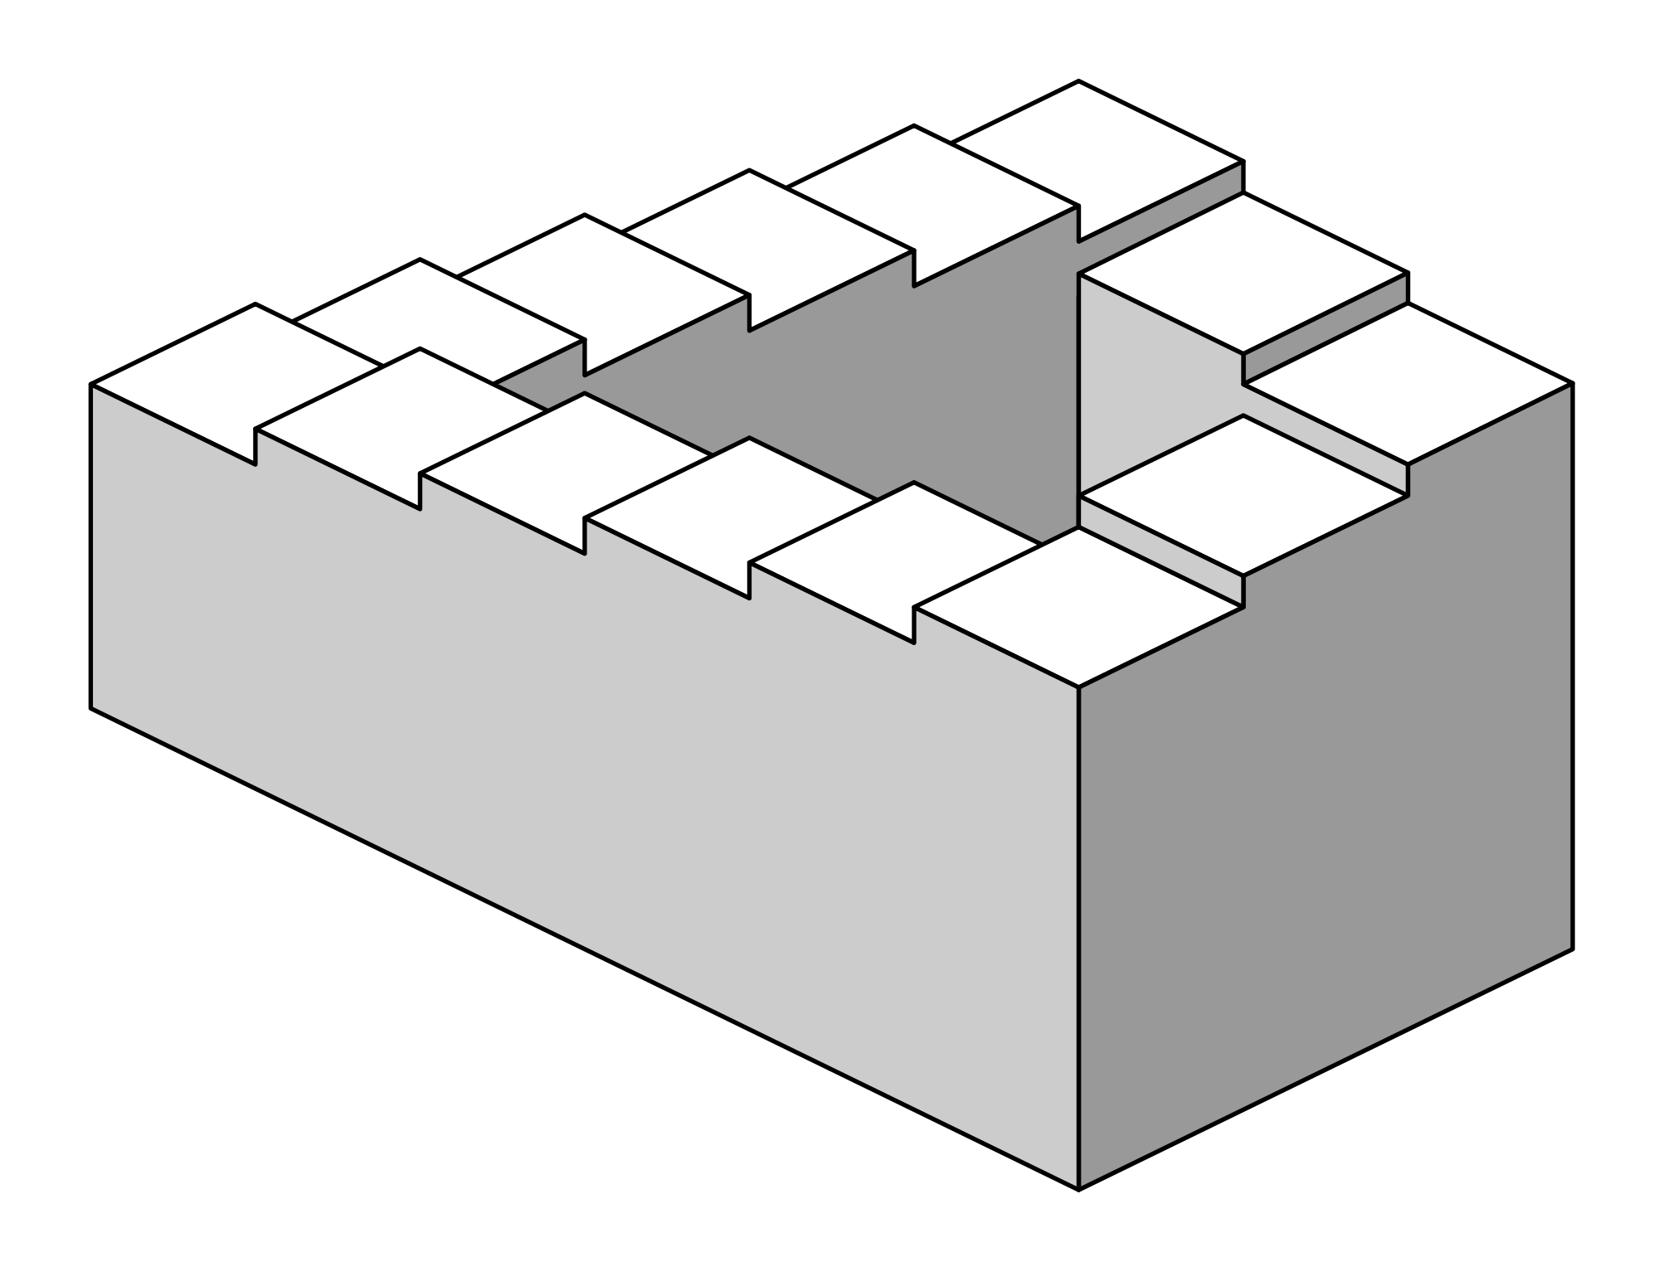
Third Dimension 2
The usage of third-dimension tricks can also fool a viewer trying to perceive the object as 3D.
This is an impossible image known as Penrose stairs, it causes confusion to viewers trying to interpret it as a 3D entity as it cannot be constructed in three dimensions.

Slide 20
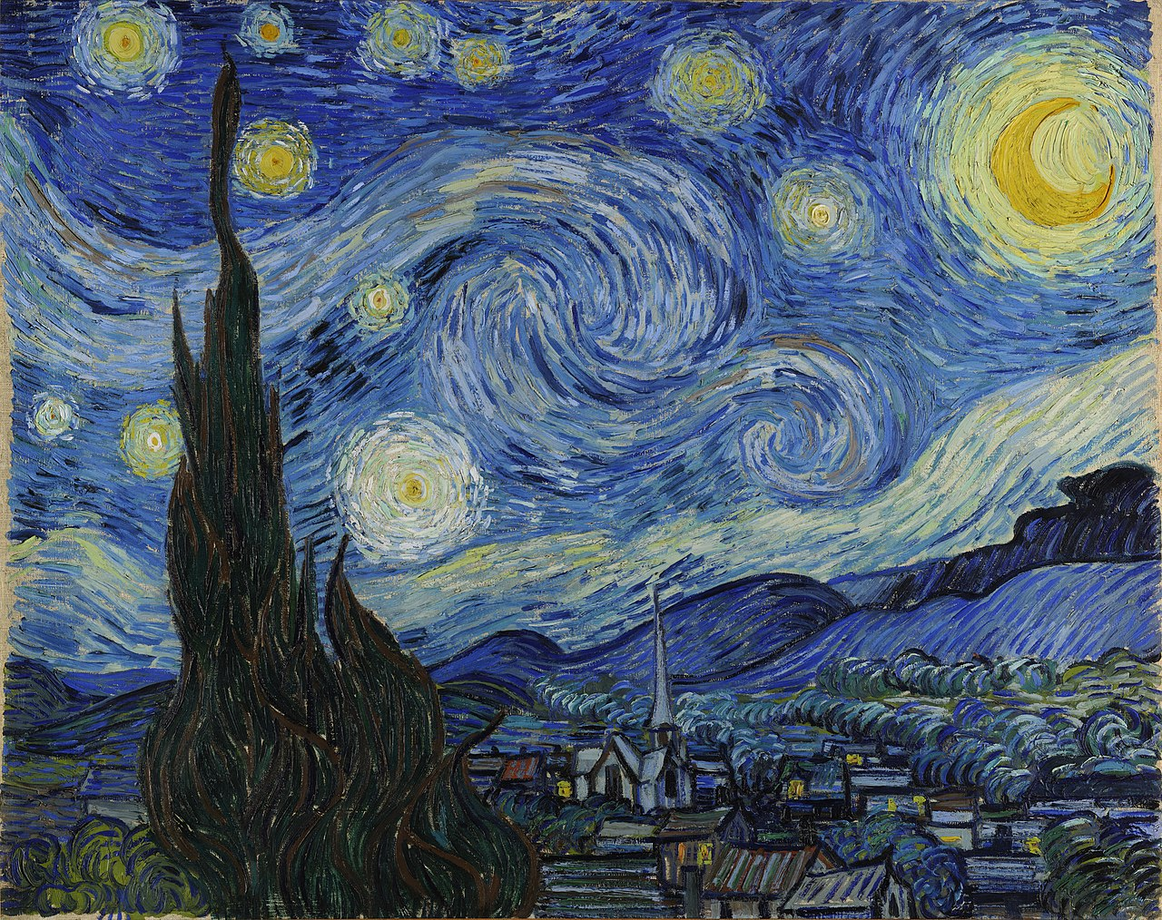
Vincent Van Gogh
Here is the painting “Starry Night”
This image makes use of Grouping and Similarity as similarly colored lines group together to form objects in the sky like the stars or the terrain.
There is Continuity in the image as our eyed follow along the strokes of the winds through the sky. The principle is also found within the strokes of the mountains and the tall plant-thing.
Third Dimension is created through the lighting in the background transitioning to darker colors as it gets further away.
The image has a sense of Sharpness due to how the elements are scattered chaotically.

Slide 21
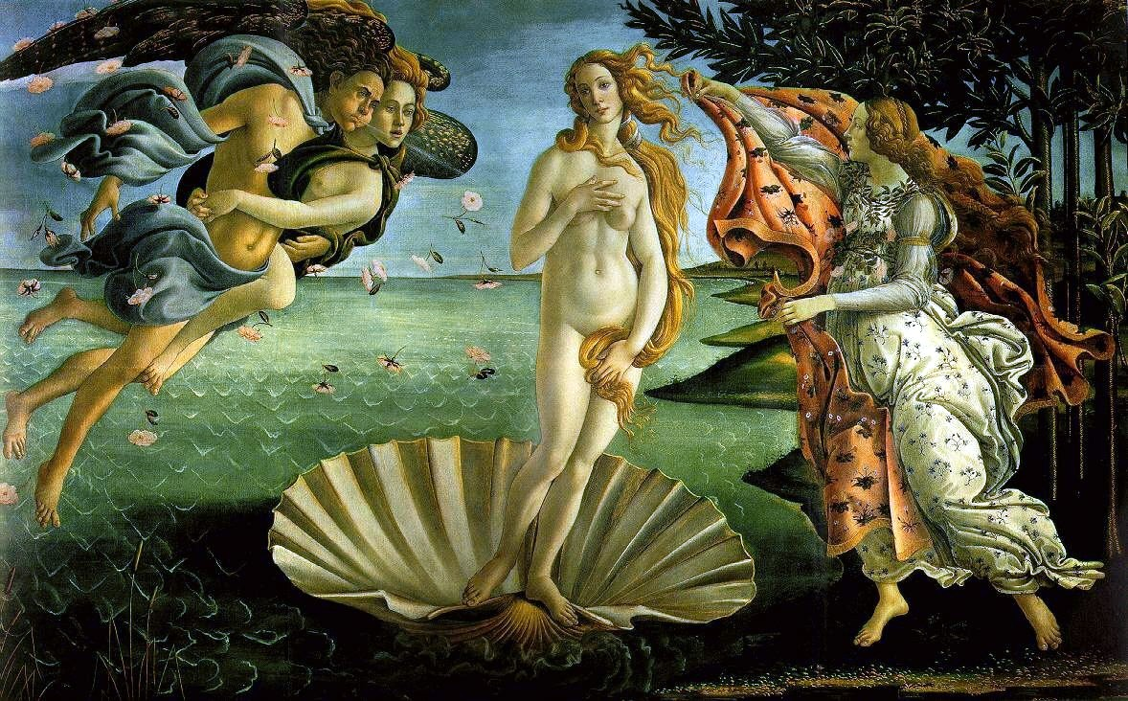
Sandro Botticelli
This image makes use of Grouping by Proximity with the two flying deities being associated with each other. Grouping by Similarity is also present with the falling flowers, patterns in the water and clothing design.
The image creates tension with the asymmetrical balance of people on each side that creates a usage of Sharpening.
We see Third Dimension as the water starts getting brighter as it goes further into the horizon.

Slide 22
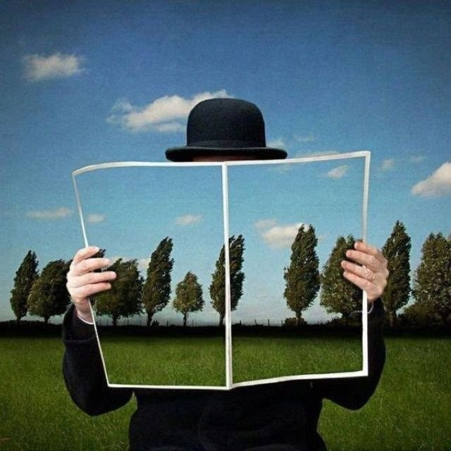
Rene Magritte
We interpret closure in the painting by completing the rest of the background or forming the rest of the man in our brain.
The usage of proximity of the trees in both the background and within the closure lead the brain to group them together as a Continuity. There is a gap in the pattern of trees that separates the continuities into two groups and becomes the focal point, creating a small usage of Sharpening in a mostly Level scene, mostly everything is on the same plane and almost symmetrical.
Third Dimension is created through the shading of the ground in the background and within the closure along with the size of the trees compared to the camouflaged man.

