Slide 1
RENNAISANCE PERSPECTIVE
Basic ideas on Western
Spatial
Representation

Slide 2
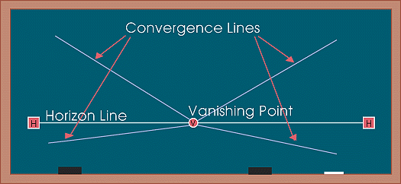
The perspective system Representing real space in a 2D surface
One point perspective
Central Perspective
One point perspective, Central or Linear perspective.
The horizon line in perspective drawing is a horizontal line across the picture. It is always at eye level - its placement determines where we seem to be looking from - a high place, or from close to the ground. The actual horizon might not be visible, but you need to draw a 'virtual' horizon to construct a picture in perspective. Objects are perceived smaller as they get close to that line.
Notes:
One point perspective or Linear perspective
The horizon line in perspective drawing is a horizontal line across the picture. It is always at eye level - its placement determines where we seem to be looking from - a high place, or from close to the ground. The actual horizon might not be visible, but you need to draw a 'virtual' horizon to construct a picture in perspective.
Convergence lines, vanishing lines, orthogonals
In Linear Perspective drawing, the diagonal lines that can be drawn along receding parallel lines (or rows of objects) to the vanishing point. drawing, the diagonal lines that can be drawn along receding parallel lines (or rows of objects) to the vanishing point.

Slide 3
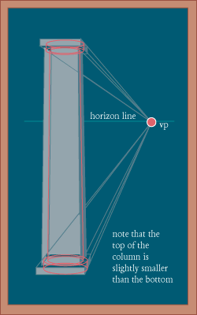
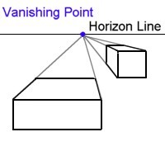
Perspective The Vanishing point
VP vanishing point
It is placed on the horizon line
All the vanishing lines converge to that point.
In Linear Perspective drawing,
The lines that go from the viewer to the infinite
(the ones that would represent 3D space
besides width and height) are drawn along receding along
towards the vanishing point.
Notes:
Vanishing lines

Slide 4
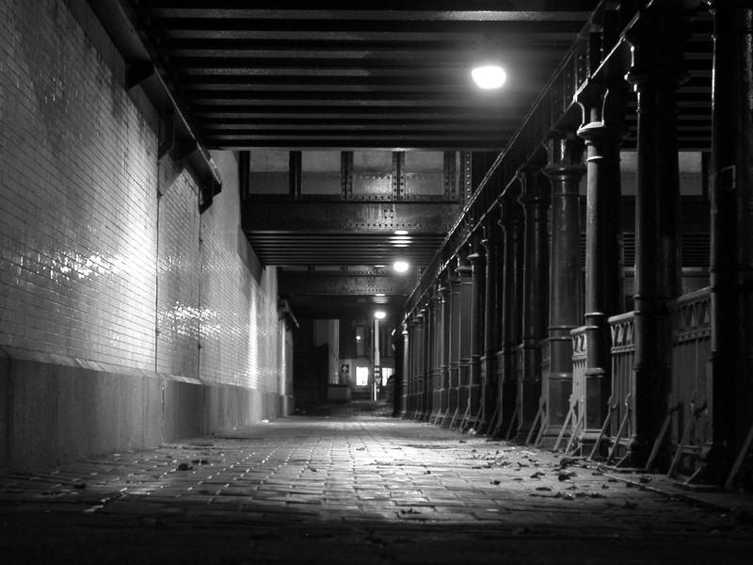
Perspective Vanishing point
VP vanishing point
On the horizon line
Where all the vanishing lines converge.
Vanishing lines. Frame of film “Lequai” from director Jean Cocteau.
Notes:
Vanishing lines
Frame of film “Lequai” from director Jean Cocteau.

Slide 5
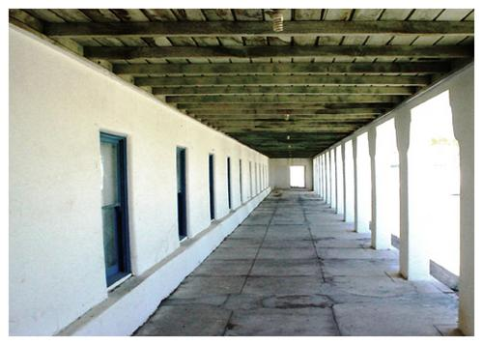
Perspective The Vanishing point in 1 point perspective
Because the perspective system is based on optics and lenses (how we humans see), Photographic images match Perspective, since they capture reality from the point of view of a lens.

Slide 6
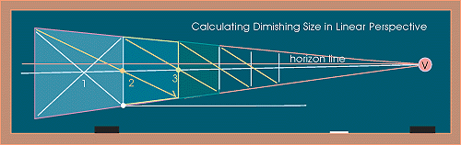
Perspective Linear Perspective
Foreshortening
The distortion that perspective causes over objects
seen from a particular viewpoint.
It is more obvious as we get closer to the horizon.
Notes:
Definition: Foreshortening

Slide 7
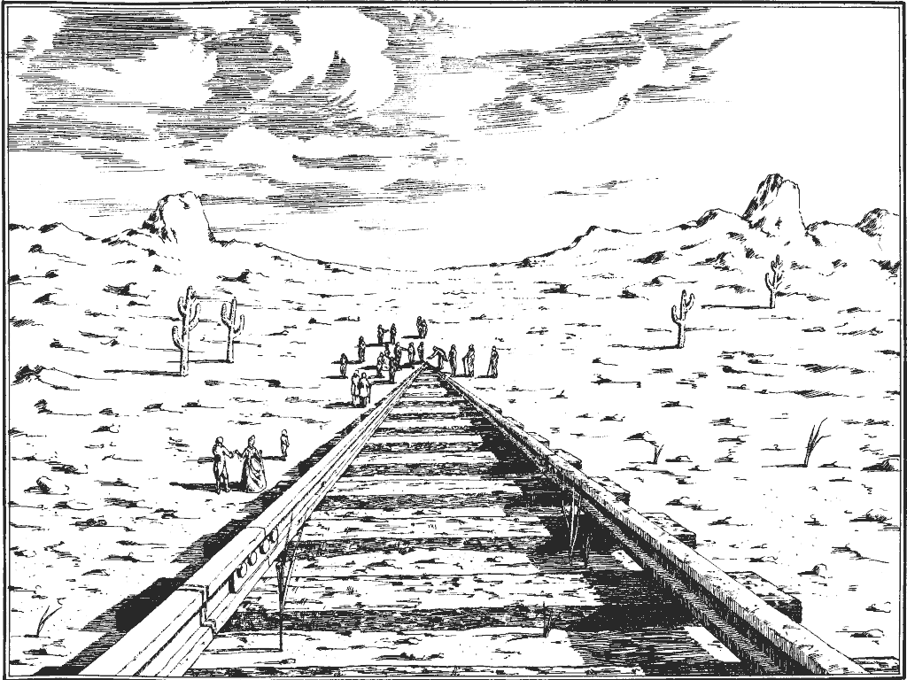
Perspective Vanishing point

Slide 8
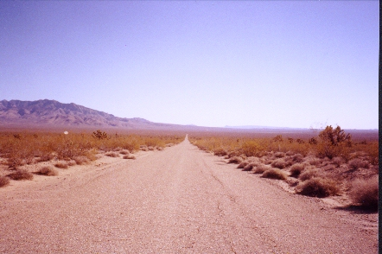
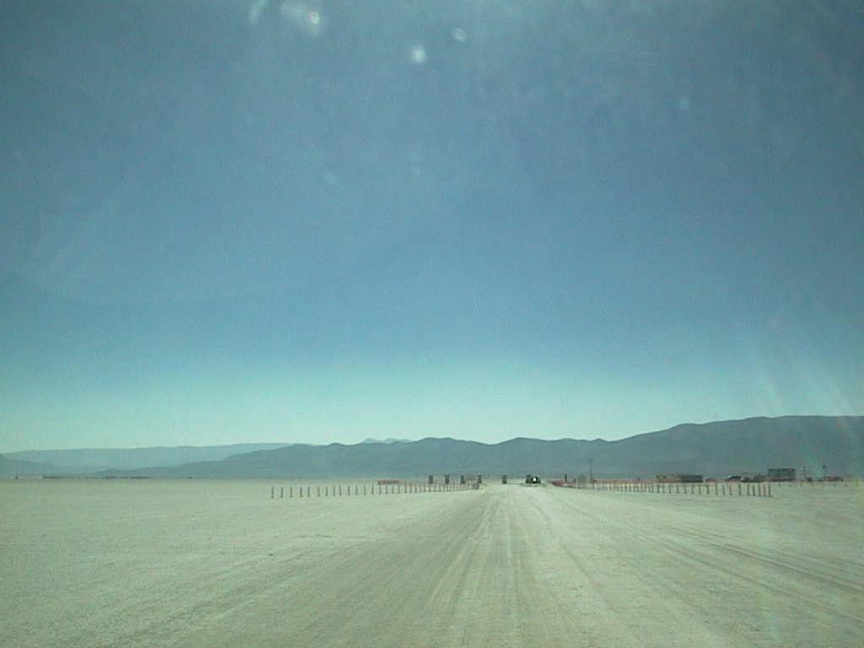
Perspective Vanishing point
The horizon line defines our position as a viewer,
It is placed at eye level
Notes:
Eye lens or through camera lens

Slide 9
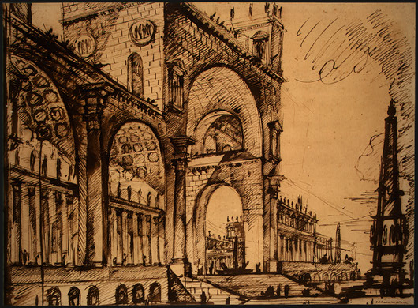
Perspective Vanishing point
Non
Congruent
Perspective
rendering

Slide 10
Perspective Vanishing point
Non
Congruent
Perspective
rendering

Slide 11
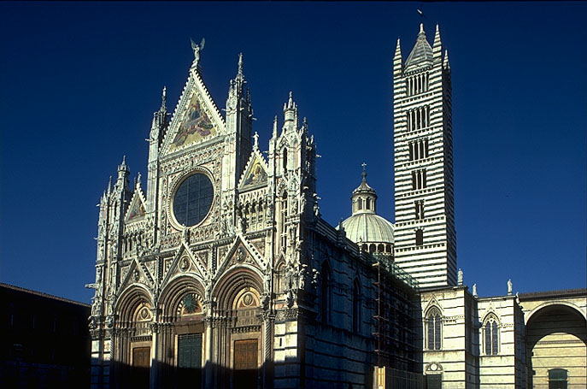
Perspective is founded on Optics, the curved lens in our eyes, or the lens in the camera
Interprets objects in a distorted but organized way.

Slide 12
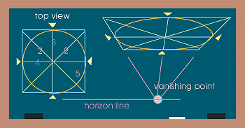
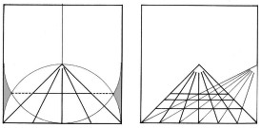
Perspective Drawing circles according to Central Perspective

Slide 13
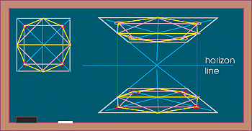
Perspective Drawing geometrical shapes according to Central Perspective

Slide 14
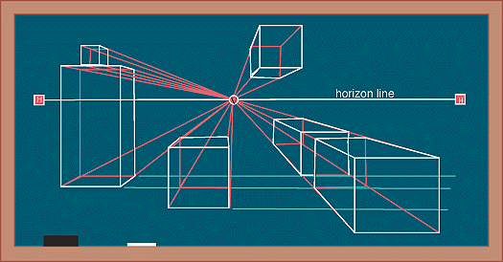
Perspective Parallel objects in a space seen with a one point perspective. (typical urban landscape seen through Central Perspective)

Slide 15
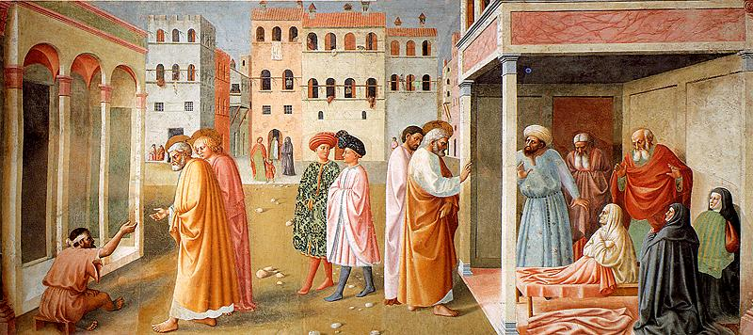
Perspective Parallel objects in a space seen with a one point perspective. (typical urban landscape)
Masaccio, and Masolino . Brancacci Chapel of Santa Maria della Carmine in Florence, 1426-28
Notes:
Masaccio, Brancacci Chapel of Santa Maria della Carmine in Florence,
1426-28

Slide 16
Perspective Parallel objects in a space seen with a one point perspective. (typical urban landscape)
Masaccio, and Masolino . Brancacci Chapel of Santa Maria della Carmine in Florence, 1426-28
Notes:
Masaccio, Brancacci Chapel of Santa Maria della Carmine in Florence,
1426-28

Slide 17
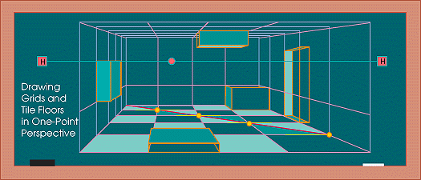
Perspective Parallel objects seen from a central point of view inside a cube. (typical interior situation)

Slide 18
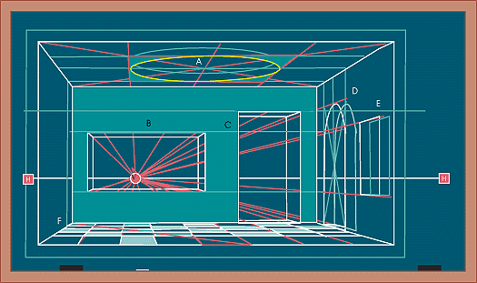
Perspective Parallel objects seen from a central point of view inside a cube. (frontal view)

Slide 19
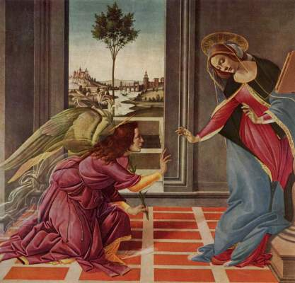
Perspective Parallel objects seen from a central point of view inside a cube. (typical interior situation,)
Early Rennaisance
Sandro Boticelli
(1445-1510)
“The Cestello Annunciation”
56 x 150 cm
(61,3 x 59,0 inches

Slide 20
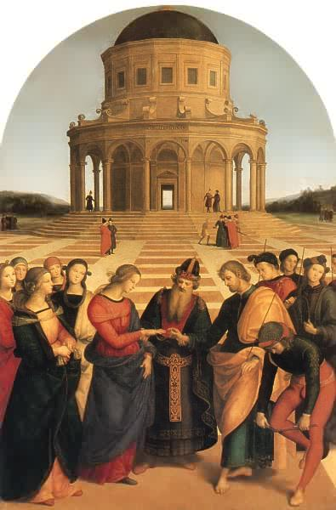
The marriage of the virgin,
1504.
“Lo sposalizio della vergine”
Pinacoteca Brera, Milano.
Raffaello

Slide 21
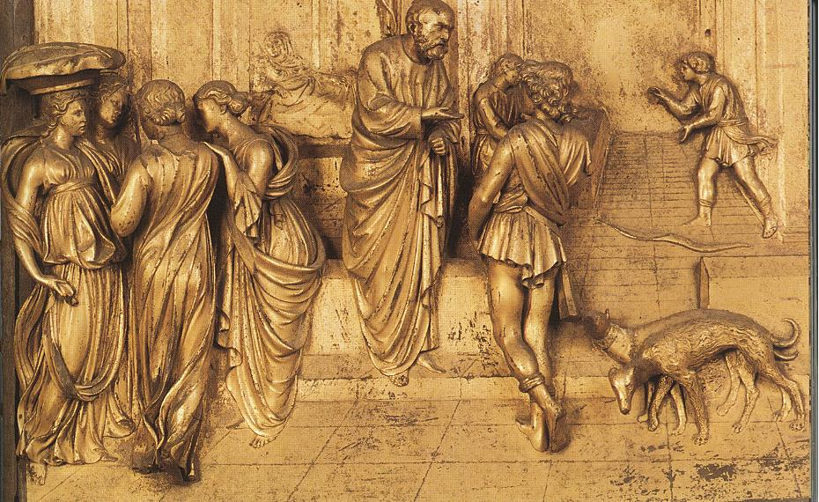
Perspective Central point of view inside a cube.
Lorenzo Ghilberti, Architect
1378-1455
Porta Baptisterio Fiorenze. Bass Relief
Notes:
Lorenzo Ghilberti, Architect
1378-1455
Porta Baptisterio Fiorenze

Slide 22
Perspective Central point of view inside a cube.
Notes:
Lorenzo Ghilberti, Architect
1378-1455
Porta Baptisterio Fiorenze

Slide 23
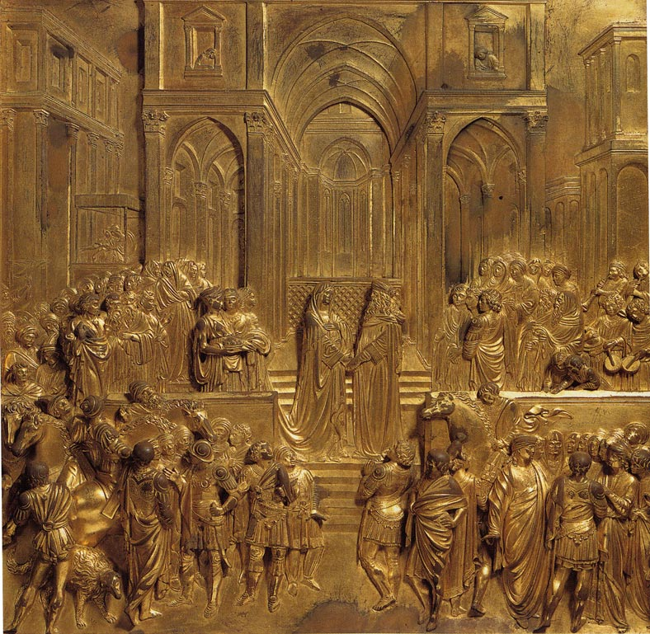
Lorenzo Ghilberti, Architect
1378-1455
Porta Baptisterio Fiorenze. Bass Relief
Notes:
Lorenzo Ghilberti, Architect
1378-1455
Porta Baptisterio Fiorenze

Slide 24
Horizon line
Lorenzo Ghilberti, Architect
1378-1455
Porta Baptisterio Fiorenze. Bass Relief
Notes:
Lorenzo Ghilberti, Architect
1378-1455
Porta Baptisterio Fiorenze

Slide 25
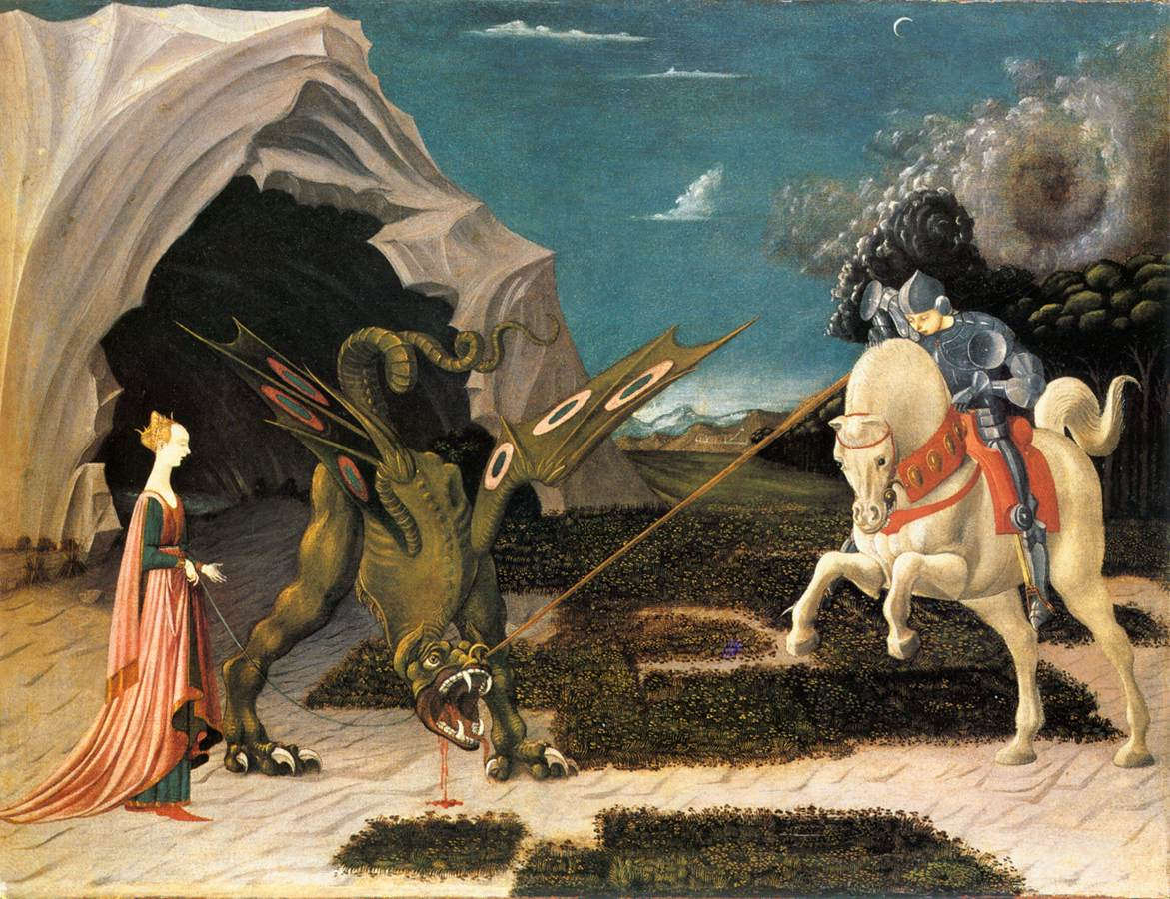
Perspective Parallel objects seen from a central point of view inside a cube.example
Paolo Ucello. St. George and the Dragon, 1456. National Gallery, London.

Slide 26
Perspective Parallel objects seen from a central point of view inside a cube.example
Paolo Ucello. St. George and the Dragon, 1456. National Gallery, London Attempt to apply perspective to nature in the XV century.

Slide 27
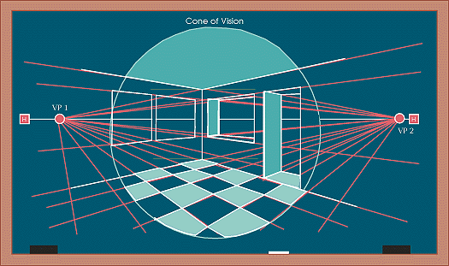
Perspective Parallel objects seen with a 2 point view inside a cube.
First vanishing point
The lines going towards the vanishing points are perpendicular to each other. As you move away from the central area objects appear somehow deformed (perspective aberration).
Second vanishing point
Horizon line

Slide 28
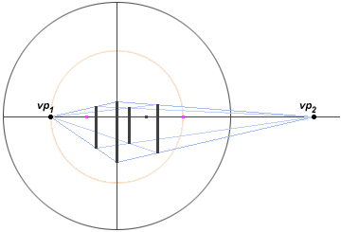
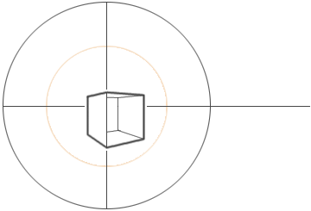
Perspective A cube seen with a 2 point view
Outside a central sphere, marked by the viewers point, objects get very deformed if placed to the bottom of the page or towards the bottom and the sides.

Slide 29
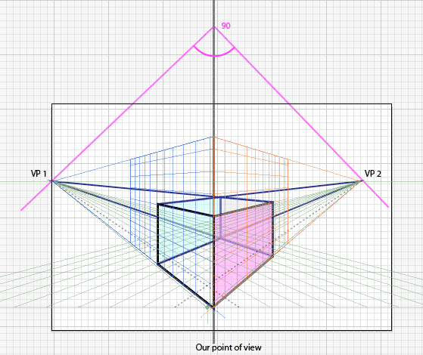
Perspective A cube seen with a 2 point view
Outside a central sphere, marked by the viewers point, objects get very deformed if placed to the bottom of the page or towards the bottom and the sides.
Notice that to truly represent a cube,
both vanishing points need to form a 90 degree angle with center on
the vertical representing the viewers
stand point.
That vertical is defined by the closest
angle of the cube.
Because this cube is placed very close to the bottom of the page it shows a lot of deformation, specially in the lower part.

Slide 30
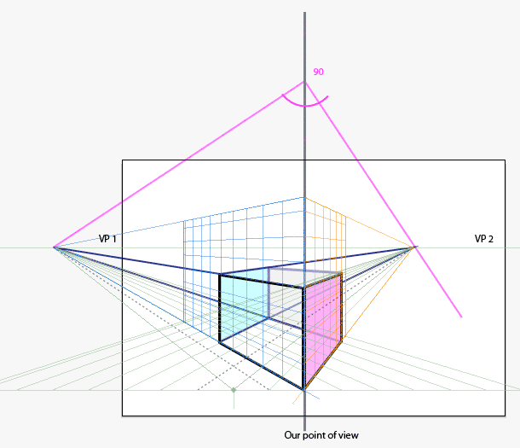
Perspective A cube seen with a 2 point view
Outside a central sphere, marked by the viewers point, objects get very deformed if placed to the bottom of the page or towards the bottom and the sides.
Both vanishing points are still forming a 90 degree angle with center on
the vertical representing the viewers
stand point.
That 90 degree can be placed upper or lower on that vertical.
It is usually calculated by making sure that the distance from the horizon to the center of the angle (up of the page) is the same than
the distance from the bottom of the drawing to the horizon.
The higher the center of that imaginary angle, the further apart the vanishing points will be and the less deformation we will get.
As a general rule the vanishing points (at lest one of them or both) should be outside the border of you paper.

Slide 31
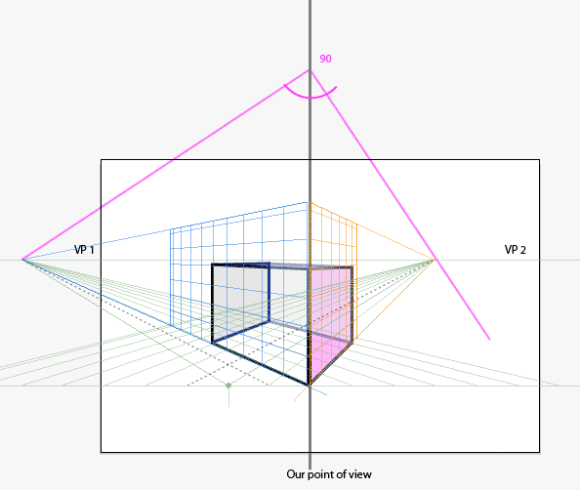
Perspective A cube seen with a 2 point view
The cube to the right has less deformation because of being placed towards the center of that imaginary sphere

Slide 32
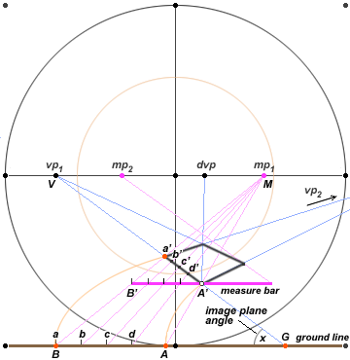
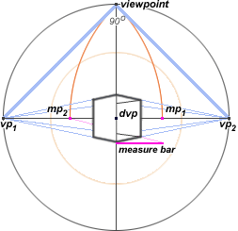
Perspective A cube seen with a 2 point view
With more measurements we could calculate how a real object (with defined measurements) would look in our defined space.
VP 2

Slide 33
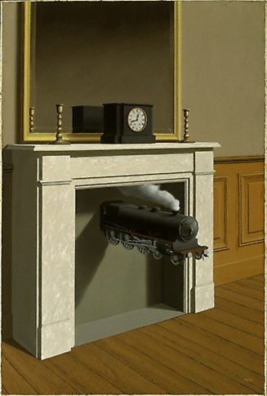
Perspective 2 point perspective (typical interior situation Side view)
Rene Magritte
French Surrealist artist.
1898-1967

Slide 34
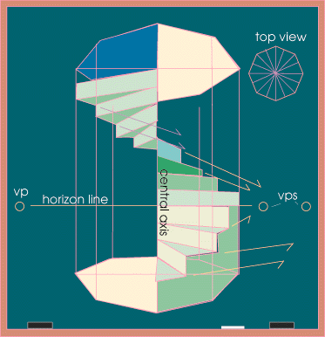
Perspective Spiral staircase

Slide 35
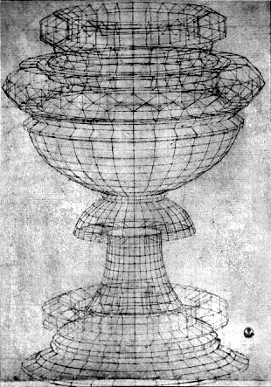
Perspective Revolving structure
Rennaisance passion for Perspective and Geometry.
Paolo Ucello,
“Drawing of a chalice”, 1430
Pen and ink
Galleria degli Uffizi, Florence
Vasari called perspective: “A tours de force of illusion “

Slide 36
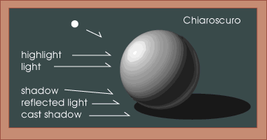
Shading an object Lit from a single source (point) of light

Slide 37
Shading a round object Lit from a single point (source)

Slide 38
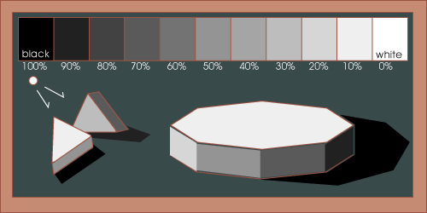
Shading an object with multiple planes Lit from a single point (source)

Slide 39
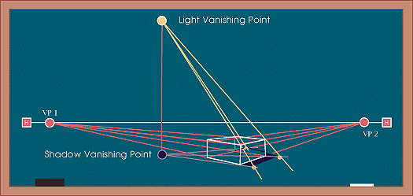
Shading an object Calculating the projected shadows of an object According to a light source.

Slide 40
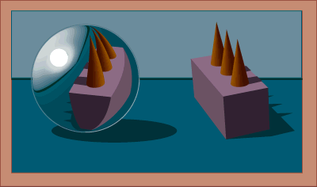
Reflective objects Calculating the reflection projected on a cylindrical surface.

