Slide 1
GESTALT PRINCIPLES
MASIE DUNEIER

Slide 2
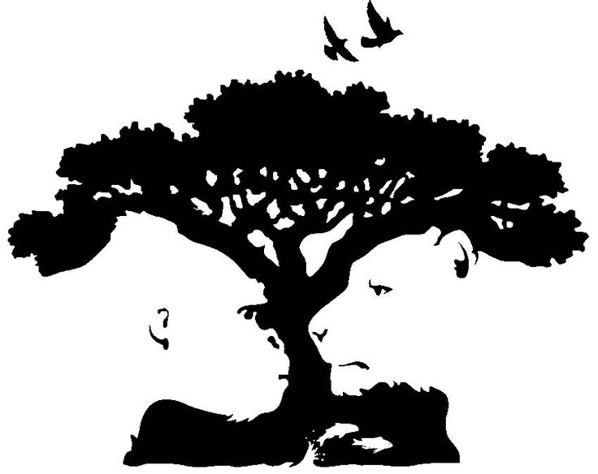
1. FIGURE & BACKGROUND
The figure in an image is the dominant shape, with a definite contour.
The background in an image is the negative space, that adopts a passive role.
The figure and background are not seen simultaneously.
In an ambiguous image, the figure and background are interchangeable, depending on focus.

Slide 3
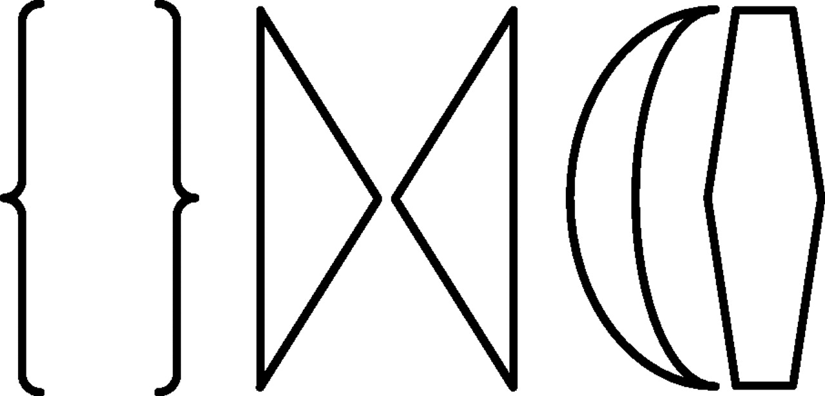
2. GROUPING
Our eyes involuntarily use grouping to organize images.
We scan the image for factors that might group parts or details together.
Grouping is relative, depending on situational contexts, which generate short-term expectations.
We look for patterns to simplify the reading of an image.

Slide 4
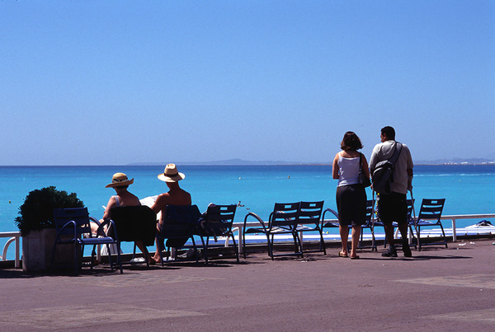
3. PROXIMITY
Proximity states that features which are close together, in an image, are related.
The parts of an image that are near to each other, are perceived as integral parts of a bigger mass.
Proximity may be thought of in terms of distance.
The proximity of features in an image is related to grouping, in that they are assumed to be associated.

Slide 5
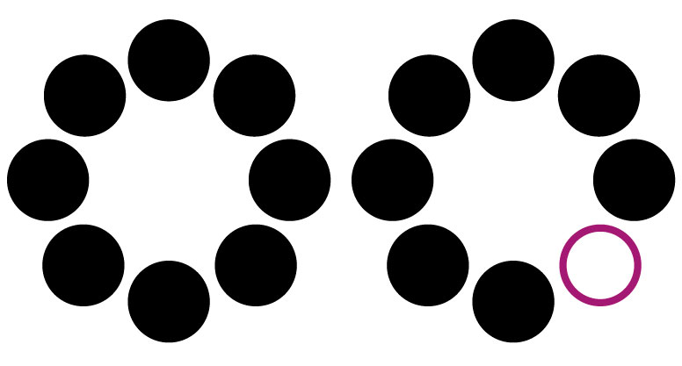
4. SIMILARITY
Features that look similar to one another, are perceived as associated.
When there is one defying element in an image, it is perceived as the main point of interest.

Slide 6
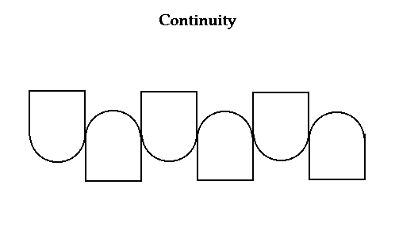
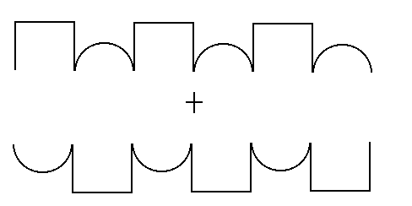
5. CONTINUITY
Continuity describes shapes, lines, and other visual elements that exist without interruption.
Contours with smooth continuity, are preferred to abrupt changes of direction.

Slide 7
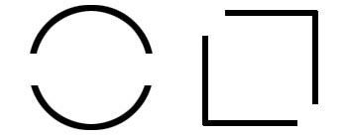
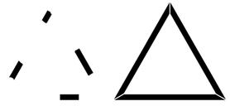
6. CLOSURE
Shapes that can be perceived as complete, will have priority over open, or incomplete, ones.
Our brains tend to involuntarily close shapes, in an attempt to simplify an image.

Slide 8
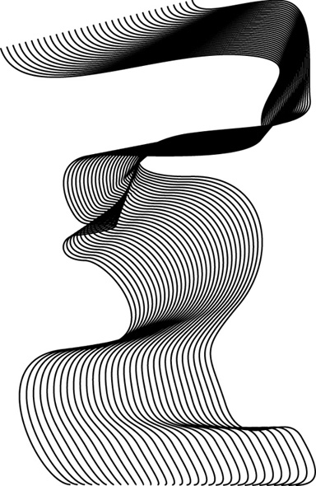
7. LEVELING & SHARPENING
Leveling forces the symmetrical placement in an image, in order to avoid tension on the page.
Sharpening occurs when there is exaggeration and contrast in an image.
Leveling and sharpening are opposites.
We prefer to interpret an exaggeration of a scene, to clarify the identity of the perceived scene.

Slide 9
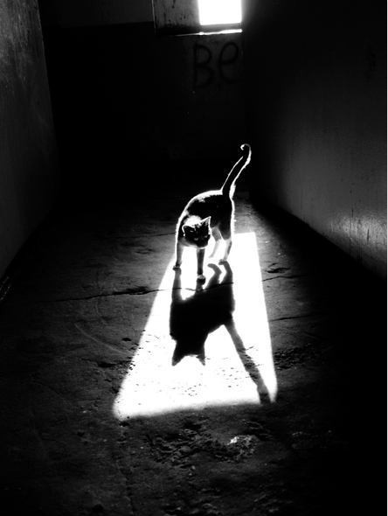
8. SURROUNDING
The Müller & Lyer Illusion proves that the surrounding affects the way we perceive a figure.
Surrounding influences our perception of other elements in our field of vision.
The principle of smallness states that smaller areas in an image, tend to be seen as figures, against a larger background.
The principle of symmetry states that symmetrical areas tend to be seen as figures, against an asymmetrical background.
Areas seen as surrounded by others, tend to be perceives as figures.

Slide 10
9. ADDING A DIMENSION
Adding a dimension adjusts the perception of space by means of an optical illusion.
Creates a 3D shape in a 2D plane.
Overlapping shapes is the simplest way to add a dimension.
Related to closure, in that the overlapping of complete and incomplete shapes create a 3D effect.

Slide 11
IMAGE #1
The most obvious of the Gestalt principles evident in this image is similarity.
There is one defying element, the woman, who is different from the other figures, and thus draws immediate attention.
The bodies of color in the image appear to be the figure, and then white negative space behind them is the background.
Our eyes group the five figures together.
All five figures are within close proximity to one another, another reason why we might group them together.
The center figure is thinner than the rest, and creates a symmetrical balance in the image.
Along the lines of closure, our eye is involuntarily uncomfortable with the uneven appearance of the central figure, and tends to fill in the blank, assuming it is the same as the others besides the woman.

Slide 12
IMAGE #2
The two people in the image can be identified as the figures, and the space behind them as the background.
The two figures are grouped together, mostly because they are in close proximity to one another.
There is an element of continuity between the two figures, as each body seems to fit directly with the other, and there is no space left for our eyes to fill in.
There is a sense of symmetry and balance, as depicted by the central placement of the two figures, that make each side of the image feel even with the other.

Slide 13
IMAGE #3
We can identify the legs and feet as the figure, and the negative white space as the background.
We group the lines in the background together, and the legs together separately.
We know that the legs belong to the same body, because they are in close proximity to one another, so we can assume there is some sort of relationship.
In addition, the legs look similar to one another, another reason they may be perceived as associated.
Our minds attempt to level out the placement of the legs, directly in the corner, so that they are evenly moving across the diagonal.
Similarly, we try to level out the placement of the lines, so that everything is symmetrical and balanced.

